Slide 1

Utilising full angle-dependent critical current data in the electromagnetic modelling of HTS coils
Stuart C Wimbush
Nicholas M Strickland

Slide 2
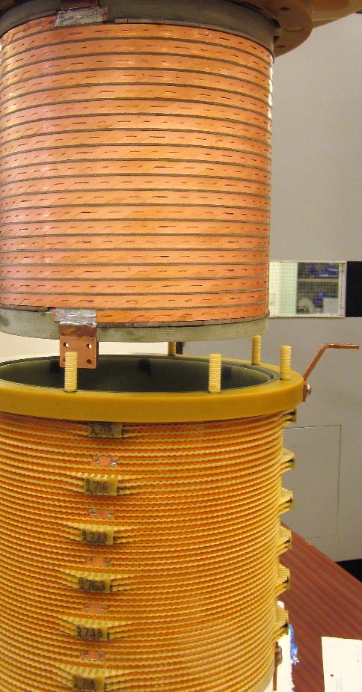
Introduction
As the construction of real-world devices from HTS coated conductors becomes more prevalent, increasingly sophisticated modelling techniques are applied to the design process.
One aspect that remains relatively rarely touched upon in practical design methodologies is the incorporation of full anisotropic critical current data in electromagnetic modelling.
This has a number of reasons:
    Scarce availability / difficulty of acquiring such data.
    Perceived difficulty of modelling such complex behaviour.
    A possible underappreciation of the variability of this data and its impact on designs.
In this talk I will outline both a detailed methodology of incorporating this data into electromagnetic designs and illustrate by way of example the range of impacts it can have on the design process and the ultimate performance of the device.
The tools used here are chosen to be available to anyone who wishes to investigate this topic for themselves. The approaches outlined are applicable to any electromagnetic modelling package.

Slide 3

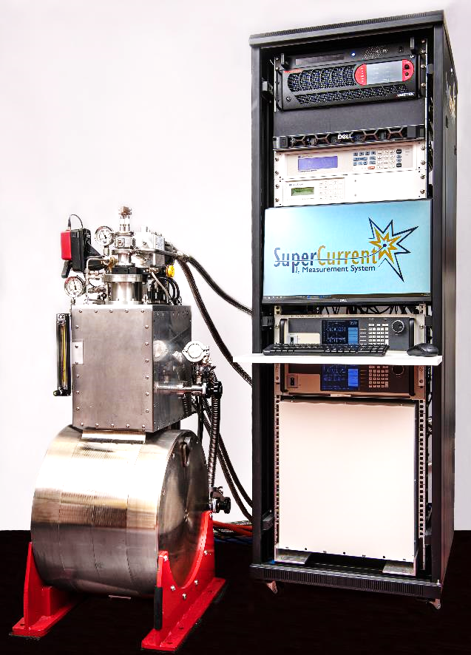
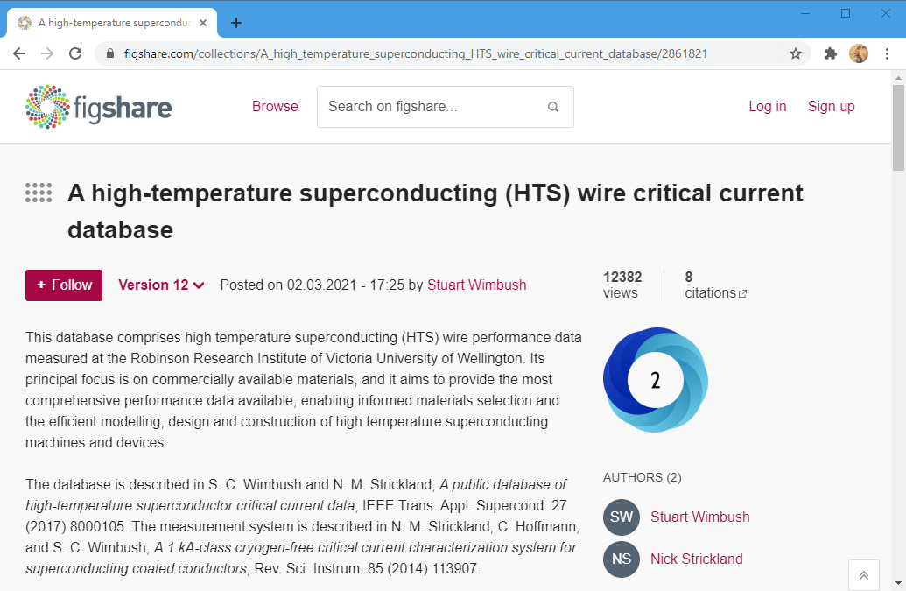
Data source
N. M. Strickland, C. Hoffmann and S. C. Wimbush.
A 1 kA-class cryogen-free critical current characterization system for superconducting coated conductors.
Rev. Sci. Instr. 85, 113907 (2014).
  Temperatures down to 15 K.
  Fields up to 8 T (12 T in some versions).
  Currents up to 1200 A (now 2400 A).
  4,000 IV curves per day.
Public wire I_{c} database https://www.robinson.ac.nz/hts-wire-database

Slide 4
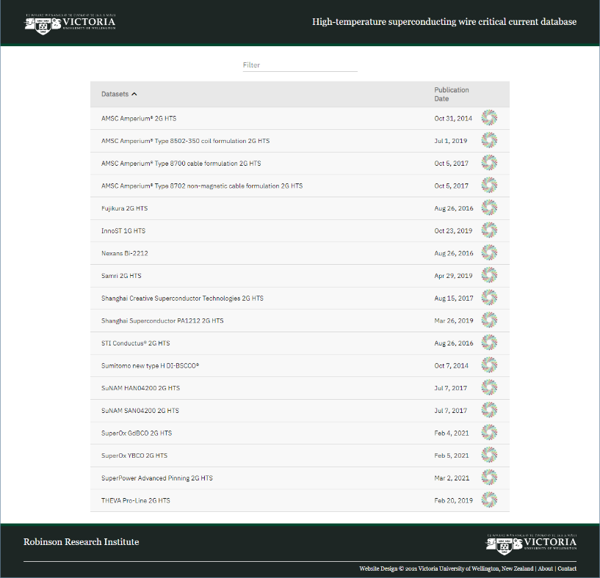
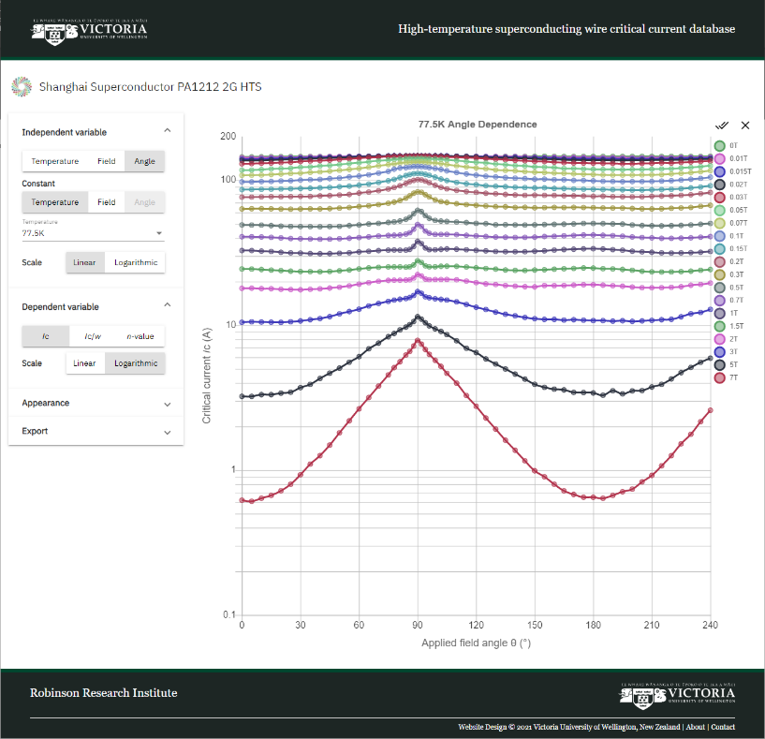
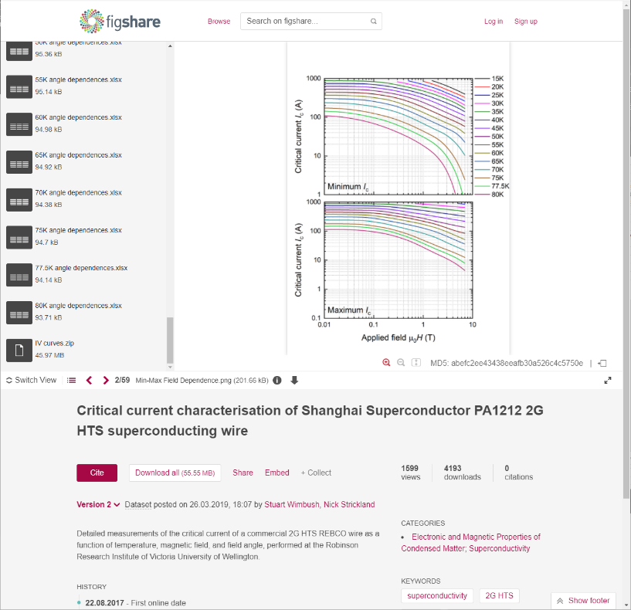
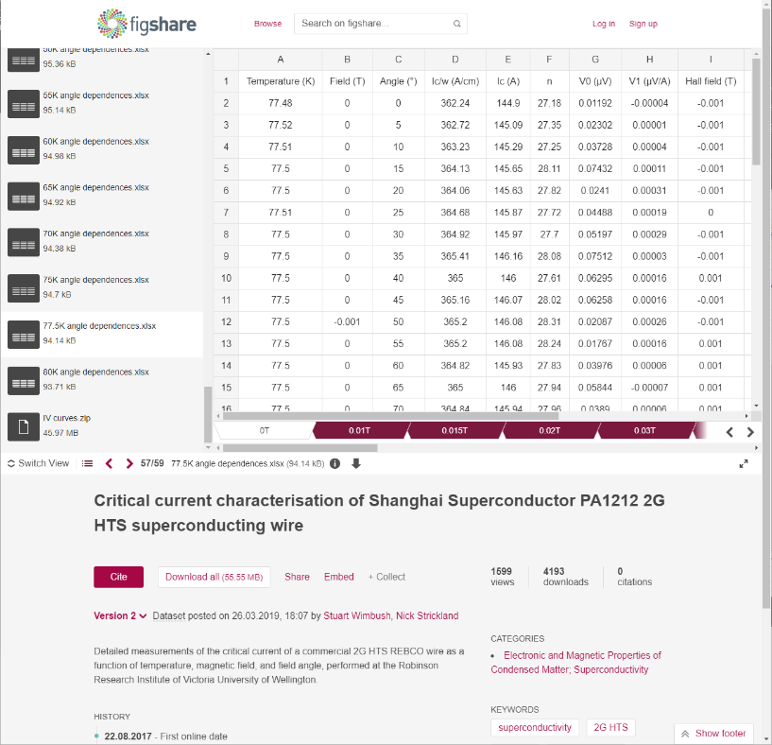
Robinson public wire I_{c} database
S. C. Wimbush and N. M. Strickland.
A public database of high-temperature superconductor critical current data.
IEEE Trans. Appl. Supercond. 27, 8000105 (2017).
https://www.robinson.ac.nz/hts-wire-database

Slide 5
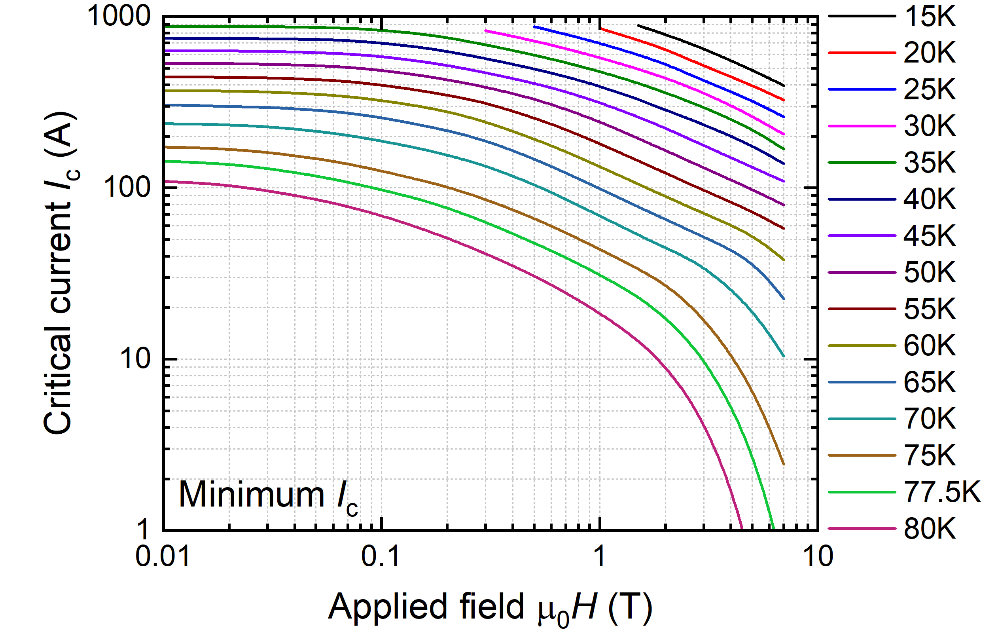
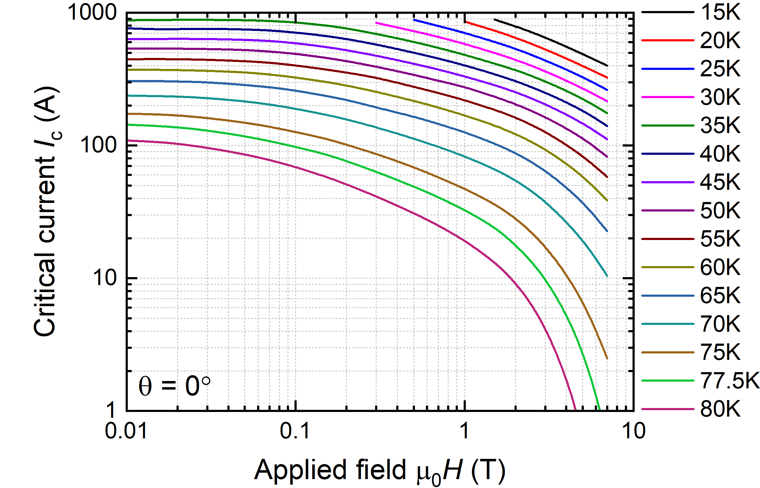
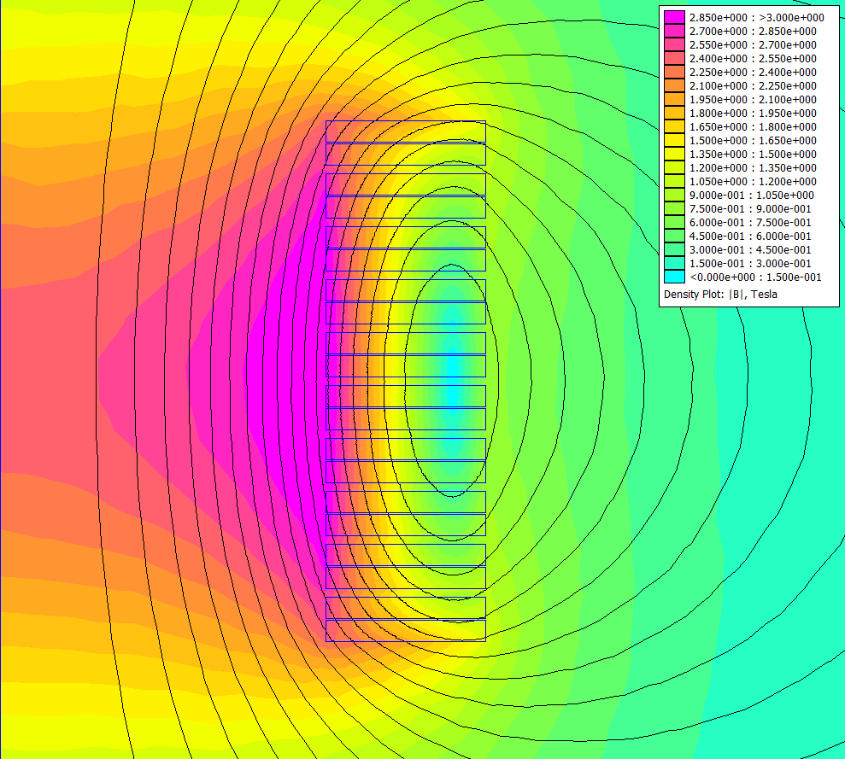
Electromagnetic modelling
D. C. Meeker.
Finite Element Method Magnetics, Version 4.2 (28Feb2018 Build).
https://www.femm.info.
Central field target: 2.5 T.
60
(B⊥)
2.5 T
Max. field on coils: 3.0 T.
3
Operating temperature > 65 K.
<
0° (field perpendicular) is not minimum I_{c}!
I_{op} = 60 A

Slide 6
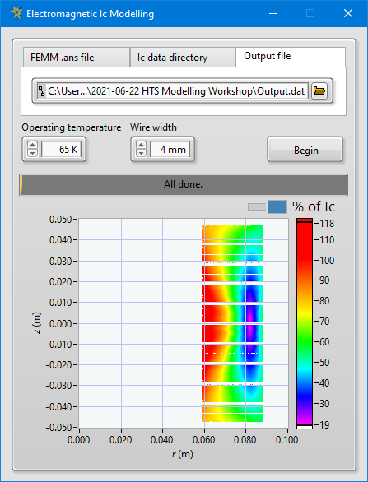
Utilise full angle-dependent I_{c} dataset
  Export (B,ϑ) values at each element in the mesh.
    (In FEMM, you need to process the potentials to give B. Other packages may provide a direct export.)
    For the 2D axisymmetric case, the components are B_{r} (B⊥) and B_{z} (B||), which is very convenient.
    In 3D, need to process the three components of B, neglecting any in-plane variation in I_{c}.
  For a given operating temperature, we then have a {T,B,ϑ} triplet at each element
  of the mesh that can be used to lookup an interpolated I_{c}(T,B,ϑ) table to yield a
  local I_{c} value at each mesh element within the conductor.
  The operating current I_{op} as a percentage of this local I_{c} tells us what fraction of I_{c}
  we are operating each point in the coil at.
  A utility to perform this process for any FEMM model and SuperCurrent I_{c} dataset
  is available at https://github.com/scwimbush/Electromagnetic-Ic-Modelling.

Slide 7
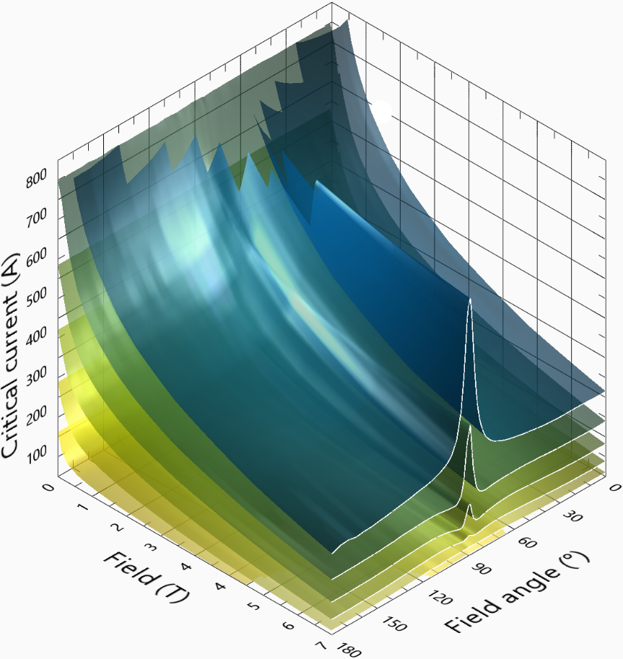
Interpolation of I_{c}(T,B,ϑ) datasets
With datasets of our density, extremely good interpolations can be performed.
Simple point-to-point interpolations, with a few tricks:
  First interpolate the angle dependences – smoothly varying.
  Then at each interpolated angle:
    Interpolate the field dependences logarithmically.
    Interpolate the temperature dependences linearly.
Doing these interpolations is the slowest part of the analysis.
Presently strictly an interpolation;
extrapolation is challenging to perform robustly and reliably.
Temperature
30 K
40 K
50 K
60 K
70 K
80 K

Slide 8
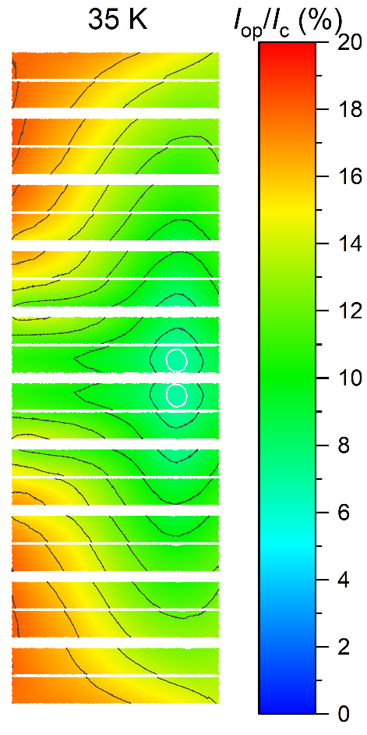
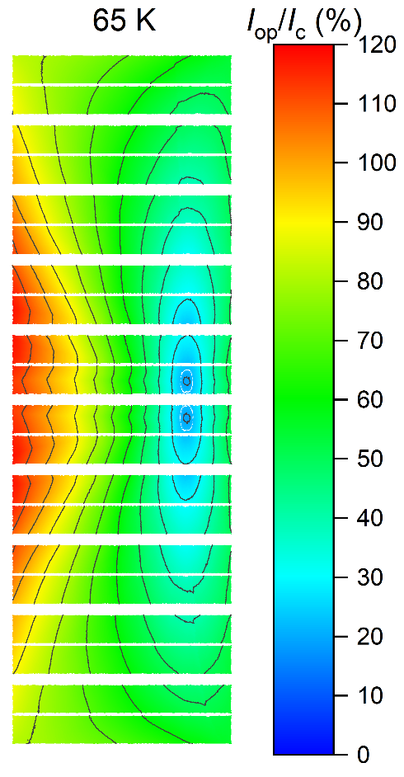
Results of I_{c} lookup
Looking at the I_{c} map across the conductor at our first proposed operating temperature of 65 K, we see:
  The critical point on the coils is the high field (fully in-plane!) region at the centre of the coil pack.
  We are 20% short of the performance required to operate.
Refining the analysis at different temperatures shows we could expect to operate at 62 K, approximately as predicted by the (true) minimum I_{c} analysis. (This is the case because the field angle at the critical point coincides with the angle of minimum I_{c}.)
If we drop the operating temperature to 35 K, the critical point shifts to the more commonly observed inner edge of the end coils, where a moderate field strength and an unfavourable field direction combine. Here a minimum I_{c} analysis would underestimate the available I_{c}.
I_{c}^{min}
I_{c}^{min}

Slide 9
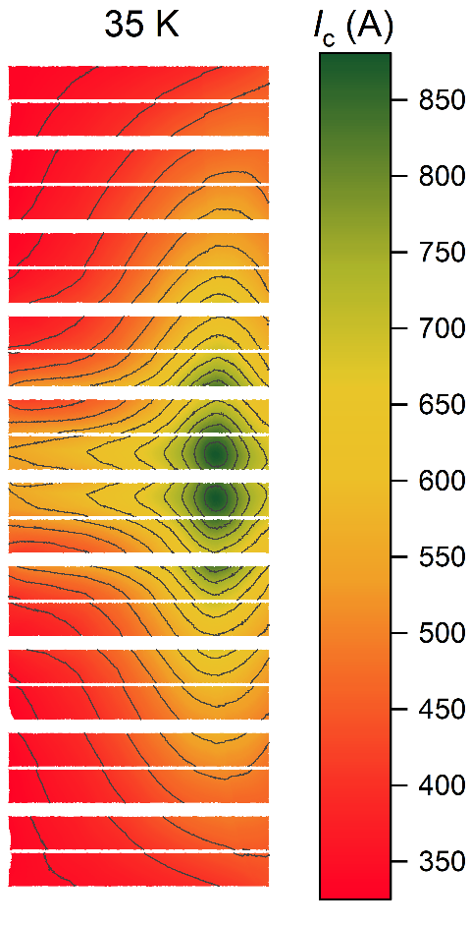
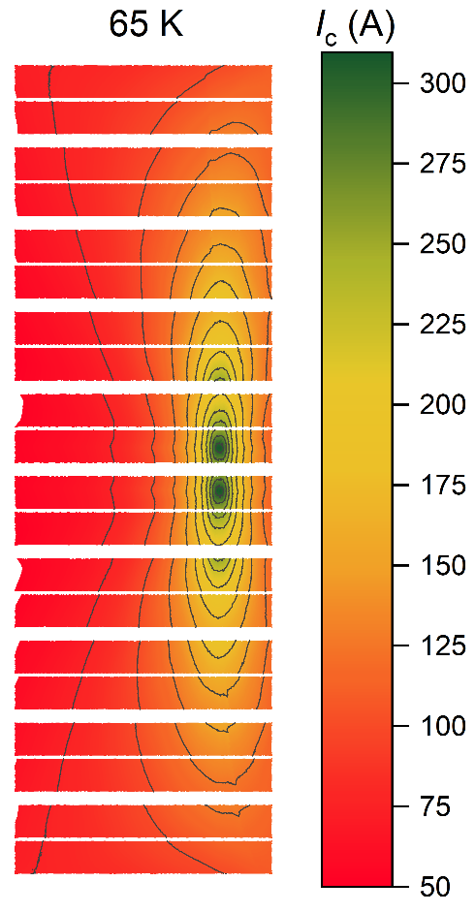
Results of I_{c} lookup
The reason for the shift in position of the critical point with temperature is evident upon comparison of the angle dependence of I_{c} under the different conditions.
This aspect of real wire behaviour cannot be captured by I_{c}(B||, B⊥) field dependences alone.
I_{c}^{min}
I_{c}^{min}

Slide 10
Applications

Slide 11
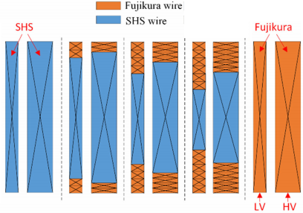
Hybrid windings
W. Song, Z. Jiang, M. Staines, S. C. Wimbush, R. A. Badcock and J. Fang.
AC loss calculation on a 6.5 MVA/25 kV HTS traction transformer with hybrid winding structure.
IEEE Trans. Appl. Supercond. 30, 5500405 (2020).
Now we know exactly where in the coil pack the critical region occurs, we can replace selected coils with higher performance wire, or simply stack the coils we have on hand in an appropriate order.
In the example presented so far, at 65 K:
  End coils I_{op}/I_{c} = 90%.
  Mid coils I_{op}/I_{c} = 120%. → Substitute better wire for these coils (only).
Many manufacturers provide wire with different performance specifications or we can select the most appropriate wire from
multiple manufacturers.
This extends beyond operating current to other performance metrics.
In the real-world example of our traction transformer design, we can lower the overall ac loss by 5–10% by incorporating relatively small quantities of high-performance wire in the right places.

Slide 12
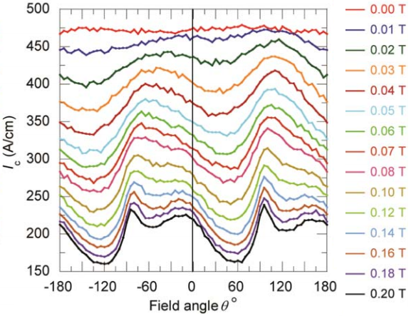
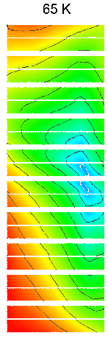
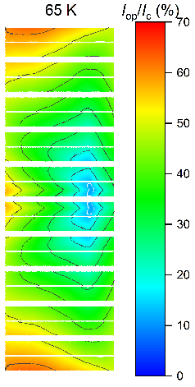
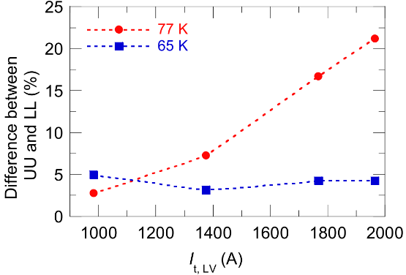
Flipped coils
Z. Jiang, W. Song, X. Pei, J. Fang, R. A. Badcock and S. C. Wimbush.
15% reduction in AC loss of a 3-phase 1 MVA HTS transformer by exploiting asymmetric conductor critical current.
J. Phys. Commun. 5, 025003 (2021).
Now that we explicitly take account of the real anisotropy of the conductors, not an approximate functional form, we can exploit detailed characteristics such as asymmetry either side of the in-plane peak.
For some conductors, this is not strongly evident, but for some it is.
Taking advantage of this is as easy as ensuring the “correct” orientation
of the coils when they are stacked.
SuperPower AP
Flip lower coils
Difference in ac loss
between UU and LL (%)
I_{op}/I_{c} max.
70%
I_{op}/I_{c} max.
63%

Slide 13
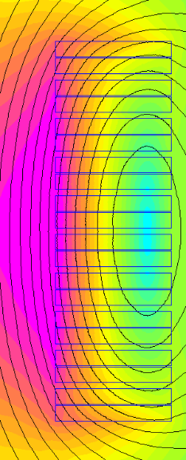
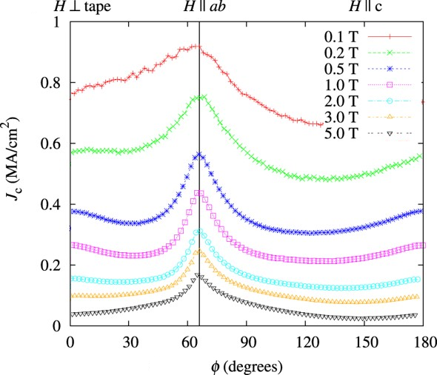

Inclined planarity coated conductors
M. Lao, J. Bernardi, M. Bauer and M. Eisterer.
Critical current anisotropy of GdBCO tapes grown on ISD-MgO buffered substrate.
Supercond. Sci. Technol. 28, 124002 (2015).
Inherent asymmetry tends to be evident only at relatively low fields. But we can intentionally select a conductor (e.g. one produced by inclined substrate deposition) that is particularly appropriate to the required operating conditions. In this case, we must ensure correct orientation and we would also only utilise such a conductor in the relevant locations in the coil pack.
To our knowledge, no such demonstrator has yet been produced.
+60°
−60°

Slide 14
Summary

Slide 15
Summary
  Electromagnetic modelling utilising full angle-dependent I_{c} data is tractable.
  Exemplary I_{c} datasets are available to trial and refine techniques.
  Targeted data acquisition for specific projects is feasible.
  Such modelling reveals features of device design that could otherwise lead to failure.
  Optimisation of real-world devices offers a 10–20% enhancement in performance
  leading to real benefits.
  These analyses lead to novel design features such as:
    Hybrid windings.
    Flipped coils.
    Inclined planarity conductors.
Thank you for your attention!
https://www.robinson.ac.nz/hts-wire-database
https://github.com/scwimbush/Electromagnetic-Ic-Modelling

