Slide 1



Modelling of the pulsed field magnetization of a (RE)BaCuO bulk with a superconducting weld
*Rémi Dorget^{1,2}, Kévin Berger¹, Joseph Longji Dadiel³, Kimiaki Sudo³, Naomichi Sakai³, Tetsuo Oka³, Masato Murakami³ and Jean Lévêque¹
¹ Université de Lorraine, GREEN, F-54000 Nancy, France
² Safran Tech, Electrical & Electronic Systems Research group, Rue des Jeunes Bois, Châteaufort, 78114 Magny-Les-Hameaux, France
³ Shibaura Institute of Technology ,3 Chome-7-5 Toyosu, Koto, Tokyo 135-8548 - Japan

Slide 2
Top seeded melt growth
RE-Ba-Cu-O bulk welding process
Description of the model
Results

Slide 3
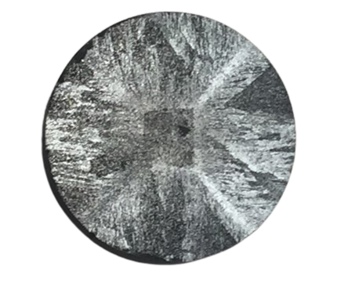
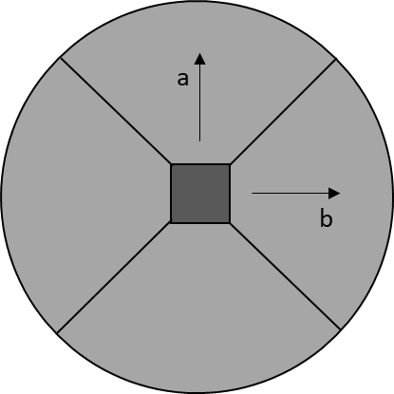
Top seeded melt growth (TSMG)
Pellet of RE-Ba-Cu-O pressed then melted and slowly cooled to let the crystal grow
The seed crystal (RE-Ba-Cu-O with higher melting point) give the crystal orientation
  Examples of seed crystals :
  Nd-Ba-Cu-O or Sm-Ba-Cu-O
Several hours of oxygen annealing
Growth sector boundaries
Seed crystal
Growth sector regions

Slide 4
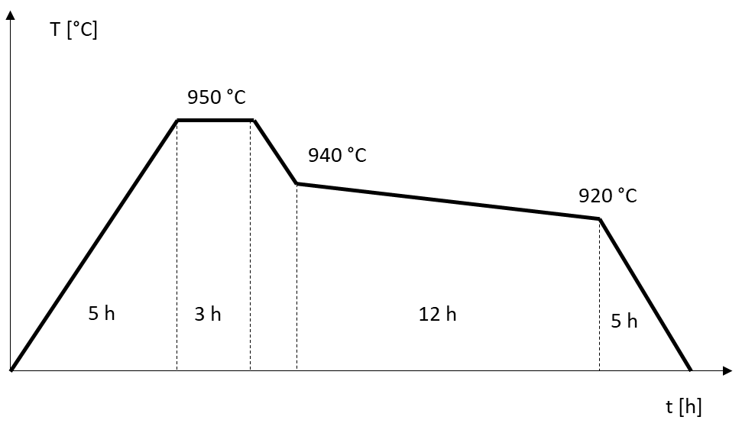
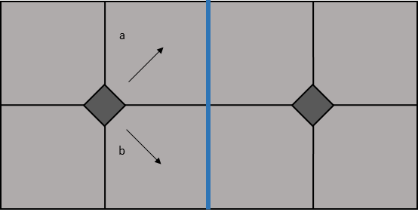
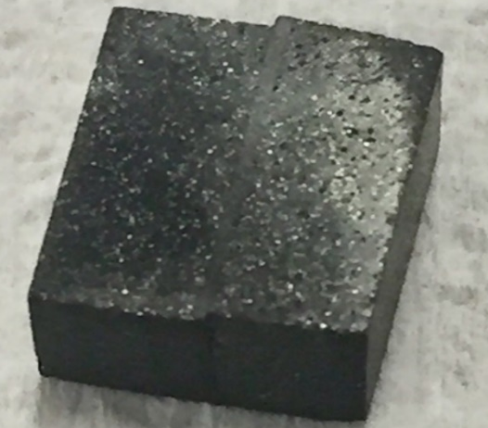
Bulk welding process
Solder material: RE-Ba-Cu-O with low melting point
Process similar to TSMG: The solder material is melted while the bulk body act as the seed
Example of the temperature process for joining
Y-Ba-Cu-O + 10%Ag with Er-Ba-Cu-O + 10%Ag
Material | Tp [°C]
Y-Ba-Cu-O | 1008 °C
Er-Ba-Cu-O | 980 °C
Y-Ba-Cu-O + 10%Ag | 956 °C
Er-Ba-Cu-O + 10%Ag | 937 °C
Good grain connection is obtain along the 110 plane

Slide 5
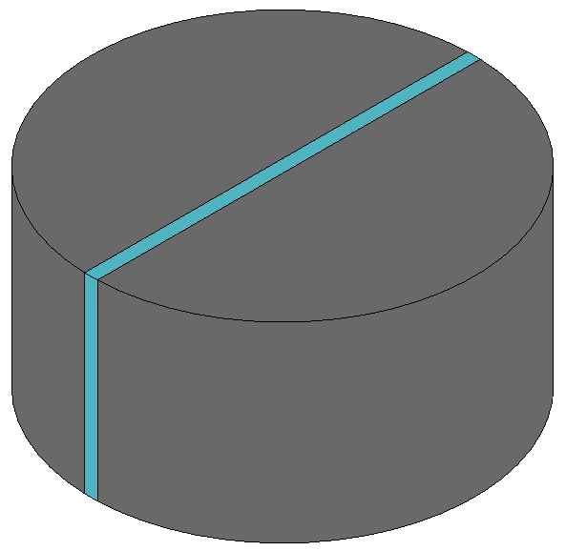
Case study
Simulation of the weld behavior during pulsed field magnetisation (PFM)
Bulk body:
  Radius : 30 mm
  Height : 15 mm
  Homogeneous superconducting properties
Weld:
  Thickness : 1 mm
  Superconducting properties different from the bulk body
Objective: study the magnetisation for different welds
Bulk body
Weld

Slide 6
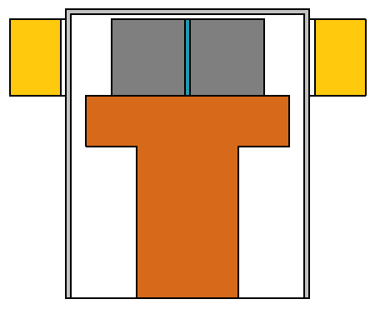
Simulated setup
Initial temperature :
T_{a} = 60 K
Cryocooler cooling power :
P_{cryo} = 50W
Applied magnetic field :
B_{a} = [0.5 T : 9 T]
Welded bulk
Magnetising coil
Cold head
Cryostat

Slide 7
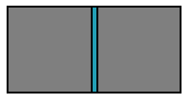





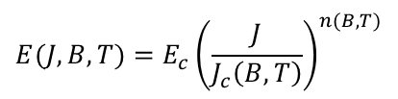



Electromagnetic and thermal models
z
z
$$\vec{(∇}∙T)∙\vec{n}=0$$
y
x
y
x
$$μ_{0}$$
$$\vec{E}∙\vec{J}$$
$${\vec{B}=B}_{a}\vec{u_{z}}$$
$$μ_{0}$$
$$Q=\vec{E}∙\vec{J}$$
$$T$$
$$E(J,B,T)=E_{c}{\left(\frac{J}{J_{c}\left(B,T\right)}\right)}^{n(B,T)}$$
$$−(\vec{∇}∙T)∙\vec{n}={−P}_{cryo}$$
3-D Electromagnetic model
3-D Thermal model

Slide 8
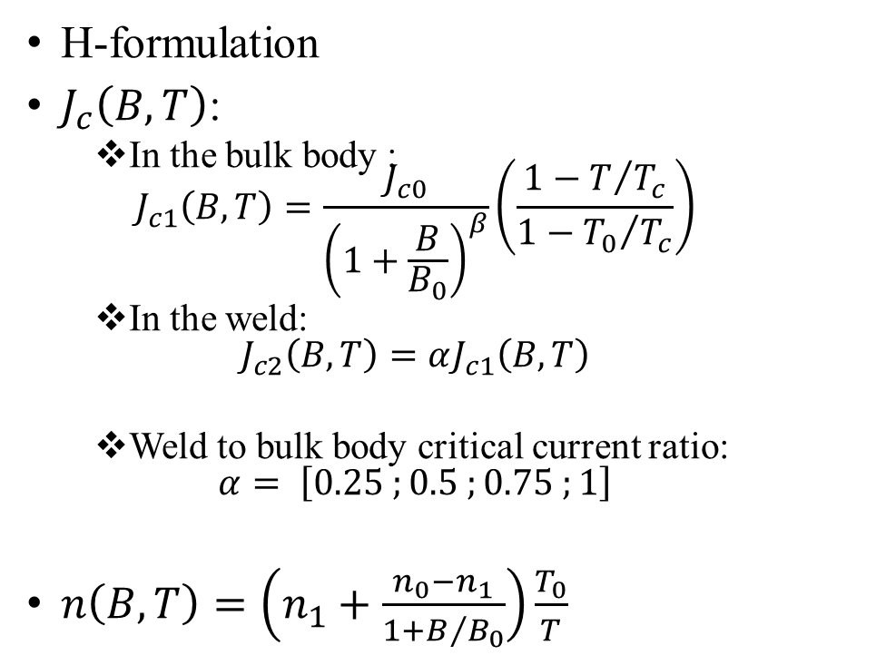
Electromagnetic model
H-formulation
$J_{c}\left(B,T\right)$:
  In the bulk body :
  $J_{c1}\left(B,T\right)=\frac{J_{c0}}{{\left(1+\frac{B}{B_{0}}\right)}^{β}}\left(\frac{1−T/{T_{c}}}{1−{T_{0}}/{T_{c}}}\right)$
  In the weld:
  $J_{c2}\left(B,T\right)=αJ_{c1}\left(B,T\right)$
  Weld to bulk body critical current ratio:
  $α= \left[0.25 ;0.5 ;0.75 ;1\right]$
$n\left(B,T\right)=\left(n_{1}+\frac{n_{0}−n_{1}}{1+B/{B_{0}}}\right)\frac{T_{0}}{T}$

Slide 9
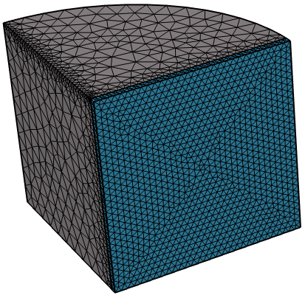
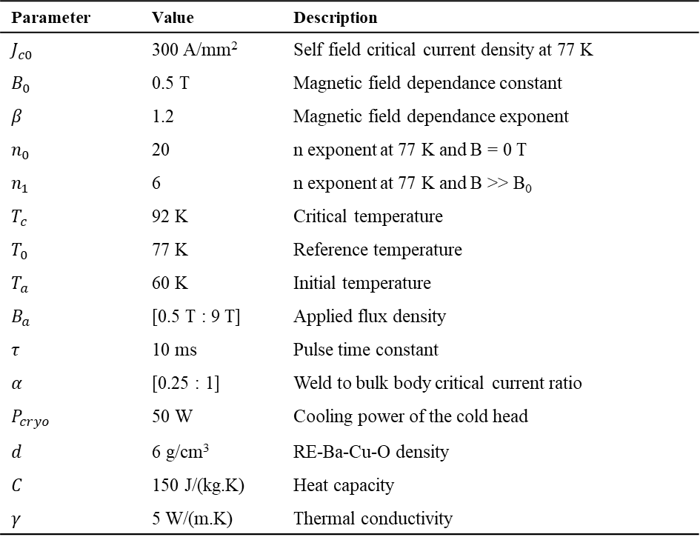
Simulation parameters
Due to symmetries → ¼ of the geometry is simulated
Parameter | Value | Description
$$J_{c0}$$ | 300 A/mm² | Self field critical current density at 77 K
$$B_{0}$$ | 0.5 T | Magnetic field dependance constant
$$β$$ | 1.2 | Magnetic field dependance exponent
$$n_{0}$$ | 20 | n exponent at 77 K and B = 0 T
$$n_{1}$$ | 6 | n exponent at 77 K and B >> B₀
$$T_{c}$$ | 92 K | Critical temperature
$$T_{0}$$ | 77 K | Reference temperature
$$T_{a}$$ | 60 K | Initial temperature
$$B_{a}$$ | [0.5 T : 9 T] | Applied flux density
$$τ$$ | 10 ms | Pulse time constant
$$α$$ | [0.25 : 1] | Weld to bulk body critical current ratio
$$P_{cryo}$$ | 50 W | Cooling power of the cold head
$$d$$ | 6 g/cm³ | RE-Ba-Cu-O density
$$C$$ | 150 J/(kg.K) | Heat capacity
$$γ$$ | 5 W/(m.K) | Thermal conductivity

Slide 10
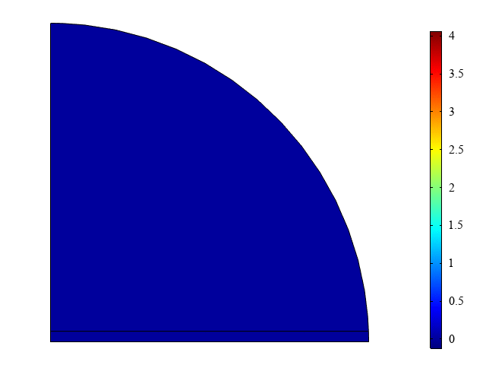
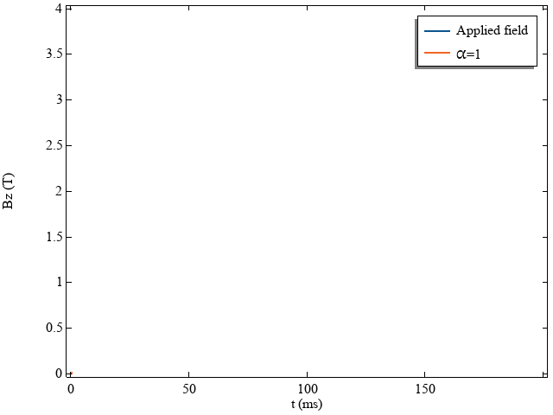
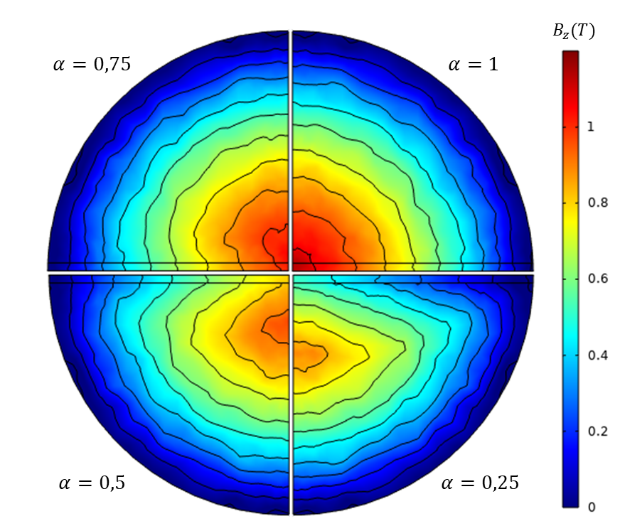

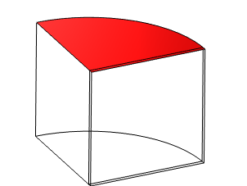
Results – Field maps
Penetration of the magnetic field during a 4 T pulse
Top: α = 1 Bottom : α = 0.5
Trapped field map after 60 s

Slide 11
Results – Trapped flux
Trapped flux on the bulk surface:
Above 2 T → weld reduces the trapped flux
Below 2 T → weld increases the trapped flux (up to 13 %)

Slide 12
Conclusion
A superconducting weld with a reduced critical current help the magnetic field to penetrate the bulk
  Increased trapped flux at low applied field
  Decreased trapped flux at high applied field
  → Applications with small inductor coil (magnetisation from armature windings)
The solder can be doped to improve its thermal properties at the expense of the magnetic properties

Slide 13
Thank you for your attention
Rémi Dorget,  (+33) (0)6 82 52 22 86,  e-mail: remi.dorget@univ.lorraine.fr

