Slide 1
Superconductive and hybrid shielding design: a 3D-modeling study
Michela Fracasso, michela.fracasso@polito.it ID: sciencesconf.org:htsmod2020:350995
Laura Gozzelino , Roberto Gerbaldo, Gianluca Ghigo, Francesco Laviano, Andrea Napolitano, Daniele Torsello.
Department of Applied Science and Technology, Politecnico di Torino, 10129 Torino, Italy
Istituto Nazionale di Fisica Nucleare, Sezione di Torino, 10125 Torino Italy

Slide 2
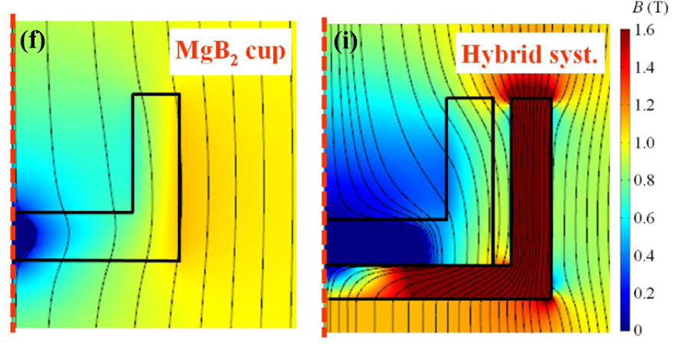
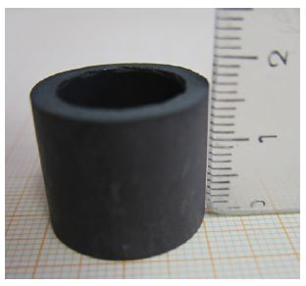
Introduction
Magnetic shielding is essential for several applications, e.g.
reduction of stray field and electromagnetic noise
achievement of low magnetic field background
How to improve the shielding abilities?
Combining growth technique able to manufacture properly shaped products with high and homogeneous critical current density, and suitable simulation tools, guiding the whole optimization process
Superimposing a sheet of ferromagnetic (FM) material
MgB₂ is a very promising option, its properties allow the fabrication of large and suitable-shaped samples
[1], [2]
A 3D modelling is needed to optimize the shield design under realistic working conditions [3], i.e. for different orientations of applied magnetic field
[4] L. Gozzelino et al., Supercond. Sci. Technol., 25, 115013, (2012).
[1] D. Barna et al., IEEE Trans. Appl. Supercond., 29, 4101310 (2019).
[2] G. Aldica M. Burdusel, V. Cioca, P. Badica Patent No RO130252-A2, DPAN 2015-383635
[3] J. F. Fagnard et al., Supercond. Sci. Technol., 32, 074007, (2019).
Cup shaped MgB₂
Tube shaped MgB₂

Slide 3
Modelling
Finite element method (FEM) solving A-V Formulation (2D model) by COMSOL Multiphysics®
$$\vec{E}=−\frac{∂\vec{A}}{∂t}−∇φ$$
$∇φ=0$[5]
$$\vec{E}=−\frac{∂\vec{A}}{∂t}$$
$$E=E_{c}{\left(\frac{J}{J_{c}}\right)}^{n}$$
a relation between the electric field and the current density is needed
(Ec =10⁻⁴Vm⁻¹ and Jc0 is the critical current density)
Not smooth at 0
$$J=J_{c}\sqrt[n]{−\frac{1}{E_{c}}∙\frac{∂A}{∂t}}$$
Defined only for odd
n if argument < 0
For $n≫1$
[6]
$$J=J_{c}tanh\left(−\frac{1}{E_{c}}∙\frac{∂A}{∂t}\right)$$
[5] Gomory et al. Supercond. Sci. Technol. 22 (2009) 034017
[6] Campbell A M, Supercond. Sci. Technol. 20 (2007) 292–5

Slide 4
Modelling
A-V Formulation (from 2D to 3D model) [7]
secures the collinearity between the current density and the local electric field
$$∂A_{x}:∂A_{y}:∂A_{z}=J_{x}:J_{y}:J_{z}$$
Solovyov et al. [7] validated the previous 2D model for 3D geometries providing two considerations
$$\sqrt{J_{x}^{2}+J_{y}^{2}+J_{z}^{2}}≤J_{c,0}$$
for isotropic J_{c}
$$\vec{J}=\frac{J_{c}}{\left|E\right|}\left(\left|E_{x}\right|tanh\left(\frac{E_{x}}{E_{0}}\right)\hat{i}+\left|E_{y}\right|tanh\left(\frac{E_{y}}{E_{0}}\right)\hat{j}+\left|E_{z}\right|tanh\left(\frac{E_{z}}{E_{0}}\right)\hat{k}\right)$$
Considering its dependence on magnetic field can reasonably describe the real behavior of the current in the whole investigated field range.
The J_{c} curves (obtained from magnetic induction cycles measured at different temperatures) were fitted by
$$J_{c}\left(B\right)=J_{c,0}exp\left[−{\left(\frac{B}{B_{0}}\right)}^{γ}\right]$$
[7] Solovyov M. and Gomory F., Supercond. Sci. Technol. 32 (2019) 115001
[8] Fujishiro H, Naito T and Yoshida T 2014 Supercond. Sci.Technol. 27 065019
[9] L. Gozzelino et al., Supercond. Sci. Technol., 32, 034004 (2019)

Slide 5
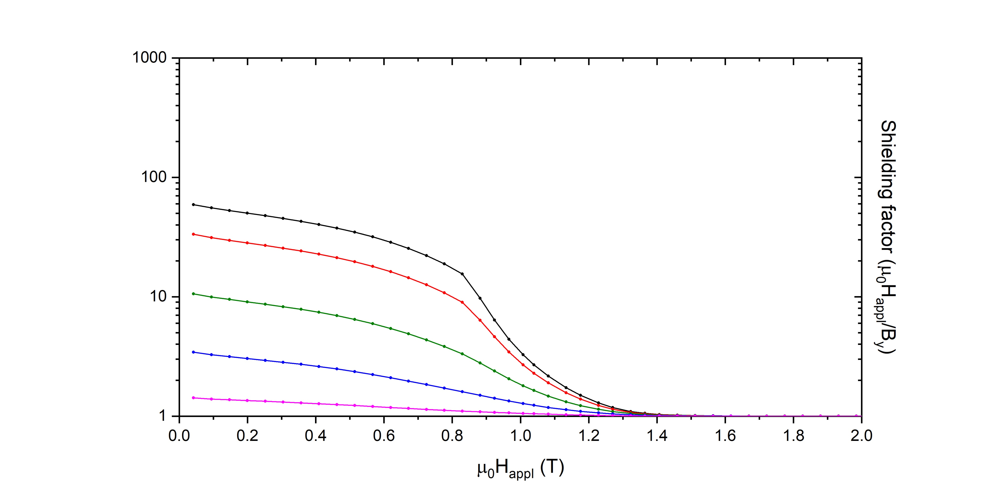
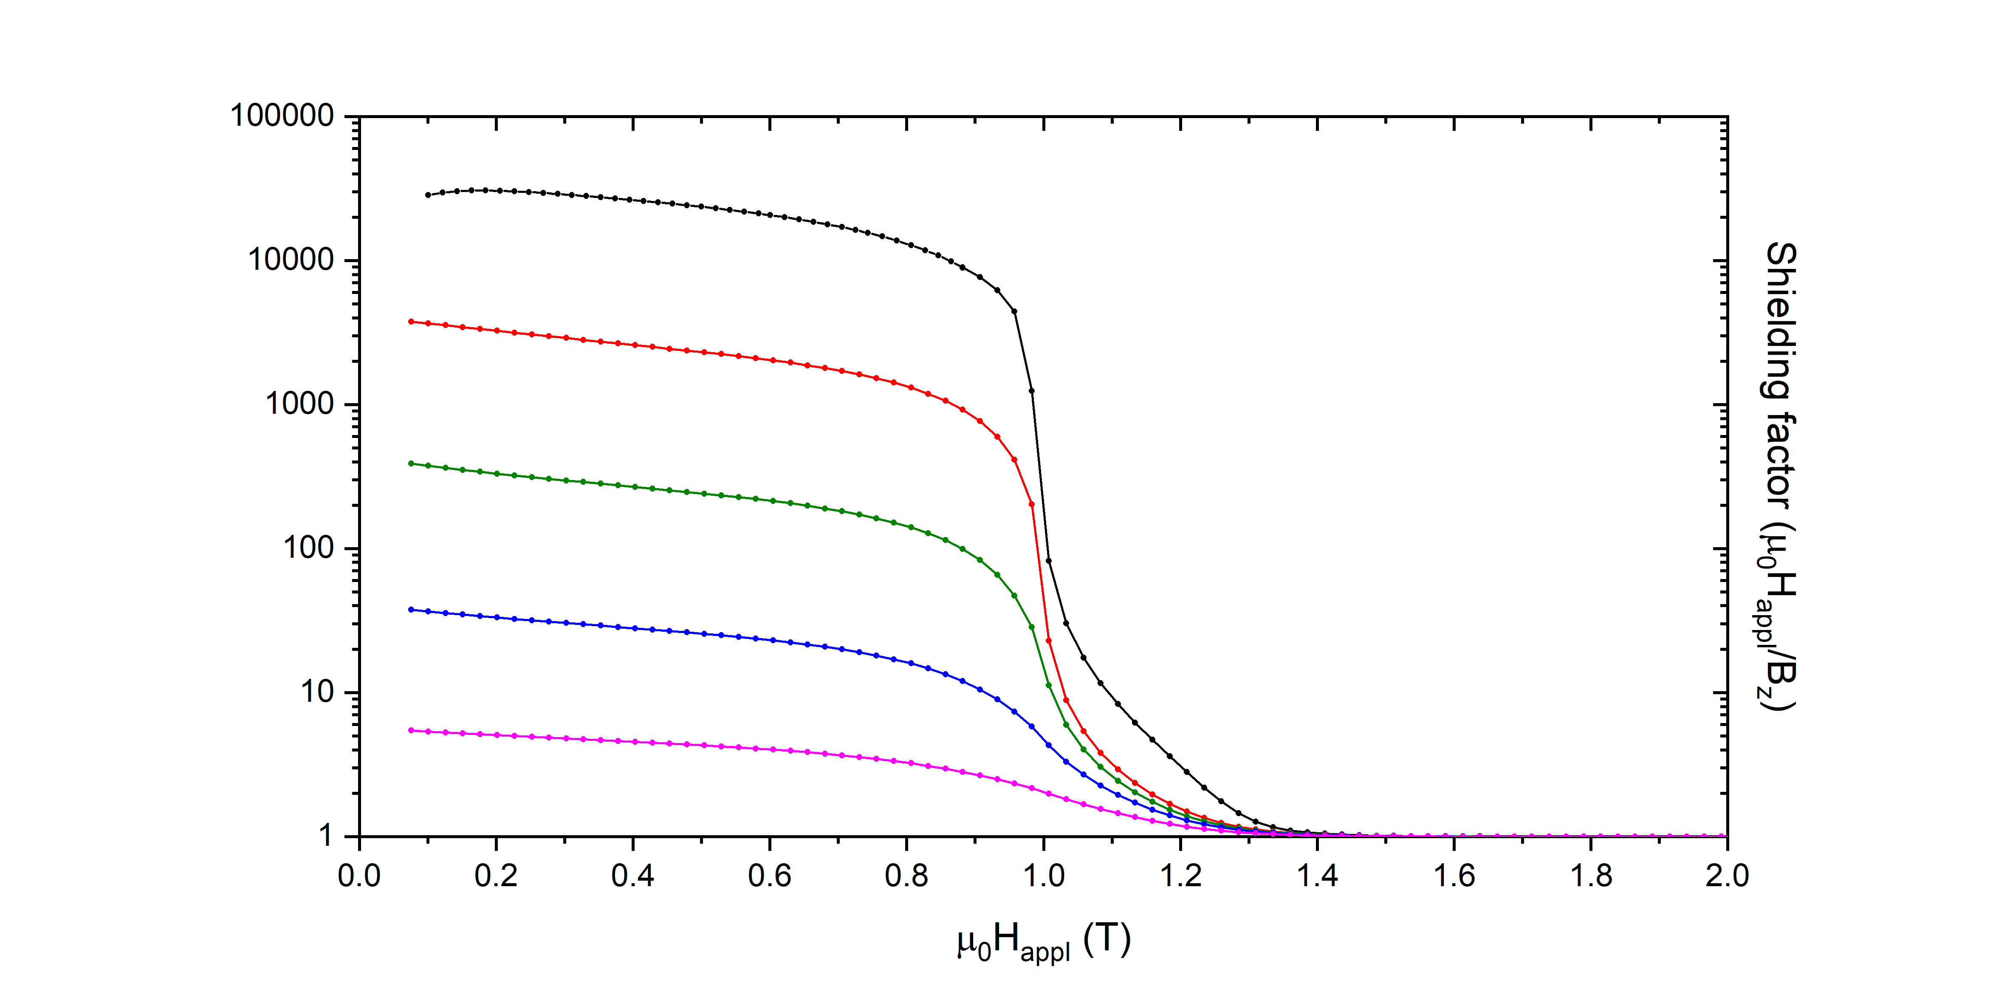
Study of new shield configurations
symbol: only SC
symbol: only SC
SF = shielding factor =$\frac{μ_{0}H_{appl}}{B_{⊥Happl}}$
SF = shielding factor =$\frac{μ_{0}H_{appl}}{B_{||Happl}}$

Slide 6
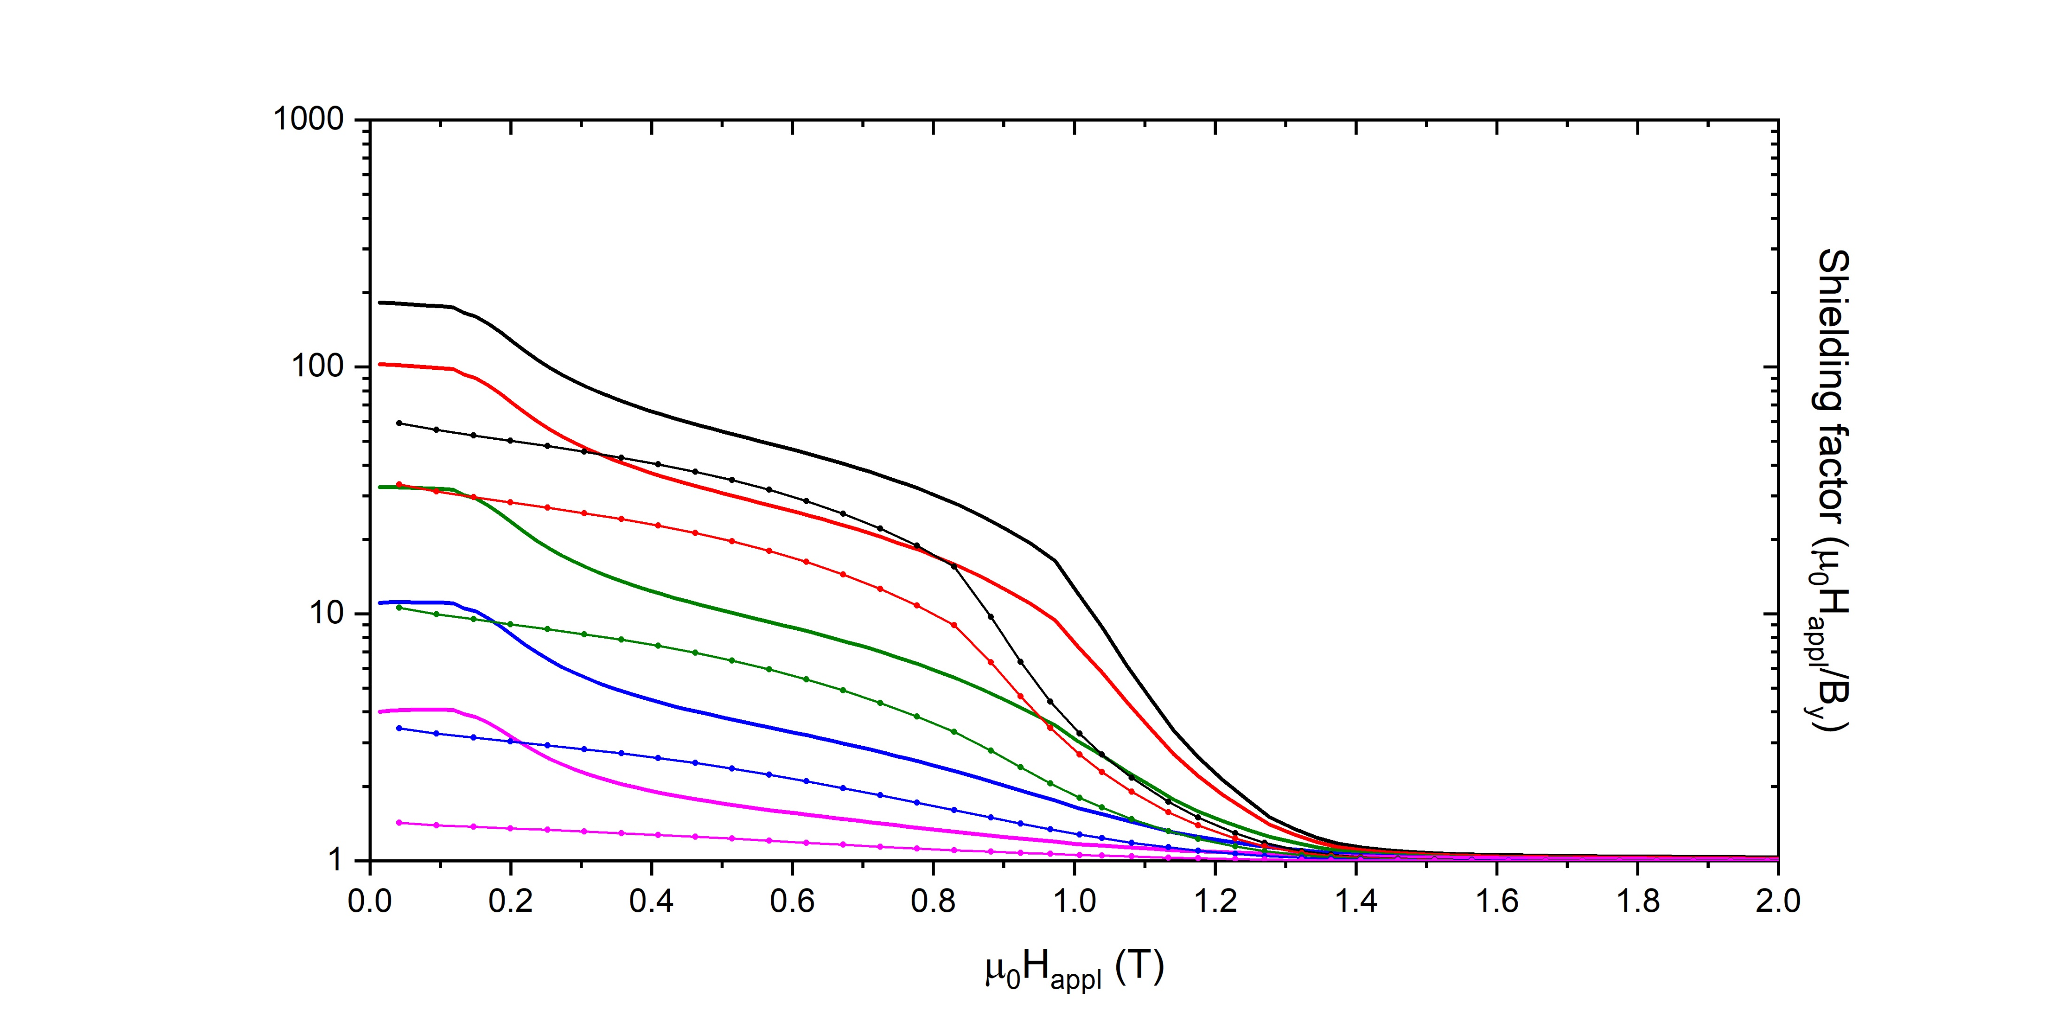
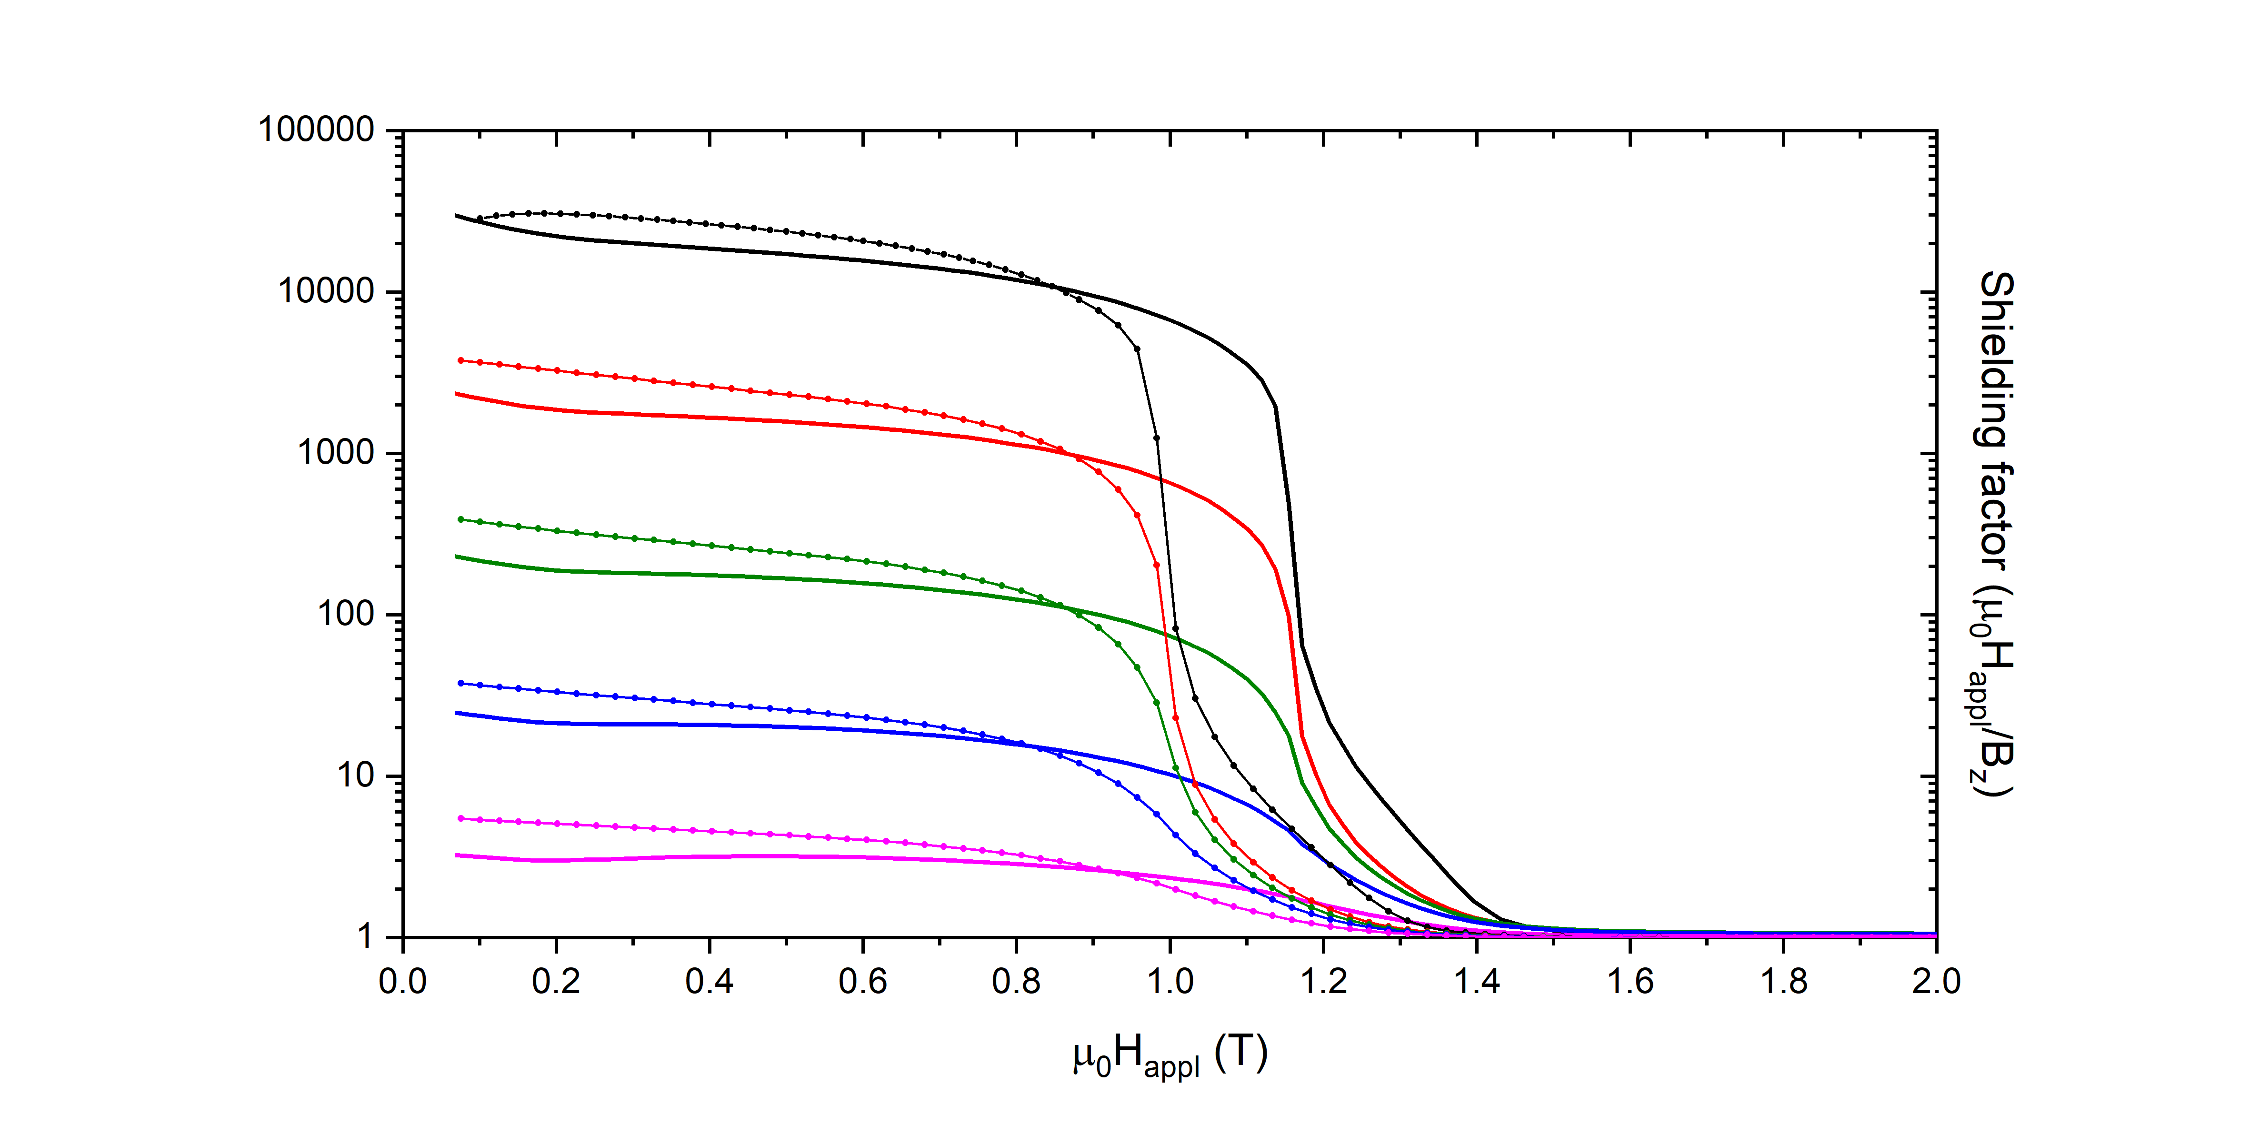
Study of new shield configurations
symbol: only SC
line: configuration1
symbol: only SC
line: configuration1

Slide 7
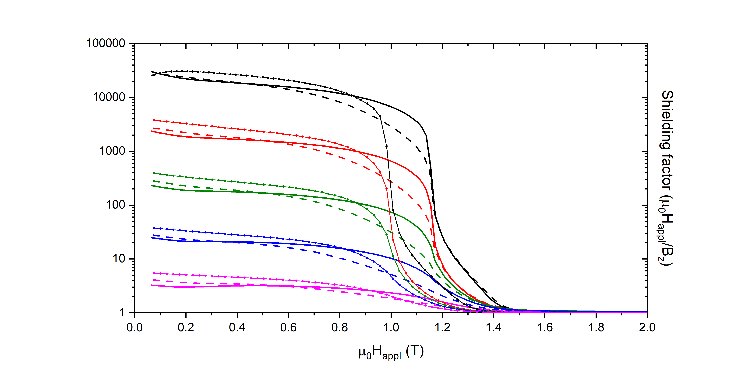
Study of new shield configurations
symbol: only SC
line: configuration1
dash line: configuration2
symbol: only SC
line: configuration1
dash line: configuration2

Slide 8
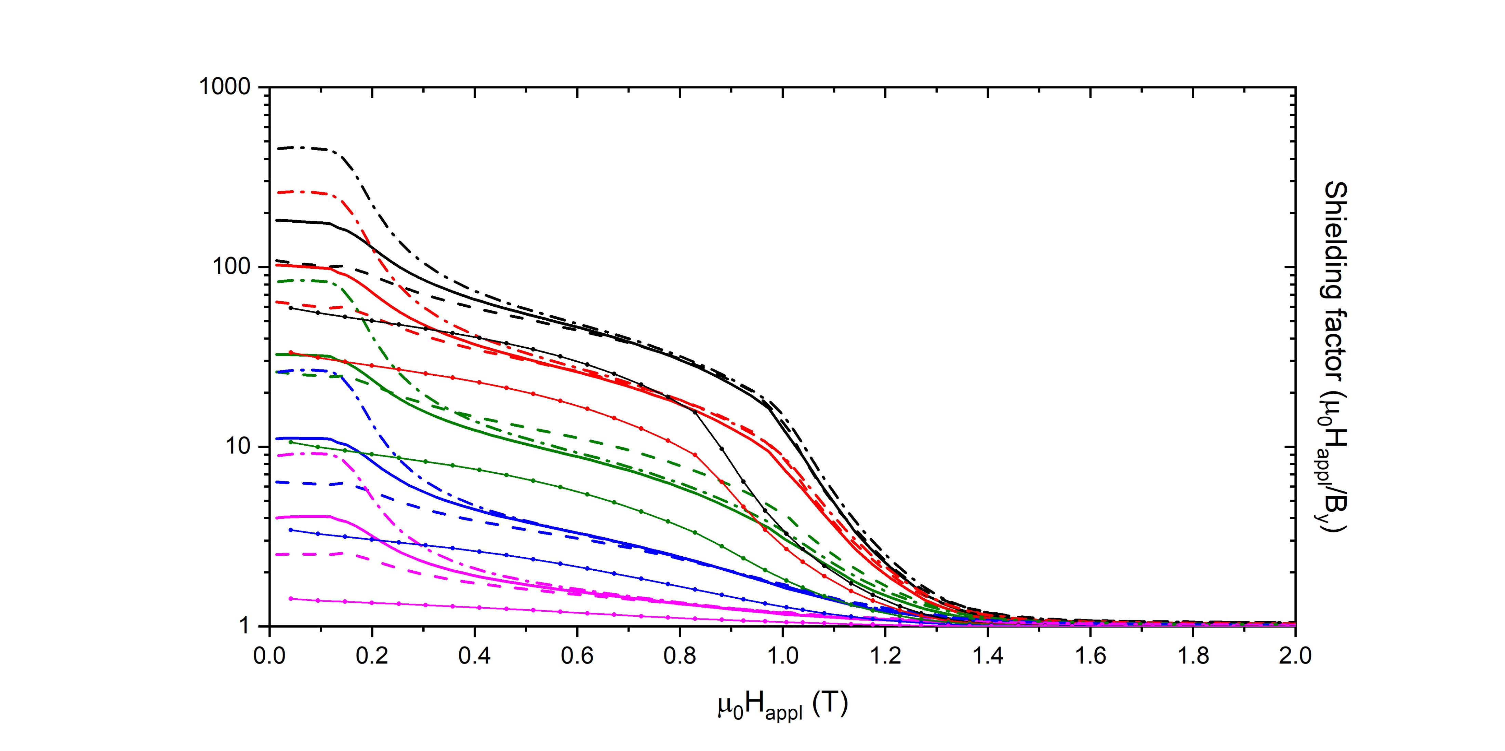
Study of new shield configurations
symbol: only SC
line: configuration1
dash line: configuration2
dash dot line: configuration3
symbol: only SC
line: configuration1
dash line: configuration2
dash dot line: configuration3
The ferromagnetic sheet addition actually improves the shielding performances for both the applied magnetic field directions

Slide 9
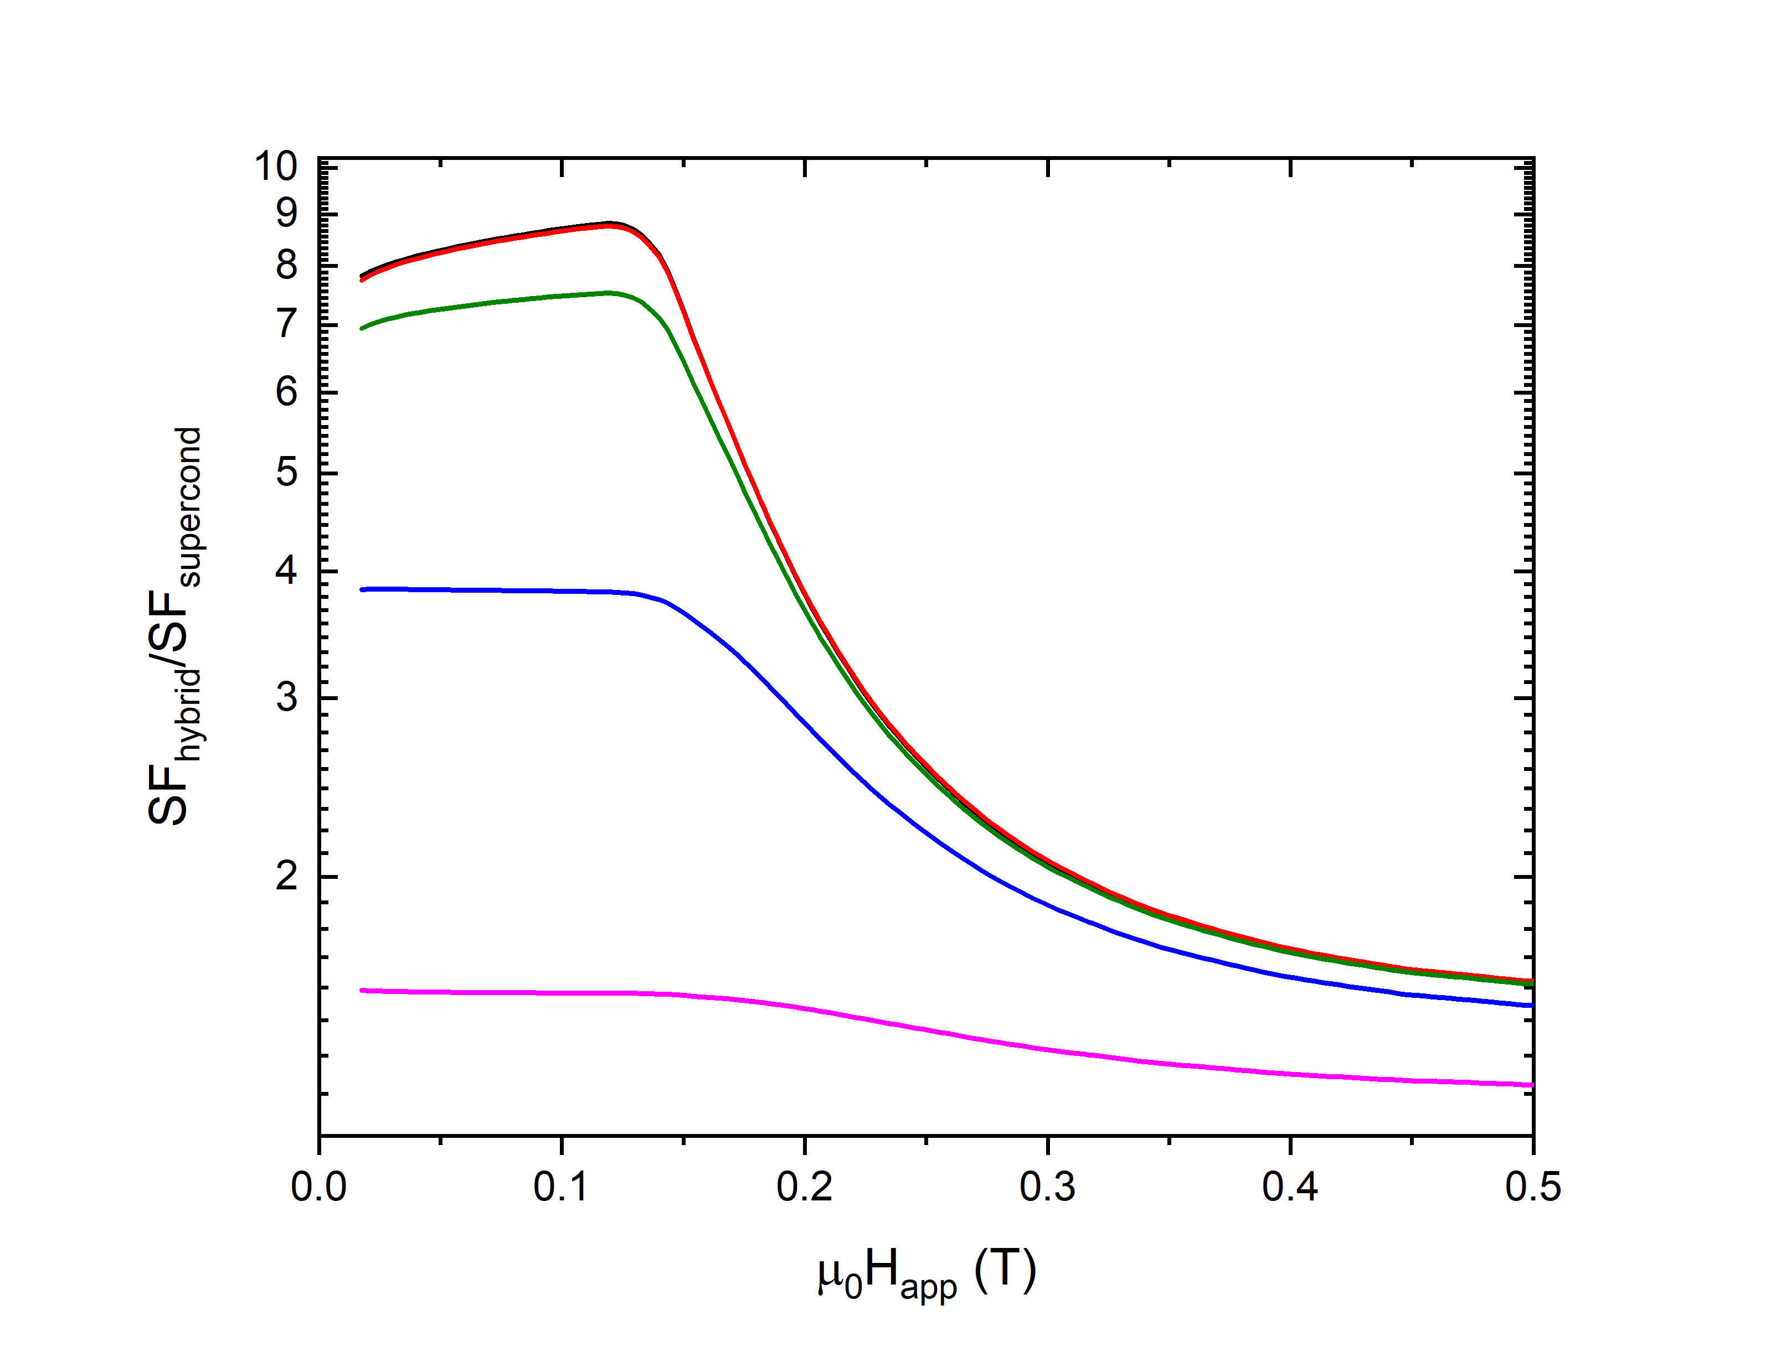
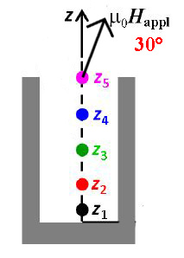
Study of different angles of H_{appl}

Slide 10
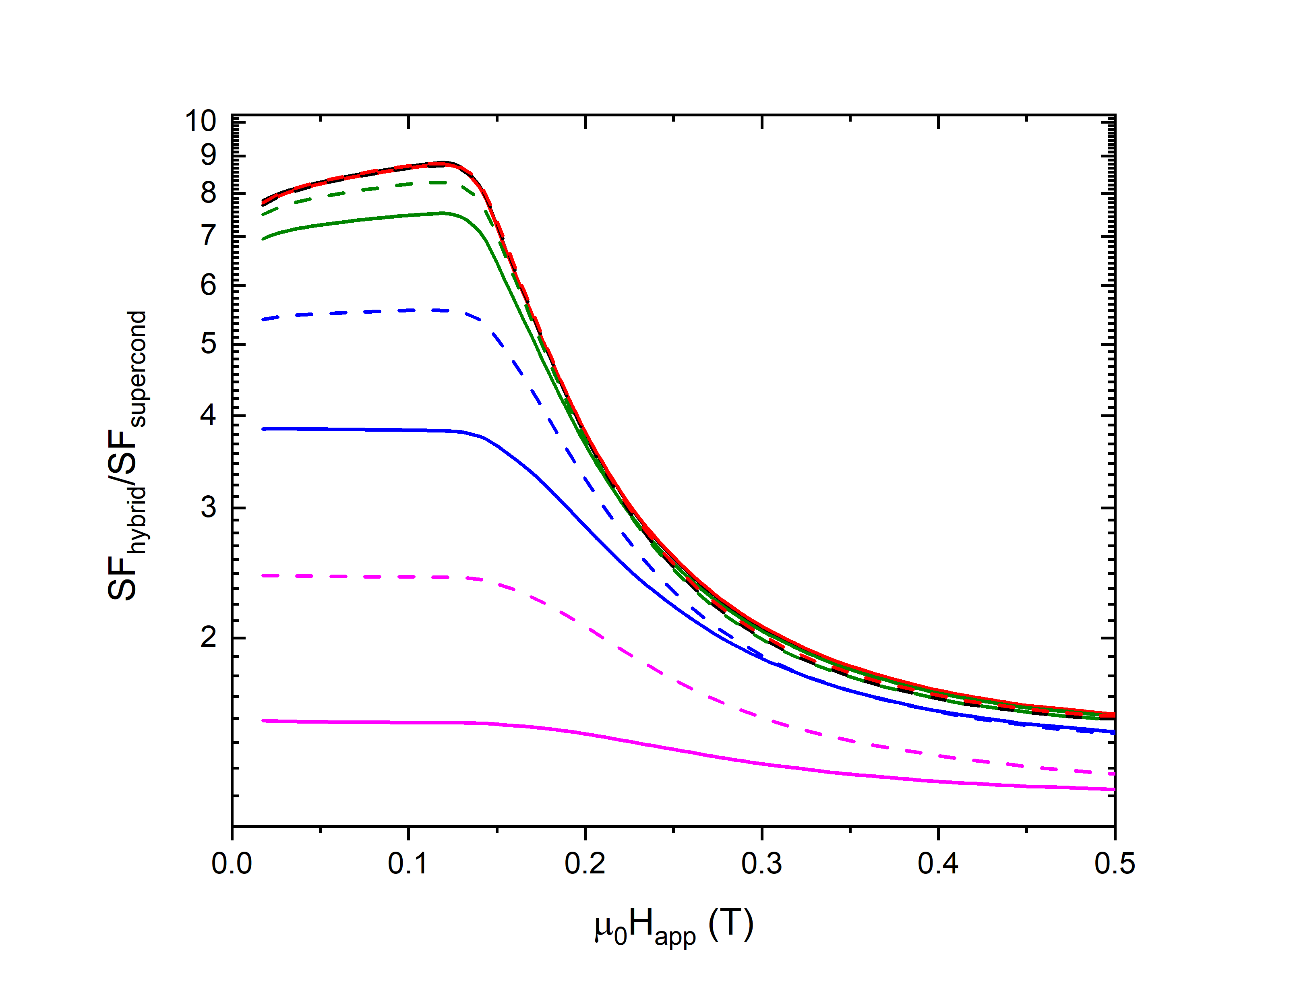
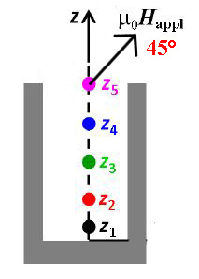
Study of different angles of H_{appl}

Slide 11
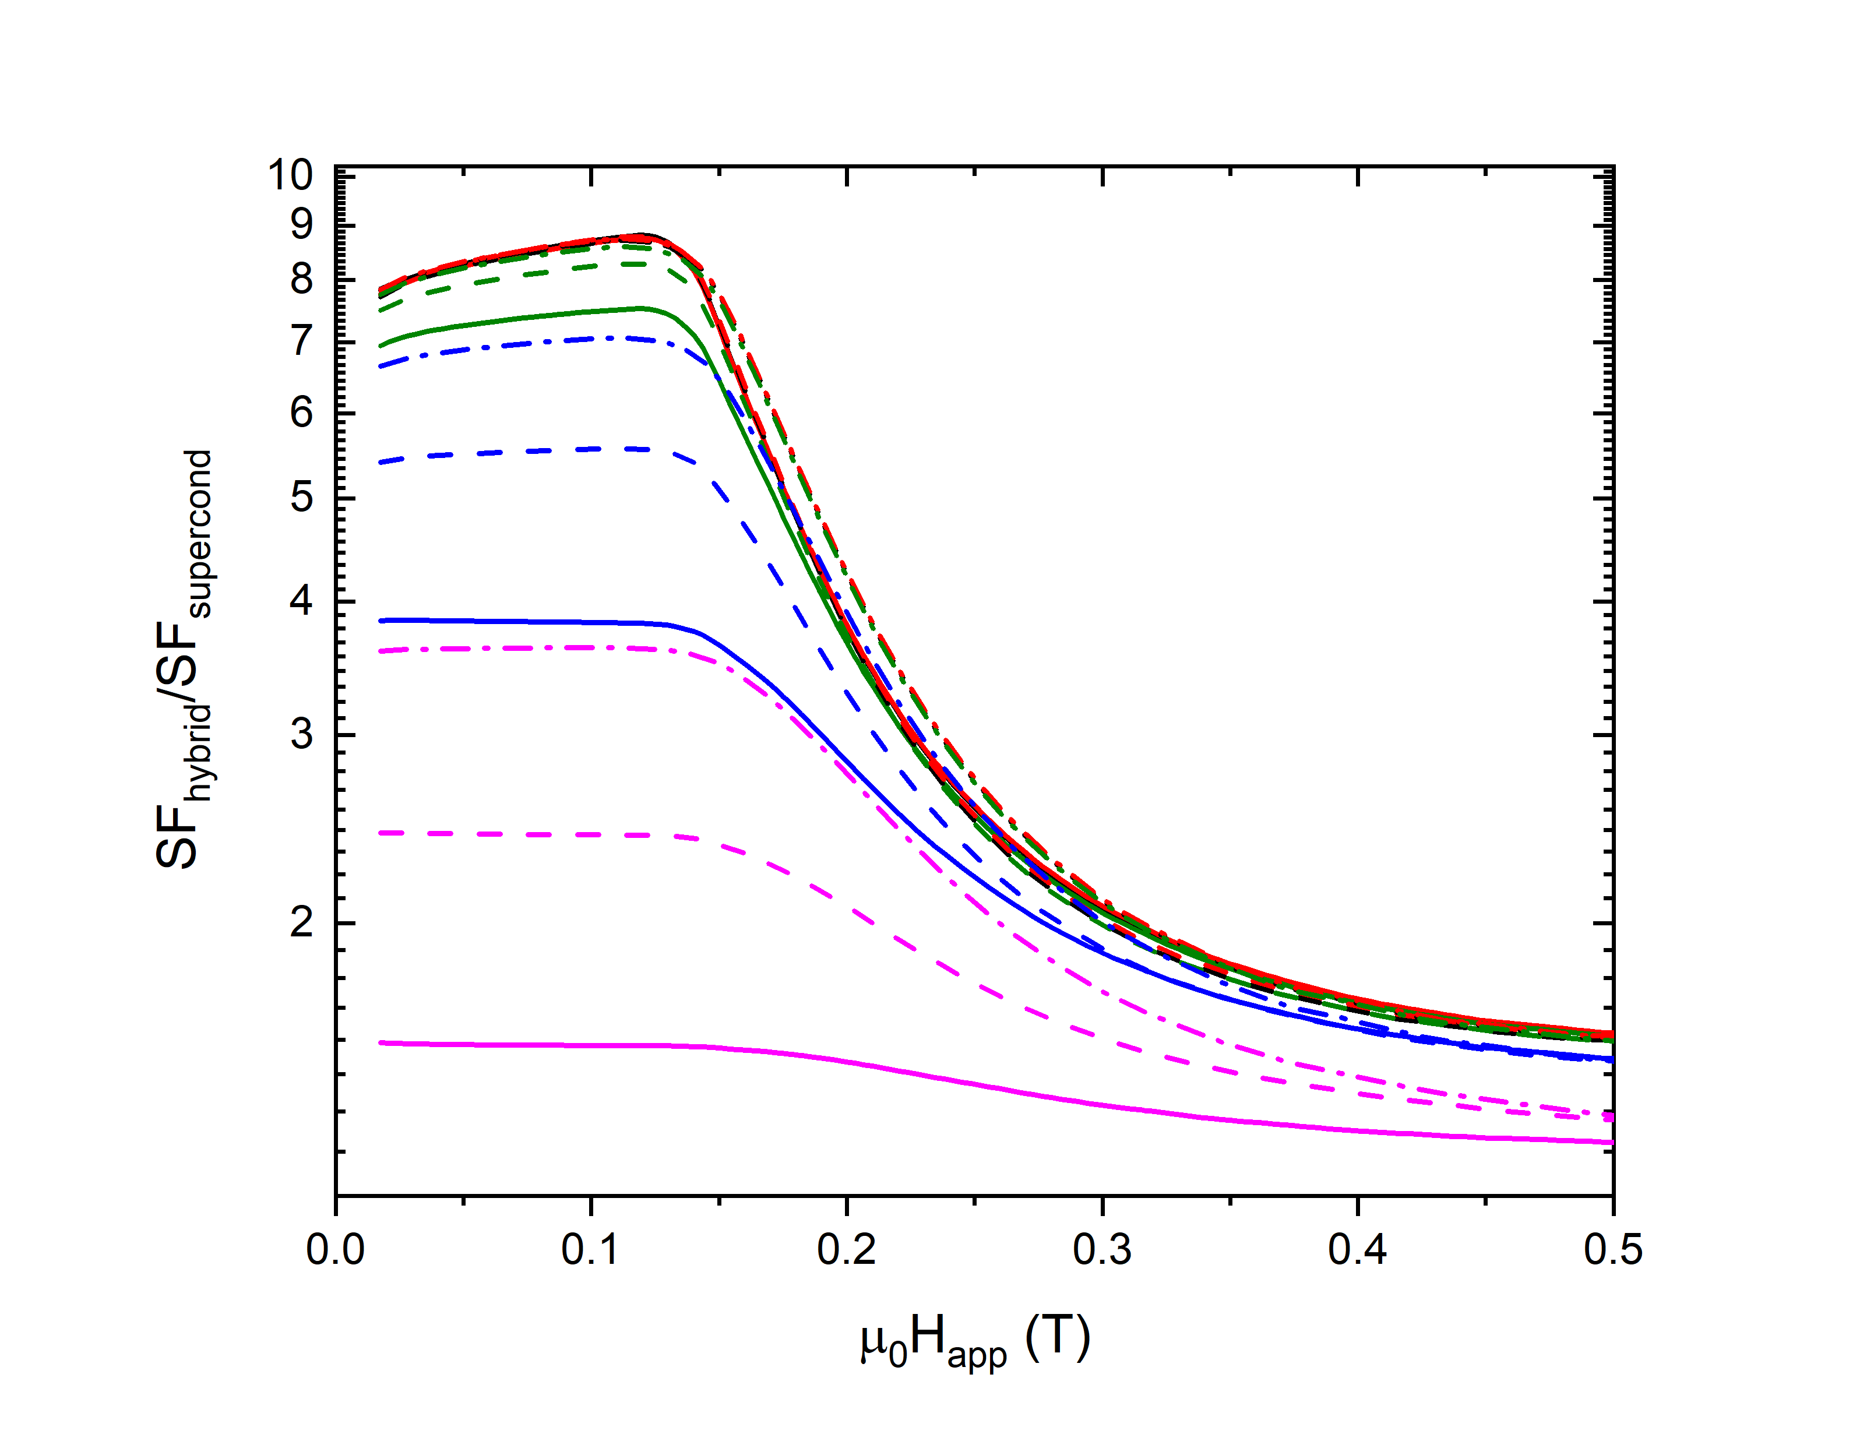
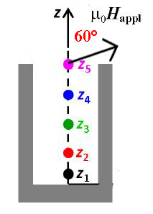
Study of different angles of H_{appl}

Slide 12
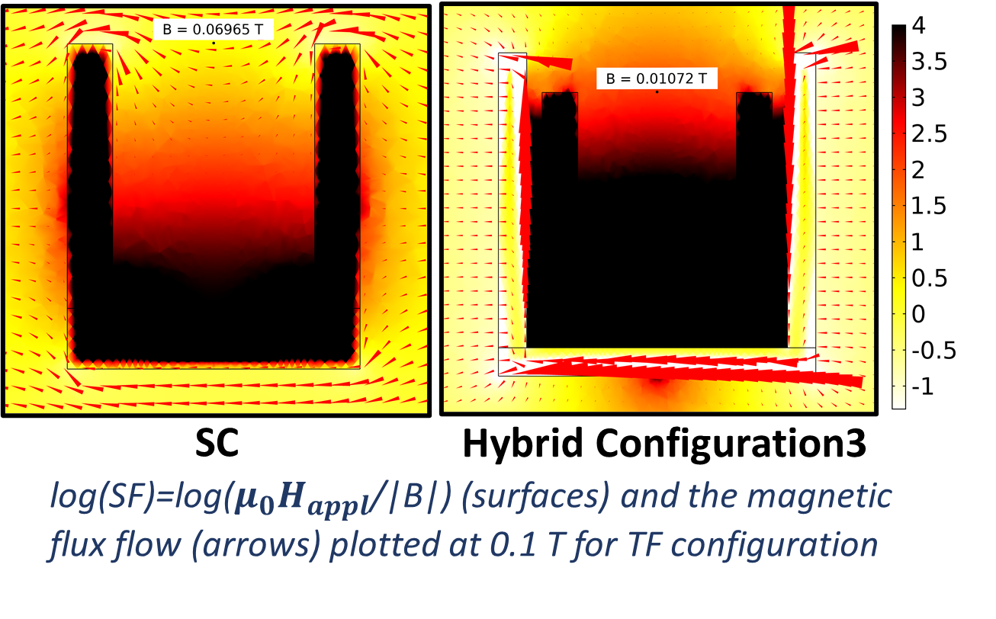

Slide 13
Conclusions…
New and efficient geometries can be investigated by 3D modelling
AF configuration for only MgB₂ cup
In the inner half of the shield: T = 30K SF > 10² up to μ₀H_{appl} ≈ 1.0 T
Near the closed extremity: T = 30K SF > 10⁴ up to μ₀H_{appl} ≈ 1.0 T
Ferromagnetic shield addition
⇨ allows the persistence of a great-SF region up to a field of ≈ 1.2 T but decreases the SF at low field
TF configuration for only MgB₂ cup
In the inner half of the shield: T = 30K SF > 7 up to μ₀H_{appl} ≈ 0.4 T
Near the closed extremity: T = 30K SF > 40 up to μ₀H_{appl} ≈ 0.4 T
Ferromagnetic shield addition
⇨ allows the persistence of a great-SF region up to a field of ≈ 1T
⇨ low field: improved performance →from SF=40 to SF=120 (configuration2) and to SF=450 (configuration3)
H_{app} angles between 0° and 90°
The addition of the FM shield always improves the performance of the structure
Near the closed extremity of the shield the enhancement is almost independent from the angle, whereas it increases with the angle near the open extremity
…and future research
Study the effect of the FM addition for more angles of the applied magnetic field, i.e. 15° and 7.5°

Slide 14
Thank you for your kind attention!

