Slide 1

2D Numerical Simulations of HTS Stacks of Tapes for Cable-in-Conduit Conductors
22nd-23rd June 2021
Virtual (Nancy, France)
7th International Workshop on Numerical Modelling of High-Temperature Superconductors
Gianluca De Marzi, ENEA

Slide 2
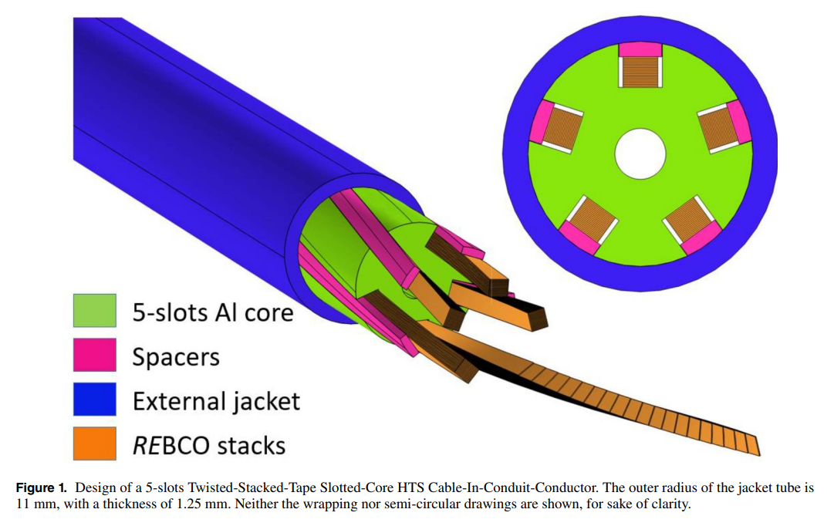
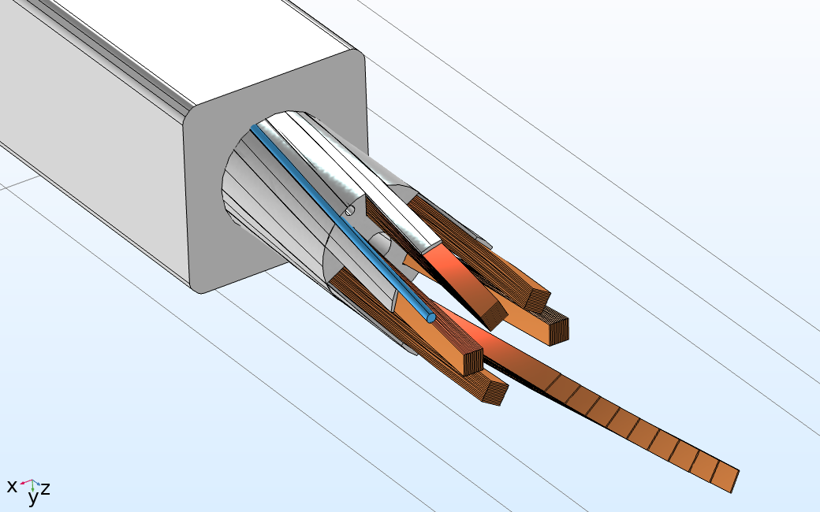
Introduction
Cable-in-conduit conductors comprised of twisted stacks of HTS tapes with aluminium slotted core constitute a very promising technology by virtue of their easy manufacturing process, flexibility capabilities, and high current densities. Currently, applications in the nuclear fusion industry of this HTS cable concept are being considered for the improvement of DTT and DEMO reactor performances.
FBG sensor
Tiles
HTS stack
jacket
He channel
Al core

Slide 3
Aim
In a cable, the current distribution among tapes is one of the key parameters affecting the cable performances
We here present a 2D finite-element model, which computes the magnetic field and current distribution in stacked tapes
This model can be also used to describe the experimental V-I results obtained in cables in which different current distributions among tapes are expected.

Slide 4
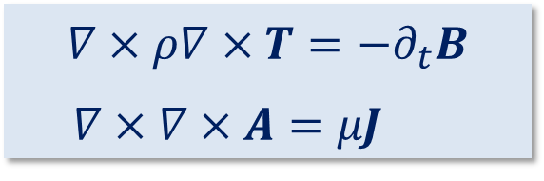



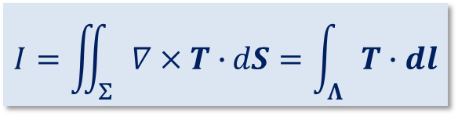
Methodology
The T-A formulation of the Maxwell's equations is a well-established model, and it has already been applied to a variety of HTS devices, such as coils and cables
$$∇×ρ∇×T=−∂_{t}B$$
$∇×∇×A=μJ$
A is defined all over the bounded universe, while T is exclusively defined along the superconducting medium
Thin strip approximation: the superconducting tapes are modeled as 1D objects
Transport currents are applied by a proper choice of the boundary conditions for T:
T-formulation
A-formulation
$n×\left(H_{1}−H_{2}\right)=$K
$$K=J_{z}∙δ\hat{z}$$
T = Tn
$$I=\iint_{Σ}{∇×T∙}dS=\int_{Λ}{T∙dl}$$
$$J_{z}=∂_{x}T$$

Slide 5
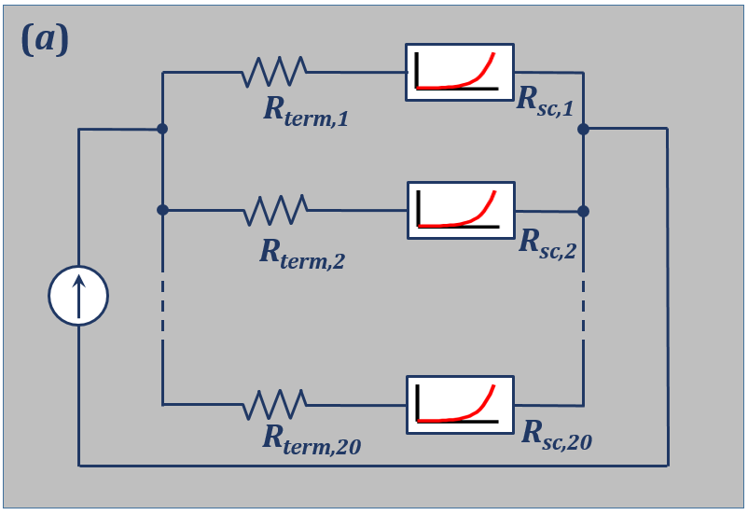
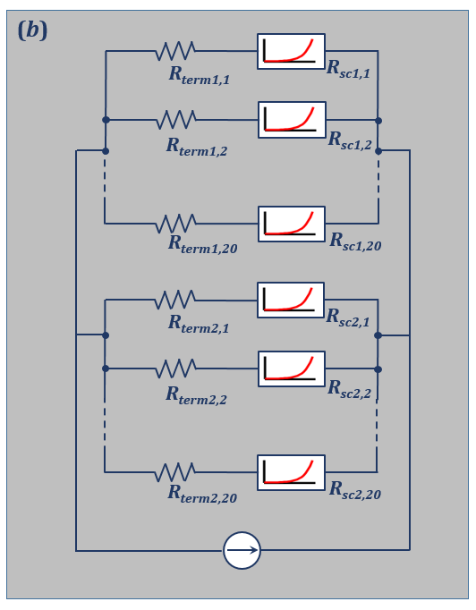
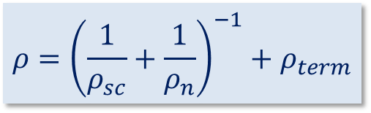
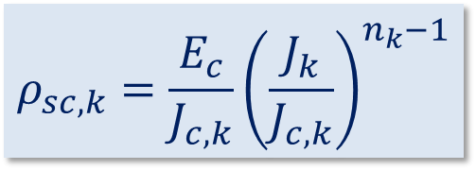
Cable’s Termination Resistances
The model includes the termination resistances
$$ρ_{sc,k}=\frac{E_{c}}{J_{c,k}}{\left(\frac{J_{k}}{J_{c,k}}\right)}^{n_{k}−1}$$
$$ρ={\left(\frac{1}{ρ_{sc}}+\frac{1}{ρ_{n}}\right)}^{−1}+ρ_{term}$$
Equivalent circuit models:
(a) single stack; (b) two stacks
This approximation is valid when tape-to-tape contact resistance is higher than the tape termination resistance as likely occurs for lab-scale samples

Slide 6

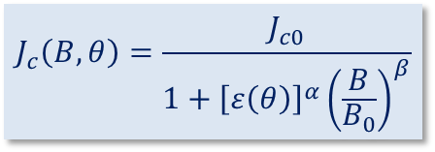
Critical Current: Angular and Field Dependence
The model includes the I_{c}(µ₀H, ϴ) dependence
$$J_{c}\left(B,θ\right)=\frac{J_{c0}}{1+{\left[ε\left(θ\right)\right]}^{α}{\left(\frac{B}{B_{0}}\right)}^{β}}$$
ϴ
B
tape
$$ε\left(θ\right)=\sqrt{g^{2}\cos^{2}\left(θ−θ_{0}\right)+\sin^{2}\left(θ−θ_{0}\right)}$$
The experimental lift factors, are globally fitted to the abovementioned equation using the Igor Pro’s Global Fit package with I_{c0}, ɡ, α, and β as global parameters and the flux density B as a local parameter.

Slide 7
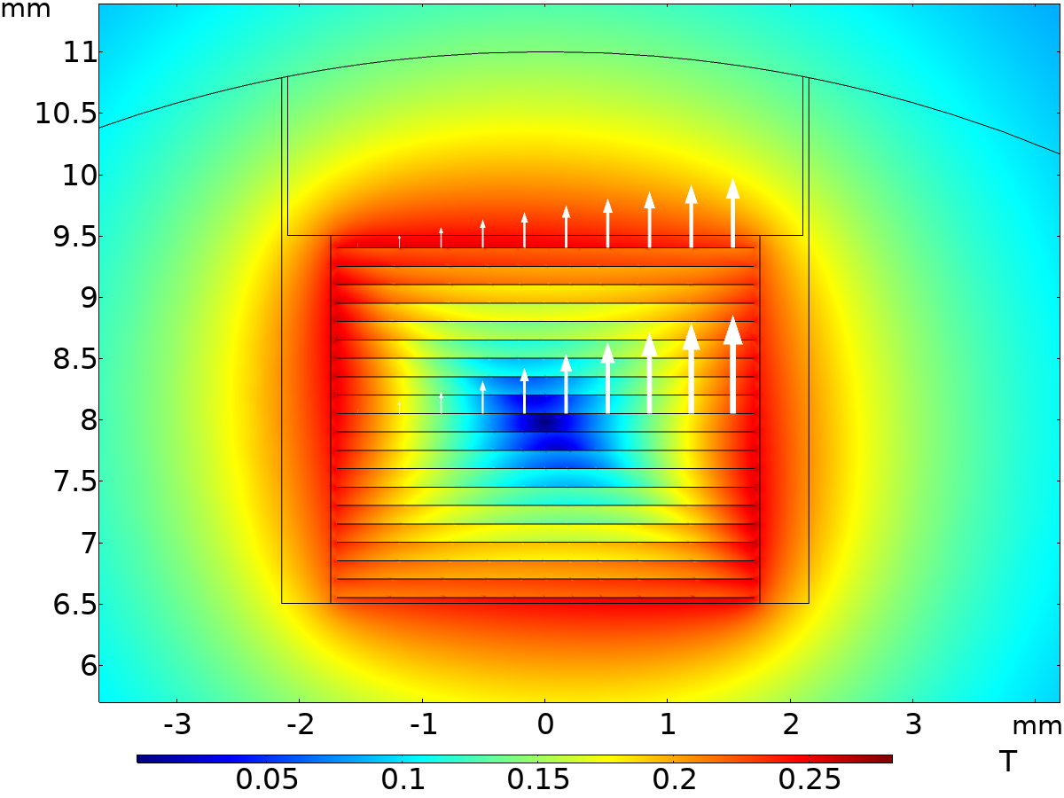
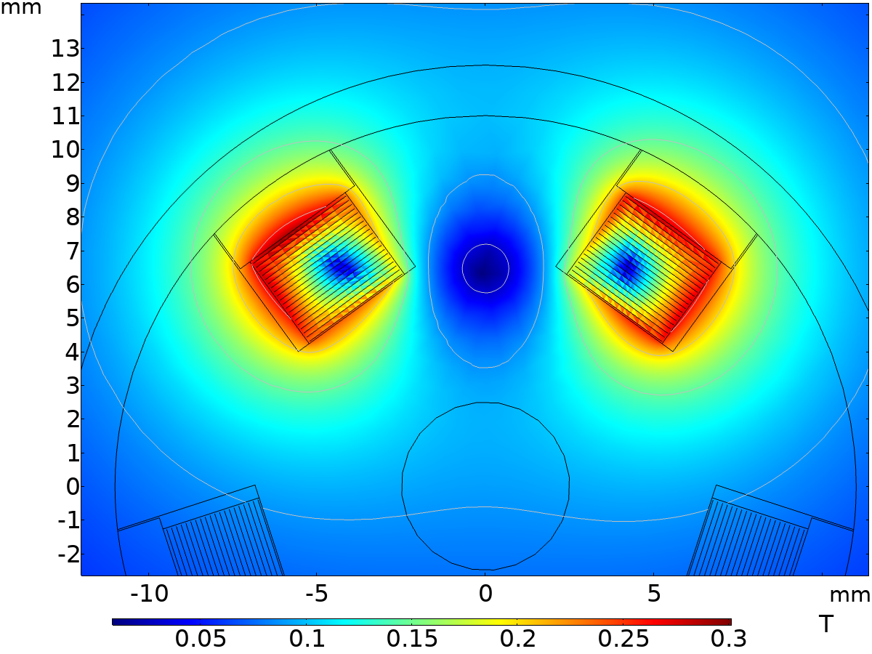
Magnetic fields and currents
Magnetic field calculated with the T-A formulation close to the S-N transition region
Left: Field map for the single stack. The direction and relative magnitude of the current vector potential T is plotted for two selected tapes, one on the top and the other in the middle of the stack. Right: field map for two adjacent stacks.

Slide 8
Experiment #1: Stack of 20 THEVA Tapes
Cu-stabilized tape Pro-Line TPL4300c, by THEVA, has been used (Table I). The investigated 1-m-long CICC sample is comprised by one stack of 20 HTS tapes and four dummy stacks of Stainless Steel (SS) tapes.
Table I Experiments #1 and #2: main parameters of the HTS tape and CICC cable (w = width; t = thickness).
Parameter | Sample
HTS tapeª Tape size (w x t) [mm x mm] Substrate, thickness [mm] Cu stabilizer’s thickness [μm] I_{c} [A], 77 K self-field Twist pitch [mm] Core diameter [mm] Number of slots Slot size (w x h) [mm x mm] Number of HTS stacks Number of tapes per HTS stack Number of dummy stacks Dummy tape, (w x t) [mm x mm] | THEVA TPL4300c 3.4 x 0.15 Hastelloy C-276, 0.1 20 (per side) ~160 ∞ 19 5 4.3 x 4.3 1 (Exp. #1), 2(Exp. #2) 20 4 (Exp. #1), 3(Exp. #2) SS, 4.0 x 0.15
ª From Datasheets provided by supplier.

Slide 9
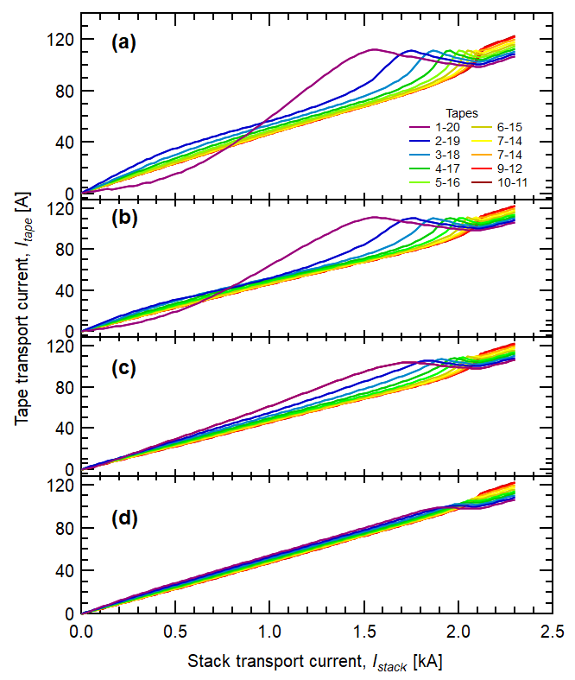
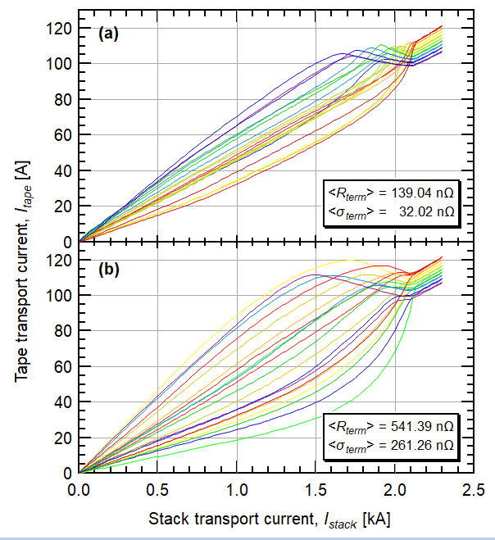
Experiment #1: Stack of 20 THEVA Tapes
Individual tape current as a function of cable current. Left side: R_{term} is equal for all tapes in the stack: (a) 1 nΩ; (b) 10 nΩ; (c) 100 nΩ; (d) 500 nΩ; Right side: gaussian distributed random values of R_{term}, with standard deviations of: (a) 32 nΩ; (b) 261 nΩ.

Slide 10
Experiment #1: Stack of 20 THEVA Tapes
For I « I_{c}, the current repartition is governed by the R_{term} values and the inductance distribution among tapes, whereas self-field effects become dominant for I ⪅ I_{c}
In spite of R_{term} variations by more than two orders of magnitude, the shape of the E-I characteristic curve of figure 3 does not change.
Individual tape current as a function of cable current. Left side: R_{term} is equal for all tapes in the stack: (a) 1 nΩ; (b) 10 nΩ; (c) 100 nΩ; (d) 500 nΩ; Right side: gaussian distributed random values of R_{term}, with standard deviations of: (a) 32 nΩ; (b) 261 nΩ.

Slide 11
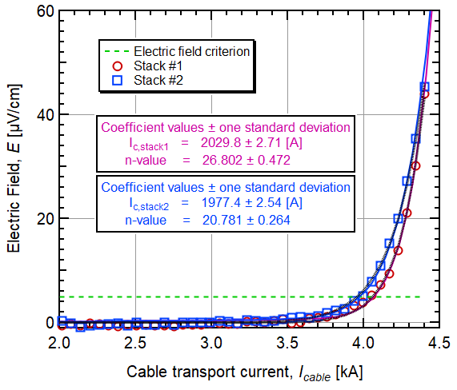
Experiment #2: Two Adjacent Stacks of THEVA Tapes
To study the current distribution among different stacks within the CICC, we made a second cable very similar to the one used in Exp. #1, using the same THEVA tapes.
The critical currents of the stacks differ by about 50 A. This can be explained in terms of different superconducting properties of the two stacks (i.e., different <I_{c}> and <n>) and by a reduced current sharing between the two stacks.

Slide 12
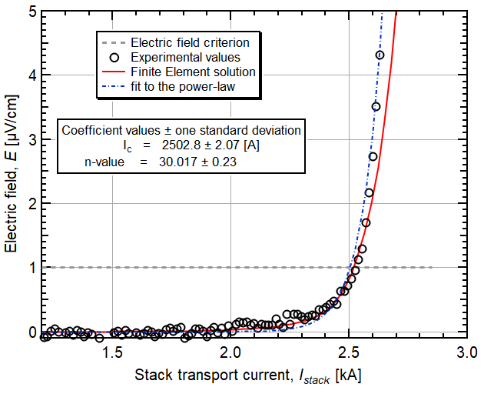
Experiment #3: Stacks in a Bent Cable
To study the effect of the variation of I_{c} among tapes, we have analyzed the current distribution in a 1-meter cable which has been bent down to R_{b} = 0.15 m.
Table II Experiment #3: main parameters of the HTS tape and CICC cable (w = width; t = thickness).
Parameter | Sample
HTS tapeª Tape size (w x t) [mm x mm] Substrate, thickness [mm] Cu stabilizer’s thickness [μm] Average I_{c} [A], 77 K self-fieldª Twist pitch [mm] Core diameter [mm] Number of slots Slot size (w x h) [mm x mm] Number of tapes per HTS stack Dummy tape, (w x t) [mm x mm] Wrapping tape, (w xa t) [mm x mm] External jacket, thickness [mm] | SuNAM SCN04150 4.0 x 0.15 Stainless steel, 0.1 20 (per side) 245 500 19 5 4.3 x 4.3 20 SS, 4.0 x 0.15 40 x 0.1 Al tube, 1.25
ª From Datasheets provided by supplier.
Each tape has been measured individually; large I_{c} variations among tapes is found.

Slide 13
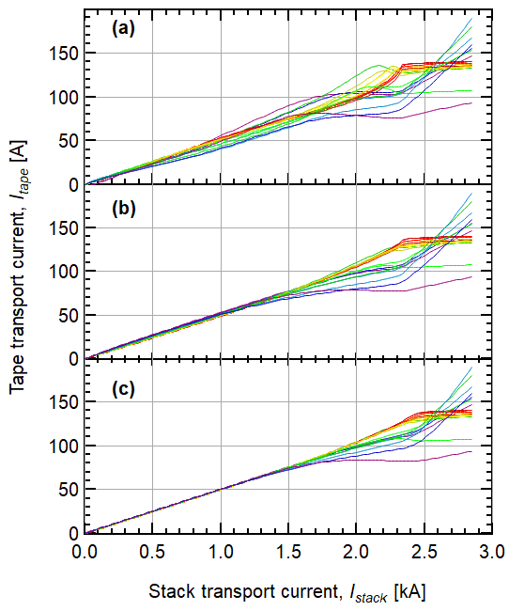
Experiment #3: Stacks in a Bent Cable
Individual tape current as a function of cable current for three different value of R_{term}: (a) 10 nΩ; (b) 100 nΩ; (c) 500 nΩ.
Measured E–I curve of the 20-tapes SuNAM stack (open circles). Continuous and dotted lines represent the FEM solution and the fit to the power law, respectively.

Slide 14
Experiment #3: Stacks in a Bent Cable
Individual tape current as a function of cable current for three different value of R_{term}: (a) 10 nΩ; (b) 100 nΩ; (c) 500 nΩ.
Some of the tapes have been damaged by bending and showed degradation.
They therefore entered the current sharing regime well before the transition to the normal phase of the whole stack
Consequently, the current distribution was highly uneven. In spite of this, the stack showed good electrical stability.
Measured E–I curve of the 20-tapes SuNAM stack (open circles). Continuous and dotted lines represent the FEM solution and the fit to the power law, respectively.

Slide 15


Experiment #3: Stacks in a Bent Cable
Individual tape current as a function of cable current for three different value of R_{term}: (a) 10 nΩ; (b) 100 nΩ; (c) 500 nΩ.
Such an unbalanced current sharing might generate thermal instabilities well below the transition, thus increasing the risk of catastrophic damage of the superconducting cable. Largely uneven I_{c} distributions should always be avoided.
Measured E–I curve of the 20-tapes SuNAM stack (open circles). Continuous and dotted lines represent the FEM solution and the fit to the power law, respectively.

Slide 16
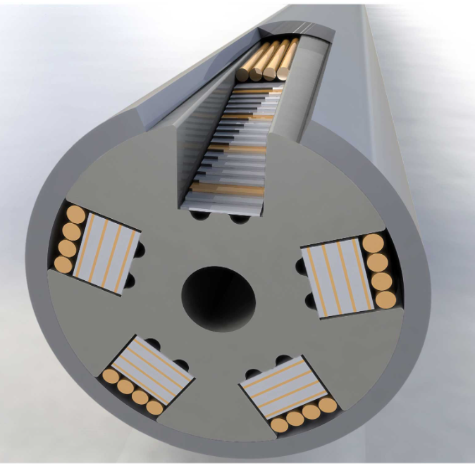
Perspectives
This model can also be useful for predicting the performance of a fully equipped HTS CICC in self-field conditions, and can be used for design and development activities of superconducting cables based on HTS coated conductor tapes.
Next step will be to implement a full 3D model to predict the behavior of a current-carrying HTS twisted stacked-tape CICC in an external magnetic field, as in typical operating conditions of a nuclear fusion reactor.

Slide 17



With kind contributions by:
Andrea Augieri
Giuseppe Celentano
Marcello Marchetti
Angelo Vannozzi
gianluca.demarzi@enea.it

