Slide 1
AC Loss Calculation of Synchronous Generators Made of HTS Superconducting Armature Windings and Permanent Magnet Rotor
Abdurrahman Erciyas, Fedai İnanir
Department of Physics, Yildiz Technical University / Turkiye

Slide 2
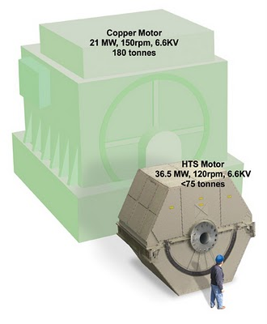
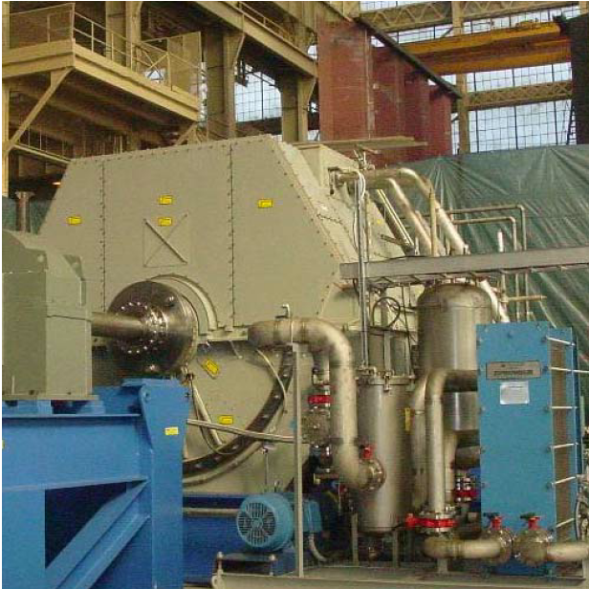
AC Machineries
Effciency
Weight
Dimensions
36.5 MW, 120 rpm (U.S. Navy, AMSC)
Notes:
AC machinery design three importan parematers should be considered.
The First parameter, efficiency depends on the AC losses at rotor and stator windings, magnet losses at the magnets and eddy current losses at the metalic part. To increase the efficiency, it should be decreased the AC losses. Other two parameters the weight and the sizes are caused mainly the the amount of current carried by the conductors placed into the rotors and stators. Superconductor can provide exraordinary benefits because of the high current carrying capacity and low AC losses.

Slide 3
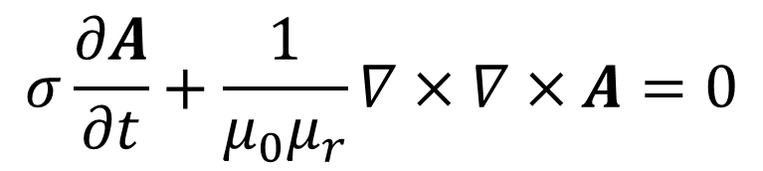
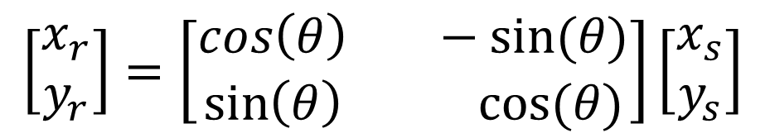
Modeling Framework
Ampére Equation
$$σ\frac{∂A}{∂t}+\frac{1}{μ_{0}μ_{r}}∇×∇×A=0$$
&
For the rotation, Deformed Mesh
$$\left[\begin{aligned}x_{r} \\ y_{r}\end{aligned}\right]=\left[\begin{aligned}cos\left(θ\right) −sin⁡(θ) \\ \sin\left(θ\right) cos⁡(θ)\end{aligned}\right]\left[\begin{aligned}x_{s} \\ y_{s}\end{aligned}\right]$$
Notes:
In order to predict the AC loss, we must solve this time dependent partitial differential equation, such as Ampere equation for the suitable bounday condition. In this work, ampere equation make it solve by employing the Comsol Multiphysics software with AC /DC module. In two demension, the magnetic vector potential has only z-component. As is well known the generators are rotating machinereies, therefore we should use together the ‘deformed Mesh Technique’. We have to add the calculation the mesh movement. For the rotation, we use the simple geometrical transformation such as,

Slide 4
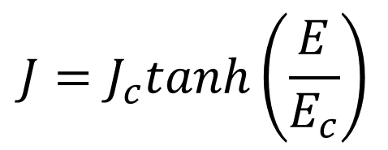
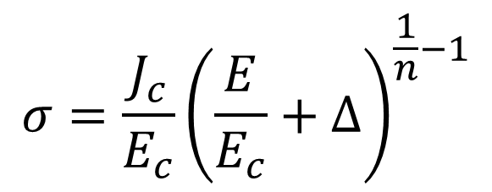
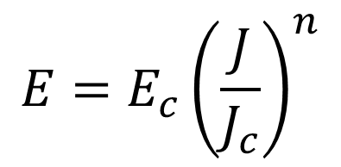

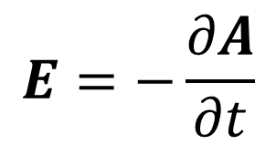
Modeling Framework
$$E=E_{c}{\left(\frac{J}{J_{c}}\right)}^{n}$$
$$J=J_{c}tanh\left(\frac{E}{E_{c}}\right)$$
$$σ=\frac{J_{c}}{E_{c}}{\left(\frac{E}{E_{c}}+∆\right)}^{\frac{1}{n}−1}$$
with
$$E=−\frac{∂A}{∂t}$$
$$A=A_{z}\hat{k}$$
Notes:
I have tried two apprimations in the evaluations and compared each other. One of them is applied a constain on the current which is employed vastly by Gömöry. Another define the conductivity based on the famous power-law equation. The conductivity of superconducting part can be given as. This paramater delta takes very small values and to avoid the divergence of the equation at the intial step. The electiric fiel can be described as and two dimension the z component of electric field is taken.

Slide 5
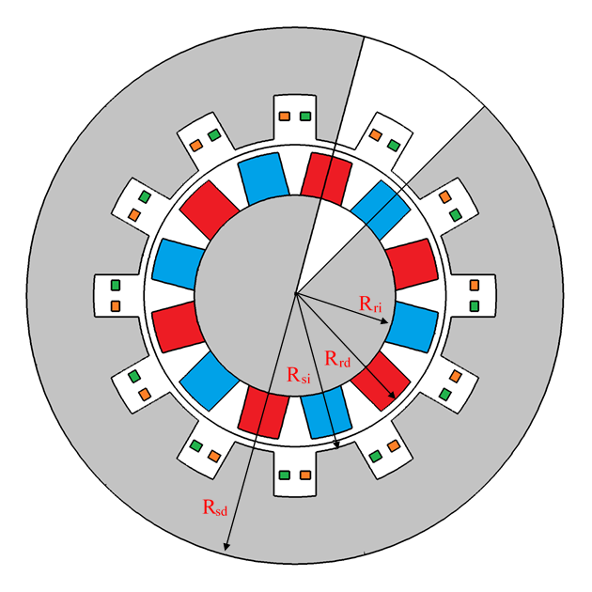
Model Generator
Table 1. Parameters used for the model generator
Parameter | Definition | Value
R_{so} (mm) | Outer Radius of Stator | 320
R_{si} (mm) | Inner Radius of Stator | 188
R_{ro} (mm) | Outer Radius of Rotor | 172
R_{ri} | Inner Radius of Rotor | 12
D_{ag} (mm) | Air Void | 16
L (mm) | Length of Generator | 600
p | The Number of Poles of the Generator | 12
s | The Number of Slots of the Generator | 12
B_{r} (T) | The Magnetic Field of Permanent Magnet | 1.2
ω (rpm) | The Angular Velocity of Generator | 10,30…180
I_{c} (A) | The Critical Current density of the Strip | 300
w_{sc} (mm) | The Width of the Strip | 12
h_{sc} (m) | The Thickness of the Strip | 100
E_{c} (V/m) | Critical Electric Field | 1x10⁻⁴
n | Exponent parameter | 25
N_{s} | The Number of the winding of stator coils | 100
Figure 1. Model generator used in calculations. The rotor of the generator was designed from permanent magnets, and the magnets were placed in a radial direction to produce an inward and outward magnetic field.
Notes:
At the simulation, we have considered two different topologies like these. One ganererator is composed of the permanent magnets at the rotor and superconducting coils at the stor. The magnet is so located that they can produce opposite direction magnetic field such as up and down way. The second generator is made of superconducting coils at both stator and rotor winding. The rotor coil carries the DC current and an AC current is induced at the stor supercondcuting coil. At the same time, opposite direction magnetic field can be produced, adjusting dc cuttent path.

Slide 6
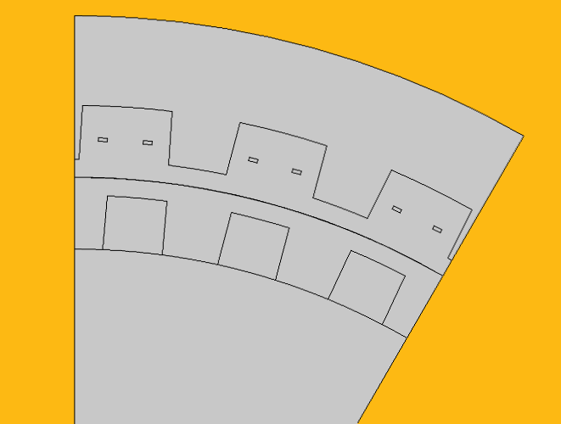
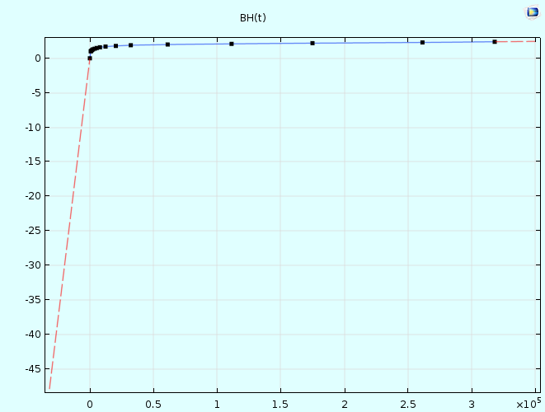
Modeling Framework
Sector Symmetry
n.B=0
Antiperiocity
A_{s}=-A_{d}
V_{m,s}=-V_{m,d}
Notes:
to simplify the calculation and to make it faster, We divide our geometry indo various sectors and only calculate the one sector because of the periocity of the problem. At the begining we specified the boundary condition that is necessary accurate calculation . In here, we define there different boundary. First boundary, sector symeetry at the sliding surfaces between rotor and stator, second is anti periocity, at which the the magnetic potantial and vector potential must be contrary to each other and the thirty boundary is the magnetic isolation at the outer surfaces. These parts are iron, the magnetic proporties of iron is given by the BH curves provided Comsol library.

Slide 7
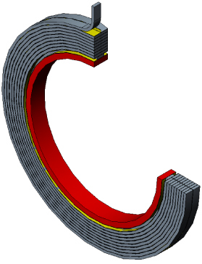
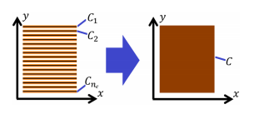
We increase the computational speed, we adopted the Homogenization approximation for the stack of tapes.
Zarmeno et al. JAP, J. Appl. Phys. 114, 173901 (2013)
Notes:
In the calculation we have amployed the homogeneous approximation, it is proposed by Zarmeno. And this method is widely used by the others. In this approximation we disregard the discrete structure of the coil wraped by many tapes and the coil is regarded as continious. This allow us amasing facilities to our calculation. This method can be applied to coils that consist of fifty turns. İf the number of turn is larger thand fity, you can use this aproximation that I have read Ainslie PhD thesis.

Slide 8
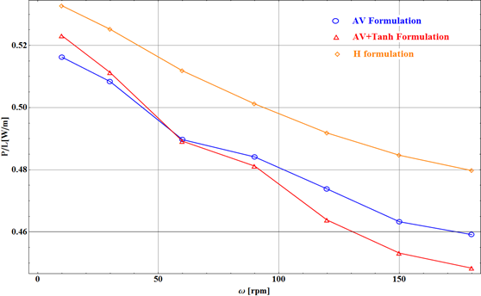
RESULTS
In Figure 2, AA losses that were calculated using all three methods for different generator velocity were shown. As it can be seen in the figure, AA losses decreased almost linearly as the angular velocity increased. The reason for this can be easily understood by looking at Figure 4 because the penetration depth of the induced current decreases as the rotational speed increases. Therefore, the losses decrease proportionally. These values ​​indicate instantaneous losses. For actual loss values, these values should be multiplied by the frequency corresponding to the speed.
Figure 2. The Variation of AA losses that were calculated by the three developed methods as a function of generator rotational speed.
Notes:
In this table, the parameters are adopted in the simulation for the permanent magnet superconductor generators. This is very small generater as you see the sizes. But the permenent magnet is strong. And it is regarded rotating low velocity just 16 tour at a minitute. This tapes is standart tapes 4 mm wide and 100 um thickness and its critical current is about 100 A. This genetor power is 1 kW.

Slide 9
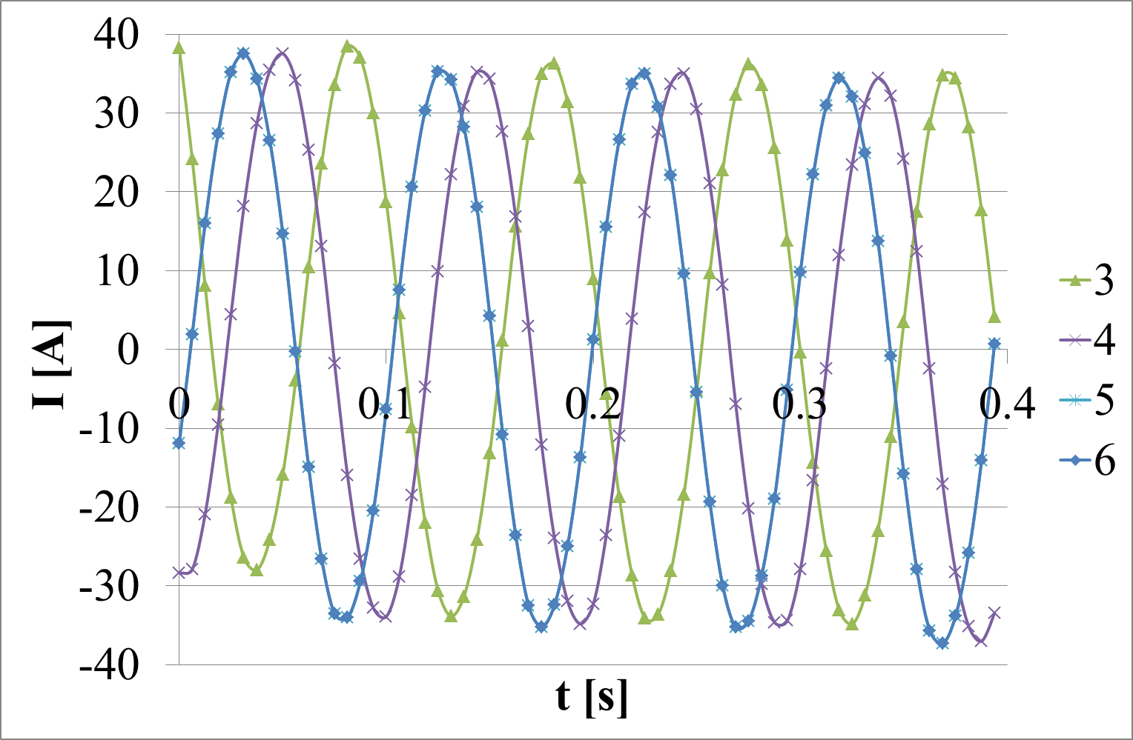
Fig. The induced current various armature coils.
Notes:
Firstly we have calculated the induced current, this generator jus only produce 40 Ampere current in each layer. It also there phase generator.

Slide 10
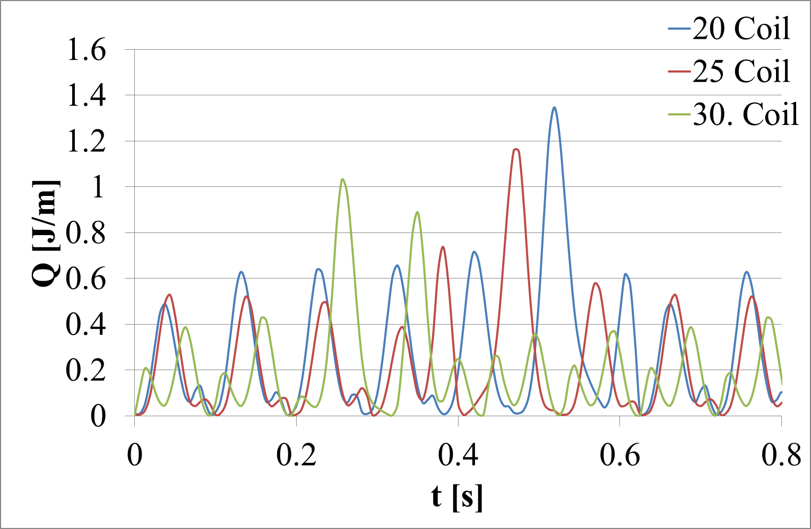
Fig. Instaneteous losses for selected three coil.
Notes:
These are the evaluated instaneus loss integrating E.J at the whole surfaces of the coil. İn our calculation total number of coil are 78, we just consider only one six of them. by integrating this curves you can get the average power loses. İt is time ingegration. I will made it when I return.

Slide 11
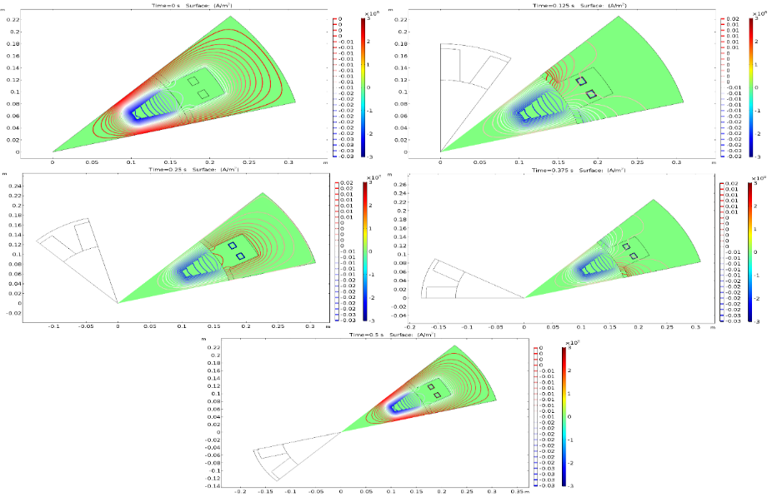
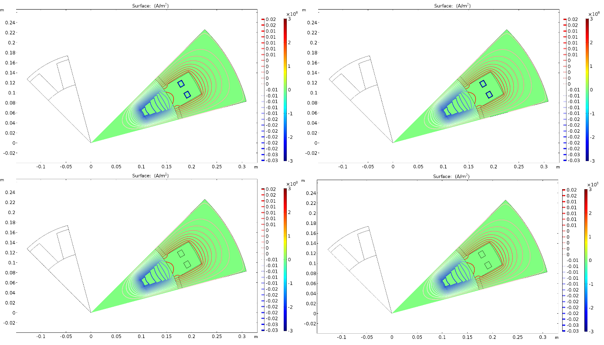
Figure 3. The distributions of the current that was induced in the superconducting coils when the rotor rotates a quarter round for ω= 10, 30, 150, 180 rpm velocities and magnetic field distribution.
Figure 4.The magnetic field distributions of the stator and rotor of the model generator for ω=60 rpm during t=0, 0.125, 0.25
0.375, 0.5 s.

