Slide 1
Field-Circuit Coupled Simulation of Magnetothermal Dynamics in an HTS Solenoid
7th International Workshop on Numerical Modelling of High Temperature Superconductors
22nd–23rd June 2021, Virtual (Nancy, France)
https://htsmod2020.sciencesconf.org/
L. Bortot^{1,2}, M. Mentink², A. Verweij², S. Schöps¹
Special Thanks: I. Cortes Garcia, H. De Gersem, M. Maciejewski

Slide 2
INTRODUCTION
High temperature superconductors (HTS)
Oxides (CuO2) doping with La, Y-Ga-Ba etc.
Higher critical temperature and coercive field with respect to low-temperature superconductors (LTS)
Quench
Local loss of the superconducting state
High energy-density → potentially irreversible effects!
Mitigation: artificial resistive zone increase → dilution of the Ohmic loss density
$$T_{hotspot}$$
$$T$$
■ Copper ■ ReBCO ■ Substrate
$${\vec{v}}_{quench}$$
$$\sim mm$$
$$\sim μm$$
$$x$$
HTS tape
Resistive zone
Figure: schematics of a copper-coated ReBCO tape
Motivation: Simulation of transient effects in circuits of accelerator magnets Field-Circuit Coupled Systems!

Slide 3
MATHEMATICAL FORMULATION
Magnet domain decomposition
$Ω_{H}=$ $Ω_{H,s}∪Ω_{H,c}$ active region → Coils:
$Ω_{H,s}$ superconductors ($σ→+∞)$
$Ω_{H,c}$ normal conductors
$Ω_{A}=$ $Ω_{A,c}∪Ω_{A,i}$ passive region → Iron yoke, air region:
$Ω_{A,c}$ normal conductors
$Ω_{A,i}$ insulators ($ρ→+∞)$
Field equations [$⋆$]
$$n$$
$$Ω_{A,i}$$
$$n$$
$$Ω_{A,c}$$
$$Ω_{H,c}$$
$$Γ_{HA}$$
$$Ω_{H,s}$$
$$Γ_{E}$$
$$Γ_{A}$$
$$Ω∈ℝ^{3}$$
$$−$$
$$∇×ρ∇×H+μ∂_{t}H+∇×χ u_{s}=0$$ |  | $H$ formulation in$Ω_{H}$
$$∇×ν ∇×A^{⋆}+ σ∂_{t}A^{⋆}=0$$ |  | $A^{⋆}$ formulation in $Ω_{A}$
$$ρ_{m}C_{p}∂_{t}T−∇⋅k∇T−J⋅ρJ=0$$ |  | Heat balance equation in$Ω$
$\int_{Ω_{H}}{χ}⋅∇×HdΩ=i_{s}$ |  | Current constraint
$$χ=−∇ξ, ξ : ∇⋅σ∇ξ=0$$ |  | Voltage distribution function
$$Γ_{J}$$
$$u_{s}$$
$$i_{s}$$
$$+$$
Figure: General representation of the computational domain
[$⋆$] Bortot, L., et al. "A Coupled A–H Formulation for Magneto-Thermal Transients in High-Temperature Superconducting Magnets." IEEE Transactions on Applied Superconductivity 30.5 (2020): 1-11.

Slide 4
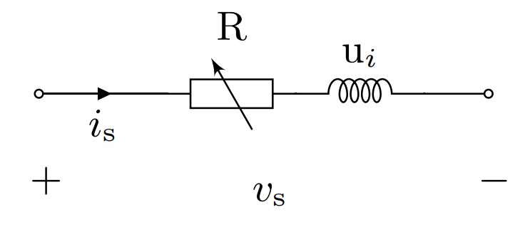
DISCRETE EQUATIONS
Discretization functions
Edge elements for $H$, $A^{⋆}$ ( 1st and 2nd order)
Nodal elements for $χ$, $T$ (1st order)
Circuit interface
External circuit connected via electric ports
FEM model → one-port component with impedance $Z_{FEM} : u_{s}=Z_{FEM} i_{s}$
$A^{⋆}$ form | Weak form PDE module
𝐇-form
Coupling terms
Heat Balance | Heat transfer in solids
Circuit coupling | Global ODEs and DAEs
$${\text{K}}^{\text{ν}}\text{+}{\text{M}}^{\text{σ}}\frac{\text{d}}{\text{d}\text{t}}$$ | $$−Q$$ | $$0$$ | $$0$$
$$Q^{T}$$ | $${\text{K}}^{ρ}\text{+}{\text{M}}^{μ}\frac{\text{d}}{\text{d}\text{t}}$$ | $$−Χ$$ | $$0$$
$$0$$ | $$Χ^{T}$$ | $$0$$ | $$0$$
$$0$$ | $$0$$ | $$0$$ | $${\text{K}}^{\text{κ}}\text{+}{\text{M}}^{\text{ρ}}\frac{\text{d}}{\text{d}\text{t}}$$
$$\text{a}$$
$$\text{h}$$
$${\text{u}}_{\text{s}}$$
$$\text{t}$$
$$0$$
$$0$$
$${\text{i}}_{\text{s}}$$
$$\text{q}\left(\text{⋅}\right)$$
$\int{\text{du} }$
$\int{\text{du} }$
$\int{\text{du} }$
$$=$$
$$\frac{d}{dt}$$
Linearized field-circuit coupling interface for solid conductors

Slide 5
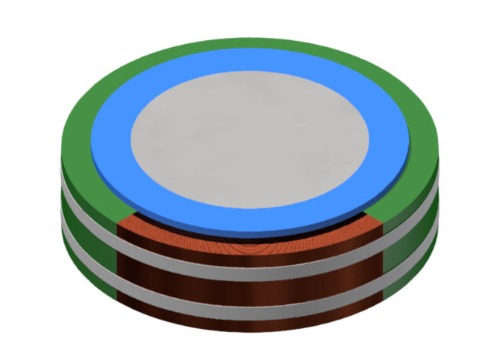
NUMERICAL EXAMPLE (1/2)
HTS solenoid protected by heater strips: 2D axisymmetric model and circuitry
$Γ_{A}$ : Homogeneous Dirichlet
Iron core
Holder
$$Ω_{H}\text{: }\text{Coil}\text{ (}\text{superc}\text{onducting}\text{)}$$
$$Γ_{HA}$$
Iron core
Holder
$$…$$
$Ω_{H}$: Heater strips
Coil
Insulation
Heater strips
2D FEM model
$$Ω_{A}$$
$Ω_{H}\text{:}$ Coil (normal conducting)
Figure: Rendering of the HTS solenoid. Part of the insulation is removed for illustration purposes.
Figure: Domain decomposition

Slide 6
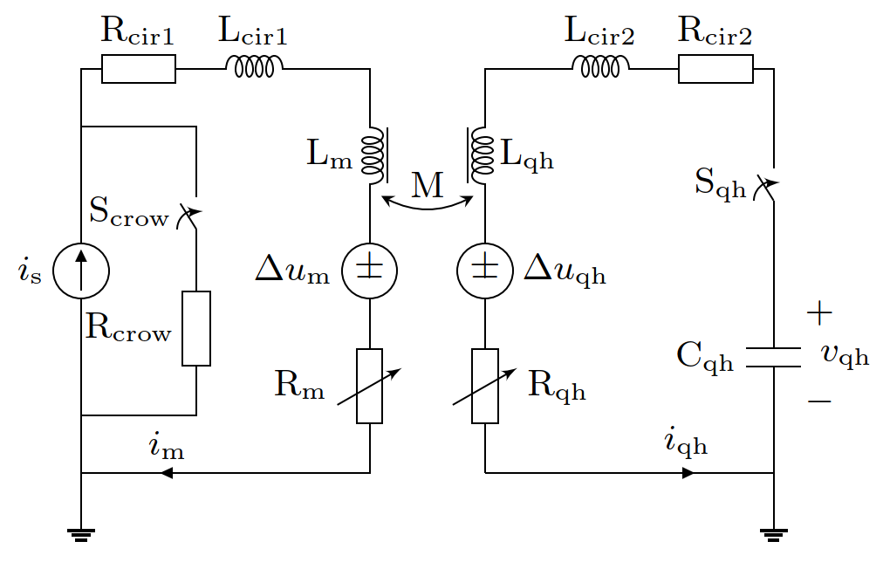
NUMERICAL EXAMPLE (2/2)
Electrical layout
Solenoid lumped-parameter representation
B.
Optimized Schwarz transmission condition for field-circuit coupled simulations with the waveform relaxation algorithm [$⋆$]
A.
Coil supply loop
Heaters supply loop
Protection mode
A. crowbar resistance
B. Heater strips
Current discharged
Observations: $R_{crow}+R_{m}$ discharge the solenoid current $R_{m}$ determined by the quench
0
5
10
150
t (ms)
($⋆$) Garcia, Idoia Cortes, et al. "Optimized field/circuit coupling for the simulation of quenches in superconducting magnets." IEEE Journal on Multiscale and Multiphysics Computational Techniques 2 (2017): 97-104.

Slide 7
(A) NUMERICAL RESULTS (1/3)
Circuital currents
Peak temperature
Induced quench
Time window$ℐ^{i}$
Max. detection time
$$≈15 ms$$
Current decay in the coil (left) and current discharge in the heater strips (right)
Adiabatic hotspot temperature in the coil, as a function of the quench detection time

Slide 8
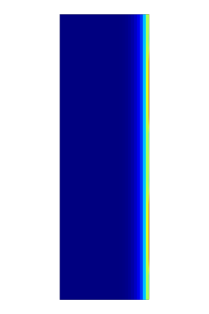
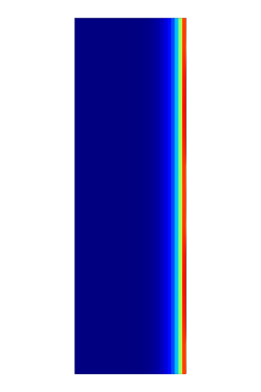
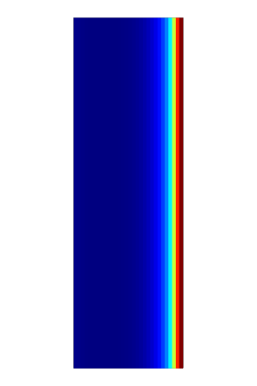
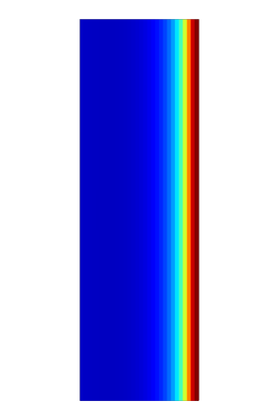
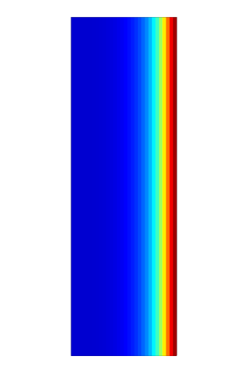
NUMERICAL RESULTS (2/3)
Heater strips
Quench
Heat diffusion
Temperature (K)
10 ms
20 ms
30 ms
50 ms
100 ms
150 ms
Temperature distribution in the superconducting coil, as a function of time

Slide 9
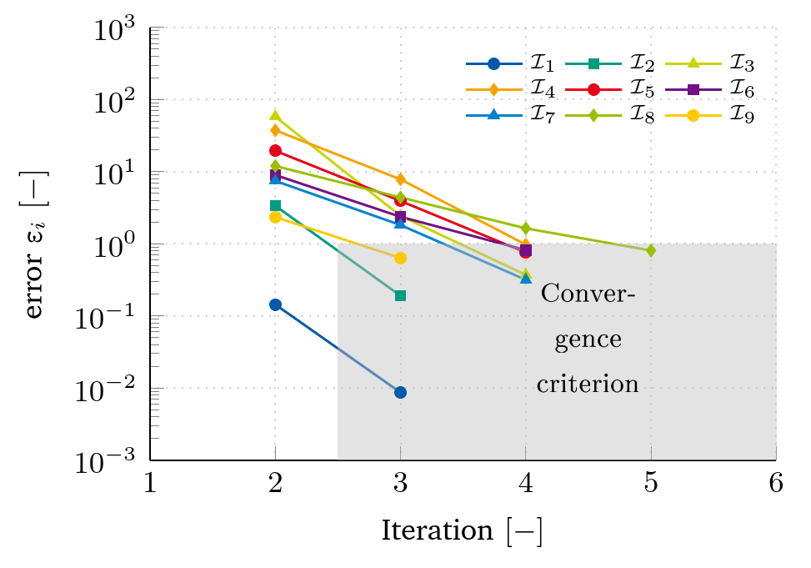
NUMERICAL RESULTS (3/3)
Definitions, at iteration $i$
$x_{i}$ signal (current in the magnet)
$ε_{abs}$ $ε_{rel}$ absolute & relative error
$ε_{i}$ convergence error
$F_{conv}$ convergence flag
Enforcement of at least three iterations per time window
Quench as abrupt change in resistivity
→ High influence on the solenoid current
→ More iterations needed!
$$ε_{abs}=0.001$$
$$ε_{rel}=0.25$$
$$ε_{i}=\max\left(\frac{\left|x_{i} − x_{i−1}\right|}{ε_{abs}+\left|x_{i}\right|ε_{rel}}\right), i≥2$$
$$F_{conv}=\left\{\begin{aligned}0, if i<2 \\ ε_{i}<1, if i≥2\end{aligned}\right.$$
$$ε_{i}≤1$$
$$i≥2$$

Slide 10
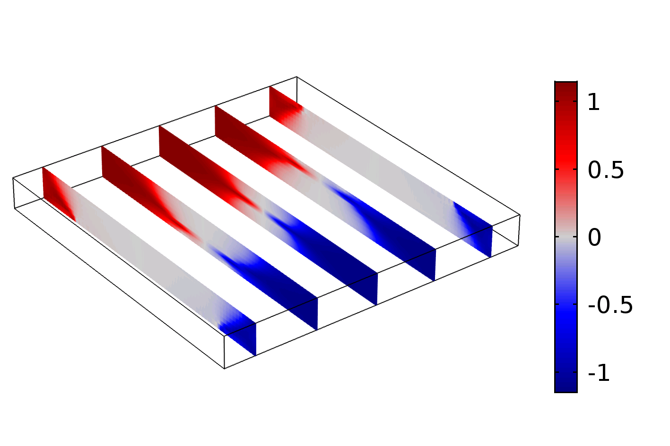
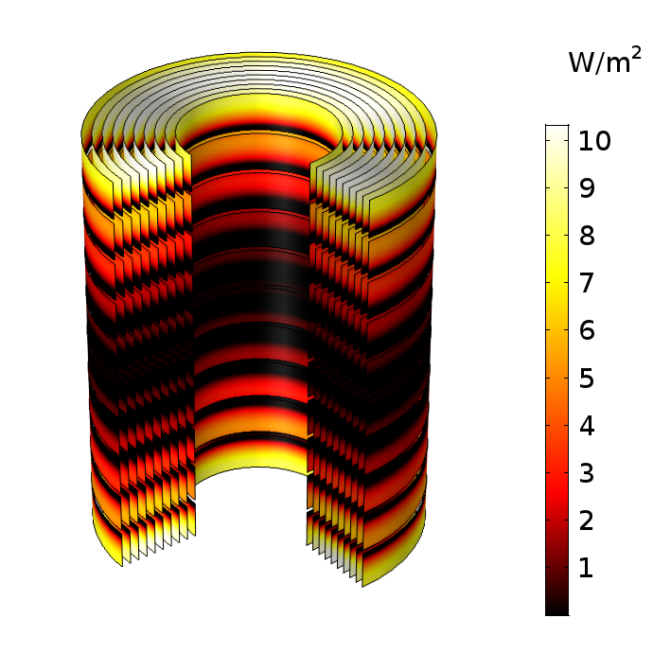
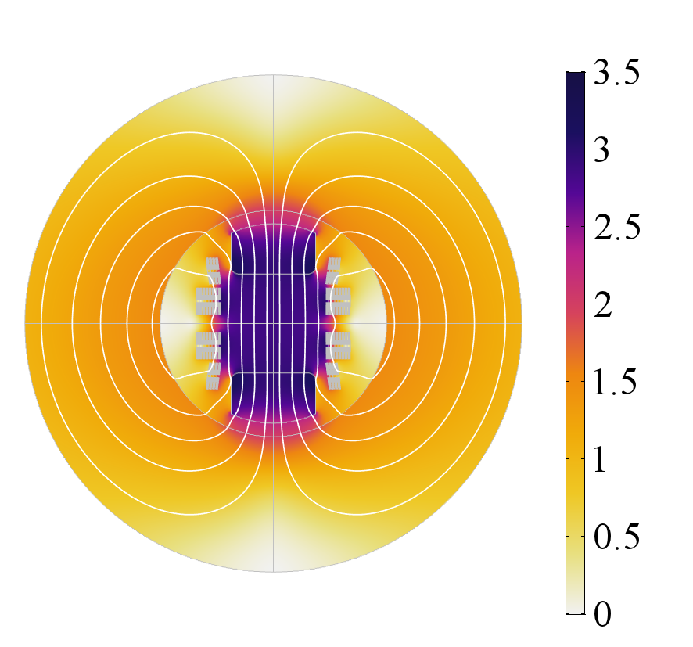
CONCLUSIONS AND OUTLOOK
Conclusions
A-H field formulation for HTS-based accelerator magnets
Field-circuit coupling interface based on solid conductor model
Co-simulation of HTS magnets with the waveform relaxation scheme
Outlook
Minimization of the quench detection time
Protection of HTS magnets in case of a quench
Dynamics of HTS magnets in accelerator circuits
$$\frac{\text{W}}{{\text{m}}^{\text{2}}}$$
Figure: normalized induced current in a HTS bulk
$$\text{T}$$
Figure: Ohmic loss distribution in a HTS solenoid
Figure: magnetic flux density in the Feather-M2 insert dipole magnet
Thank you for your attention! Contact: lorenzo.bortot@cern.ch

