Slide 1

The Campbell penetration depth in type-II superconductors
Jan Srpčič¹, M. D. Ainslie¹, Y. Shi¹, J. H. Durrell¹
E-mail: jsrpcic@gmail.com
1 Bulk Superconductivity Group, Department of Engineering, University of Cambridge
Notes:
Recently, I have been interested in the effect of small AC fields on vortex movement in the mixed state.
Namely, how the vortices move within their potential wells.
I want to show you how to determine hysteretic losses for these conditions and how to measure the effective size of the pinning potential (a closely related parameter).

Slide 2
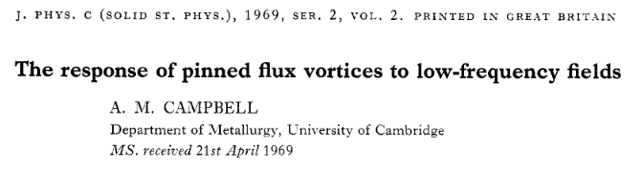
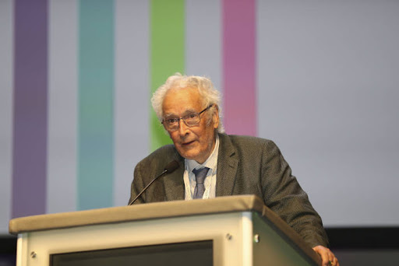
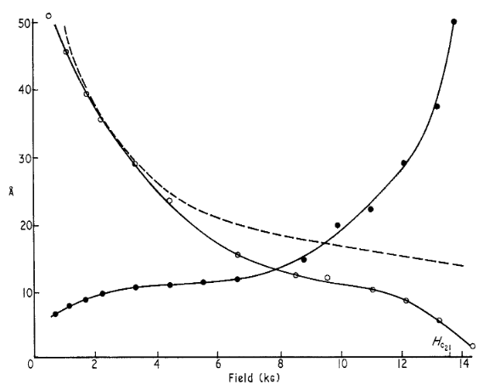
The same measuring technique, 50 years apart
Notes:
First point I want to make is we cannot use the Bean model to determine the losses.
Bean model: any electromotive force induces the full Jc and establishes the critical state.
Reality: A sufficiently small force will move the flux vortices within their potential well but not unpin them.
Campbell model: accounts for this by assuming the pining force at small displacements is not constant (as in the Bean model), but linear with displacement.
Essentially every flux vortex is treated as a linear harmonic oscillator.
Hence, the area of the force-displacement hysteresis curve in the Campbell model will be smaller than in Bean model. Hence the predicted losses will be lower.

Slide 3
What is the limit of the Bean model?
The Bean model:
Ignores the finite size of pinning potential (any J is J_{C}),
Overestimates the hysteretic losses.
The Campbell model [1]:
Assumes finite reversible movement of flux vortices (hence, lower losses),
Provides an easy technique of measuring the size of the pinning potential.
[1] A. M. Campbell, The response of pinned flux vortices to low-frequency field, J. Phys. C., 1969.
Notes:
First point I want to make is we cannot use the Bean model to determine the losses.
Bean model: any electromotive force induces the full Jc and establishes the critical state.
Reality: A sufficiently small force will move the flux vortices within their potential well but not unpin them.
Campbell model: accounts for this by assuming the pining force at small displacements is not constant (as in the Bean model), but linear with displacement.
Essentially every flux vortex is treated as a linear harmonic oscillator.
Hence, the area of the force-displacement hysteresis curve in the Campbell model will be smaller than in Bean model. Hence the predicted losses will be lower.

Slide 4
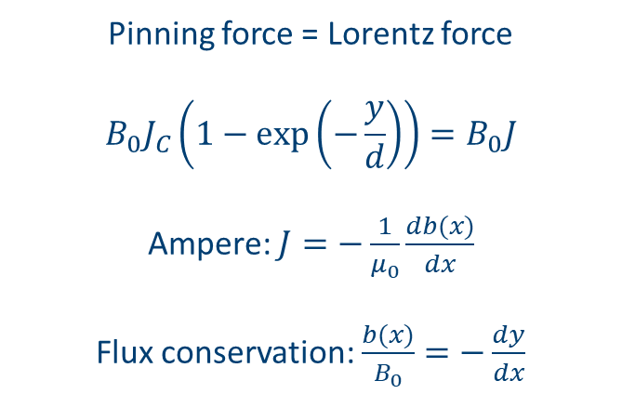
Campbell model: field profile b(x)=?
Long superconductor in DC field B₀.
We superpose a small ripple field B_{AC} <<B₀.
Field profile b(x) inside = ???
Pinning force = Lorentz force
$$B_{0}J_{C}\left(1−\exp\left(−\frac{y}{d}\right)\right)=B_{0}J$$
Ampere: $J=−\frac{1}{μ_{0}}\frac{db(x)}{dx}$
Flux conservation: $\frac{b(x)}{B_{0}}=−\frac{dy}{dx}$
Notes:
Derivation: we have a long thin superconductor in the field cooled state, ergo constant field B.
We superpose a small ripple field and we want to calculate the field profile b(x) in the superconductor.
We start with a force balance equation for 1 vortex; pinning force equals Lorentz force.
Pinning force shape: linear for displacements smaller than d and constant for displacements larger than d. Smooth transition from Hooke’s law to the Bean model.
Current density is expressed with Amperes law.
The second differential equation comes from flux conservation. Together, we get a second order ordinary differential equation which we can solve and get the field profile b(x).

Slide 5
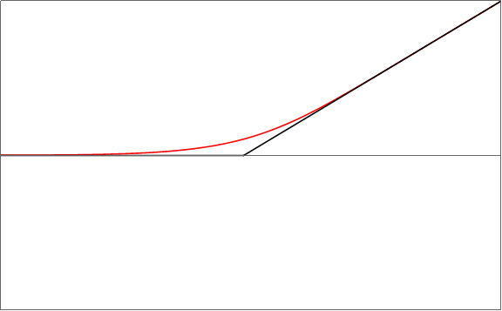



Calculated field profiles
Bean model: $\frac{∂b(x)}{∂x}={±μ}_{0}J_{C}$
Campbell model: $\frac{∂b(x)}{∂x}=μ_{0}J_{C}\left(1−\exp\left(−\frac{y}{d}\right)\right)$
+B_{AC}
Campbell
Bean
λ_{Campbell}
SC AIR
Magnetic field profile, b(x)
λ_{Bean}
$$λ=\sqrt{\frac{B d}{μ_{0}{ J}_{C}}}$$
-B_{AC}
Position, x
Notes:
The solution. Field profile in the SC, B vs position.
SC domain, AIR domain. In AIR, we apply an ac field BAC.
Black line bean model, constant slope of magnetic field. Red line, Campbell model, smoothed field profile.
Looking at equations, in the bean model the field goes linearly with distance. In the Campbell model, if we assume a linear force for small displacements, the field decays exponentially with distance, with a characteristic scale Campbell penetration depth, which is directly determined by the size of the pinning potential.

Slide 6
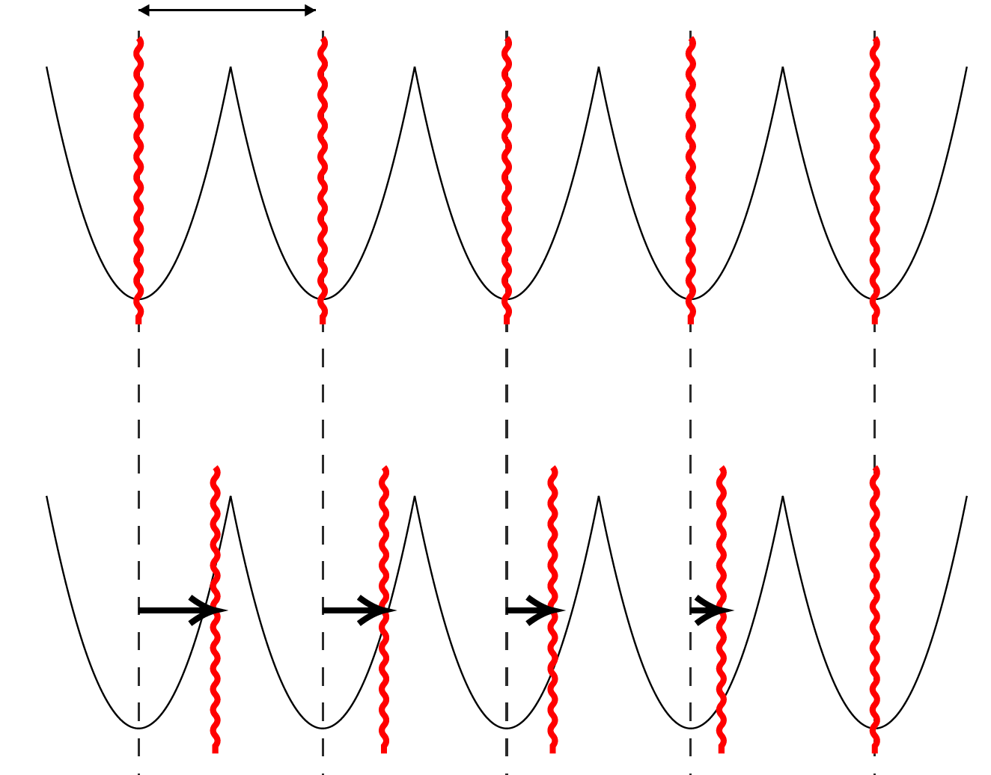

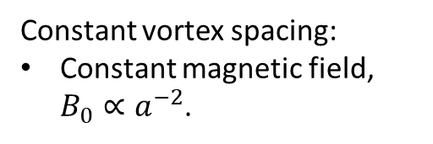


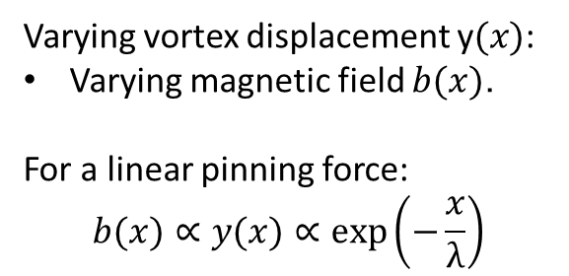
Campbell penetration depth
vortex
$$a$$
Constant vortex spacing:
Constant magnetic field, $B_{0}∝a^{−2}$.
surface
pinning potential
Varying vortex displacement y$(x)$:
Varying magnetic field $b(x)$.
For a linear pinning force:
$$b(x)∝y(x)∝\exp\left(−\frac{x}{λ}\right)$$
$$y(x)$$
$$x$$
Notes:
What is happening here:
We start with a constant field in the superconductor, hence with a constant vortex spacing.
Then, we raise the external field by a small amount. The vortex nearest the surface will move from its equilibrium position but not become unpinned.
This movement is equivalent to a shielding surface current being induced, hence the next vortex will be shielded partially from the external field.
Therefore its displacement will be smaller and the next even smaller and so on.
If we assume the pinning force is linear, we can show that this displacement from equilibrium decays exponentially with distance, with a characteristic distance the Campbell penetration depth.

Slide 7
Measurement setup
Sample: 10 mm by 5 mm GdBa₂Cu₃O_{7-δ} bulk
AC field: 1 mT (peak), 300 Hz
DC field: 0.5 T – 6 T
Temperature: 70 K
AC current
Oscilloscope
DC current
Notes:
If we know the filed profile in the superconductor we know the total flux.
The total flux can be measured with the pickup coil method.
We used a 10mm in height by 5 mm diameter gdbco bulk, with a pick up coil wound around its perimeter.
This was inserted into an ac solenoid which was used to produce the small ripple field, 1mT amplitude.
Everything tohgether was inserted into a dc coil with which a dc field up to 6 tesla was applied.
The bulk was kept at 70k.

Slide 8
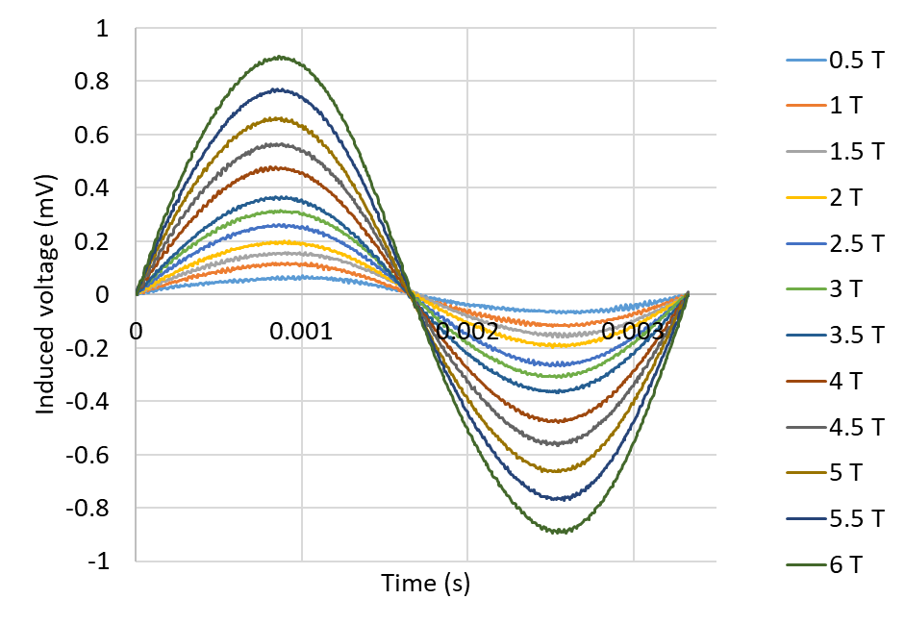

Results
Calculation
Measurement
T = 70 K, B_{AC} = 1 mT (peak), frequency 300 Hz
$$∝λ$$
Notes:
This is the resultant signal.
On the left is what calculation gives: if we integrate the 2. order differential equation at different times and calculate the time derivative of the flux to get the induced voltage. It can be shown that the slope at zero is determined by the Campbell penetration depth.
On the right is the measured signal and is of the shape we’d expect. The measurement is performed at different values of dc field so we can extract the dependence of the Campbell penetration depth on dc field.

Slide 9


Results
$$d=\frac{μ_{0}{ J}_{C} λ^{2}}{B}$$
$$α=\frac{B{ J}_{C}}{d}$$

Slide 10
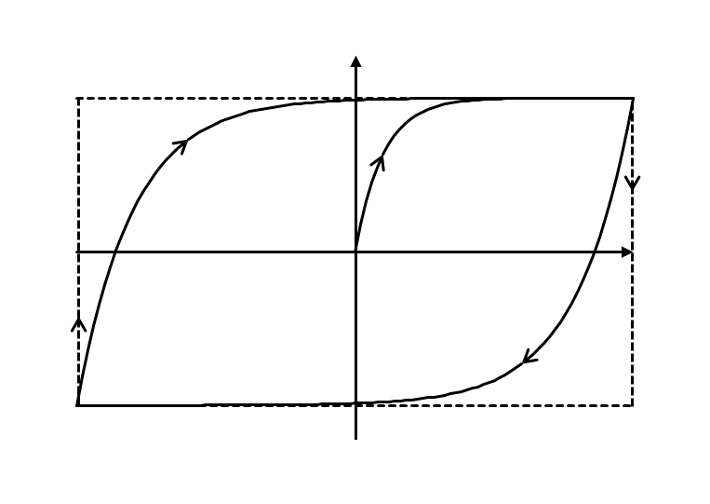
Hysteretic losses: Campbell and Bean comparison
Pinning force
Bean
BJ
Campbell
y
-BJ

Slide 11
Thank you for your attention.

