Slide 1


Fast and efficient HTS modelling using ANSYS A-V formulation
SLS 2.0
Kai Zhang :: Insertion Device Group :: Paul Scherrer Institute
Acknowledgement: Mark Ainslie (Cambridge), Lucas Brouwer (LBNL), Ryota Kinjo (RIKEN Spring-8), Marco Calvi, Thomas Schmidt and Sebastian Hellmann (PSI)
7th International Workshop on Numerical Modelling of High Temperature Superconductors
23.06.2021, Virtual (Nancy, France)

Slide 2
Outline
HTS for undulator applications
HTS modelling using ANSYS A-V formulation
      Resistivity-adaptive algorithm (RAA)
              Critical state model: 2D
      Direct iteration method
              Flux creep model (E-J power law): 2D and 3D
              Critical state model: 2D
      Backward computation method
              Critical state model: 2D and 3D
Conclusion

Slide 3
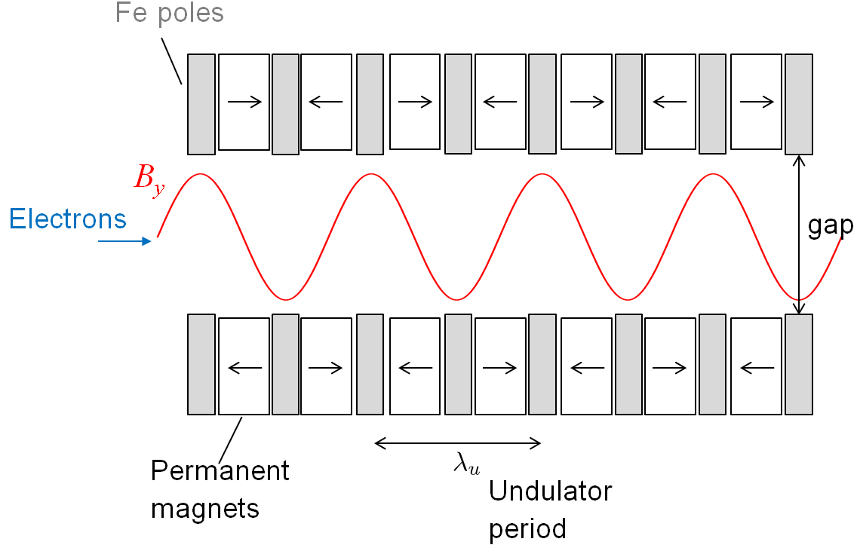
PSI Light sources: Storage Rings and FELs
undulator
Storage Rings
undulator
Free-Electron Lasers

Slide 4

SwissFEL, Aramis beamline (PM undulator)
15mm period
3mm gap
B₀ = 1.28T
3500 periods
40m long
In future, we want to go to 10mm period …

Slide 5
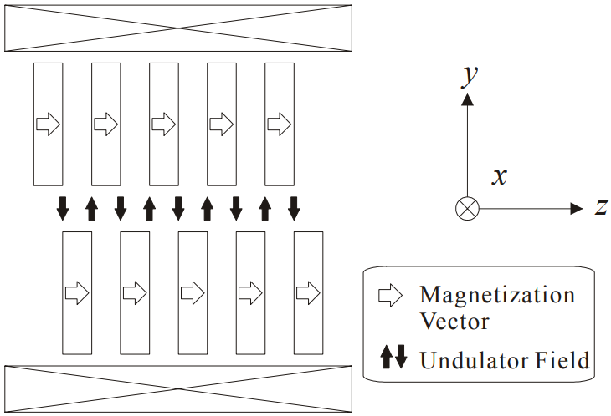
Staggered-array bulk Re-Ba-Cu-O undulator
Kinjo R et al 2008 Proc. 30th FEL Conf. 473-76
GdBCO Bulks
Ideally, B_{y} can reach 2T when ∆𝐵_{𝑠} = 10T.
This HTS undulator concept is attractive to the new hard x-ray beamlines planned for both SLS2.0 and SwissFEL at PSI.
@6K
10mm period & gap = 4mm
R.Kinjo et al. Appl.Phys. Express 6 (2013)

Slide 6
Our big Challenge is large-scale HTS magnetization simulation and optimal
design of the magnetic field (fast simulation desired)
@6K
10mm period & gap = 4mm
ANSYS

Slide 7
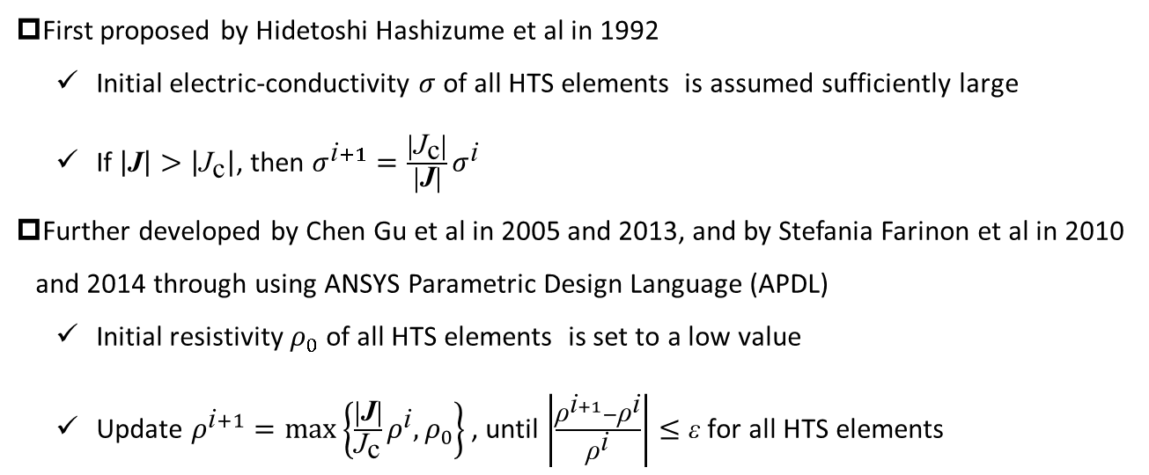
A: Resistivity-Adaptive Algorithm (RAA)
First proposed by Hidetoshi Hashizume et al in 1992
    Initial electric-conductivity $σ$ of all HTS elements is assumed sufficiently large
    If $\left|\text{J}\right|>\left|{\text{J}}_{\text{c}}\right|$, then $σ^{\text{i}+1}=\frac{\left|{\text{J}}_{\text{c}}\right|}{\left|\text{J}\right|}σ^{\text{i}}$
Further developed by Chen Gu et al in 2005 and 2013, and by Stefania Farinon et al in 2010 and 2014 through using ANSYS Parametric Design Language (APDL)
    Initial resistivity $ρ_{0}$ of all HTS elements is set to a low value
    Update $ρ^{\text{i}+1}=max⁡\left\{\frac{\left|\text{J}\right|}{{\text{J}}_{\text{c}}}ρ^{\text{i}}, ρ_{0}\right\}$ , until $\left|\frac{{\text{ρ}}^{\text{i}+1}−{\text{ρ}}^{\text{i}}}{{\text{ρ}}^{\text{i}}}\right|≤\text{ε}$ for all HTS elements
Hashizume H et al 1992 IEEE Trans. Magn. 28 1332-35
Gu C and Han Z 2005 IEEE Trans. Appl. Supercond. 15 2859-62
Farinon S et al 2010 Supercond. Sci. Technol. 23 115004
Farinon S et al 2014 Supercond. Sci. Technol. 27 104005
Gu C et al 2013 IEEE Trans. Appl. Supercond. 23 8201708

Slide 8
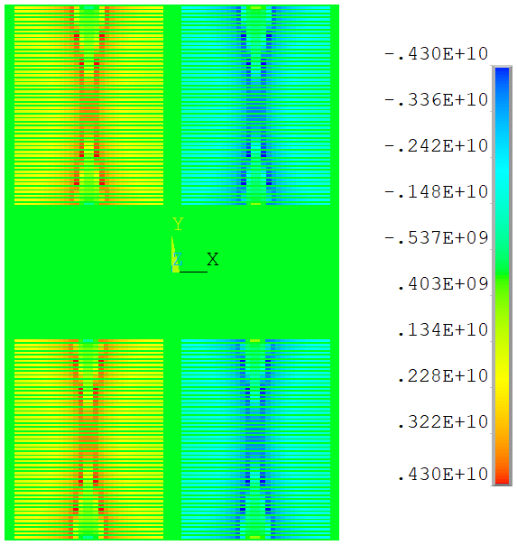
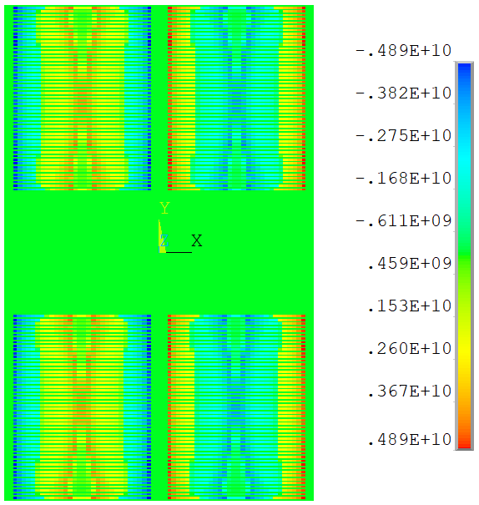
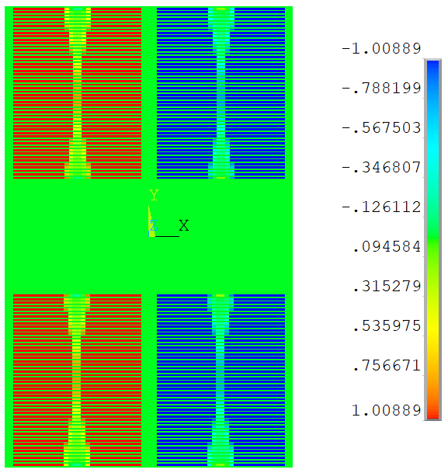
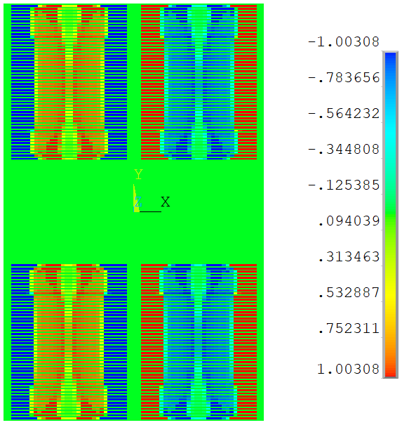

A: RAA – Screen currents
I_{op} = 1060A I_{op} = 0A
$${\text{J}}_{\text{e}}\left({\text{B}}_{//},{\text{B}}_{⊥}\right)={\text{J}}_{\text{e}\text{0}}∙{\left(\text{1}+{\sqrt{{(\text{k}|{\text{B}}_{//}|)}^{\text{2}}+{{|\text{B}}_{⊥}|}^{\text{2}}}}/{{\text{B}}_{\text{c}}}\right)}^{−\text{b}}$$
J_{Z} (A/m²)
On the left is the simulated screen currents inside a periodical FEA model (transport current I_{op} ramps to 1060A and drops to 0A).
The rigorous critical state in the outer layer can still be reached during I_{op} drops, but there is a slight decay in the inner layer (this issue was also emphasized in [Gu C. et al 2013] and remained to be solved).
1
-1
J_{Z}/J_{e}
Computation speed: ~5 min for 60000 DOFs

Slide 9
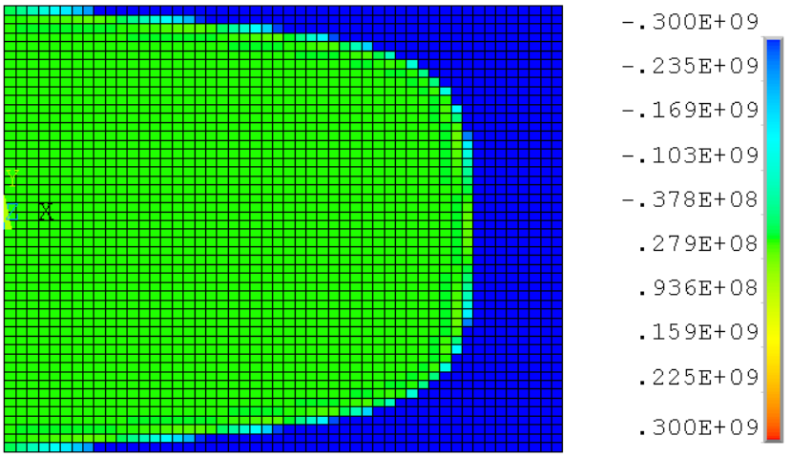
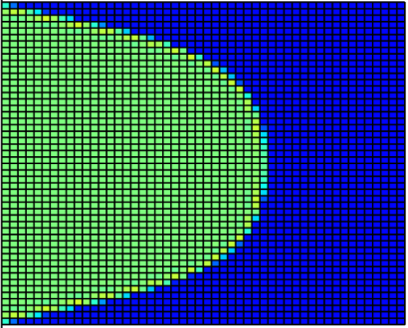
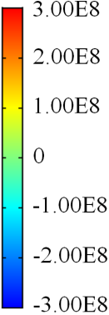
A: RAA - Cylindrical bulk superconductor
Trapped J_{Z} after ZFC magnetization from 0 to 1T, J_{e}=3e8 A/m²
ANSYS(RAA), critical state COMSOL(E-J power law), n = 100
Inconsistent critical state magnetization currents are found in ANSYS and COMSOL models, further examination with backward computation method proves the COMSOL result is correct.
It is still unclear why the RAA method fails in modelling the bulk superconductor ? Only feasible for transport current cases ? More research studies are required to address this problem …

Slide 10
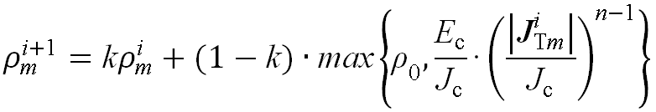
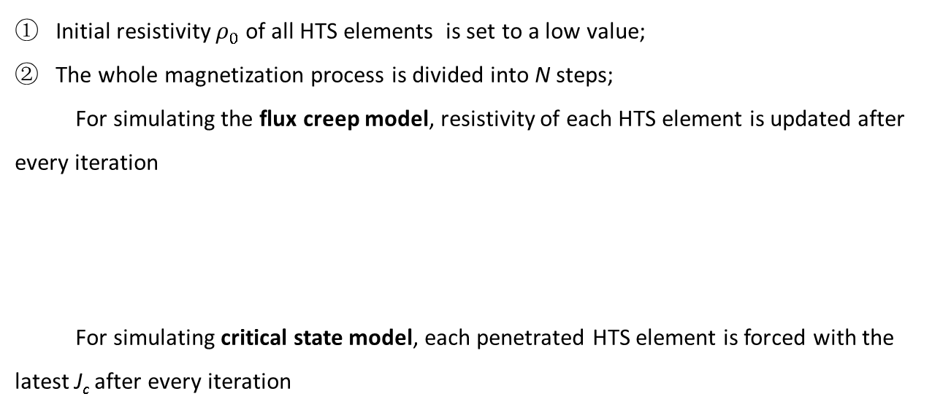
B: Direct iteration method
  Initial resistivity $ρ_{0}$ of all HTS elements is set to a low value;
  The whole magnetization process is divided into N steps;
  For simulating the flux creep model, resistivity of each HTS element is updated after every iteration
  For simulating critical state model, each penetrated HTS element is forced with the latest J_{c} after every iteration
reservation coefficient, usually quite large

Slide 11
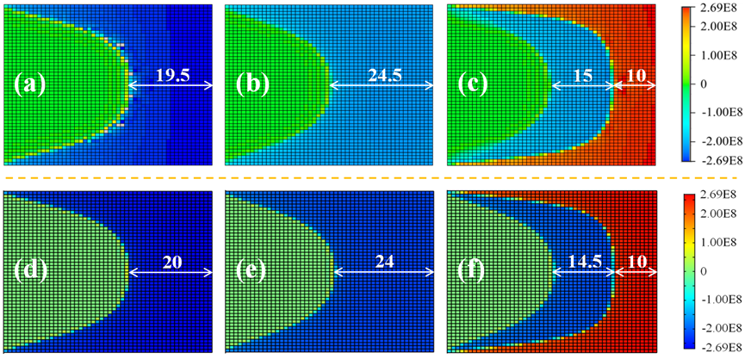
B: Direct iteration method (E-J power law, 2D)
Applied magnetic field versus time
J_{Z} in the magnetized bulk HTS (n = 20) at (a) t = 500 s, (b) t = 1000 s and (c) t = 1500 s from using ANSYS A-V formulation;
J_{Z} in the magnetized bulk HTS at (d) t = 500 s, (e) t = 1000 s and (f) t = 1500 s from using COMSOL H-formulation.
Zhang K et al 2021 IEEE Trans. Appl. Supercond. 31 6800206
Related APDL codes are shared in
https://www.researchgate.net/profile/Kai-Zhang-32

Slide 12
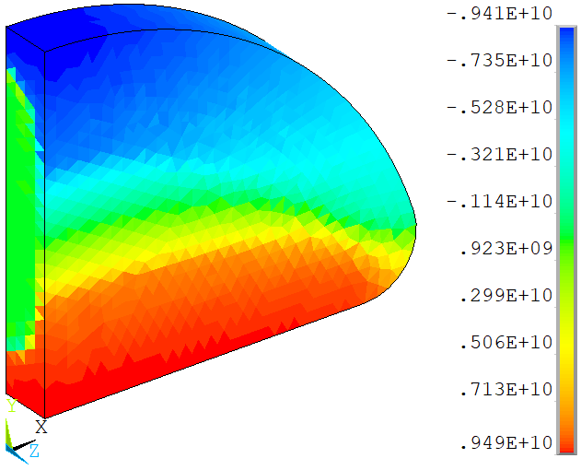
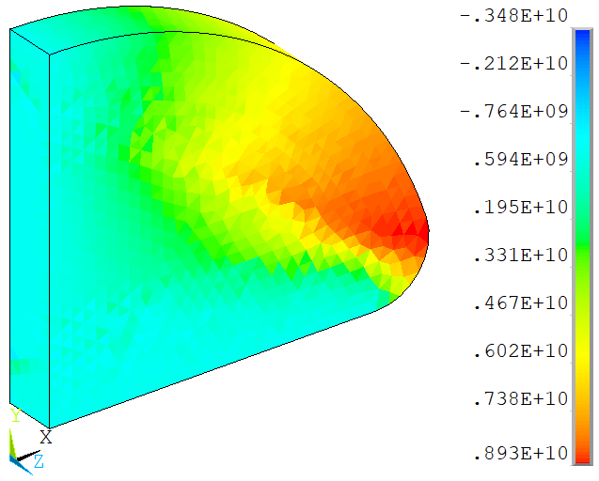
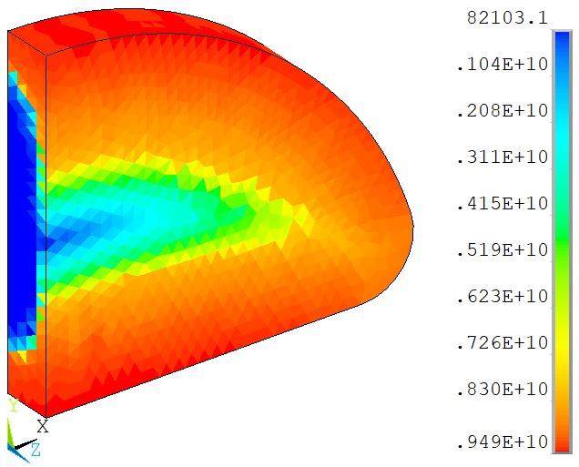
B: Direct iteration method (E-J power law, 3D)
A/m²
A/m²
A/m²
J_{X}
J_{Y}
J_{Sum}
Trapped current in a ¼ half-moon shaped bulk superconductor model after FC magnetization from 8T to zero (J_{e} = 1e10 A/m², n = 20)
Problems: a number of iteration steps (usually >200) are essential to obtain smooth E-J power law based simulation results, this might result in a large amount of computation time for complex 3D FEA model.

Slide 13
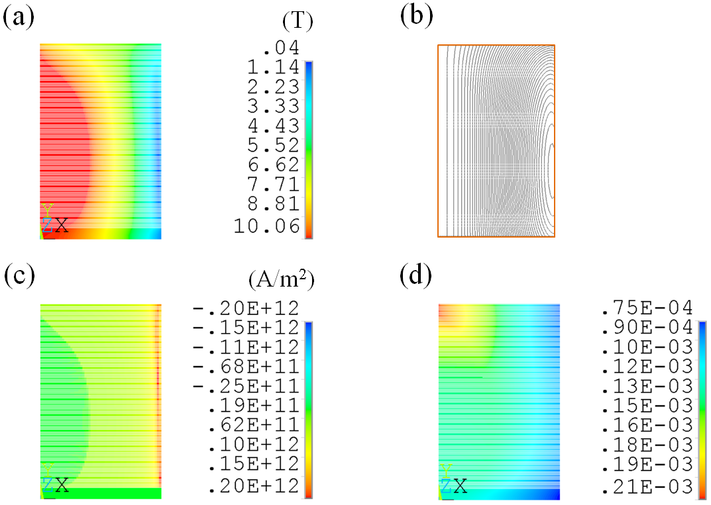
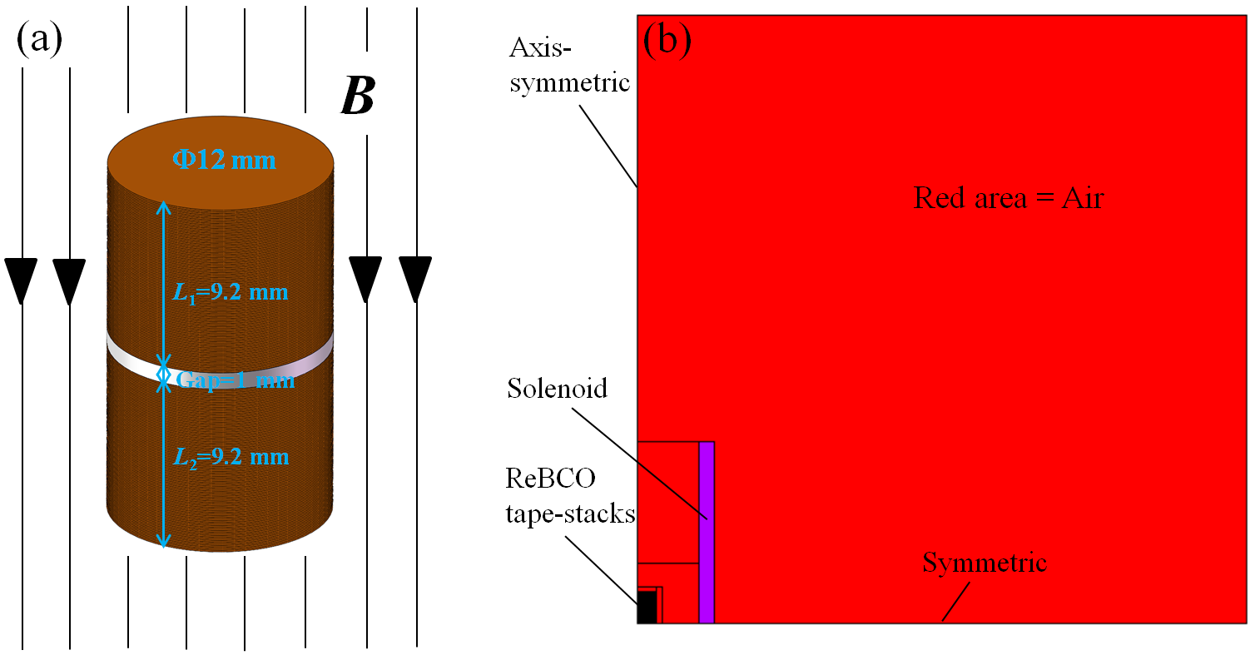
B: Direct iteration method (critical state model, 2D)
(a) FC magnetization of the ReBCO tape stack; (b) 2D axis-symmetric half FEA model.
(a) Trapped B_{s}, (b) flux lines, (c) J_{z}, and (d) hoop strain in the ReBCO tape stack after FCM from 10 T.
Related APDL codes are shared in
http://www.htsmodelling.com/ (model #23)
Zhang K et al 2020 IEEE Trans. Appl. Supercond. 30 4700805

Slide 14
C: Backward computation method
Ideal: HTS bulk acts as a permanent magnet after FC magnetization.
Reality: this situation can never be realized since the flux pinning force is always limited.
Assuming HTS bulk is FC-magnetized under isothermal conditions,
eddy currents will gradually penetrate inwards
following a quasi-static critical state model.

Slide 15
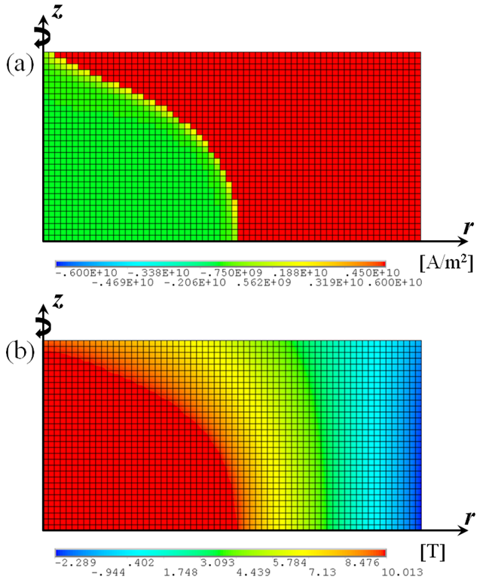
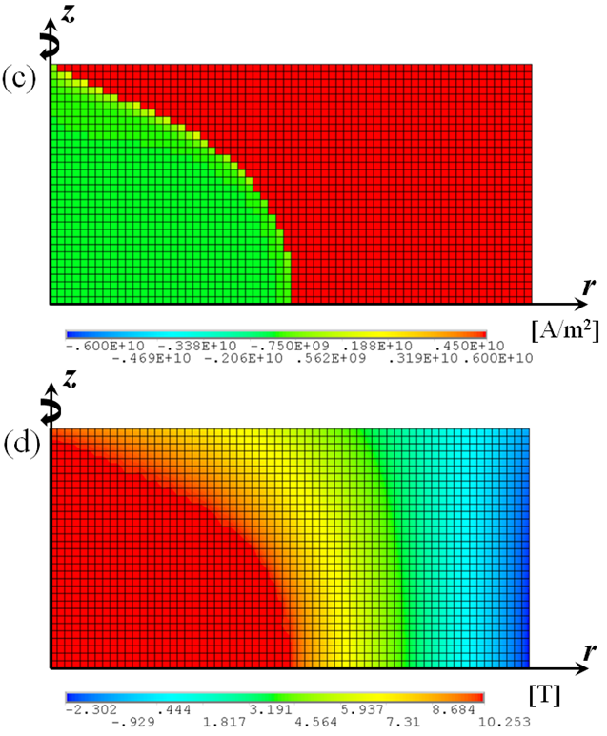
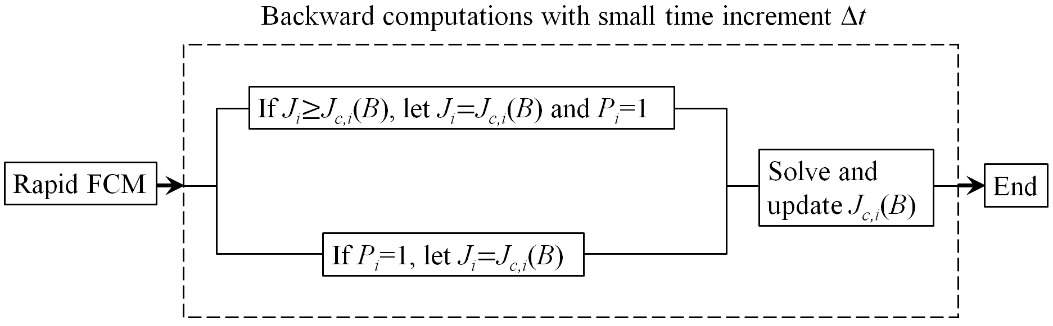
C: Backward computation method
Critical state model – 2D
One more penetration layer
Algorithm for the backward computation method for computing the critical state in a field-cooled magnetized bulk superconductor.
Critical state after FCM from 10T
(with minimum electro-magnetic entropy production [Pardo E 2017 J. Comput. Phys 344 339-63])
Trap >10T field after introducing an additional penetration layer

Slide 16
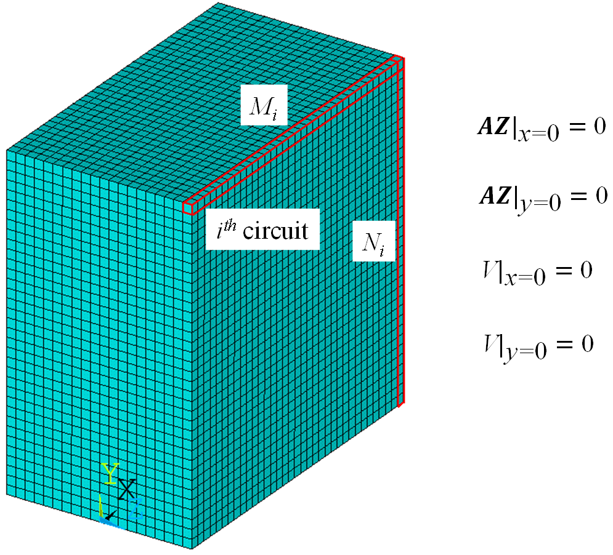
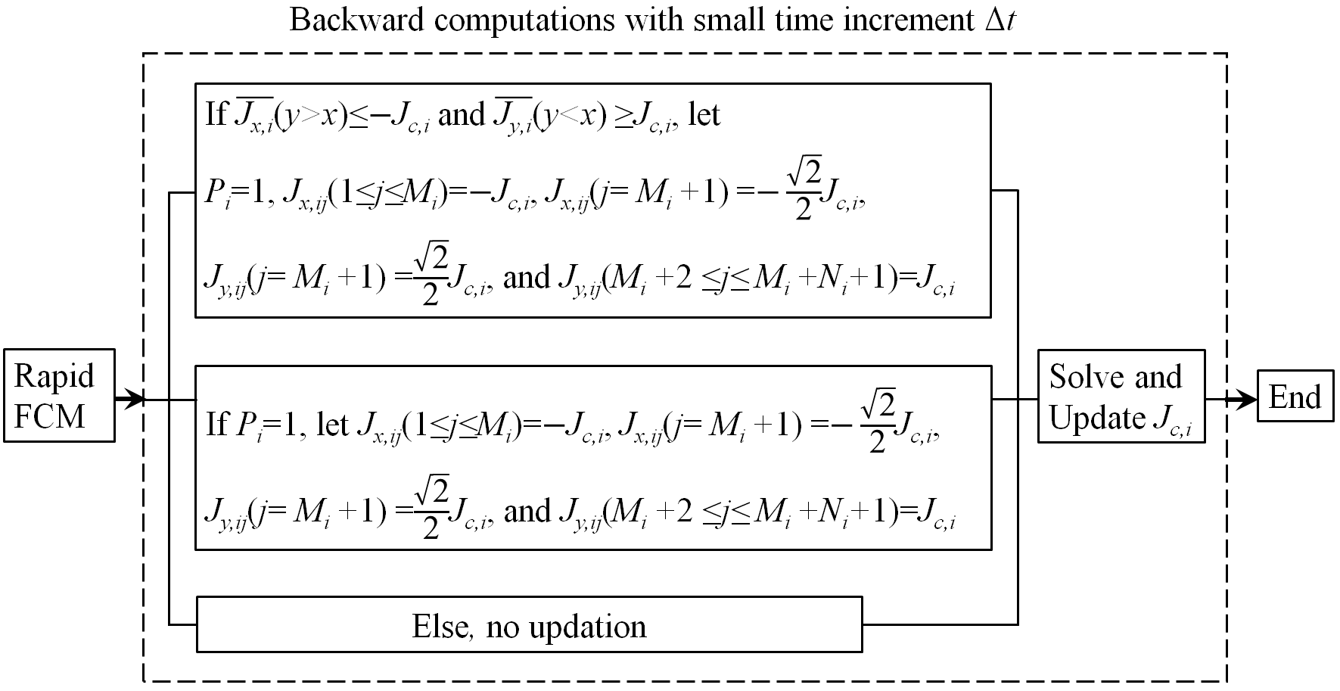
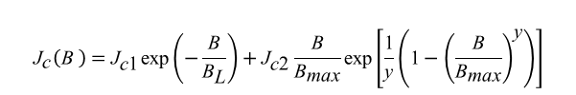
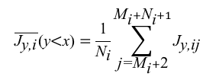
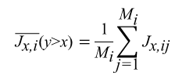
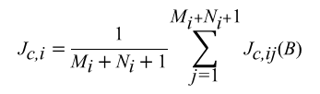
C: Backward computation method
Critical state model – 3D
$$\overline{{\text{J}}_{\text{x}\text{,}\text{i}}}\text{(}\text{y}\text{>}\text{x}\text{)}=\frac{\text{1}}{{\text{M}}_{\text{i}}}\sum_{\text{j}\text{=}\text{1}}^{{\text{M}}_{\text{i}}}{{\text{J}}_{\text{x}\text{,}\text{ij}}}$$
$$\overline{{\text{J}}_{\text{y}\text{,}\text{i}}}\text{(}\text{y}\text{<}\text{x}\text{)}=\frac{\text{1}}{{\text{N}}_{\text{i}}}\sum_{\text{j}\text{=}{\text{M}}_{\text{i}}+\text{2}}^{{\text{M}}_{\text{i}}+{\text{N}}_{\text{i}}+1}{{\text{J}}_{\text{y}\text{,}\text{ij}}}$$
Schematic of 1/4 cuboid bulk
$${\text{J}}_{\text{c}}\left(\text{B} \right)={\text{J}}_{\text{c}\text{1}}\text{exp}\left(−\frac{\text{B}}{{\text{B}}_{\text{L}}}\right)+{\text{J}}_{\text{c}\text{2}}\frac{\text{B}}{{\text{B}}_{\text{max}}}\text{exp}\left[\frac{\text{1}}{\text{y}}\left(\text{1}−{\left(\frac{\text{B}}{{\text{B}}_{\text{max}}}\right)}^{\text{y}}\right)\right]$$
$${\text{J}}_{\text{c}\text{,}\text{i}}=\frac{\text{1}}{{\text{M}}_{\text{i}}+{\text{N}}_{\text{i}}+\text{1}}\sum_{\text{j}\text{=}\text{1}}^{{\text{M}}_{\text{i}}+{\text{N}}_{\text{i}}+\text{1}}{{\text{J}}_{\text{c}\text{,}\text{ij}}\text{(}\text{B}\text{)}}$$

Slide 17
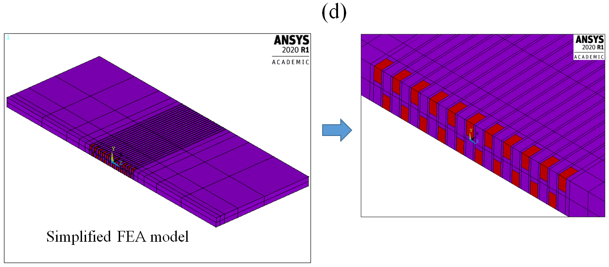
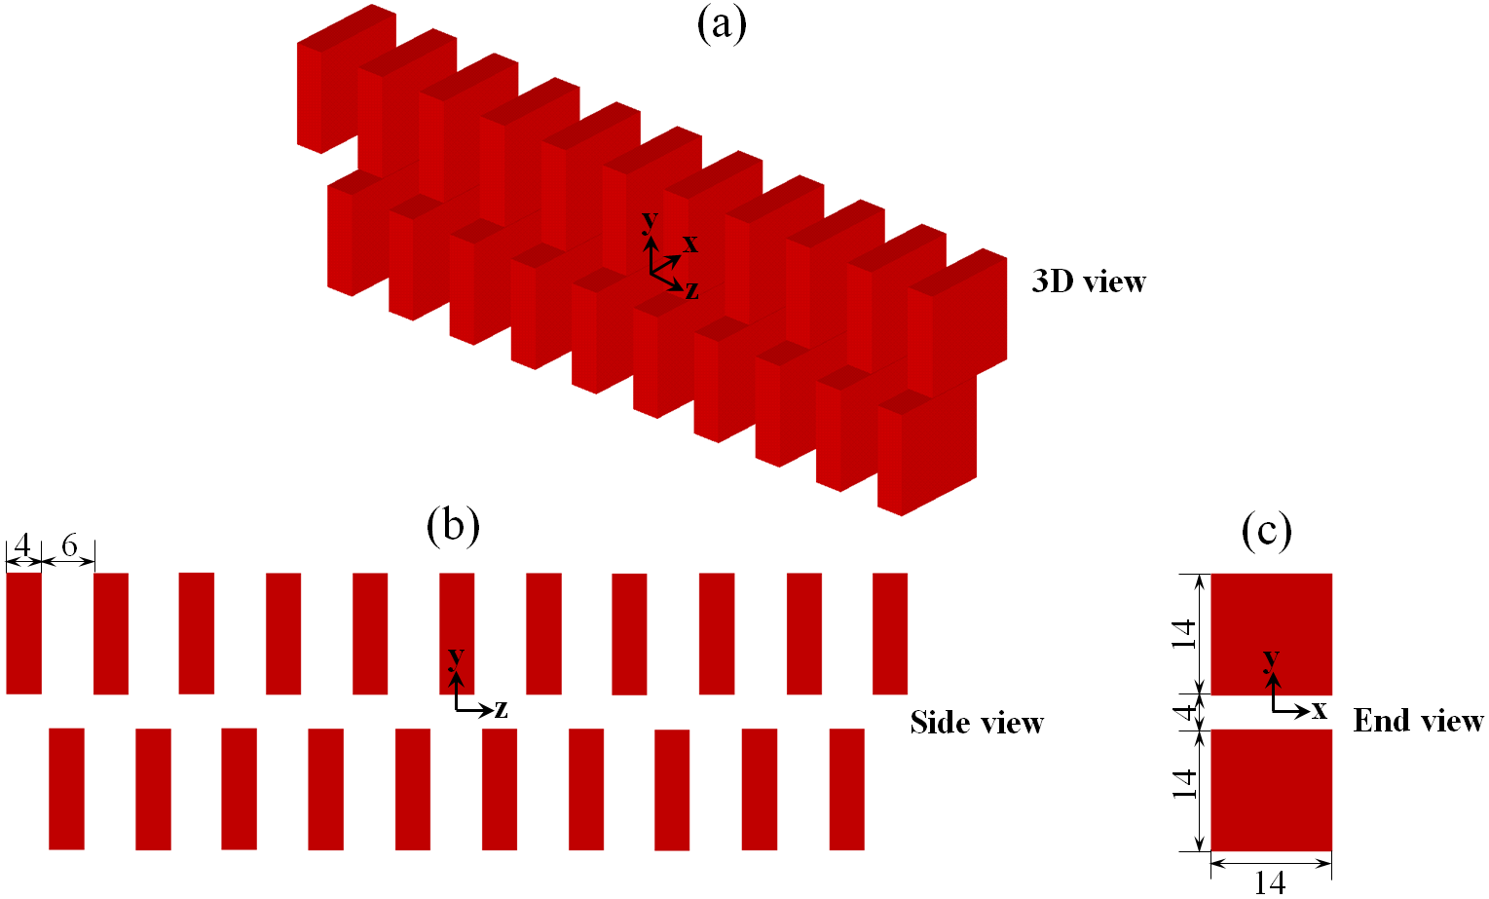
C: Backward computation method
FEA model of 3D bulk HTS undulator
Number of DOFs: 6.5 million !

Slide 18
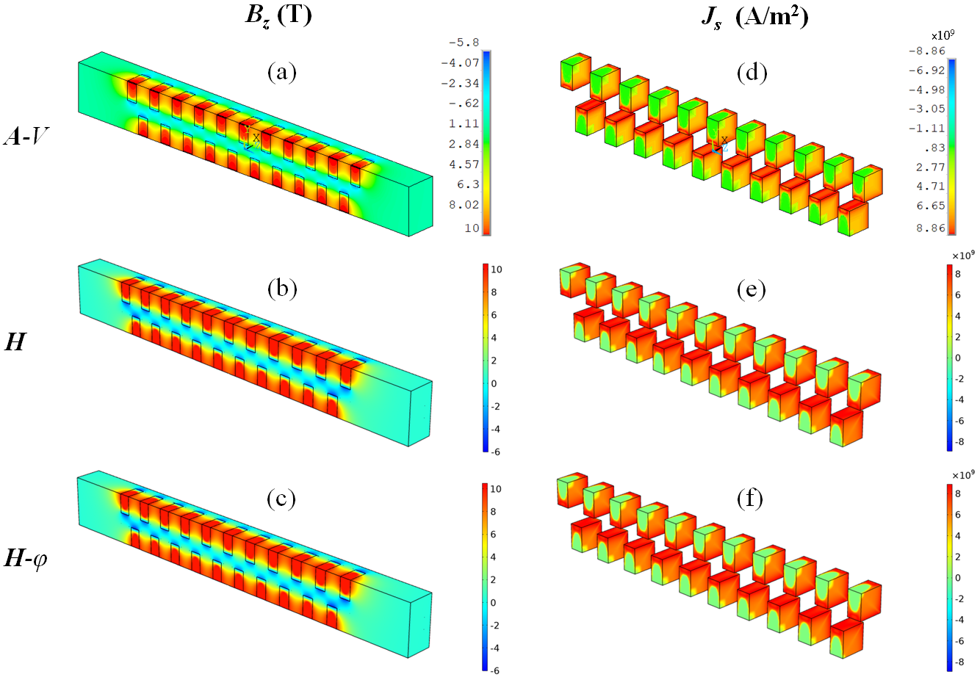
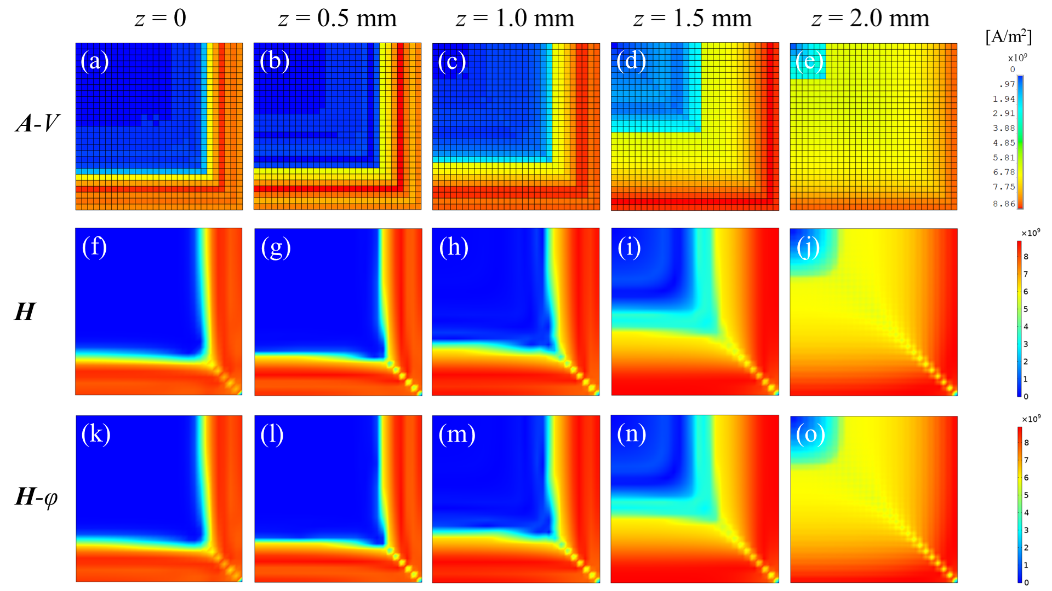
C: Backward computation method
Modelling of 3D bulk HTS undulator
ANSYS
ANSYS
COMSOL
COMSOL
COMSOL
COMSOL
Magnitude of J_{s} in the central HTS bulk in the xy-plane. “z = 0” refers to the mid-plane of the HTS bulk; “z = 2 mm” refers to the outer surface of the HTS bulk.
Magnetic field component B_{z} and the magnetization current density J_{s} in the BHTSU obtained using the A-V, H and H-φ [see A. Arsenault’s talk] formulations

Slide 19
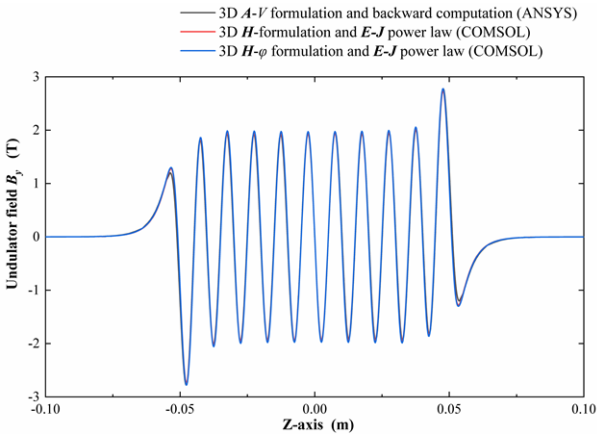
C: Backward computation method
Modelling of 3D bulk HTS undulator
Summary of computation times for the ten-period bulk HTS undulator
 |  | No. of DOFs (million) | Computation time (hour)
ANSYS | A-V (backward computation) | 6.5 | 12.5
COMSOL | H | 3.2 | 151
COMSOL | H-φ | 1.3 | 23
Comparison of the calculated on-axis undulator field obtained using the A-V, H and H-φ formulation models
Related APDL codes and COMSOL models will be shared soon in
http://www.htsmodelling.com/
Zhang K et al 2021 arXiv:2105.01761

Slide 20
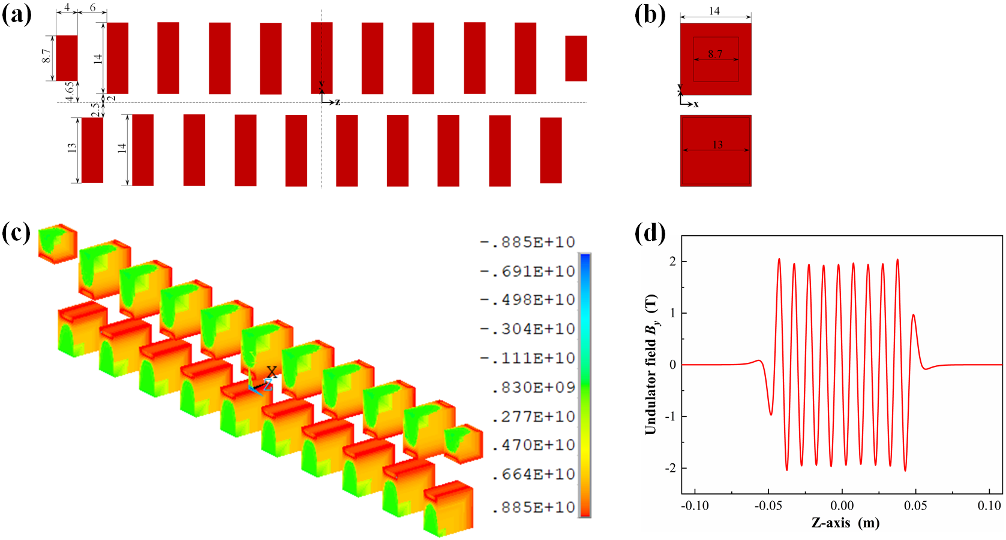
C: Backward computation method
Optimal design of bulk HTS undulator
(a) Side view of the optimized BHTSU; (b) End view of the optimized BHTSU; (c) Vector sum of the magnetization current density in the simplified BHTSU model; (d) Undulator field B_{y} along z-axis;

Slide 21
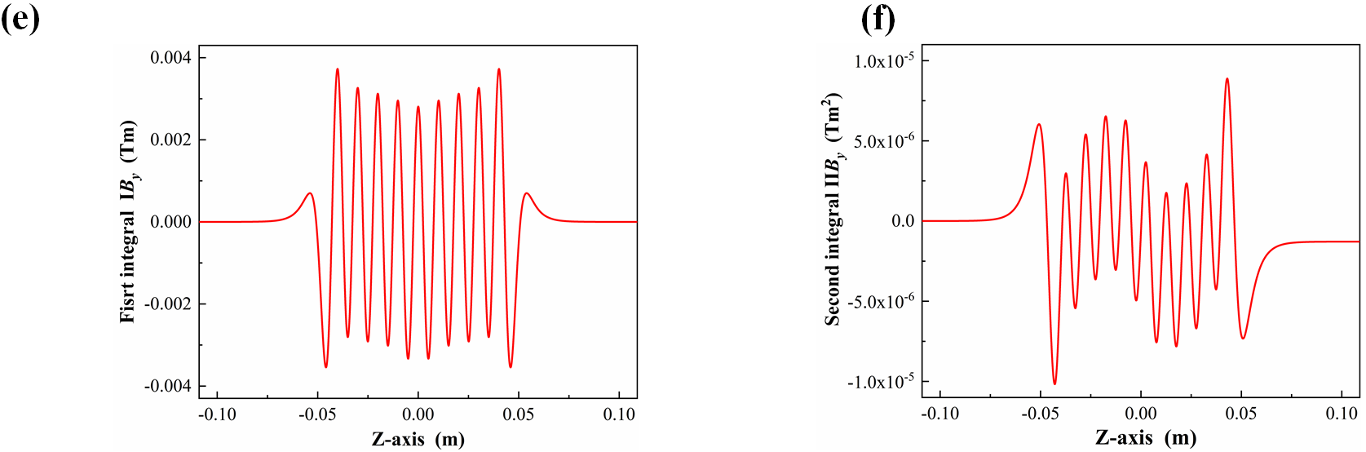
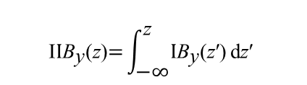
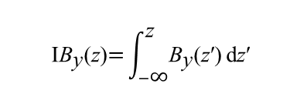
C: Backward computation method
Optimal design of bulk HTS undulator
$$\text{I}{\text{B}}_{\text{y}}\text{(}\text{z}\text{)}\text{=}\int_{−\text{∞}}^{\text{z}}{{\text{B}}_{\text{y}}\text{(}\text{z}\text{′)}}\text{d}\text{z}\text{′}$$
$$\text{I}{\text{I}\text{B}}_{\text{y}}\text{(}\text{z}\text{)}\text{=}\int_{\text{−}\text{∞}}^{\text{z}}{{\text{I}\text{B}}_{\text{y}}\text{(}\text{z}\text{′)}}\text{d}\text{z}\text{′}$$
(e) First integral of the undulator field IB_{y} along z-axis; (f) Second integral of the undulator field IIB_{y} along z-axis.

Slide 22
Conclusion
Three numerical algorithms implemented in ANSYS are benchmarked with COMSOL H/H-φ formulation.
The RAA method shows fast computation of the screen currents in HTS coils charged with transport current; problems are met for simulating bulk superconductors.
The direct iteration method can solve magnetization problems for both flux creep model (E-J power law) and critical state model, and for both 2D & 3D; the critical state solution is fast while the flux creep solution is slow (a large amount of iteration steps are required).
The backward computation method shows extremely fast computation speed in modelling the critical state in large-scale (6.5 million DOFs) bulk HTS undulator model for both 2D & 3D (important for optimal design).
ANSYS is quite flexible for secondary development; most of the HTS magnetization or multi-physics coupled problems can be solved efficiently by using the above mentioned numerical algorithms.

Slide 23
The APDL codes for both the RAA and the direct iteration method have been shared on the HTS modelling workgroup (#19, #23); the APDL codes for the backward computation will also be shared on the webpage soon.
We are delighted to share our APDL codes and stimulate the ANSYS community in HTS modelling !
Contact： kai.zhang@psi.ch

Slide 24
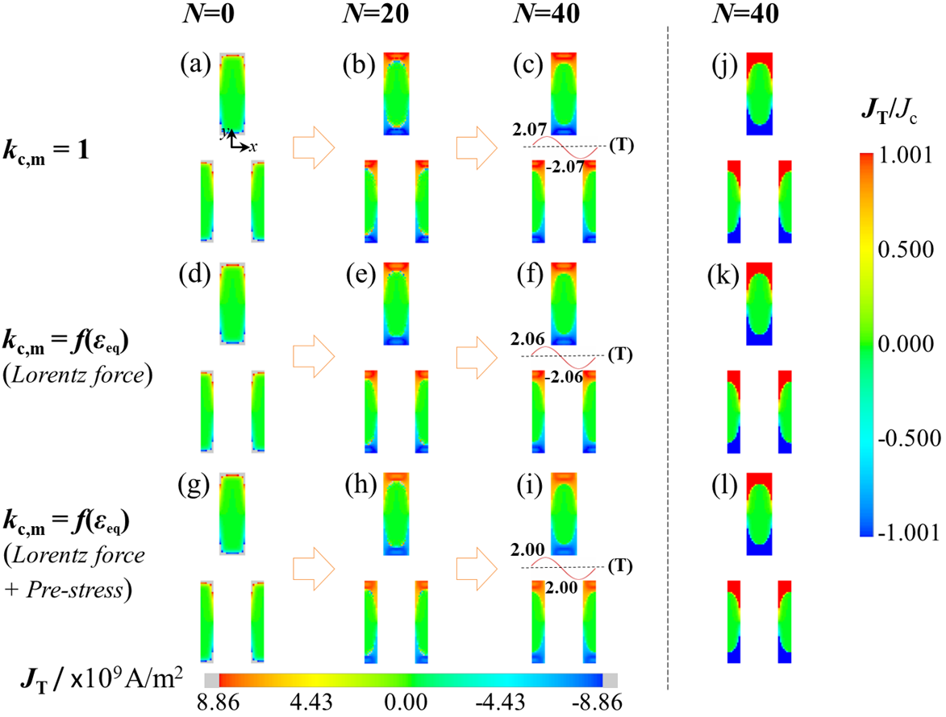
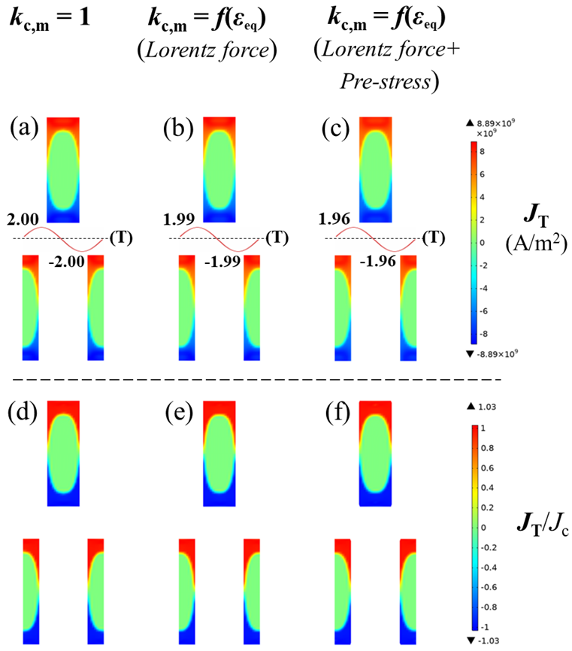
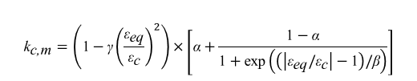

Extra - Backward computation method
Magnetization current J_{T} in the periodical HTS bulk undulator during the backward iterations
Magnetization current J_{T} in the periodical HTS bulk undulator solved using COMSOL H-formulation
[Ainslie M et al 2016]
[Trillaud F et al 2018]
Zhang K et al 2020 SUST 33 114007
Ainslie M et al 2016 SUST 29 074003
Trillaud F et al 2018 IEEE TASC 28 6800805
${\text{J}}_{\text{c}}\left(\text{B},{\text{ε}}_{\text{eq}}\right)={\text{k}}_{\text{c}\text{,}\text{m}}\left\{{\text{J}}_{\text{c}\text{1}}\text{exp}\left(−\frac{\text{B}}{{\text{B}}_{\text{L}}}\right)+{\text{J}}_{\text{c}\text{2}}\frac{\text{B}}{{\text{B}}_{\text{max}}}\text{exp}\left[\frac{\text{1}}{\text{y}}\left(\text{1}−{\left(\frac{\text{B}}{{\text{B}}_{\text{max}}}\right)}^{\text{y}}\right)\right]\right\}$;
$${\text{k}}_{\text{c}\text{,}\text{m}}=\left(\text{1}−\text{γ}{\left(\frac{{\text{ε}}_{\text{eq}}}{{\text{ε}}_{\text{c}}}\right)}^{2}\right)×\left[\text{α}+\frac{\text{1}−\text{α}}{\text{1}+\text{exp}\left(\left(\left|{\text{ε}}_{\text{eq}}/{\text{ε}}_{\text{c}}\right|−\text{1}\right)/\text{β}\right)}\right]$$

Slide 25
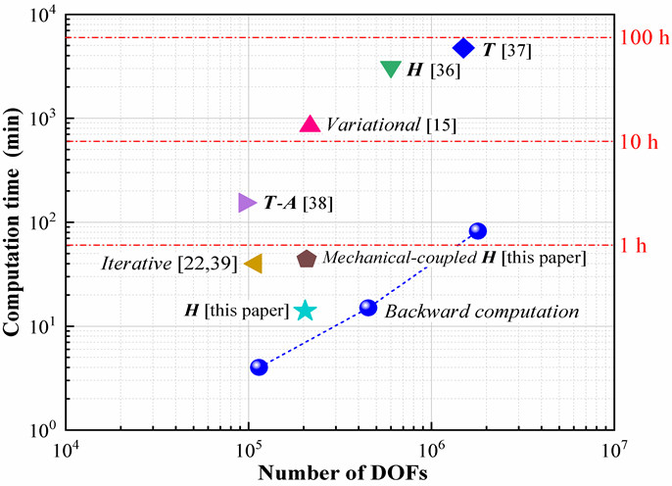
Extra - Backward computation method
Comparison of computation times reported in the literature for other state-of-the-art techniques for the electromagnetic analysis of HTS materials.
Note: the listed H-, T- and T-A formulation were implemented for other applications (e.g., AC loss or SCIF) and that benchmarking this particular problem would provide a true comparison.
Zhang K et al 2020 Supercond. Sci. Technol. 33 114007

