Slide 1
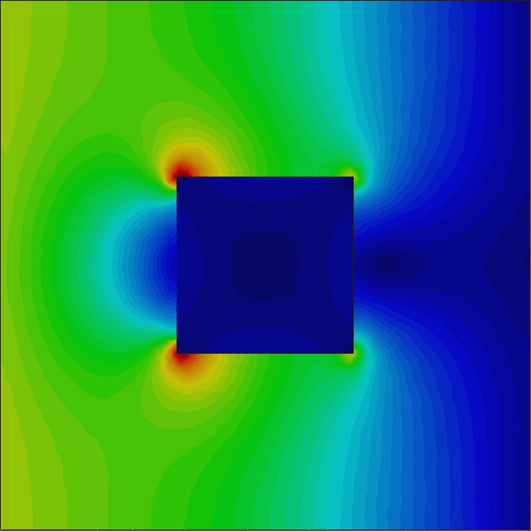
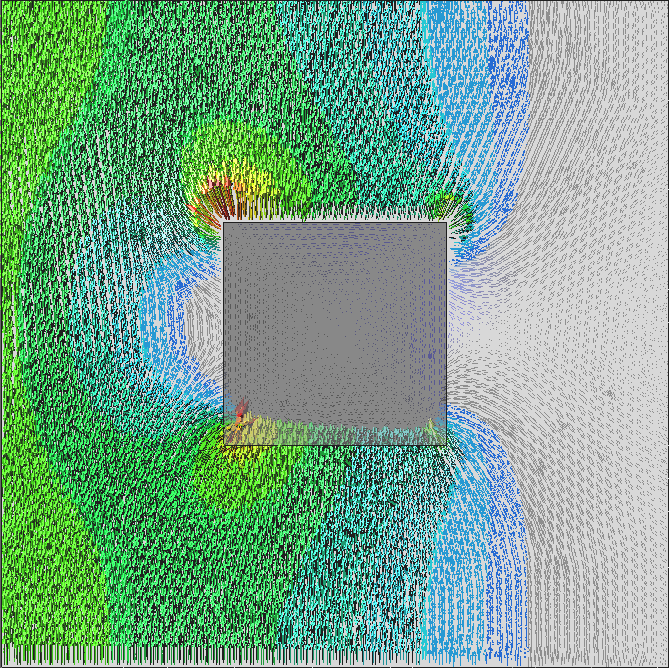
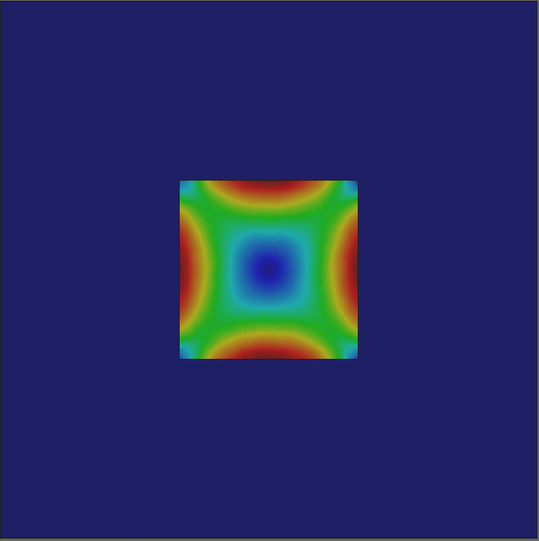
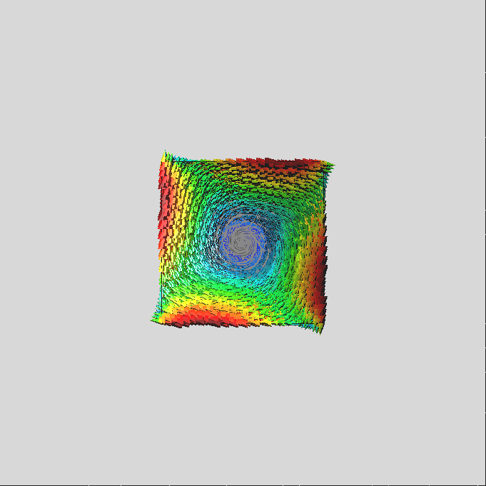
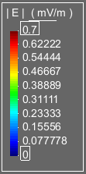
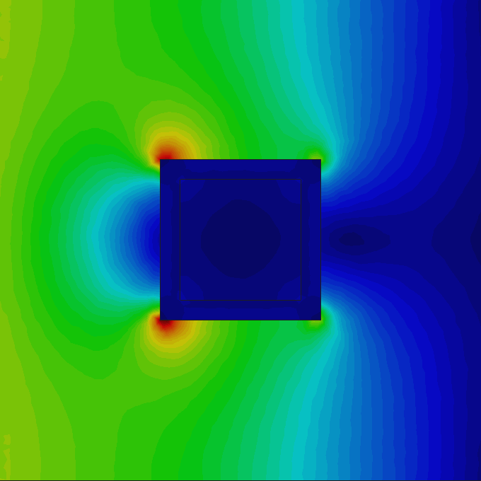
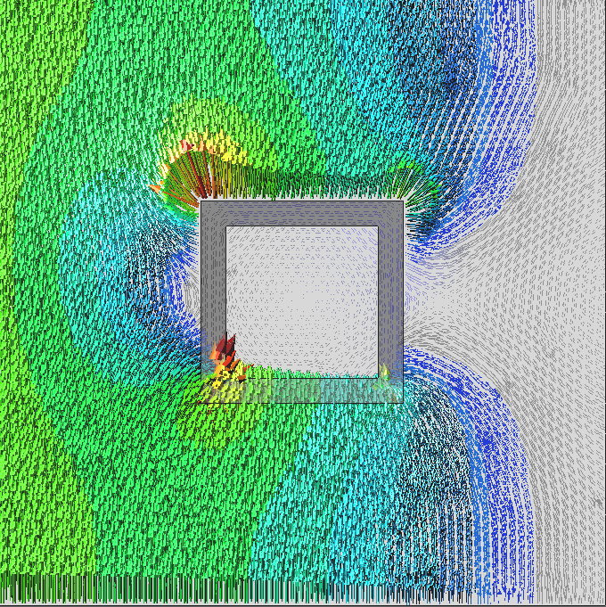
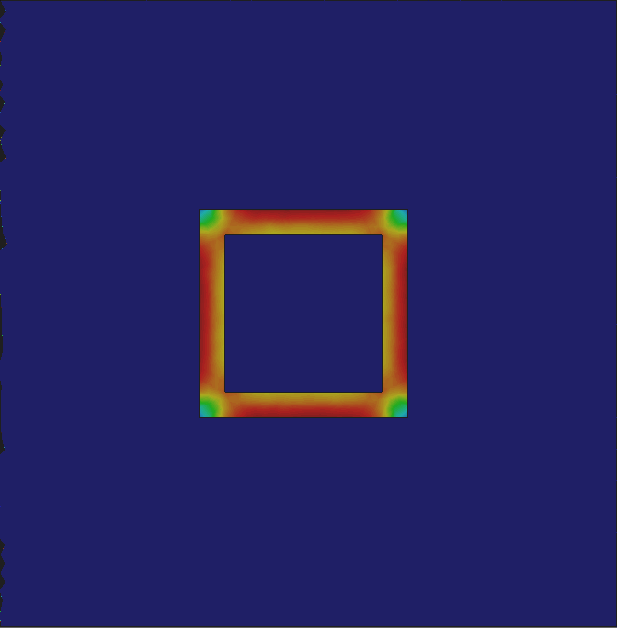
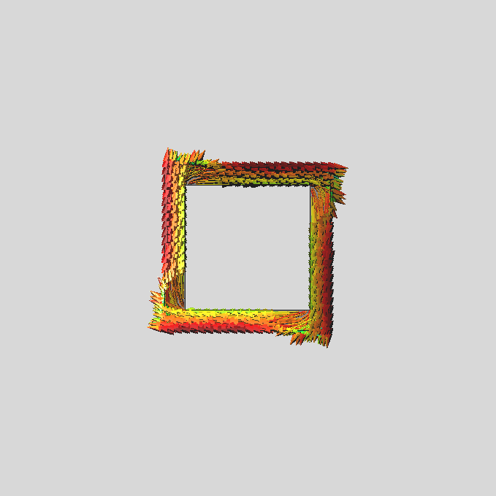
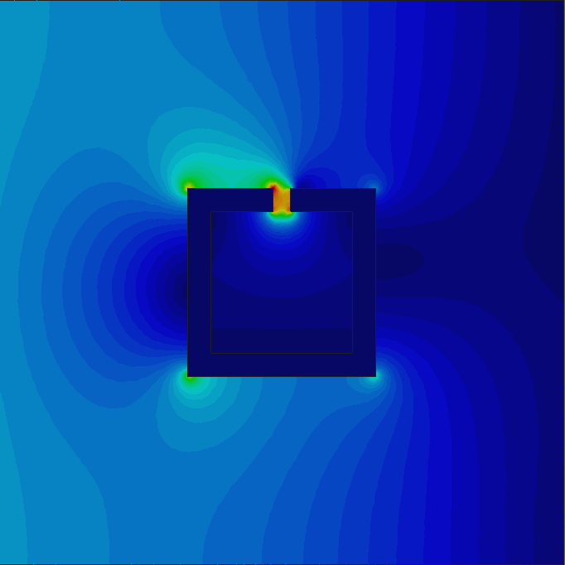
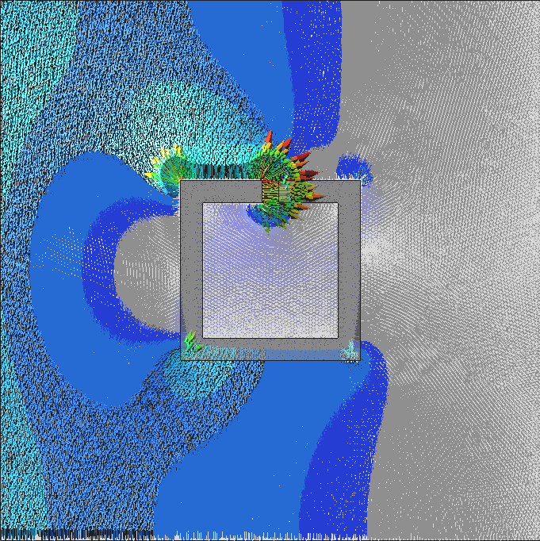
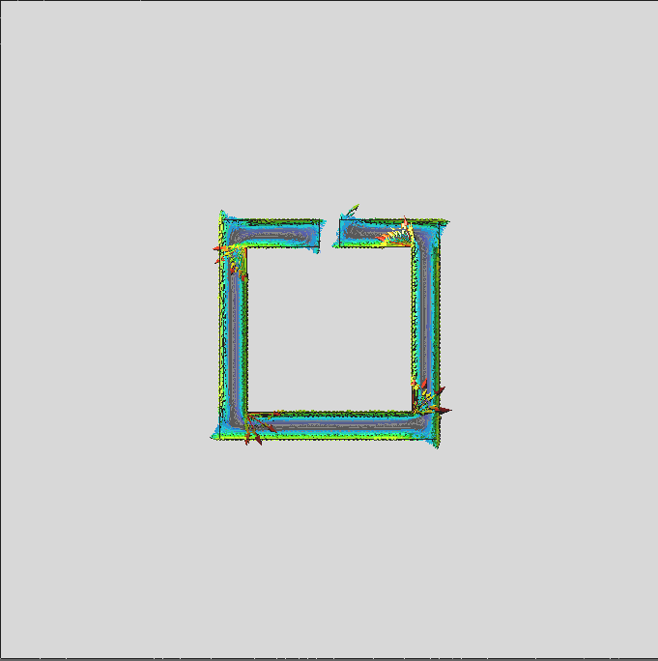
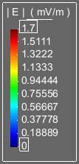
A new E-field finite element formulation for the numerical modelling of high temperature superconductors
Ruben Otin¹, Shafa Aria¹, Zhang Heng¹, Aleksander Dubas¹, Andrew Davis¹, and Frank Schoofs¹
¹UK Atomic Energy Authority - Culham Science Centre, OX14 3DB, Oxfordshire, United Kingdom
Features:
Results:
σ = 10 MS/m
Electric field is the main unknown, which allows the direct calculation of the induced eddy currents and other magnitudes of interest (e.g. Joule heating) without resorting to derivatives.
It does not require the addition of extra unknowns (e.g. Lagrange multipliers or scalar potentials) to be stable.
It can account for capacitive and inductive effects simultaneously, even at low frequencies.
Same formulation can be used at low and high frequencies.
It uses 1st order nodal elements enriched with inner and surface bubbles (easier interpolation in multiphysics problems).
Iterative solver friendly (resultant matrix is well conditioned and it can be solved easily with lightly preconditioned iterative solvers).
J = 1e6 A/m²
Freq = 50 Hz
PEC
| E | ( mV/m )
| J | ( A/m² )
Formulation:
σ = 10 MS/m
| E | ( mV/m )
| J | ( A/m² )
| E | ( mV/m )
| J | ( A/m² )
References:
H. Duan, P. Lin, and R.C.E Tan, "Solving a Maxwell interface problem by a local L2 projected C0 finite element method". Numerical Mathematics and Advanced Applications - ENUMATH 2013. Lecture Notes in Computational Science and Engineering, vol 103. 2015.
R. Otin, “ERMES: A nodal-based finite element code for electromagnetic simulations in frequency domain,” Computer Physics Communications, vol. 184 (11), 2013.

