Slide 1



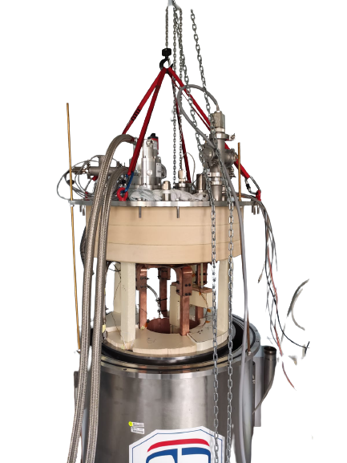
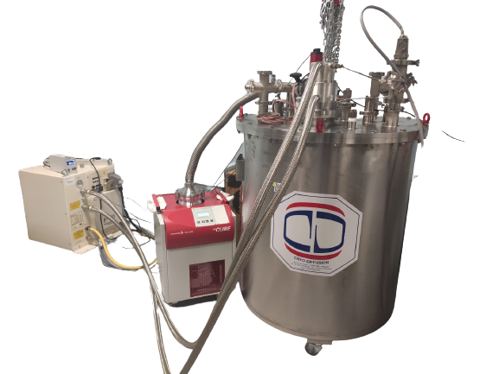
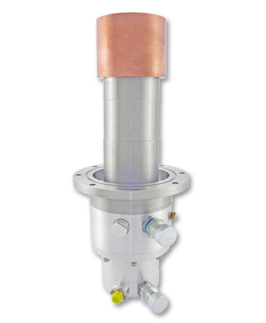

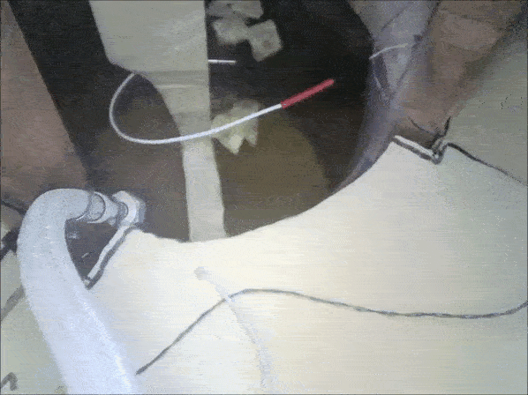

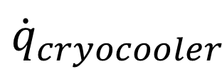

Design and Testing of a New Cooling System using Solid Nitrogen
for Pulsed Field Magnetization and Characterization of HTS Bulks
Ghazi Hajiri¹, Kévin Berger¹ and Jean Lévêque¹
1 – Groupe de Recherche en Energie Electrique de Nancy, University of Lorraine, France
Abstract
Cooling systems
Solid Nitrogen (SN2) can provide a uniform and stable cryogenic environment for High Temperature Superconducting (HTS) systems such as bulk samples during their magnetization and/or characterization. In this paper, we are studying a SN2 cooling system consisting of a cryocooler Sumitomo CH-110 and an exchanger in a Liquid Nitrogen (LN2) bath. In order to design this cooling system, an analytical model based on a nodal method coupled to a formulation of the thermal capacity (NMCTC) was realized. The model considers the thermal parameters variation as well as the phase change of the Nitrogen. In order to compare our results, we performed a 3D simulation on COMSOL Multiphysics. The performance of the cooling system was evaluated and we estimates that 50 L of LN2 can be cooled down to 20 K in 50 hours.
Temperature sensor output
Pressure sensor
F-70 Indoor Water-Cooled Compressor
CH-110 77K Cryocooler
Governing Equations
The heat diffusion equation :
HiCube 300 Classic, DN 100 CF-F
Cryo Diffusion
Open cryostat view
Copper heat exchanger « CuC1 »
Results
T(K)
$$\dot{q}$$
SN₂ bath center
Polystyrene support
$${\dot{q}}_{cryocooler}$$
Temperature sensor
SN₂
The thermal conductivity k :
The specific enthalpy H :
Reality
3D Simulation
The specific heat capacity C_{p} :
Conclusion
The analytical model based on a nodal method coupled with a heat capacity formulation and the 3D simulation in COMSOL were validated with experimental measurements.
The Dirac pulse :
Pulsed field magnetization tests and characterization of HTS bulbs are planned soon.

