Slide 1
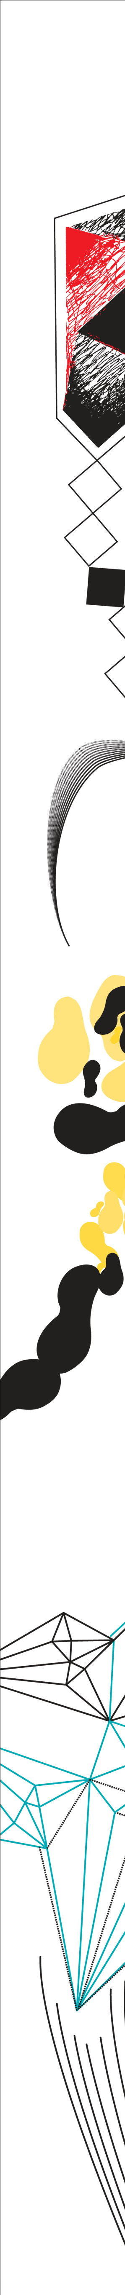



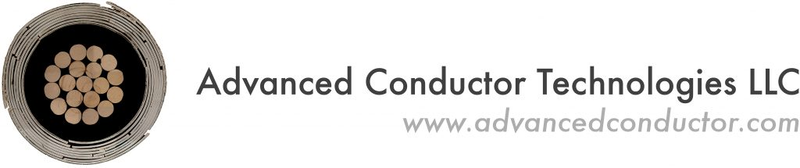

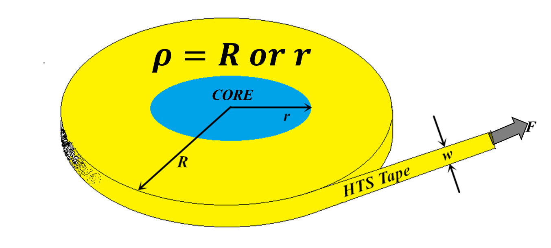
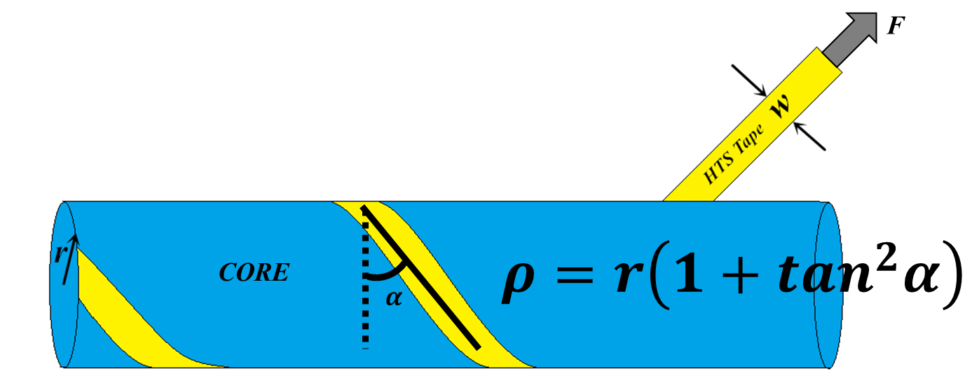
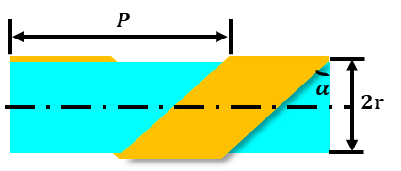
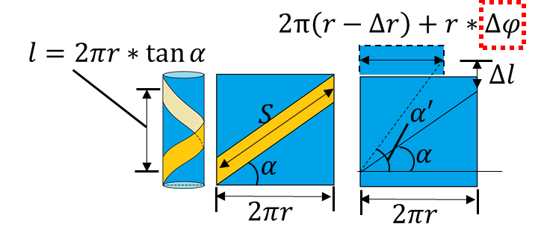

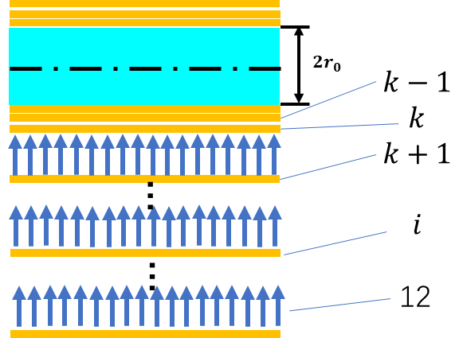

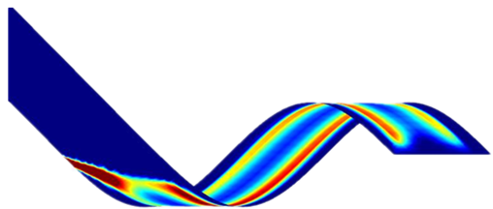
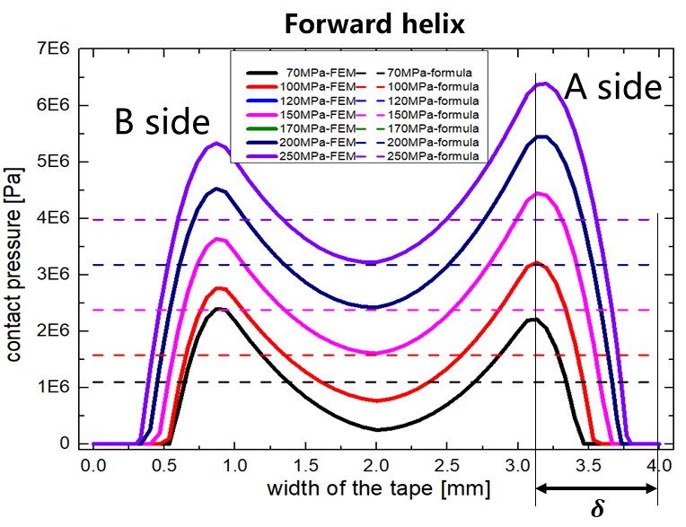
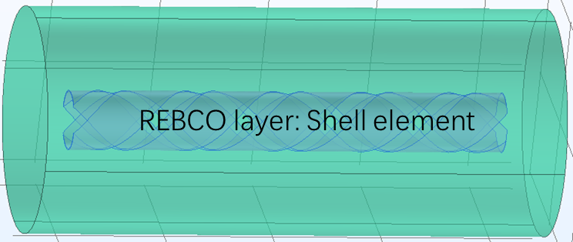
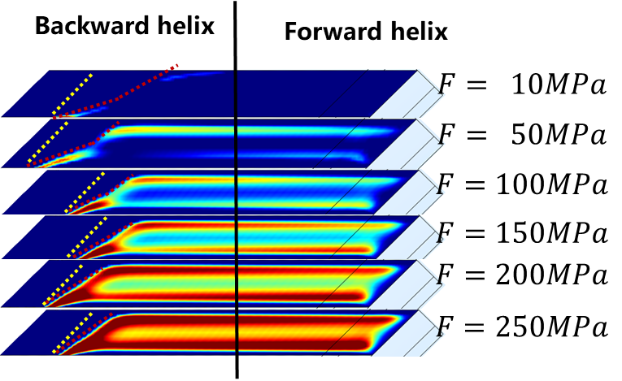
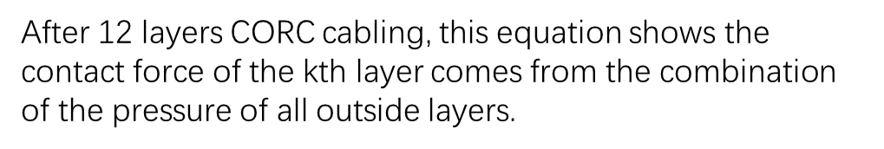
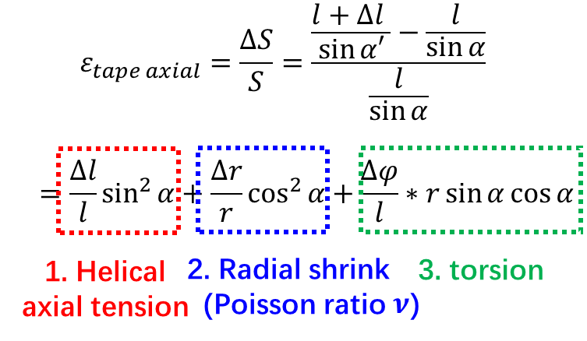



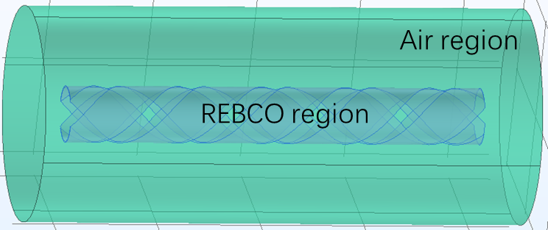
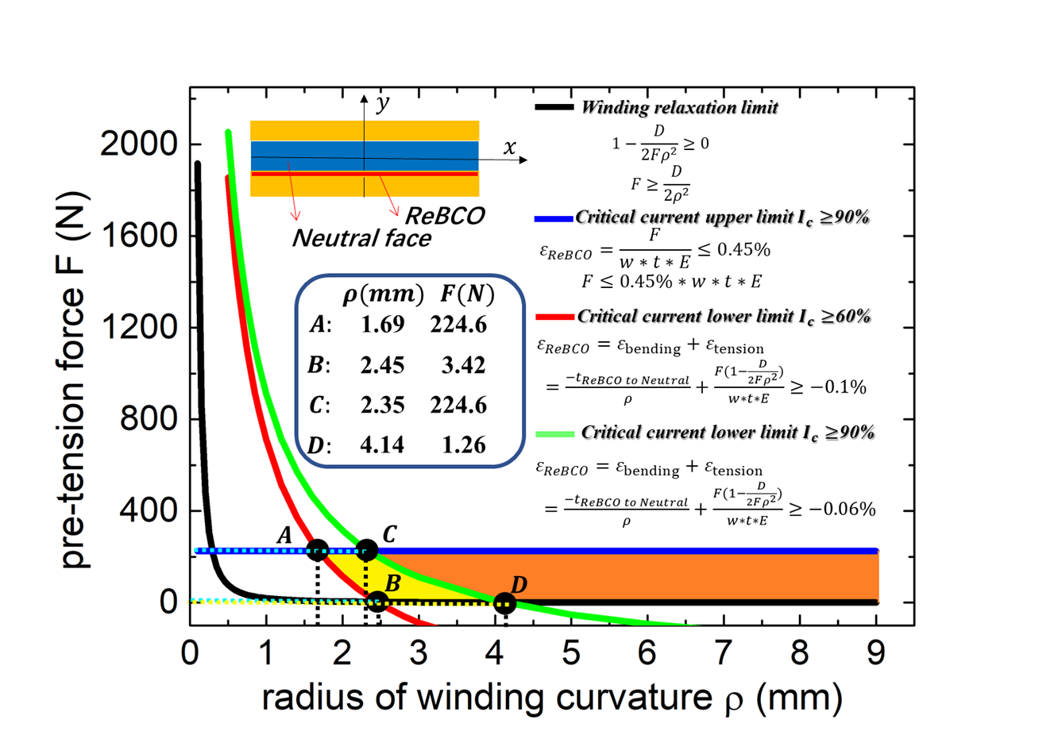
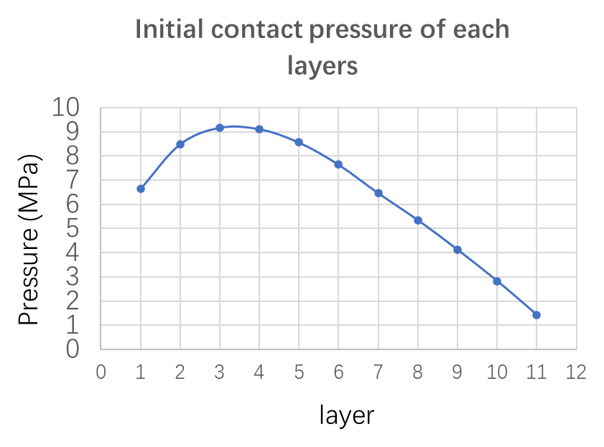
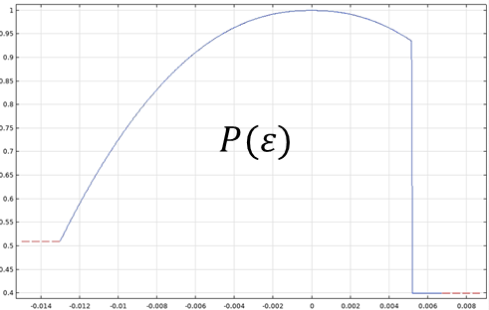
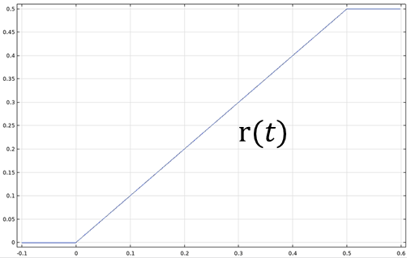
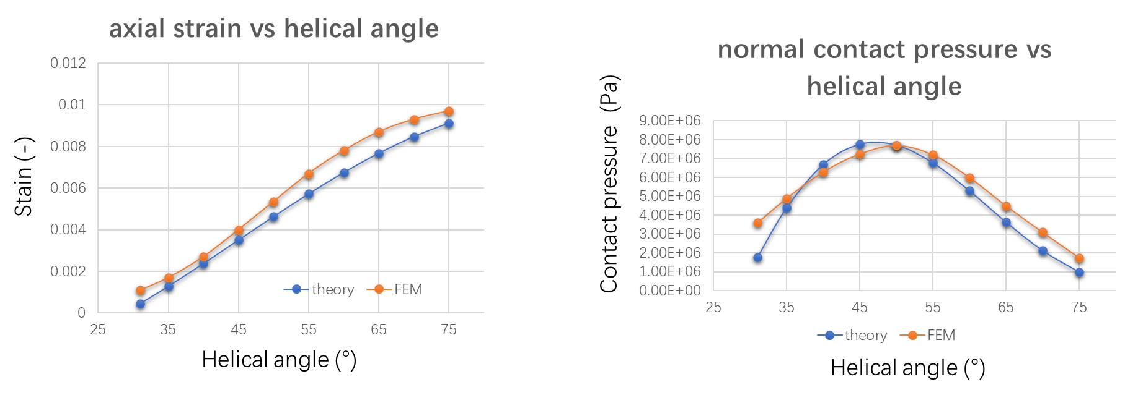
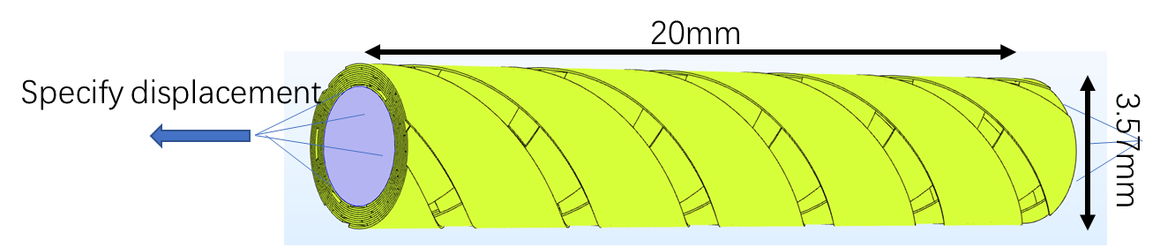
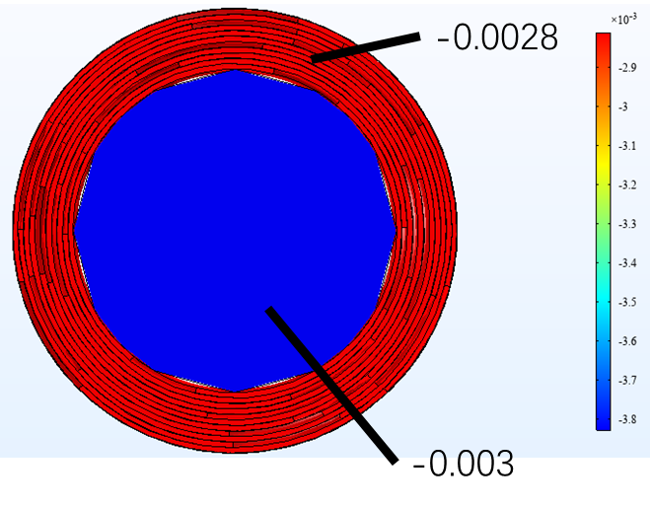
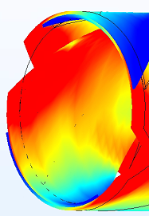
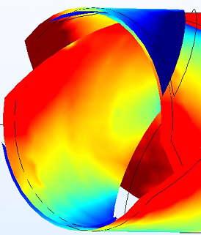
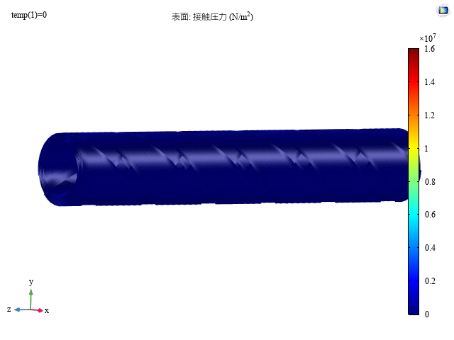
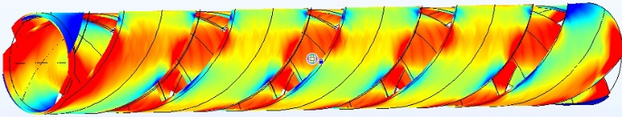
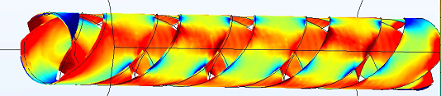
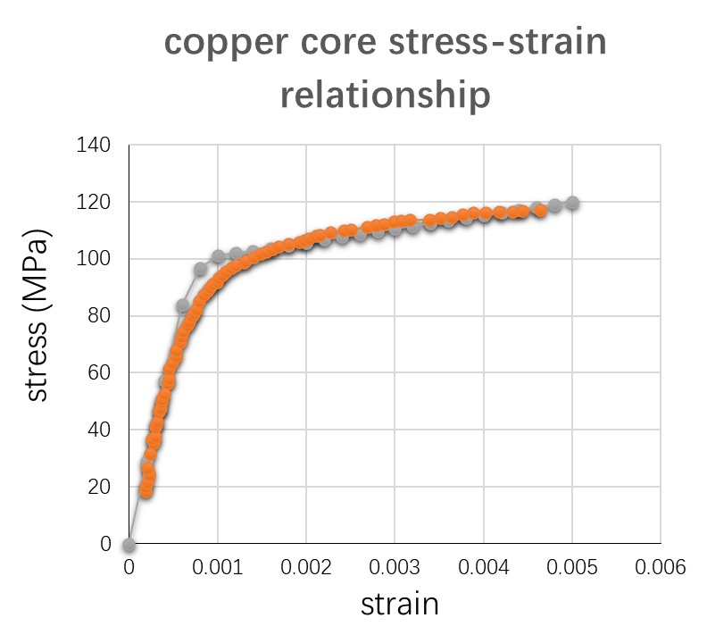
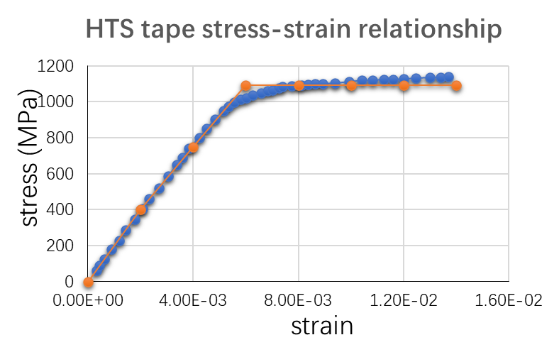
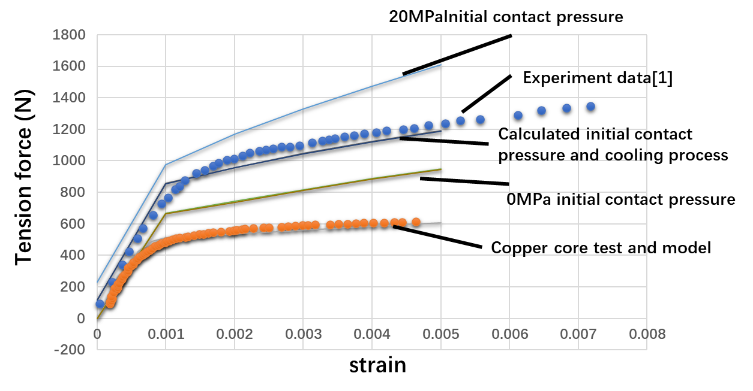
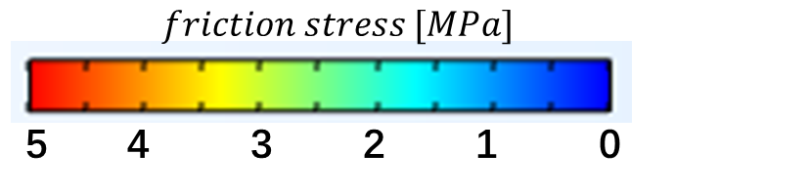
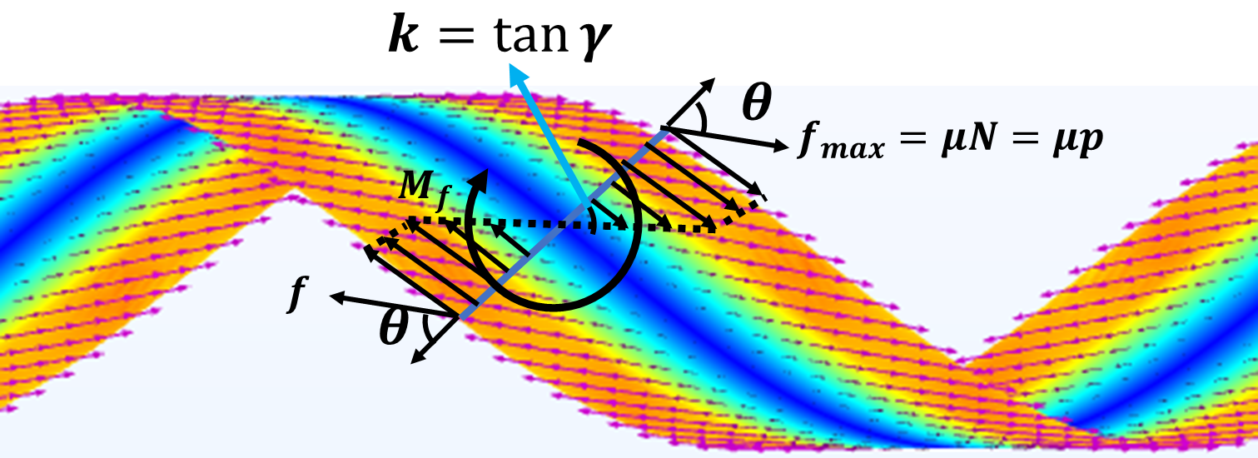
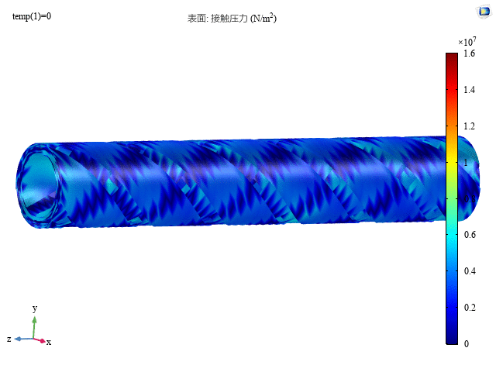

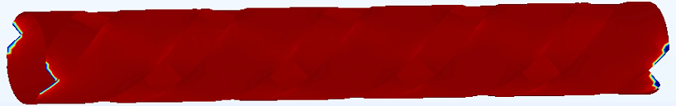
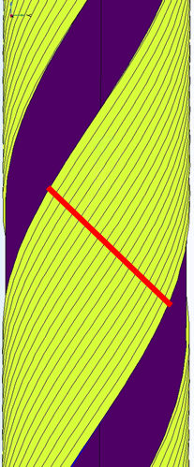
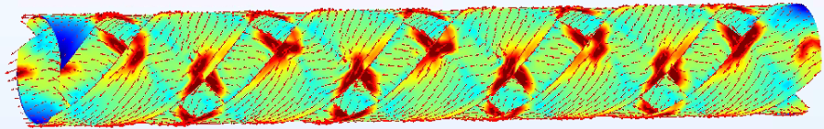
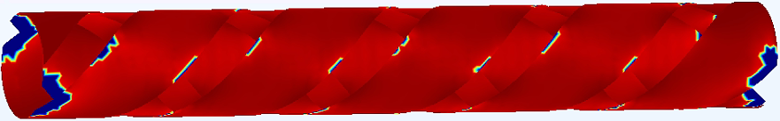
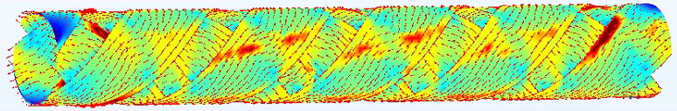
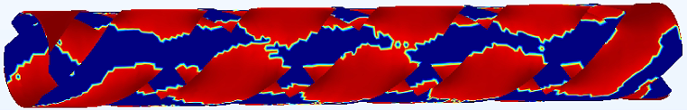
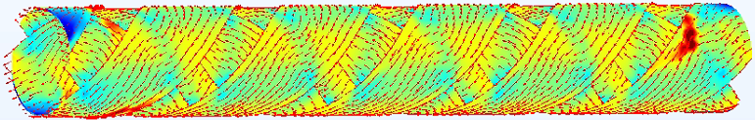
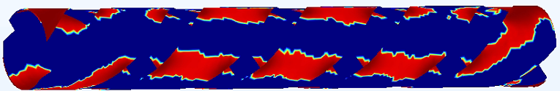
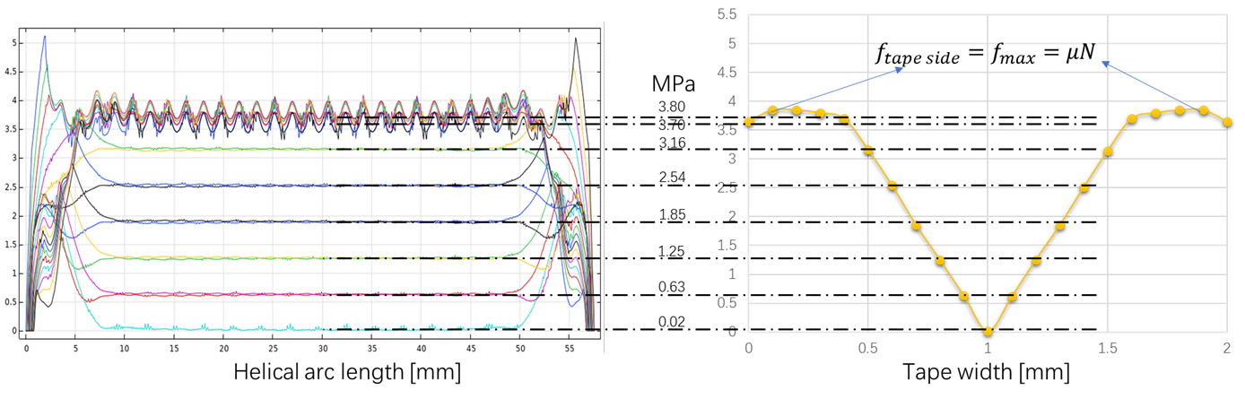
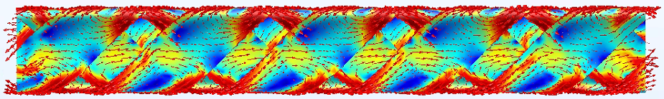
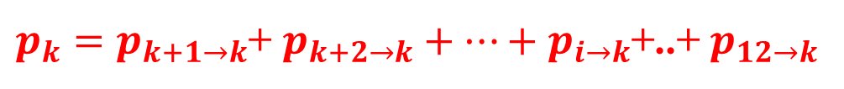










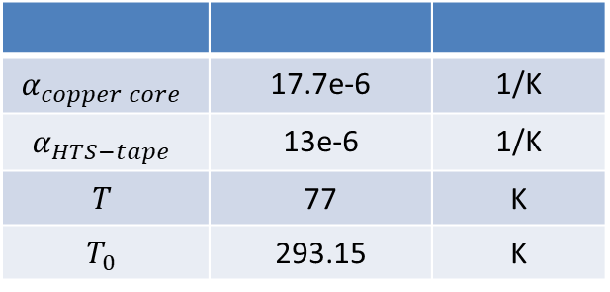







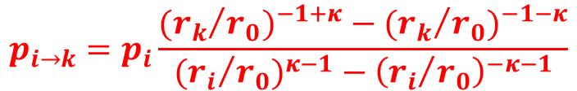




Poster id: htsmod2020:350772
Lanzhou University
Analysis of contact behavior in CORC® cabling and under axial tension
K. Wang^{1, 2}, V. A. Anvar^{1, 3}, Y. Gao², J D Weiss⁴, D.C. van der Laan⁴, A. Nijhuis¹
¹The University of Twente, Faculty of Science & Technology, 7522 NB Enschede, Netherlands, ² College of Civil Engineering and Mechanics, Lanzhou University, 730000 Lanzhou, China, ³Institute for Superconducting and Electronic Materials, University of Wollongong, Wollongong, Australia,
⁴Advanced Conductor Technologies and University of Colorado, Boulder CO 80301, USA,
Abstract
CORC® cables or wires are composed of helical wound HTS REBCO tapes in multiple layers with high flexibility. In this study, starting with the cabling process, the deformation of the tape and the initial contact force distribution between the tape and the core are described. Then axial tensile loading of the CORC® is simulated and compared with the experimental curve including its critical current degradation. The results describe the interaction between tape and core that occurs during the tensile loading. The tape and the core are extruded and friction is generated, directly causing critical current degradation. The developed analytical and FE models can predict the mechanical and electrical properties of CORC® cables.
CORC cabling process
Multilayer CORC cabling process
Theory of CORC tension process
3D T-A method for CORC tension process consider contact behavior
Average one layer contact force: $\overline{q}=\frac{p}{w}=\frac{F\left(1− \frac{EI/(1−ν^{2})}{2Fρ^{2}}\right)}{ρw}$
Step-1 solid:
Calculate the overall strain of the cable
Radius of curvature：$ρ=\left(1+\tan^{2}α\right)r$
Pitch and core radius： $tanα=\frac{P}{2πr}$
A side：
no relaxation
B side：relaxation
$$p_{i→k}=p_{i}\frac{{{{(r}_{k}}/{r_{0}})}^{−1+κ}−{{{(r}_{k}}/{r_{0}})}^{−1−κ}}{{{{(r}_{i}}/{r_{0}})}^{κ−1}−{\left({r_{i}}/{r_{0}}\right)}^{−κ−1}}$$
$$κ=\frac{E_{hoop}}{E_{radial}}$$
Step-2 shell:
Calculate the strain in the REBCO layer
$p_{k}=p_{k+1→k}$+ $p_{k+2→k}+…+p_{i→k}$+..+ $p_{12→k}$
Step-3 T-A
Calculate the critical current, current distribution, magnetic field, AC loss and other electric behavior
Tape selection
Tape thickness t [mm]
Tape Width w [mm]
Approximate average contact force:
$$\overline{q}=\frac{F\left(1− \frac{EI/(1−ν^{2})}{2Fr^{2}}\right)}{rw}$$
Winding method
Core radius r [mm]
SCS4050
Winding angle $α$ [°]
$$p_{k}$$
Tape Tension F [N]
Base equation
Apply contact pressure(Pa)$P_{i}$
Approximated as: $ε_{tape}=ε_{cable}{(sin}^{2}{α−ν}\cos^{2}{α)}$
1. T-formulation
2. A-formulation
3. Power law
Edge Lifting affects depth of the tape edge:
$$δ≈\frac{π}{2}\sqrt[4]{\frac{t^{2}r^{2}}{3(1−ν^{2})}}$$
$$J_{c}(ε)=J_{c0}∗P(ε)$$
Contact pressure define(MPa)$p_{k}$
4. AC & DC applied current
and magnetic field
AC
$$I_{apply}=I_{0}\sin{(2πft)}$$
DC
$$I_{apply}=I_{0}r{(t)}$$
Tension model considering Initial Contact
Cooling process
$$B_{apply}=B_{0}\sin{(2πft)}$$
$$B_{apply}=B_{0}\sin{(2πft)}$$
$$α_{copper core}$$ | 17.7e-6 | 1/K
$$α_{HTS−tape}$$ | 13e-6 | 1/K
$$T$$ | 77 | K
$$T_{0}$$ | 293.15 | K
2-layers tensile CORC results (cable strain: 1%, winding angle：45°-45°, core radius：1.29 mm)
$$ε_{cooling}=α(T−T_{0})$$
$$ε_{tape}=ε_{cable}{(sin}^{2}{α−ν}\cos^{2}{α)}$$
$$p=\overline{σ_{tape}}∗ρ=EAε_{tape}∗ρ$$
Helical angle (r=1.29 mm, w=2 mm, $μ$=0.3, $ν$=0.3, $ε_{cable}=1\%$)
Step-1 solid
Tape axial strain
Step-2 shell
REBCO axial strain
Linear hardening model
Friction force
Case 1. When there is no background magnetic field, only DC transport current.
Idea plastic model
0 MPa initial contact pressure
Transport current distribution [A/m²]
Critical current degradation J_{c}/J_{c0} [1]
test data [1]
test data [1]
0.5%
$$σ_{ys}=σ_{ys0}+E_{iso}ε_{pe}$$
1.0%
$\frac{1}{E_{iso}}=\frac{1}{7e9[Pa]}$- $\frac{1}{E}$
$$σ_{ys}=σ_{ys0}$$
5 MPa initial contact pressure
1.5%
[1]D C van der Laan, D M McRae and J D Weiss, Effect of monotonic and cyclic axial tensile stress on the performance of superconducting CORC® wires. Supercond. Sci. Technol. 32 (2019) 054004
The friction is the largest at the edge and the least in the middle.
The direction of friction is different from the tape axis.
2.0%
Conclusions
The contact behavior of CORC® cable is studied in FE model and theoretical method.
A CORC® axial tensile model was built. The tape strain, normal contact stress and friction force were calculated.
The electromagnetic analysis model of CORC® cable considering the tape deformation and interlayer contact during cabling process, cooling process and axial tensile loading process was established. The validations are ongoing.
Case 2. When there is no transport current, only the current generated by the background magnet.

