Slide 1
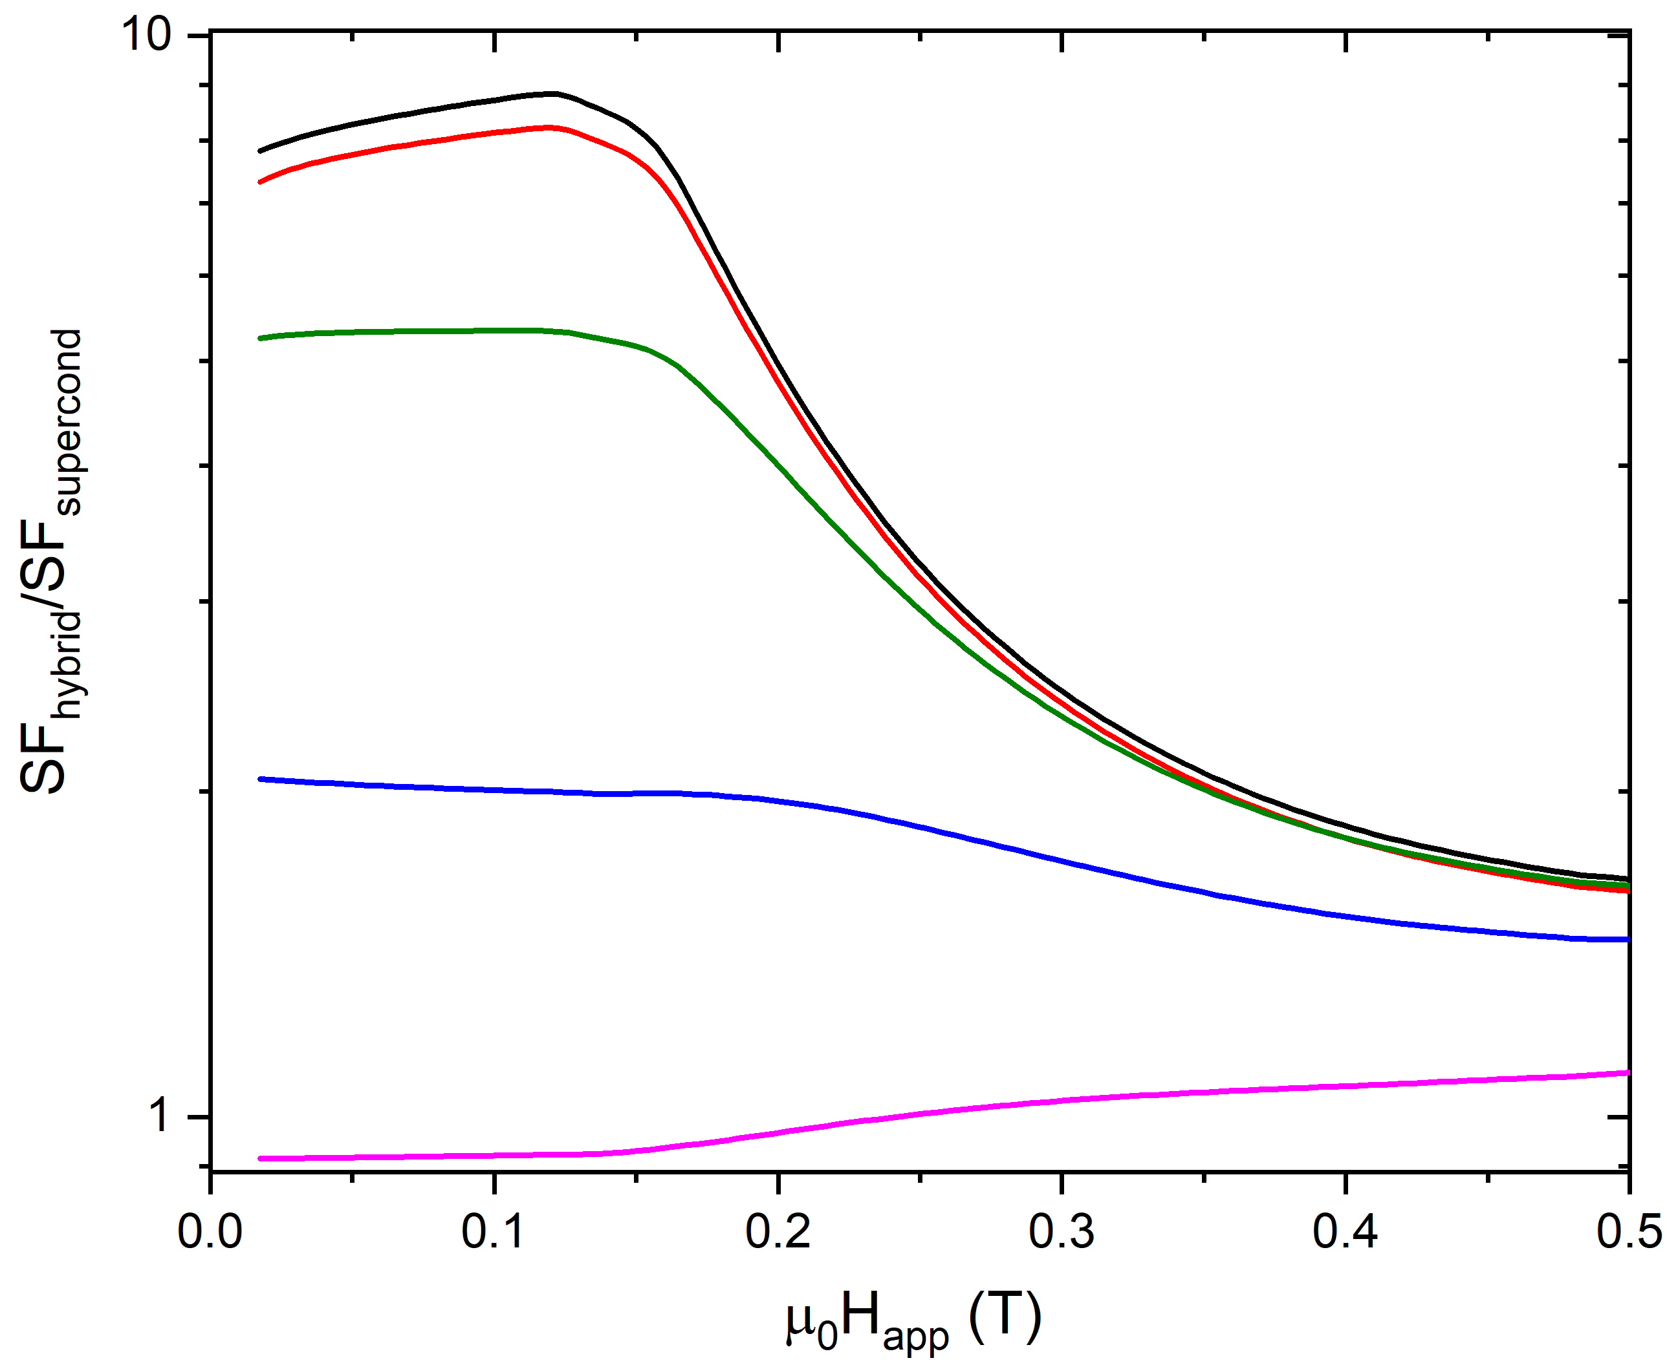
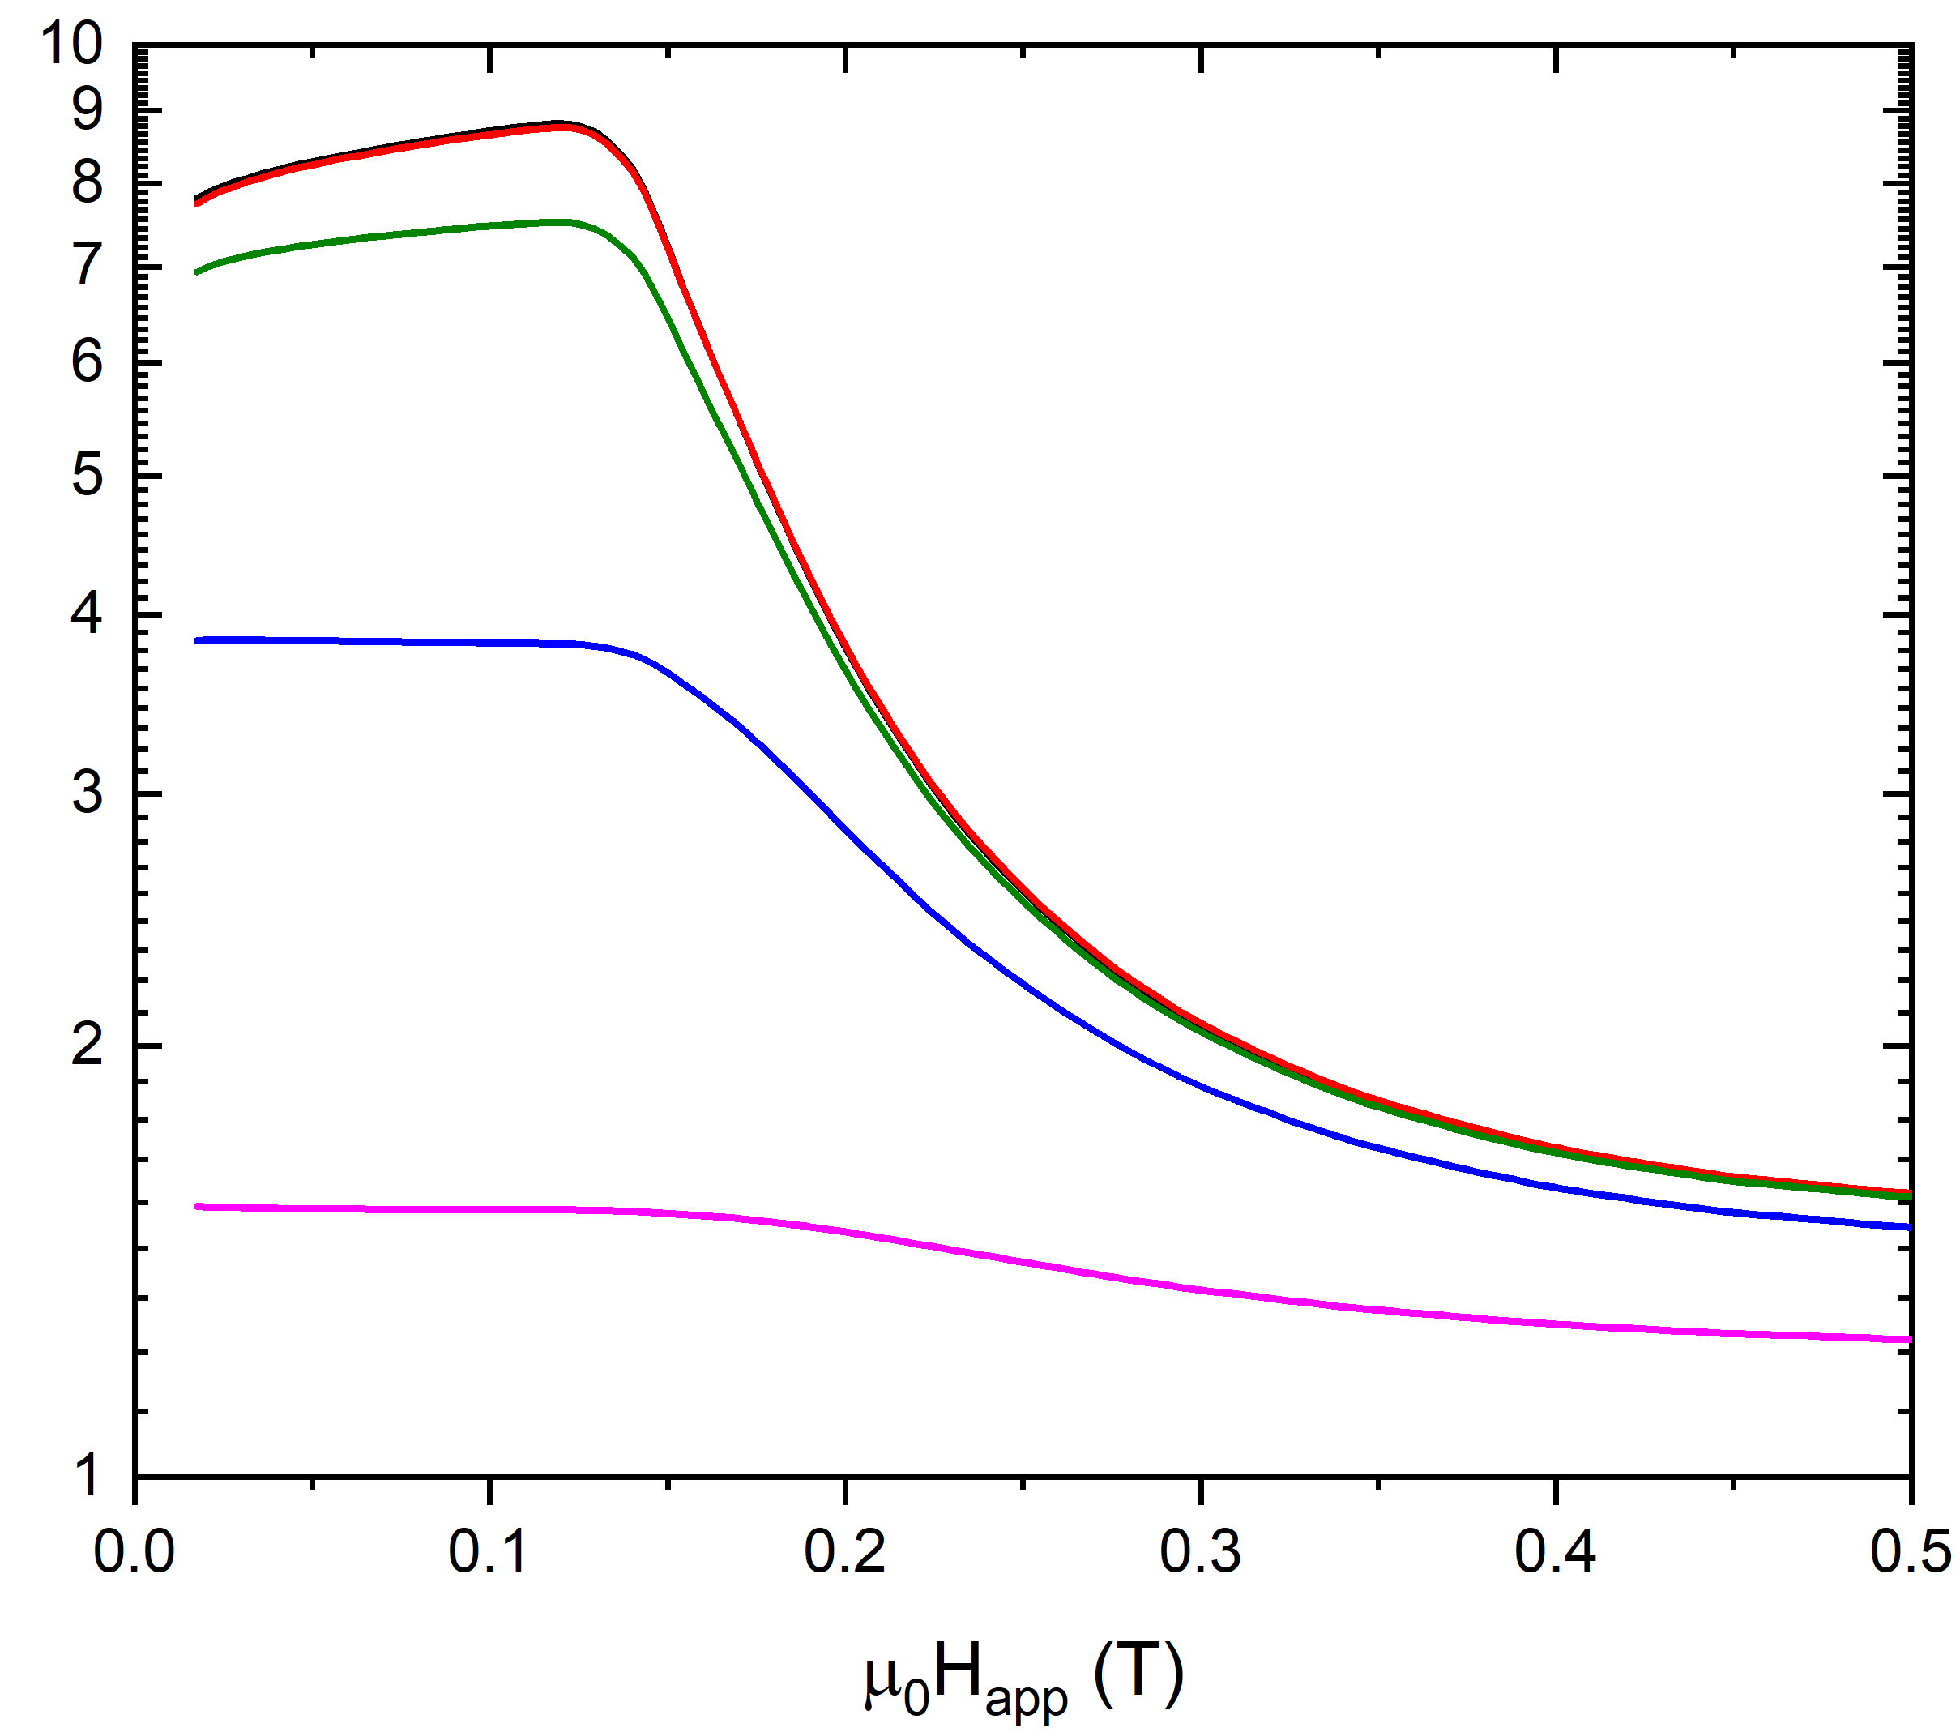
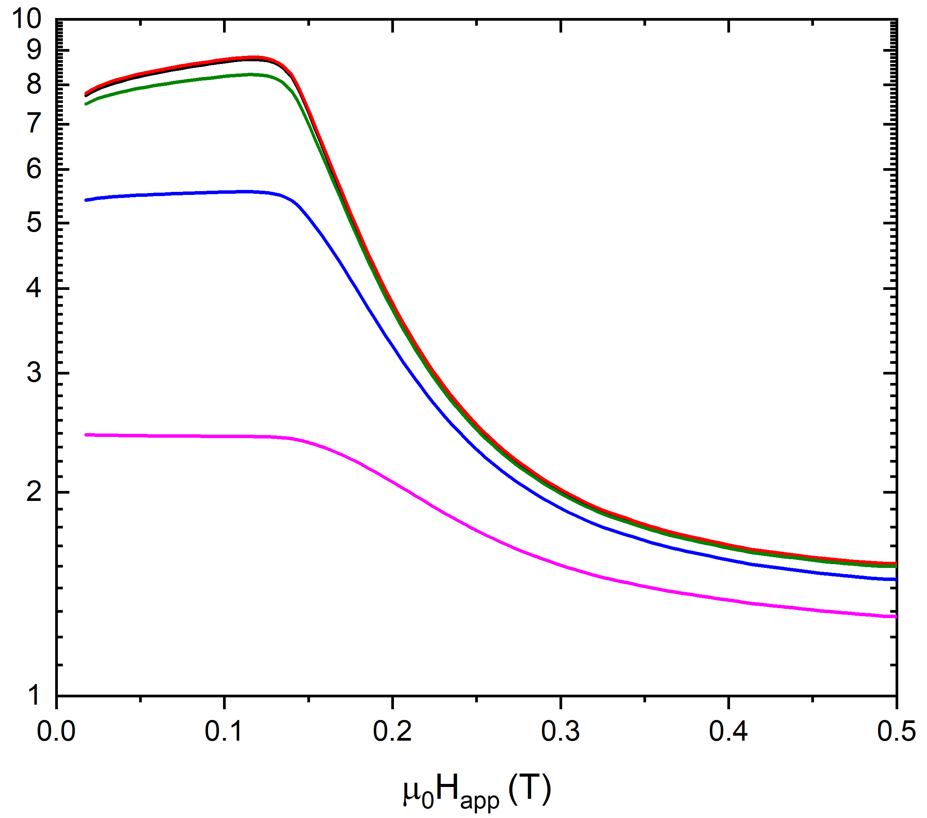
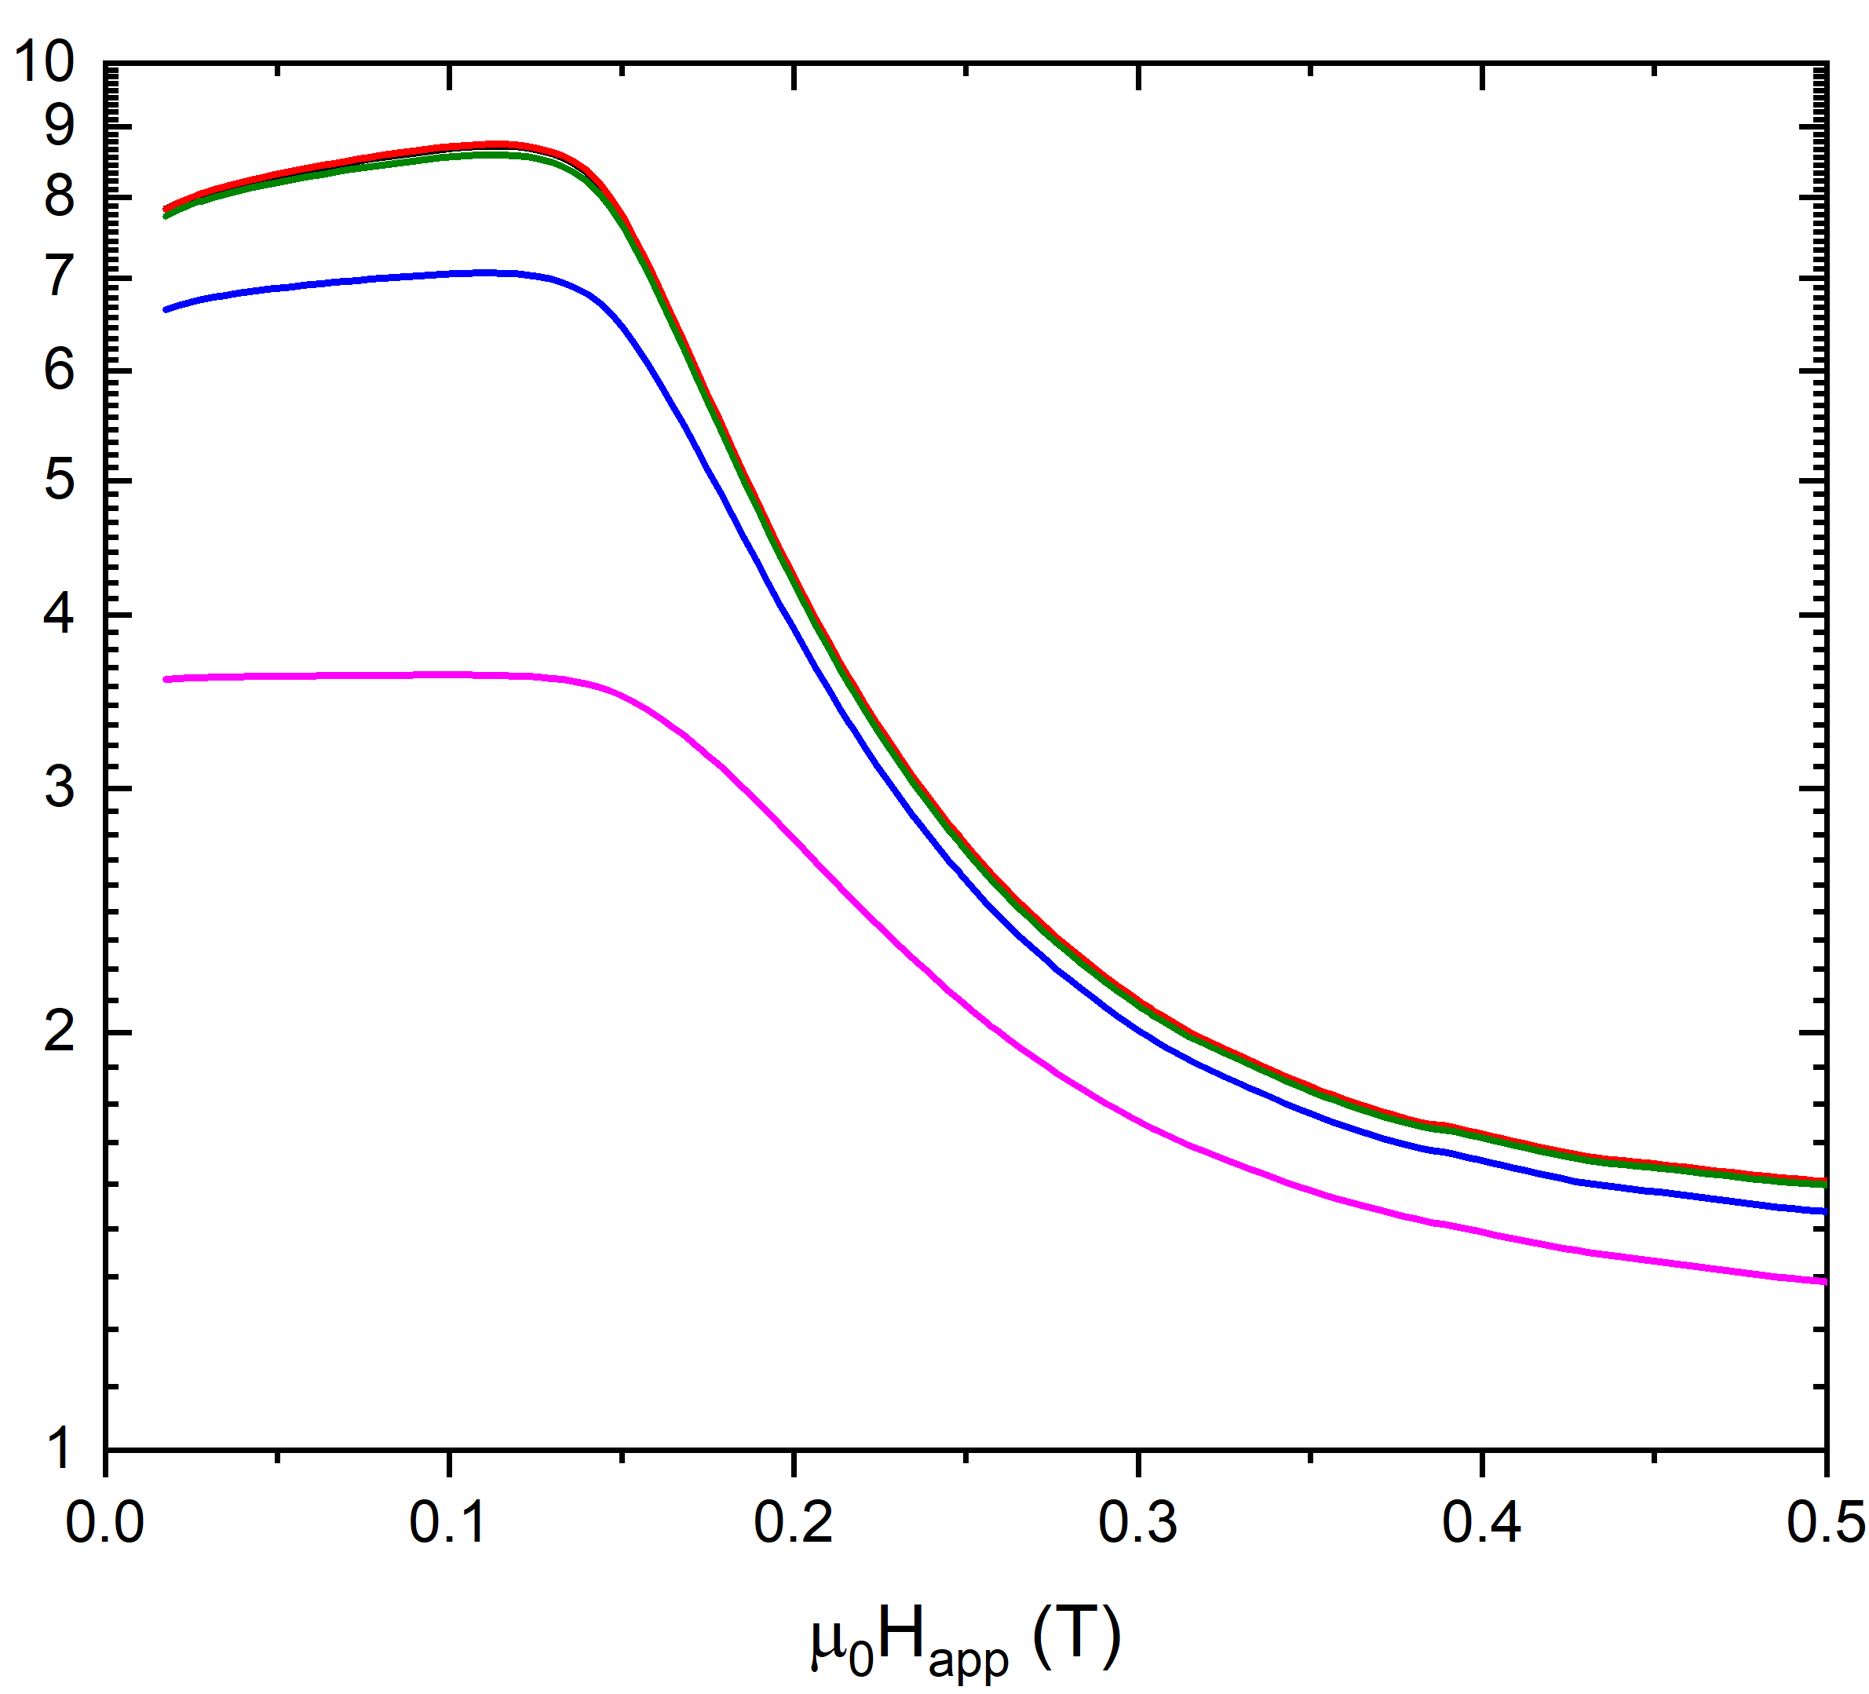
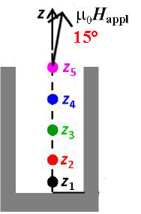
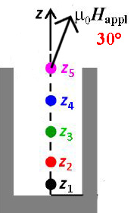
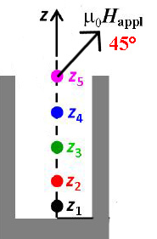
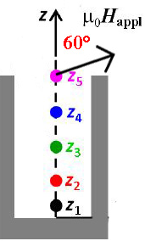
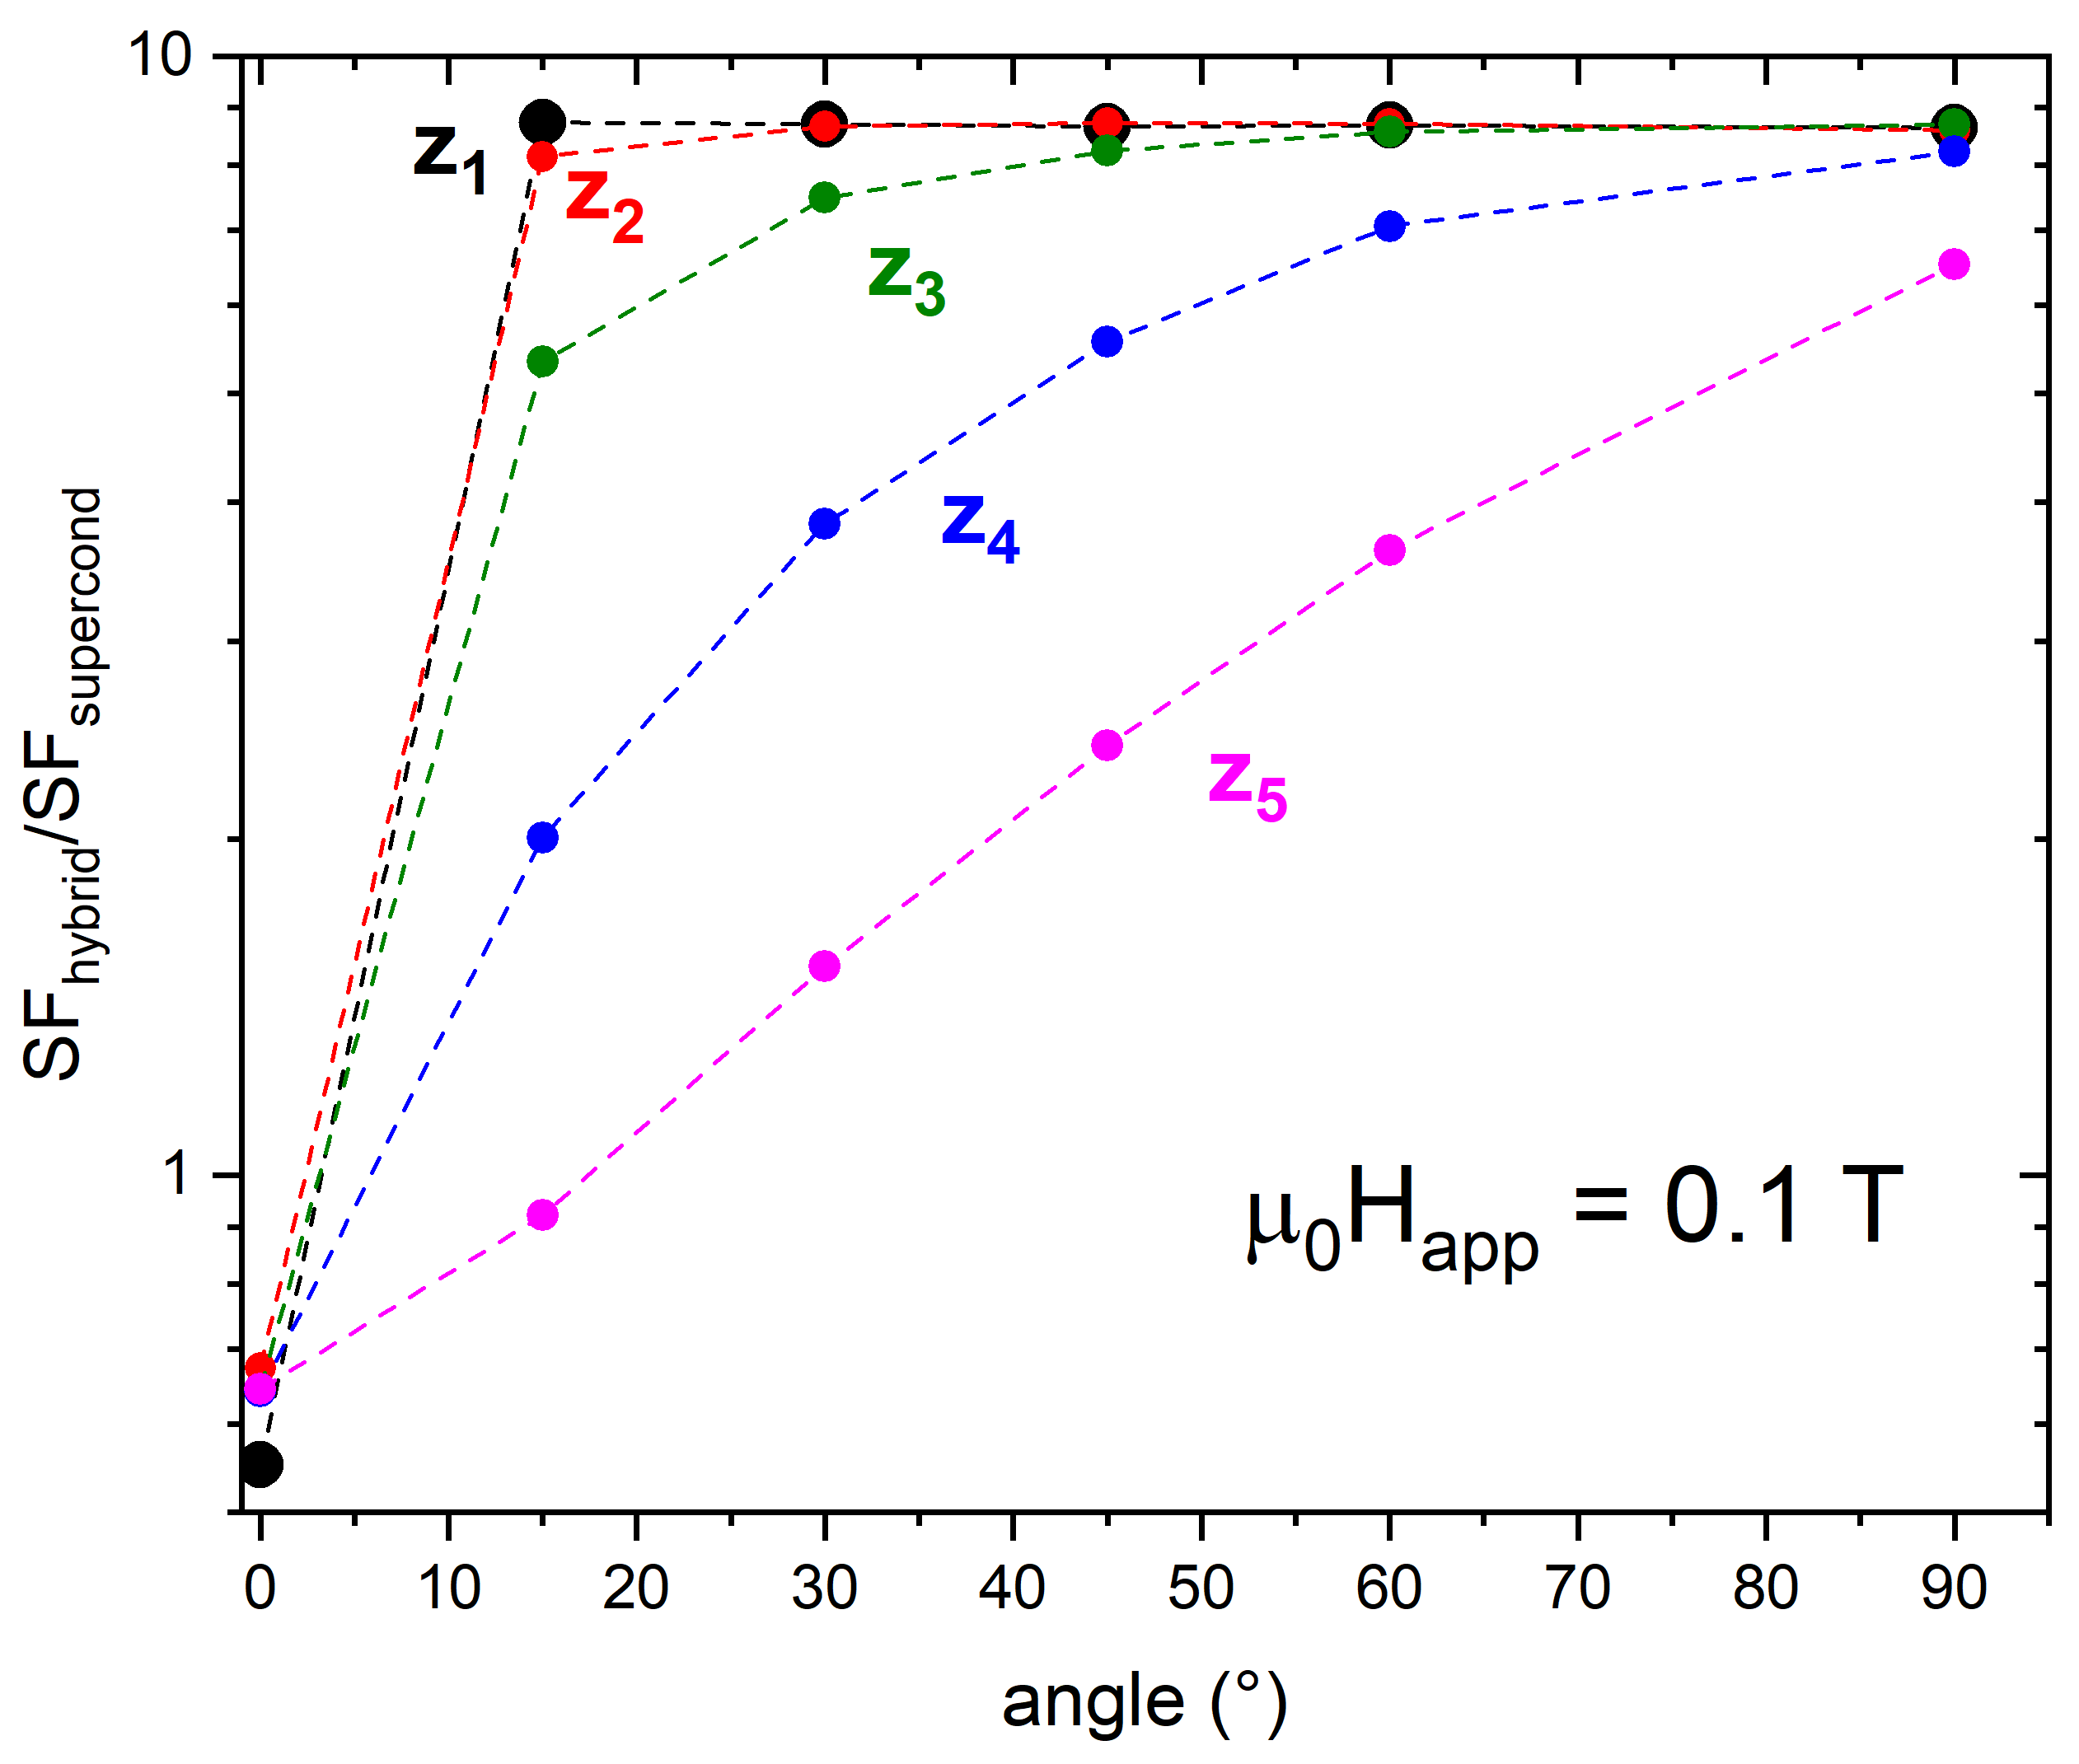
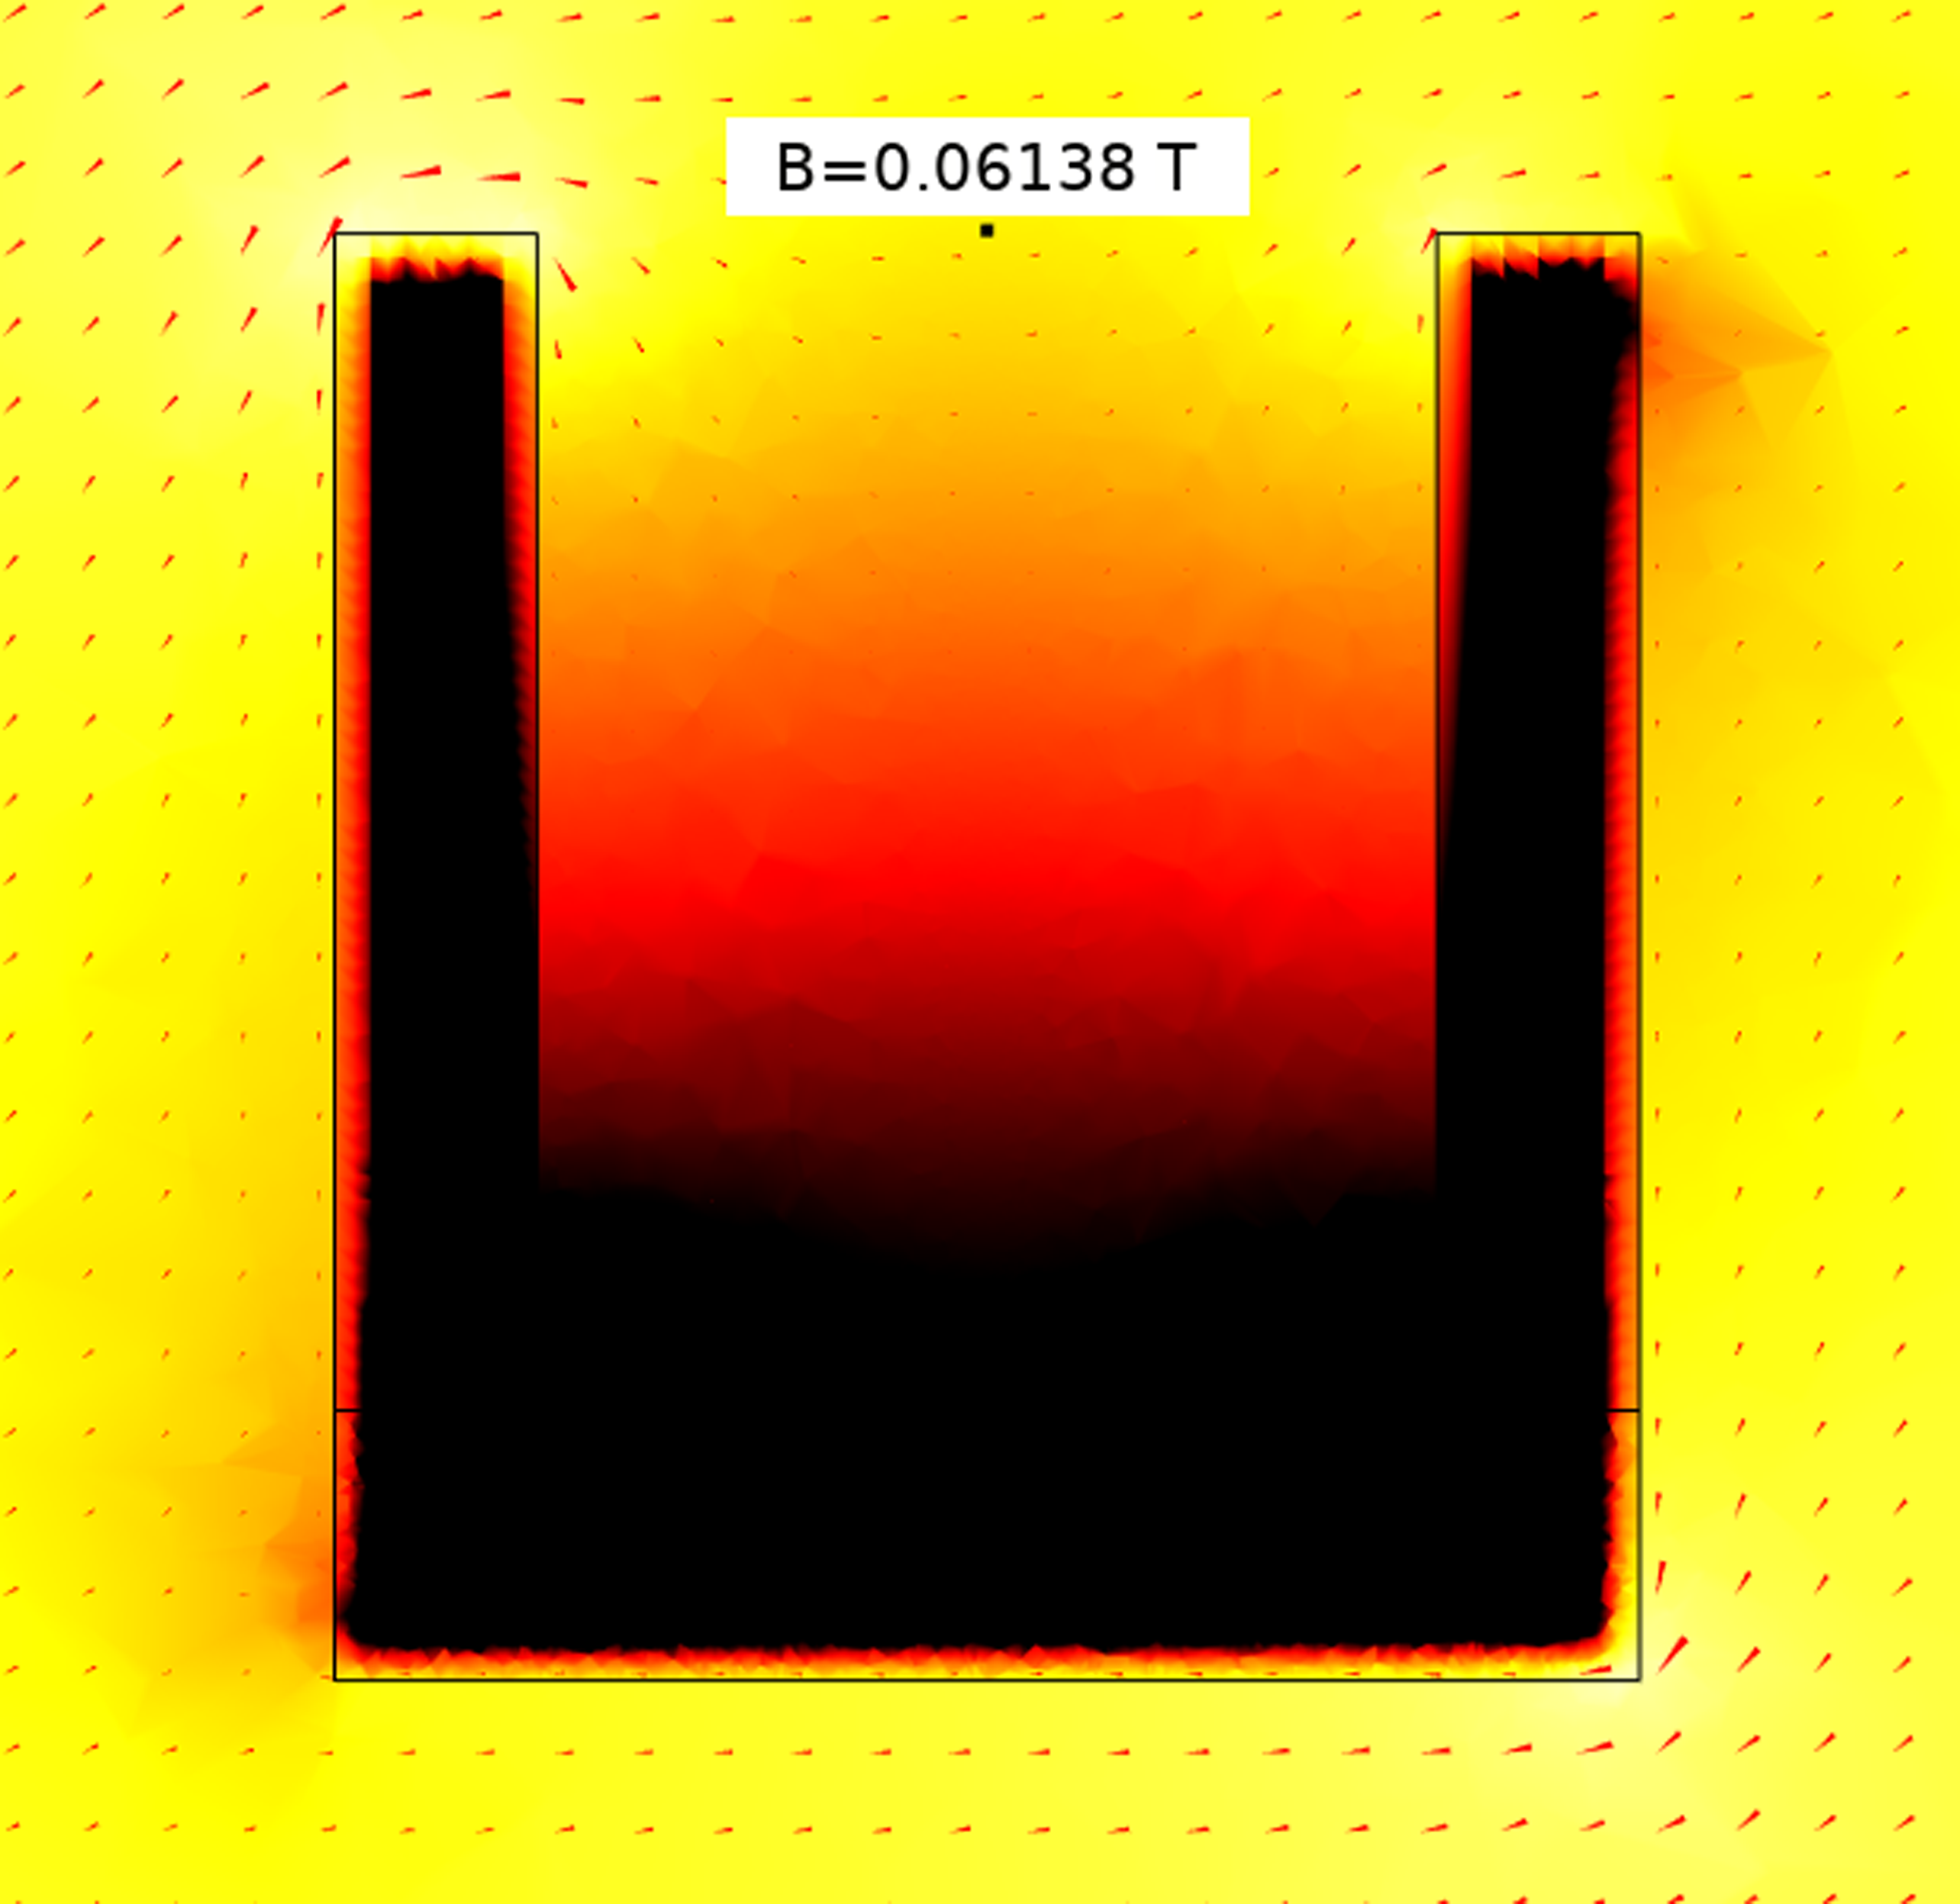
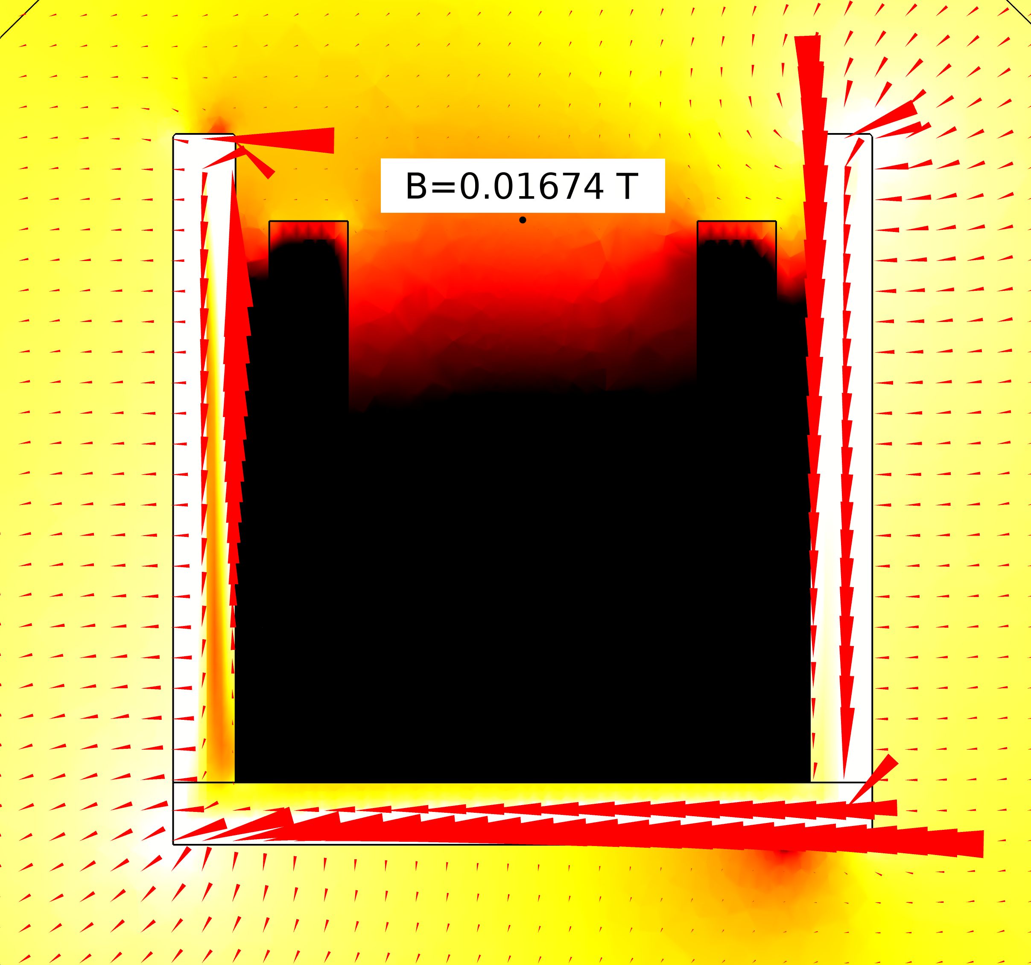
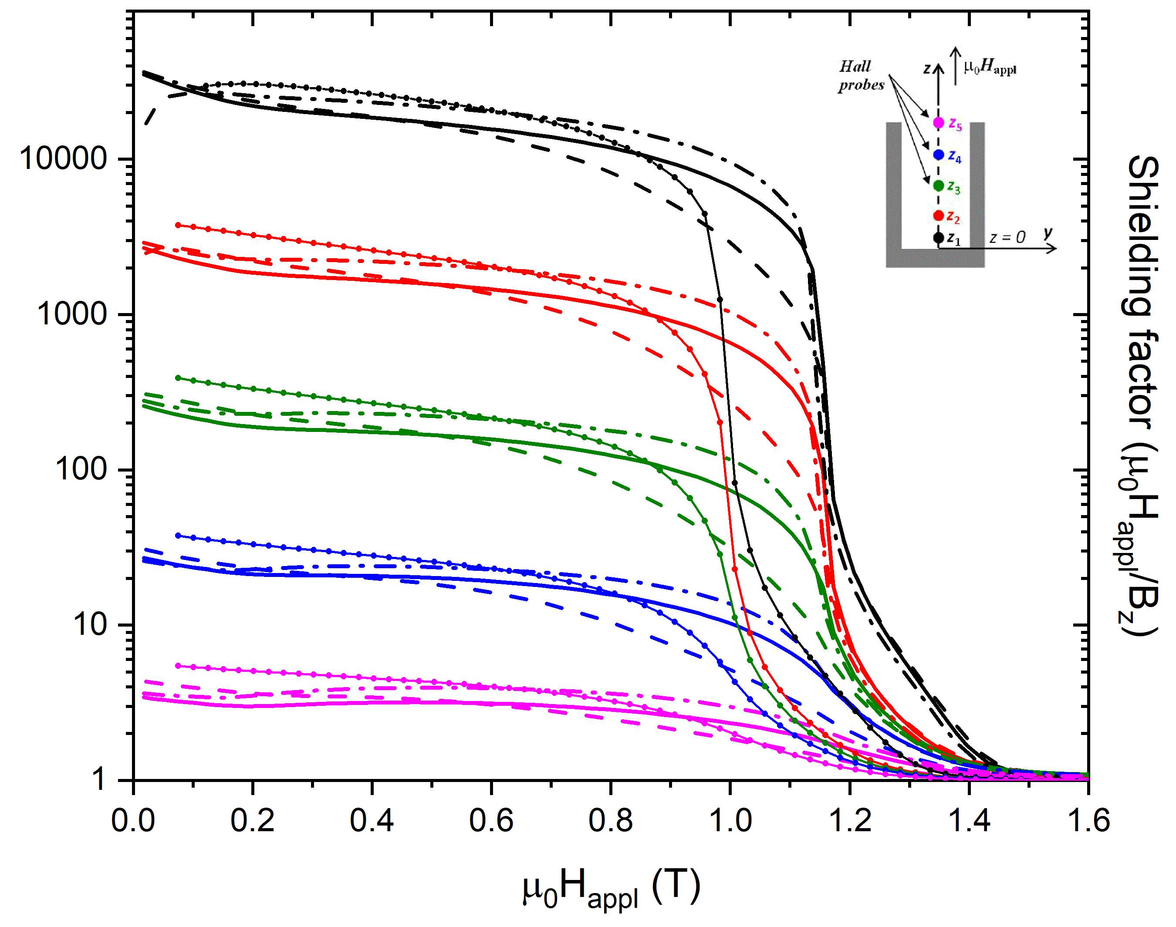
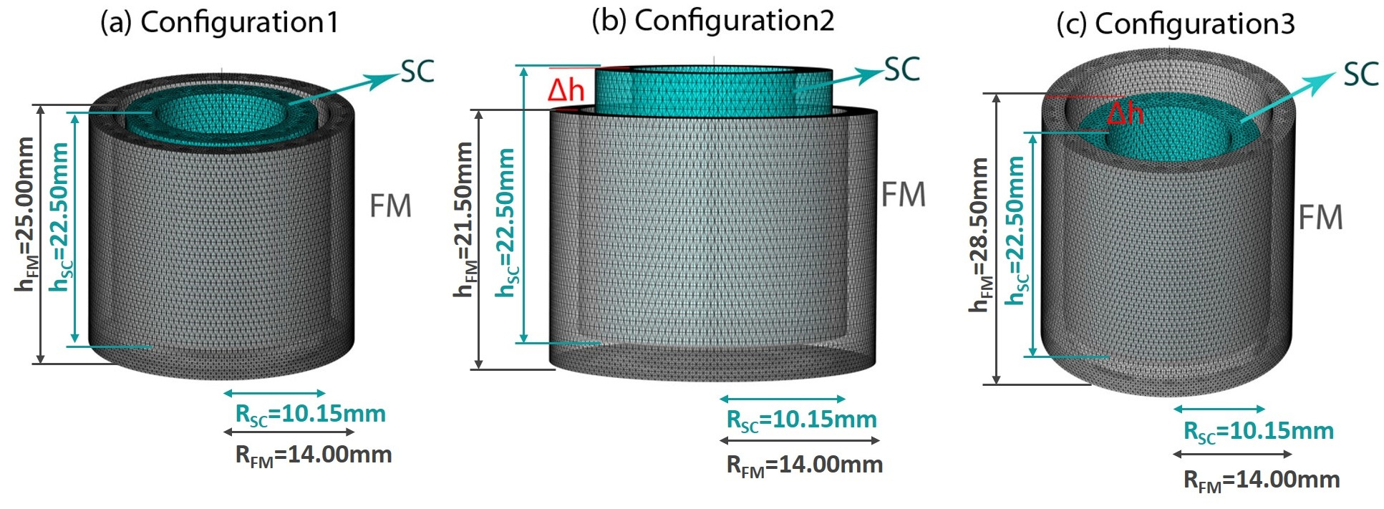
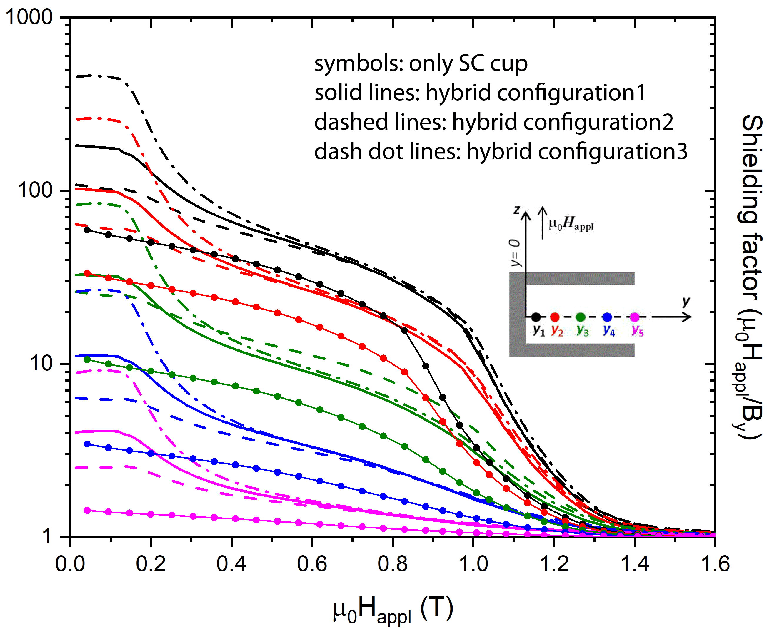
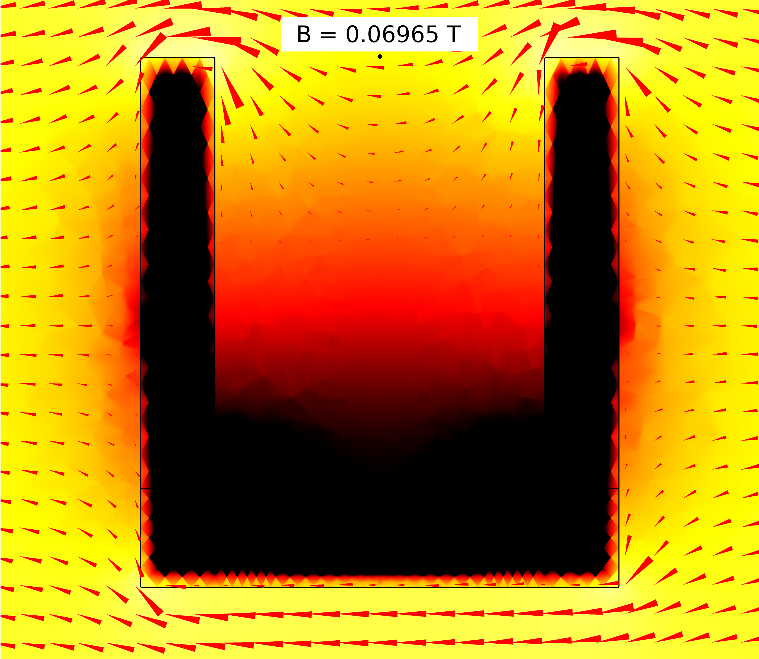
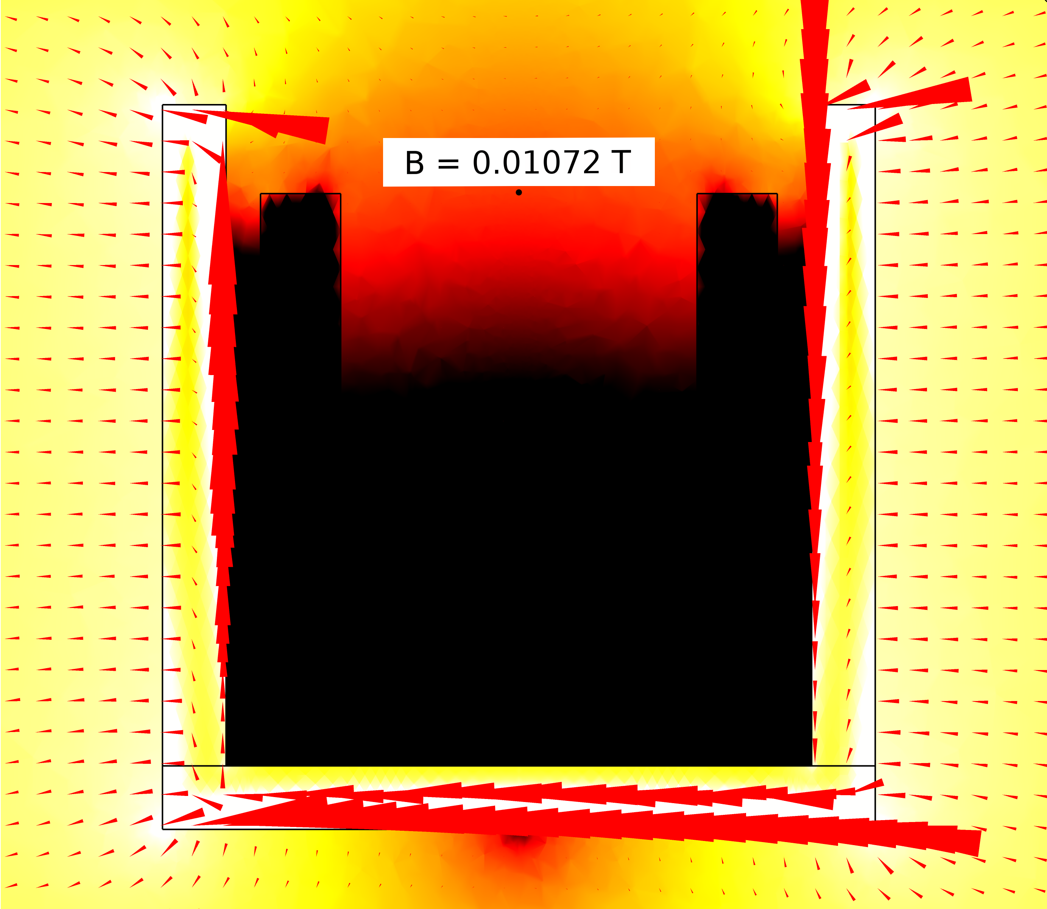
Superconductive and hybrid shielding design: a 3D-modeling study
M. Fracasso ^{1,2}, L. Gozzelino ^{1,2}, R. Gerbaldo ^{1,2}, G. Ghigo ^{1,2}, F. Laviano ^{1,2}, A. Napolitano ^{1,2}, D. Torsello ^{1,2}
¹ Department of Applied Science and Technology, Politecnico di Torino, Italy
² I.N.F.N., Sezione di Torino, Italy
Bulk superconductors have recently found a mighty application in magnetic shielding [1] and MgB₂ has been proved to be a very promising option, allowing the fabrication of large and suitable-shaped samples [2]. For this purpose, a combination of modelling procedure and growth technique able to manufacture properly shaped products with high and homogeneous critical current density, can be a successful approach guiding the whole optimization process.
In this work, we exploit a 3D modeling procedure based on a vector potential formulation by finite element calculations with COMSOL Multiphysics® [3] to calculate the shielding properties of cup-shaped superconductors (SC) with and without the superimposition of a ferromagnetic (FM) shield. Relying on the past validation of the model [4], this numerical procedure was applied to explore new shield design with similar aspect ratio but optimized performance. The shielding efficiency of three different cup-shaped arrangements were compared both in axial-field (AF) and transverse-field (TF) configurations, studying the effect of superimposing ferromagnetic vessels of different sizes around the superconductor.
In particular, focusing on the most efficient hybrid arrangement, we investigated the effects of ferromagnetic shield addition for different angles of the applied magnetic field and compared the results with that obtained with the only SC arrangement.
Modelling
Study of different angles of H_{appl}
Finite element method (FEM) solving A-V Formulation by COMSOL Multiphysics® [5]
Ensuring the collinearity between the current density and the local electric field [6] and considering an isotropic J_{c} the current density is related to the electric field, and, therefore to the time derivative of A by
$$\vec{J}=\frac{J_{c}}{\left|E\right|}\left(\left|E_{x}\right|tanh\left(\frac{E_{x}}{E_{0}}\right)\hat{i}+\left|E_{y}\right|tanh\left(\frac{E_{y}}{E_{0}}\right)\hat{j}+\left|E_{z}\right|tanh\left(\frac{E_{z}}{E_{0}}\right)\hat{k}\right)$$
The J_{c} behaviour was modelled by
$$J_{c}\left(B\right)=J_{c,0}exp\left[−{\left(\frac{B}{B_{0}}\right)}^{γ}\right]$$
where J_{c,0} = 5,02*10⁸ A/m², B₀ = 0,98 T and $γ$= 3,78 are the constant parameters obtained fitting the experimental curves at T = 30 K [7].
Ferromagnetic shield made out of Fe ARMCO and modelled starting from its experimental BH curve.
The shielding performances of only SC cup and hybrid configuration3 (i.e. the hybrid configuration were the best performance are expected) are investigated for different angles of the applied magnetic field, namely 15°, 30°, 45° and 60° with respect to the cup axis. We focused on low applied field, where the use of a hybrid configuration could be dubious.
Superconducting shield modelling
z₁ = 1 mm
z₂ = 5 mm
z₃ = 9.2 mm
z₄ = 13.7 mm
z₅ = 18.3 mm
Ferromagnetic shield modelling
The addition of FM cup can improve the shield efficiency of the only SC arrangement, reaching SF_{hybrid} values up to 8 times greater than SF_{supercond} , for each H_{app} angles. In particular:
for the inner probes z₁ and z₂ a constant gain is reached by using the FM addition
for the outer probes z₃, z₄, and z₅ improvements are obtained with increasing angles of magnetic applied field
Effect of different arrangements
The model validation is presented in [4] and it allows to implement the computational procedure in order to explore new hybrid (SC+FM) configurations. Based on previous study outcomes [8], [9], the performances of three different cup-shaped arrangements were investigated in both AF and TF configurations.
SC
Hybrid Configuration3
log(SF)=log($μ_{0}H_{appl}$/|B|) (surfaces) and the magnetic flux flow (arrows) plotted at 0.1 T for H_{app} at 60°
Conclusion
References
AF configuration
Adding FM sheet enlarges the high-shielding region up to a field of ≈ 1.2 T, even though at lower fields higher values of SF can not be gained.
TF configuration
Low transverse field: best performance → from SF ≈ 50 with only SC to SF=450 using Configuration3
New and efficient geometries can be investigated by 3D modelling
AF configuration for only MgB₂ cup
In the inner half of the shield: T = 30K SF > 10² up to μ₀H_{appl} ≈ 1.0 T
Near the closed extremity: T = 30K SF > 10⁴ up to μ₀H_{appl} ≈ 1.0 T
Ferromagnetic shield addition
⇨ allows the persistence of a great-SF region up to a field of ≈ 1.2 T but decreases the SF at low field
TF configuration for only MgB₂ cup
In the inner half of the shield: T = 30K SF > 7 up to μ₀H_{appl} ≈ 0.4 T
Near the closed extremity: T = 30K SF > 40 up to μ₀H_{appl} ≈ 0.4 T
Ferromagnetic shield addition
⇨ allows the persistence of a great-SF region up to a field of ≈ 1T
⇨ low field: improved performance →from SF=40 to SF=120 (configuration2) and to SF=450 (configuration3)
H_{app} angles between 0° and 90°
The addition of the FM shield always improves the performance of the structure
Near the closed extremity of the shield the enhancement is almost independent from the angle, whereas it increases with the angle near the open extremity
[1] K.Hogan et al., Supercond. Sci. Technol. 31, 015001 (2018)
[2] D.Barna et al., IEEE Trans. Appl. Supercond., 29, 4101310 (2019)
[3] COMSOL Multiphysics®5.4 software (http://www.comsol.com)
[4] L. Gozzelino et al., Digest HTS2020 (sciencesconf.org:htsmod2020:316157), Superconducting and hybrid magnetic shields: comparison between 3D modeling and experiment, oral presentation at HTS2021.
[5] M. Solovyov et al., Supercond. Sci. Technol., 32, 115001, (2019)
[6] F. Gomory et al., Supercond. Sci. Technol., 22, 034017, (2009)
[7] L. Gozzelino et al., Supercond. Sci. Technol., 33, 044018, (2020)
[8] L. Gozzelino et al., Supercond. Sci. Technol., 29, 034004, (2016)
[9] G. P. Lousberg et al., IEEE Trans. Appl. Supercond., 20, 33-41, (2010)
Aknowledgements
We wish to thank Fedor Gomory and Mykola Solovyov for their help in the 3D modelling approach.
SC
Hybrid Configuration3
log(SF)=log($μ_{0}H_{appl}$/|B|) (surfaces) and the magnetic flux flow (arrows) plotted at 0.1 T for TF configuration

