Slide 1


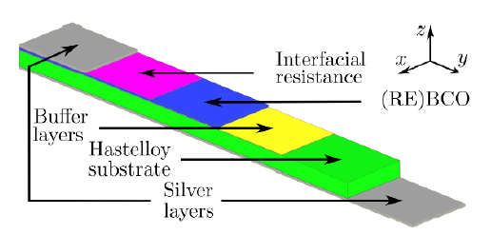
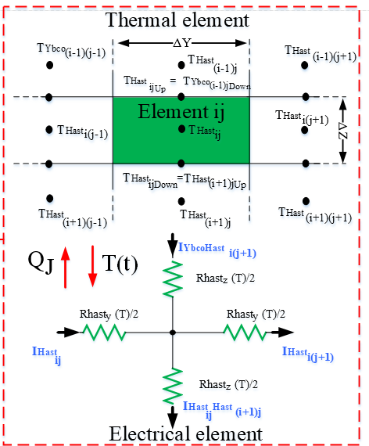
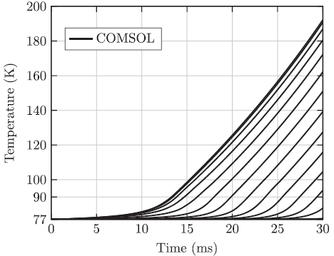
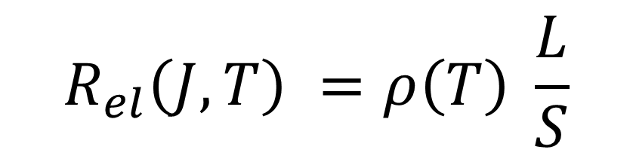
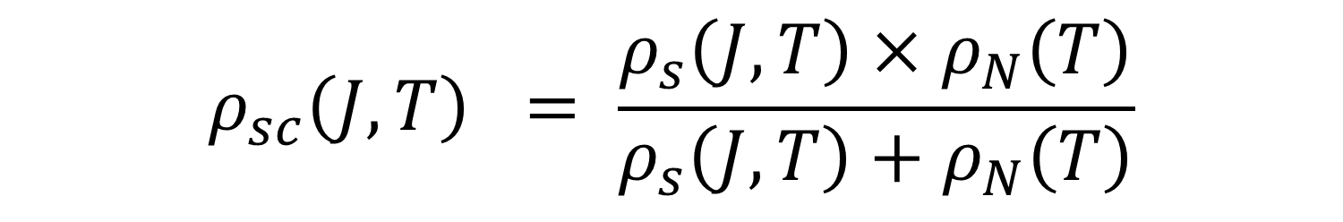
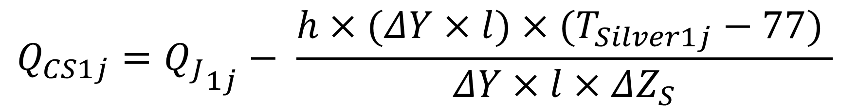
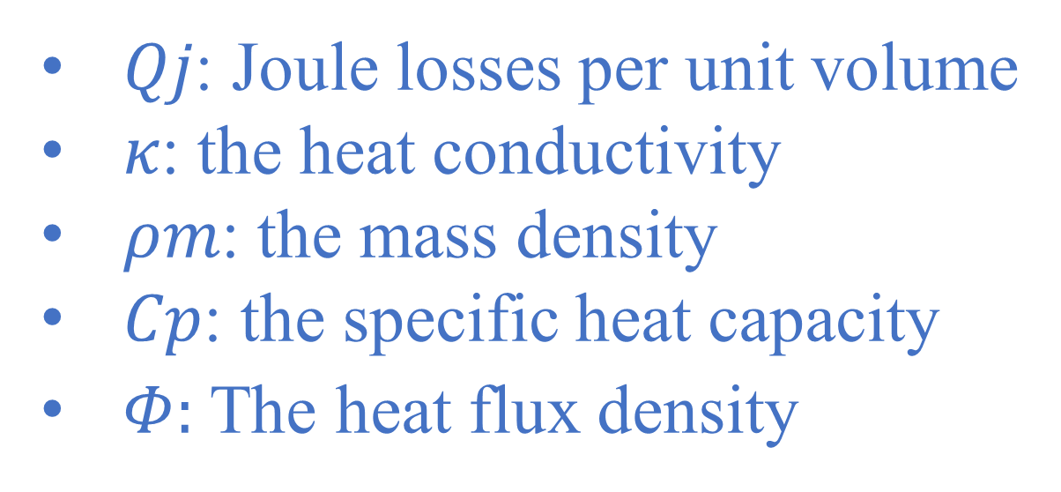
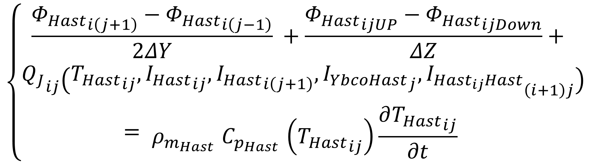
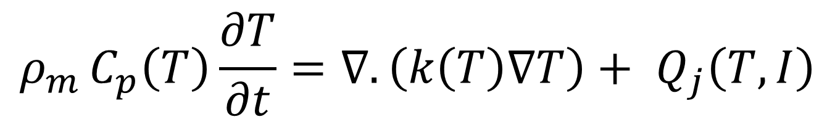
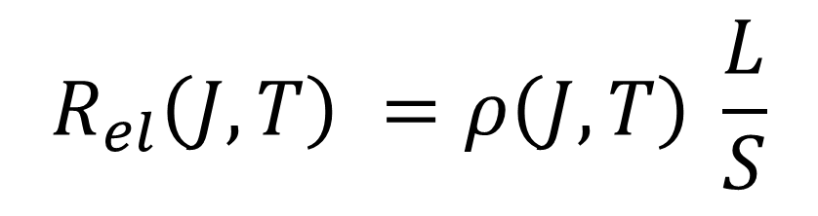
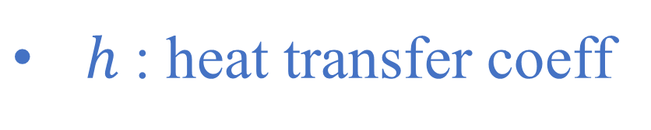
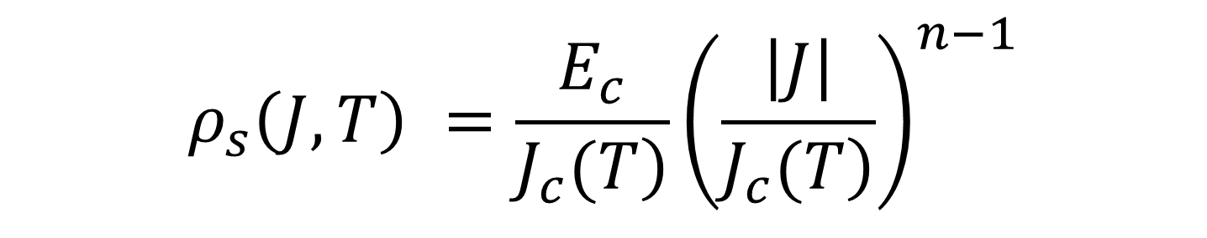
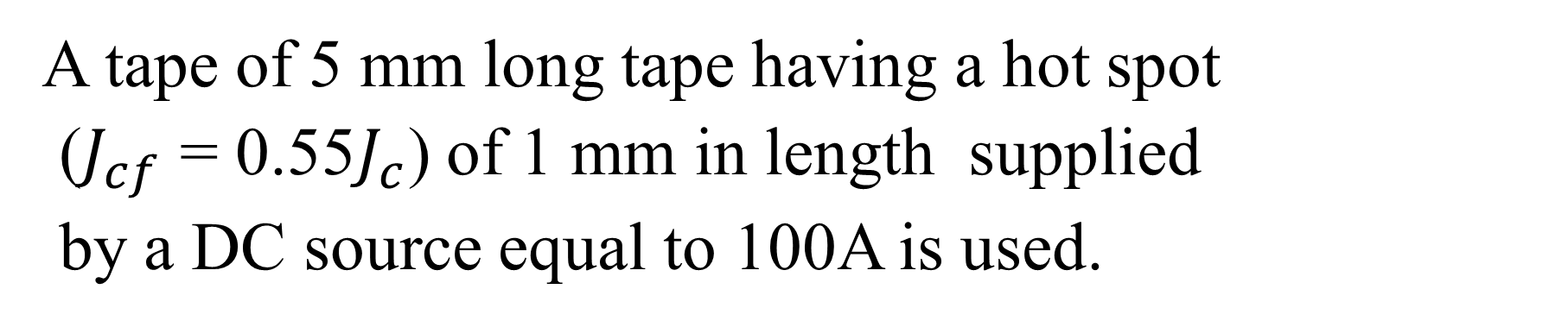
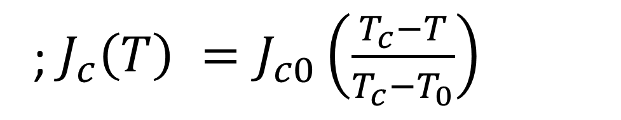
Modelling and simulation of resistive type superconducting fault current limiter using OpenModelica.
A. DJAOUTI G. DIDIER D. NETTER and C. BONNARD
Université de lorraine, GREEN, 54500 Vandoevre-Lès-Nancy, France
abderrahmane.djaouti@univ-lorraine.fr
1. Abstract
In order to introduce high-temperature superconducting fault current limiters (SFCL) into electrical networks, a model is needed to predict the various phenomena that appear within the limiter. This paper presents a model of a resistive type superconducting fault current limiter developed in OpenModelica software. The finite difference method is used to solve the heat equation. The model considers the electrical and thermal phenomena in the thickness and the length of the HTS tape, which allows to study the presence of hot spots phenomenon. The obtained results are compared with finite element analysis.
2. Electrical Model
3. Thermal Model
The resistance of each silver and Hastelloy discretization element:
General heat equation:
𝑄𝑗: Joule losses per unit volume
𝜅: the heat conductivity
𝜌𝑚: the mass density
𝐶𝑝: the specific heat capacity
$Φ:$The heat flux density
$$\begin{aligned}&R_{el}\left(J,T\right) =ρ\left(T\right) \frac{L}{S}\#\end{aligned}$$
$$\begin{aligned}&ρ_{m }C_{p}\left(T\right)\frac{∂T}{∂t}=∇.\left(k\left(T\right)∇T\right)+ Q_{j}\left(T,I\right)\#\end{aligned}$$
The resistance of each (RE)BCO discretization element:
Finite difference discretized form:
$$\begin{aligned}&R_{el}\left(J,T\right) =ρ\left(J,T\right) \frac{L}{S}\#\end{aligned}$$
$$\left\{\begin{aligned}\frac{{Φ_{Hast}}_{i\left(j+1\right)}−{Φ_{Hast}}_{i\left(j−1\right)}}{2ΔY} +\frac{{Φ_{Hast}}_{ijUP}−{Φ_{Hast}}_{ijDown}}{ΔZ}+ \\ {Q_{J}}_{ij}\left({T_{Hast}}_{ij},{I_{Hast}}_{ij},{I_{Hast}}_{i\left(j+1\right)},{I_{YbcoHast}}_{j},{I_{{Hast}_{ij}Hast}}_{\left(i+1\right)j}\right) \\ = \begin{aligned}&ρ_{m_{Hast } }C_{p_{Hast }}\left({T_{Hast}}_{ij}\right)\frac{∂{T_{Hast}}_{ij}}{∂t}\# \#\end{aligned} \end{aligned}\right.$$
Power law:
$$\begin{aligned}&ρ_{s}\left(J,T\right) =\frac{E_{c}}{\left.J_{c}(T\right)}{\left(\frac{\left|J\right|}{\left.J_{c}(T\right)}\right)}^{n−1}\#\end{aligned}$$
; $\begin{aligned}J_{c}\left(T\right) =J_{c0}\left(\frac{T_{c}−T}{T_{c}−T_{0}}\right)\#\end{aligned}$
$\text{(}\text{RE}\text{)}\text{BCO} \text{normal}\text{−}\text{state} \text{resistivity}\text{:}$
Conservation of the flux density between layers.
$$\begin{aligned}&ρ_{N}\left(T\right) = ρ_{TC}+α(T−T_{c})\#\end{aligned}$$
For the boundary conditions, the Neumann condition is applied.
The final resistivity of the (RE)BCO:
The cooling:
$$\begin{aligned}&ρ_{sc}\left(J,T\right) = \frac{ρ_{s}\left(J,T\right)×ρ_{N}\left(T\right)}{ρ_{s}\left(J,T\right)+ρ_{N}\left(T\right)}\#\end{aligned}$$
$$Q_{CS1j}={Q_{J}}_{1j}− \frac{h×(ΔY×l)×(T_{Silver1j}−77) }{ΔY×l×ΔZ_{S}}$$
Apply Kirchhoff's laws
$h$: heat transfer coeff
Hot spot study in the tape length:
Results and Comparisons
Conclusions & Perspectives
This paper presents a multi-scale model of a rSFCL that takes into account electrical and thermal phenomena in the length and thickness of the tape (2D model).
The model is configurable and allows to simulate physical phenomena in 1D and 2D including the presence of thin layers (interfacial effects). The 3D model can be obtained by discretizing and considering a heat diffusion according to the width.
The open-source OpenModelica software offers the advantage that it is compatible with the FMI (Functional Mock-up Interface) standard for co-simulation and model exchange.
the simplicity of the finite difference method allows to reduce the calculation time of the simulation.
A tape of 5 mm long tape having a hot spot
($J_{cf}$ = 0.55$J_{c}$) of 1 mm in length supplied
by a DC source equal to 100A is used.
OpenModelica
The solver (DASSL) integrated in OpenModelica has been used to solve the non-linear coupled equations
with a large number of variables.
Each temperature curve represents a different virtual measurement location, distributed equidistantly along
the y axis (one measurement at every 250μm)
There is excellent agreement between the models, where the curves can hardly be distinguished (<1%)
Jc0 | Ec | n | 𝜌𝑇c | α | Rinter | 𝑇c | T0 | Width | Thickness (S Top) | Thickness (S Bottom) | Thickness (RE)BCO | Thickness (Hast)
2.5 MA cm⁻² | 1 µV cm-1 | 15 | 30 µΩcm | 0.47µΩcm-1 | 40 µΩ | 90K | 77K | 4 mm | 2 µm | 2 µm | 1 µm | 50 µm

