Slide 1
2D and 3D validation of a hybrid method based on
A and H formulations for Pulsed Field Magnetization
Jakub KAPEK, Kévin BERGER, Jean LÉVÊQUE

Slide 2
Outlines
Introduction
Formulation A – H
Validation of the formulation A – H
Summary

Slide 3
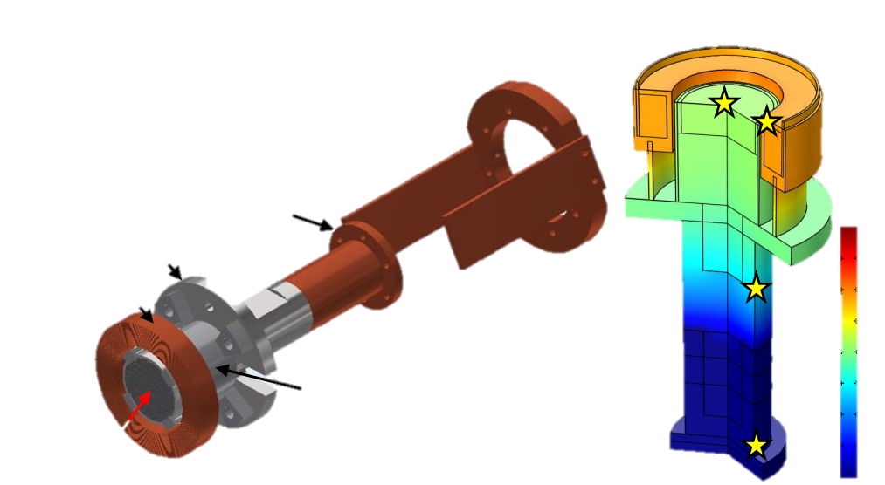
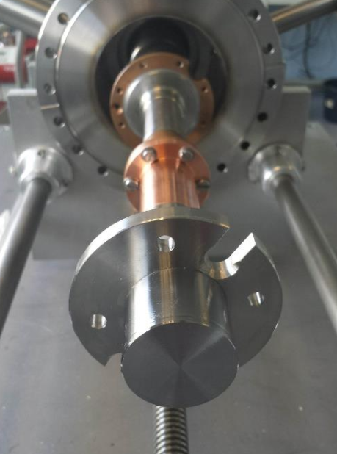

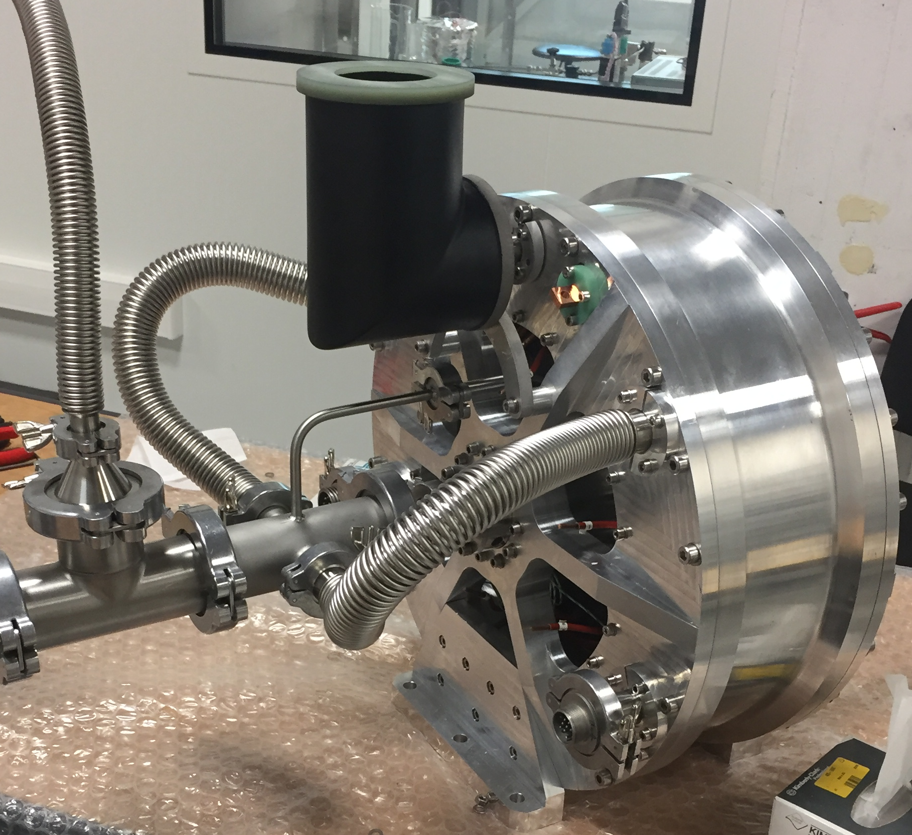
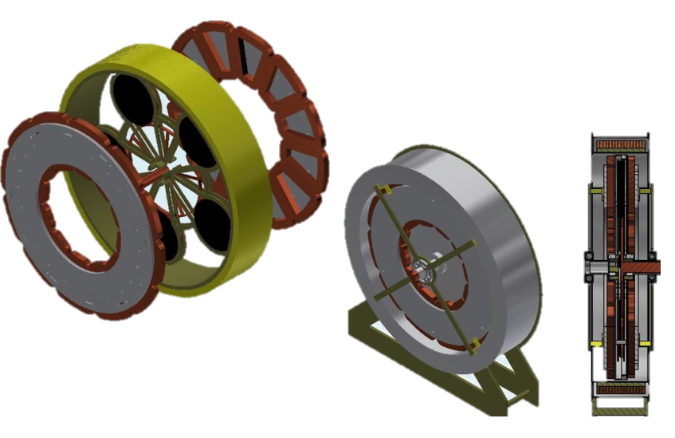
1. Introduction
Examples of projects carried out in the GREEN laboratory

Slide 4



1. Introduction
Newton's method
Newton's method
IRON
IRON
SC
SC
Formulation A
Formulation H
Formulation A
Recommended for superconductor problems
Recommended for problems with ferromagnetic materials

Slide 5
2. Formulation A – H
Formulation en A – H :
Example of a model to apply the A-H formulation.

Slide 6
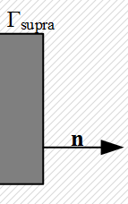
2. Formulation A – H
Interface conditions for electromagnetic fields between two different media:
A
μ_{r} = 1
ε_{r} = 1
H
Coupling :
μ_{r} = 1
μ_{r} = 1
ε_{r} = 1
ε_{r} = 1

Slide 7
3. Validation of the formulation A – H
Model 3D
Model 2D
Formulation A
Formulation H
Formulation A (PDE)
Formulation A (mf)
Formulation H (PDE)
Formulation H (mfh)
Formulation A (PDE)
Formulation A (mf)
Formulation
A(mf) – H
Formulation
A – H
Formulation H (PDE)
Formulation H (mfh)

Slide 8
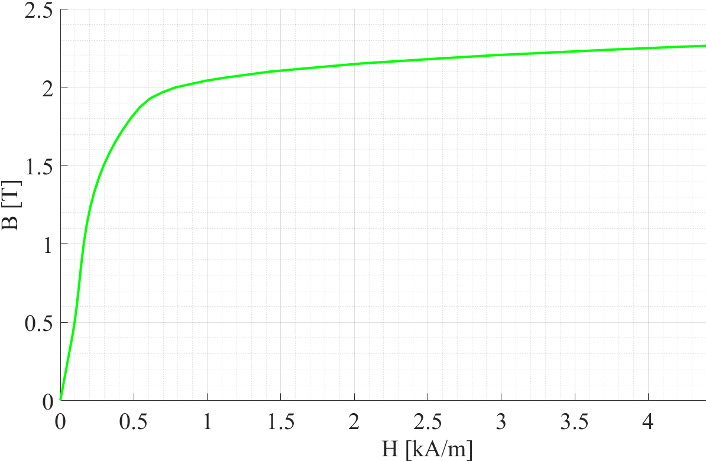
3. Validation of the formulation A – H, 2D
Symbol | Materials | Electrical parameters | Magnetic parameters
Ω_{supra} | SHT | ¹⁾ ou ²⁾
Ω_{ind} | Cuivre | ¹⁾ ou ²⁾
Ω_{fer} | Fer | ¹⁾ ou ²⁾ | ¹⁾ ou ²⁾
Ω_{A} | Air | ¹⁾ ou ²⁾
1) for the formulation in H, 2) for the formulation in A
Electrical and magnetic parameters of the materials used for the verification of the formulation A – H.
2D axisymmetric problem used to verify the A – H formulation.
8
Form of the current in the inductor.
B(H) curve shape of iron-cobalt material.

Slide 9
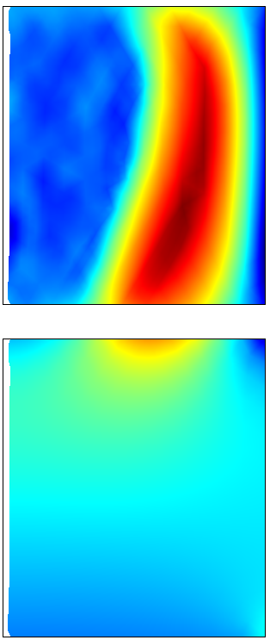
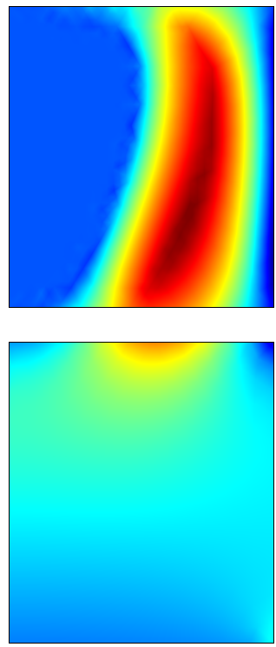
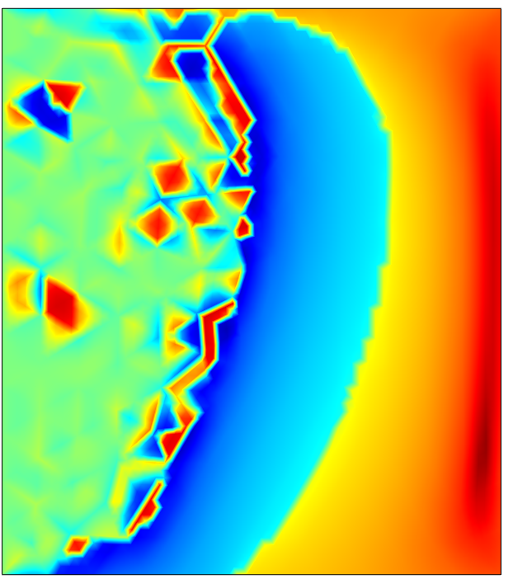
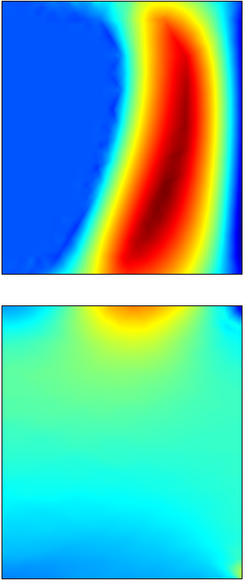
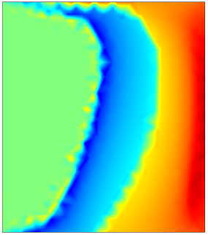

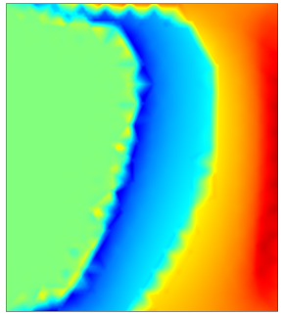
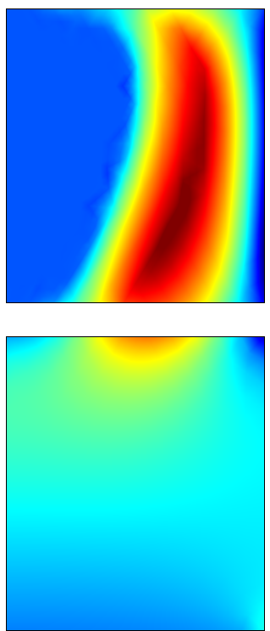
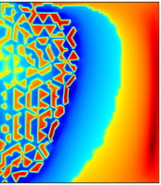
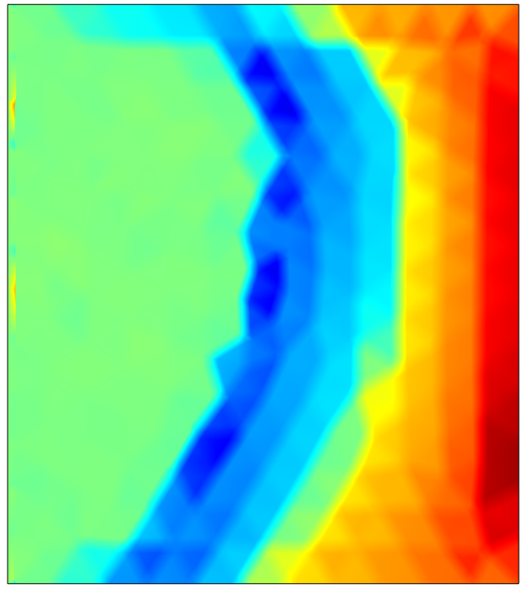
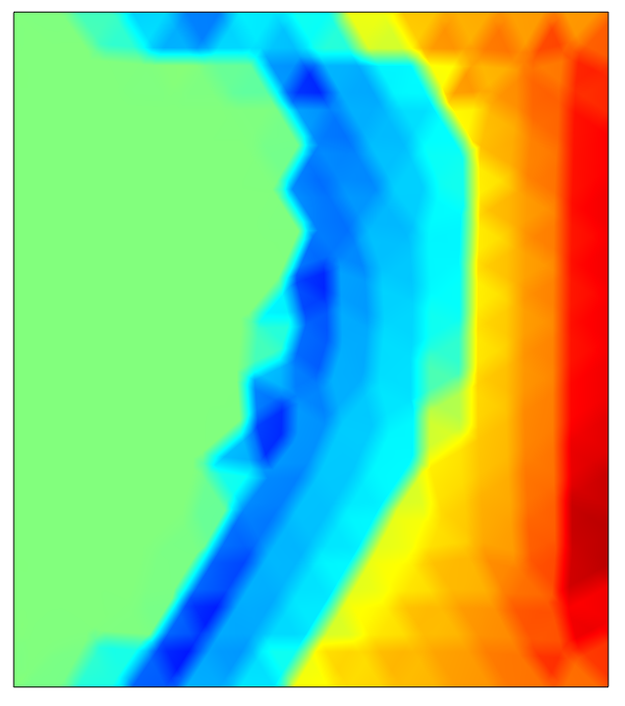
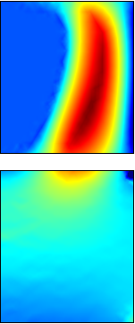
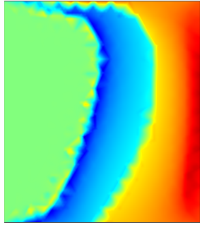
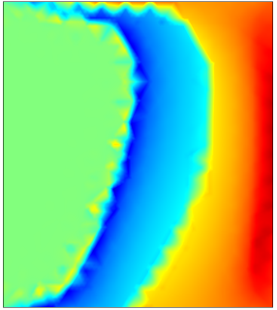
3. Validation of the formulation A – H, 2D
A – H
B_{z}
J_{φ}
A(mf)–H
B_{z}
J_{φ}
SHT
J_{φ} = σd_{t}A
Fer
A
B_{z}
J_{φ} = σd_{t}A
A(mf)
B_{z}
J_{φ} = σd_{t}A
J_{φ} = ∇×H
J_{φ} = ∇×H
H
B_{z}
H(mfh)
J_{φ}
J_{φ} = ∇×H
J_{φ}
B_{z}

Slide 10
3. Validation of the formulation A – H, 2D
Comparison of computation time and number of degrees of freedom for a 2D axisymmetric problem.
Formulation | Calculation time | Number of degrees of freedom (DDL)
Formulation A – H | 3 min 7 s | 5 244
Formulation A(mf) – H | 3 min 0 s | 5 244
Formulation A | 28 s | 4 150
Formulation A(mf) | 21 s | 4 150
Formulation H | 9 min 49 s | 10 242
Formulation H(mfh) | 12 min 14 s | 10 242

Slide 11
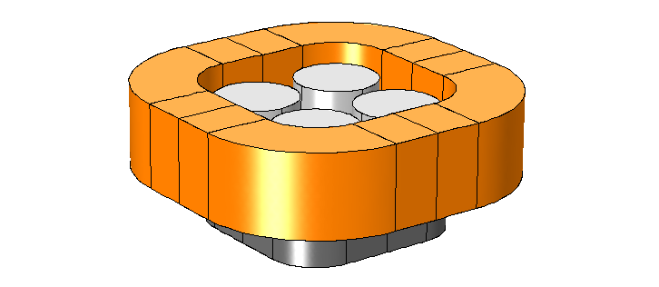
3. Validation of the formulation A – H, 3D
3D model for magnetization of superconductors
The s-plane cuts both the superconductor and the iron.

Slide 12
3. Validation of the formulation A – H, 3D
A – H |  | A(mf) – H
B₁, t = 2 ms
B₂, t = 100 ms
B₁, t = 2 ms
B₂, t = 100 ms
A | A(mf)
B₁, t = 2 ms
B₂, t = 100 ms
Not solved
Not solved
H | H(mfh)
B₁, t = 2 ms
B₂, t = 100 ms
B₁, t = 2 ms
B₂, t = 100 ms

Slide 13
3. Validation of the formulation A – H, 3D
A – H |  | A(mf) – H
J₁, t = 2 ms
J₂, t = 100 ms
J₁, t = 2 ms
J₂, t = 100 ms
J_{φ} = σd_{t}A
A | A(mf)
J₁, t = 2 ms
J₂, t = 100 ms
J_{φ} = σd_{t}A
Not solved
Not solved
J_{φ} = ∇×H
H | H(mfh)
J₁, t = 2 ms
J₂, t = 100 ms
J₁, t = 2 ms
J₂, t = 100 ms
J_{φ} = ∇×H

Slide 14
3. Validation of the formulation A – H, 3D
Comparison of the computation time and the number of degrees of freedom for a 3D problem.
Formulation | Calculation time | Number of degrees of freedom (DDL)
Formulation A – H | 7 h 20 min 42 sec | 141 132
Formulation A(mf) – H | 1 j 0 h 8 min 44 sec | 199 704
Formulation A | 1 j 9 h 27 min 29 sec | 126 447
Formulation A(mf) | Not solved | 196 264
Formulation H | 4 h 7 min 25 sec | 196 264
Formulation H(mfh) | 5 h 22 min 28 sec | 196 264

Slide 15
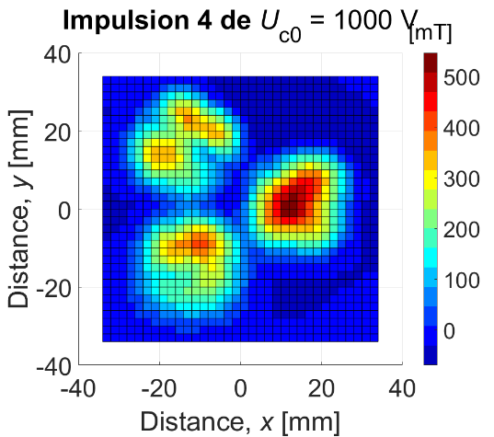
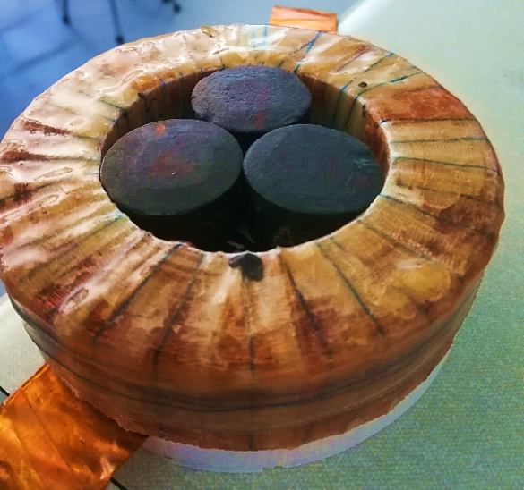
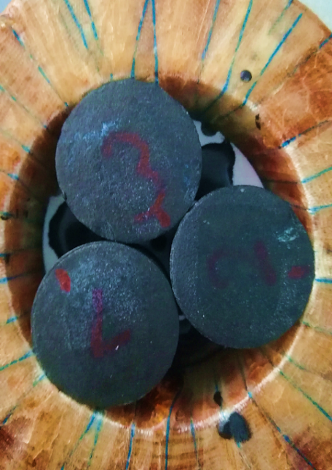
6. Summary
The A – H formulation in 2D and 3D has been presented
Good convergence with superconductors
Potential use in modeling magnetization problems or superconducting electric motors
The A – H formulation was combined with a thermal model and used to simulate the magnetization process of 3 HTS

Slide 16
Thank you for your attention

