Slide 1
Thermal-hydraulic models for HTS power-transmission cables: status and needs
S. Viarengo, D. Placido, L. Savoldi

Slide 2
Outline
HTS cables for power transmissions:
Use and design
Materials
Models:
1D (+1D)
2D
3D
Model needs
Conclusions

Slide 3
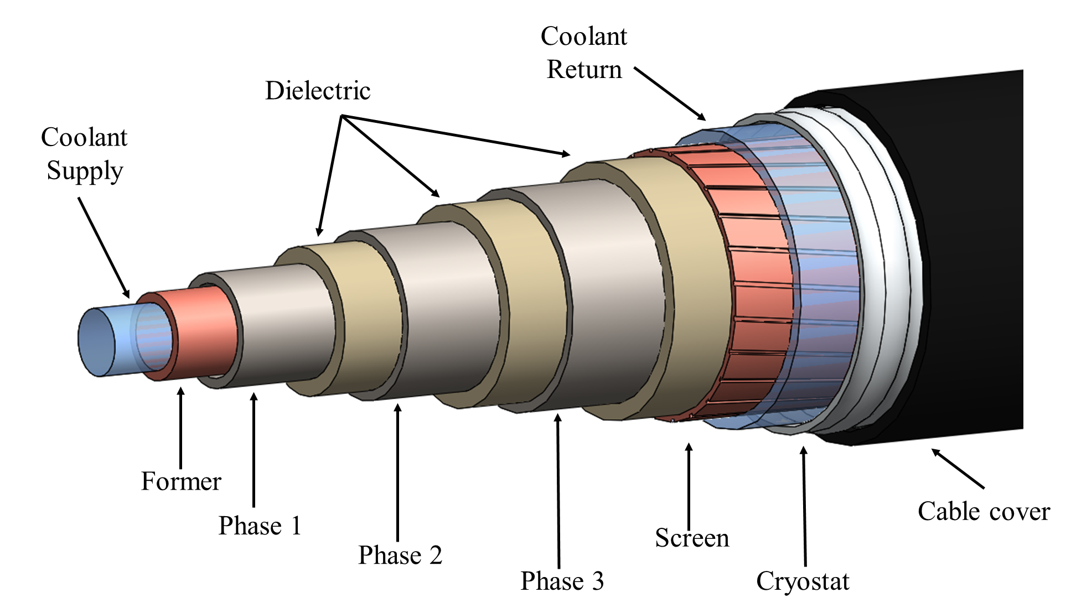
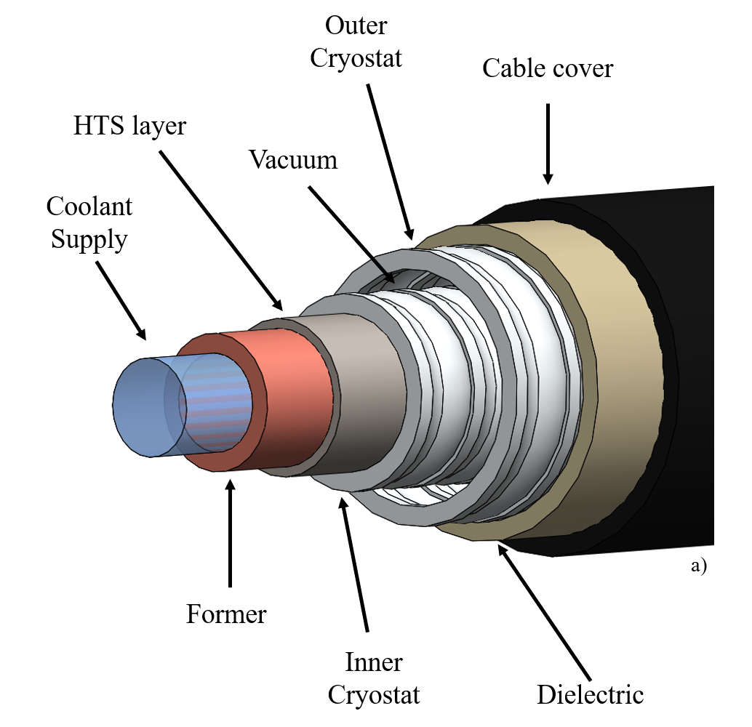
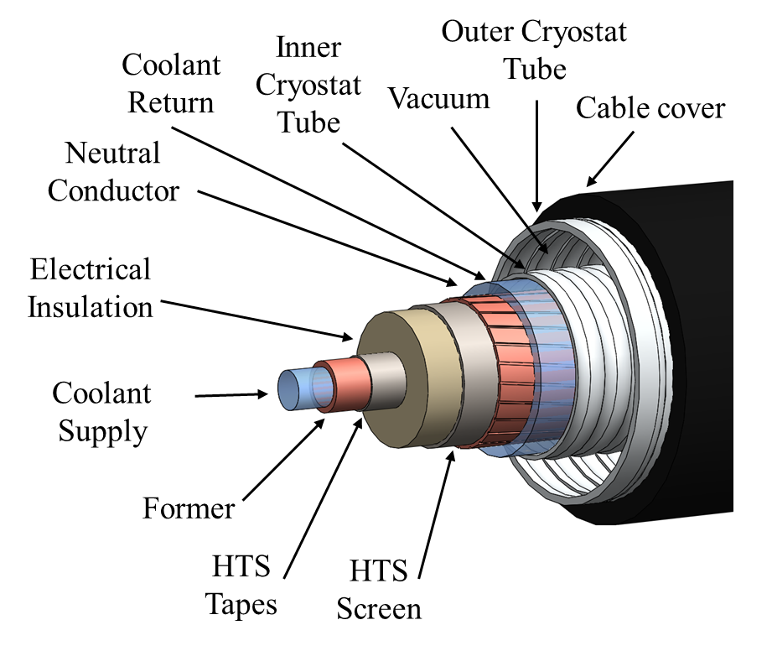
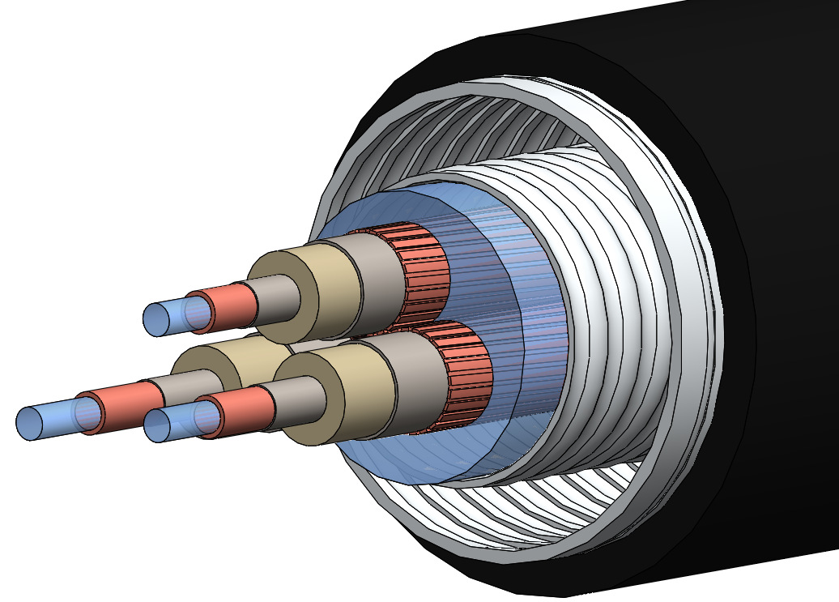
HTS cables for power transmission
SC transmission lines (SCTL):
High power AC transmission or distribution lines: TRL = 7 ^{(*)}
DC lines: TRL = 5 ^{(*)}
SC transmission cables (SCTC):
Shipboard and aircraft applications (DC cables)
(*) H. Thomas, Renew. Sust. Energ. Rev., 2016

Slide 4
Aim of this work
Technical feasibility already demonstrated, but no long SCTL are currently in operation
Substantial cost reduction + improvement of the system safety and reliability needed to reach TRL 9
→ Availability of reliable numerical models for the design, optimization and performance assessment in normal and off-normal conditions?

Slide 5
Models: 1D (axial) - I
Only for the coolant:
$$\left\{\begin{aligned}\frac{{\dot{m}}_{s}}{ρ}∙\left(\frac{∂p}{∂T}−ρ\frac{∂w}{∂T}\right)∙\frac{dT}{dx}+\frac{{\dot{m}}_{s}}{ρ}∙\left(\frac{∂p}{∂ρ}−ρ\frac{∂w}{∂ρ}\right)∙\frac{dρ}{dx}+{\dot{Q}}_{GEN_{int}}+{\dot{Q}}_{HS_{ext}}=0 \\ −\frac{{\dot{m}}_{s}}{ρ}∙\frac{∂p}{∂T}∙\frac{dT}{dx}+\frac{{\dot{m}}_{s}}{ρ}∙\left(\frac{{\dot{m}}_{s}^{2}}{ρ^{2}}−\frac{∂p}{∂ρ}\right)∙\frac{dρ}{dx}−{\dot{m}}_{s}∙g∙\sin{θ}−\frac{{\dot{m}}_{s}}{ρ}∙\frac{P_{fl}}{A_{fl}}τ_{fl}=0 \end{aligned}\right.$$
x
$$\dot{m}c_{p}\frac{dT_{sup/rf}}{dx}= ±\dot{q}\left(x\right)+\frac{{\dot{q}}_{el}}{2}+{\dot{q}}_{0}$$
[S. Fuchino et al., IEEE TAS 2002]
$${\dot{m}}_{s}=ρ∙v$$
[G. Angeli et al., IEEE TAS 2017]

Slide 6
Models: 1D (axial) - II
r
x
For the coolant and the solids:
$\left\{\begin{aligned}&\frac{∂w}{∂t}+v\frac{∂w}{∂x}=\frac{1}{V_{fld}ρ_{fld}}\dot{Q} \\ &ρc\frac{∂T_{i}}{∂t}=k\frac{∂^{2}T_{i}}{∂x^{2}}+{\dot{Q}}_{in}−{\dot{Q}}_{out} \\ &\frac{dp}{dx}= −\frac{2fρ_{fld}v^{2}}{d_{e}}\end{aligned}\right.$
Sinda/fluint network model
[M. Furuse et al., IEEE TAS 2011]
[Y. Sato et al., IEEE TAS 2015]
[T. Yasui et al., IEEE TAS 2017]
[W. Choi et al., Energies 2020]
Simulink model, including transient coupled conduction equations for solids, and conservation laws for fluids along each pipe segment, including 2-phase and compressibility effects:
${\left(\frac{∂ρ_{i}}{∂p_{i}}\right)}_{u_{i}}\frac{dp_{i}}{dt}+{\left(\frac{∂ρ_{i}}{∂e_{i}}\right)}_{p_{i}}\frac{du_{i}}{dt}+ρ_{f}\frac{dχ_{f}}{dt}+ρ_{fg}\frac{dχ_{fg}}{dt}+ρ_{g}\frac{dχ_{g}}{dt}$ $=\frac{{\dot{m}}_{i,in}−{\dot{m}}_{i,out}}{V_{i}}$
[S. Yang et al., IEEE TAS 2021]

Slide 7
Models: 1D (radial) and 1D + 1D (radial + axial)
$$\frac{1}{α}\frac{∂T}{∂t}=\frac{∂^{2}T}{∂r^{2}}+\frac{1}{r}\frac{∂T}{∂r}+\frac{\dot{Q}}{k}$$
[Z. Zhou et al., IEEE TAS 2013]
[G. Del-Rosario-Calaf et al., IEEE TAS 2013]
$$\frac{d^{2}T_{η}}{dr_{η}^{2}}+\frac{1}{r_{η}}\frac{dT_{η}}{dr_{η}}+\frac{{\dot{Q}}_{η}}{k_{η}}=0$$
[WTB De Sousa et al., IEEE TAS 2018]
ALSO COUPLED TO
$$\frac{dT_{sl/rl}}{dx}=±\frac{h_{sl/rl}∙π∙\tilde{d}∙\left(T_{w_{sl/rl},z}−T_{sl/rl}\right)}{\dot{m}∙\overline{c_{p}}}−\frac{{\dot{q}}_{ext}}{\dot{m}∙\overline{c_{p}}}$$
[E. Shabagin et al., Cryogenics, 2017]
[D. Kottonau et al., IEEE TAS 2019]
[WTB De Sousa et al., IEEE TAS 2019]
$+$ supply line
$−$ return line
return line only
OR TO
Single phase, compressible 1D
Mass // momentum // energy conservation laws along the axis
[N. Hu et al., Physica C, 2011]

Slide 8
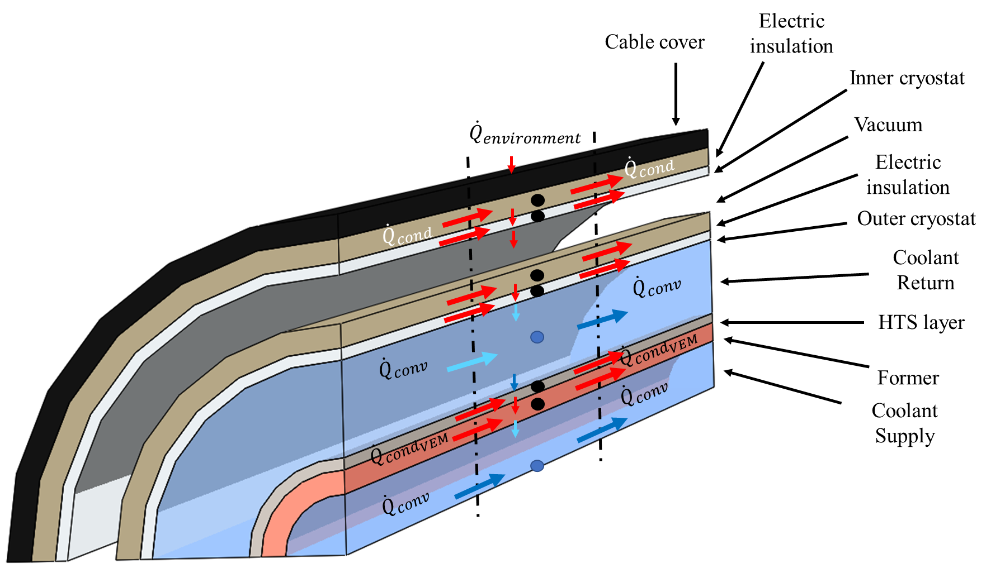
Models: 2D (Discrete)
Volume Element Model (VEM):
Dimensional:
$$\left\{\begin{aligned}&M_{He}c_{v,He}\frac{dT_{j}^{i}}{dt}= {Q^{i}}_{j−k}+{\dot{m}}_{He}c_{p,He}\left(T_{j}^{i−1}−T_{j}^{i}\right) \\ &M_{solid}c_{v,solid}\frac{dT_{k}^{i}}{dt}= {Q^{i}}_{j−k}+Q_{GEN,SC}+Q_{cond,in}^{i}−Q_{cond,out}^{i}\end{aligned}\right.$$
Dimensionless:
$$\left\{\begin{aligned}\frac{dτ_{j}^{i}}{d\tilde{t}}=\left[−{\tilde{Q}}_{j−k}^{i}+ψ_{j}\left(τ_{j}^{i−1}−τ_{j}^{i}\right)−{\tilde{W}}_{fr,j}^{i}\right]\frac{1}{{\tilde{M}}_{j}^{i}\tilde{{c_{v}}_{j}}} \\ \frac{dτ_{k}^{i}}{d\tilde{t}}=\left[{\tilde{Q}}_{j−k}^{i}+{\tilde{Q}}_{GEN,SC}^{i}{+\tilde{Q}}_{cond,in}^{i}−{\tilde{Q}}_{cond,out}^{i}\right]\frac{1}{{\tilde{M}}_{k}^{i}{\tilde{c}}_{k}}\end{aligned}\right.$$
Coupled to FDTD electric analysis
[J.A. Souza et al., IEEE TAS 2011]
[J.C. Ordonez et al., IEEE TAS 2013]
[N.G. Suttel et al., IEEE TAS 2017]
[D. I. Doukas et al., IEEE TAS 2017]
[N.G. Suttel et al., Appl Therm Eng 2018]
[D. I. Doukas et al., IEEE TAS 2017]

Slide 9
Models: 2D (Continuum)
2D FEM models of the SC lines
2D FD
Coupled to global pressure drop in an open-source code
[N.G. Suttel et al., IEEE TAS 2017]
[S.J. Lee et al., Energies 2019]
Fully 2D model for solid components
$$\frac{ρc}{k}\frac{∂T}{∂t}=\frac{∂^{2}T}{∂r^{2}}+\frac{1}{r}\frac{∂T}{∂r}+\frac{∂T^{2}}{∂x^{2}}+\frac{1}{k} \dot{Q}$$
[W.T.B. De Sousa et al., IEEE TAS 2019]
$$former or Copper$$
$$ρc\frac{∂T_{sl/rl}}{∂t}±ρ{cv}_{sl/rl}\frac{∂T_{sl/rl}}{∂x}=\frac{h_{sl/rl}P_{sl/rl}\left(T_{frm/Cu}−T_{sl/rl}\right)}{A_{frm/Cu}}+\frac{{\dot{q}}_{rad}}{A_{frm/Cu}}$$
Return line only
$+$ supply line
$−$ return line
Transient 1D advection in fluids
[W.T.B. De Sousa et al., Supercond. Sci. Technol. 2021]

Slide 10
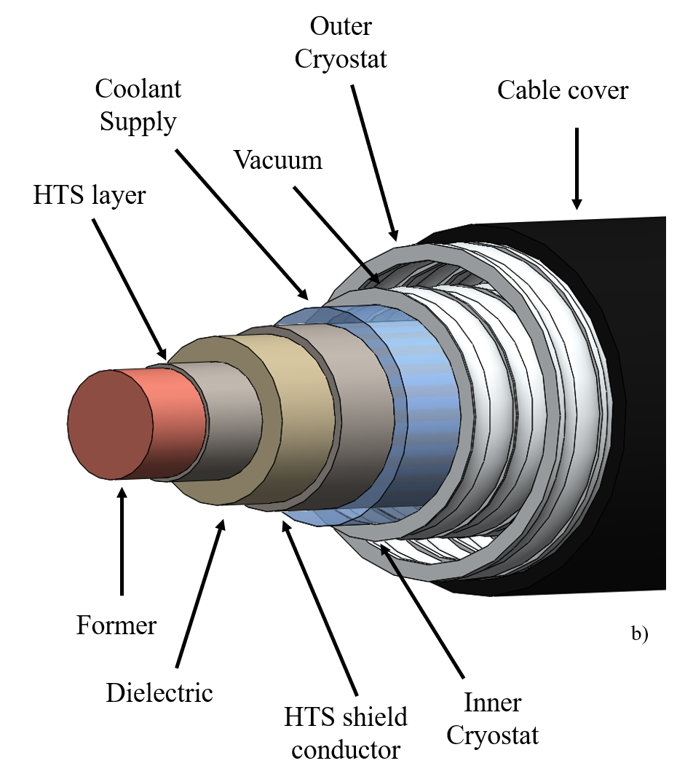
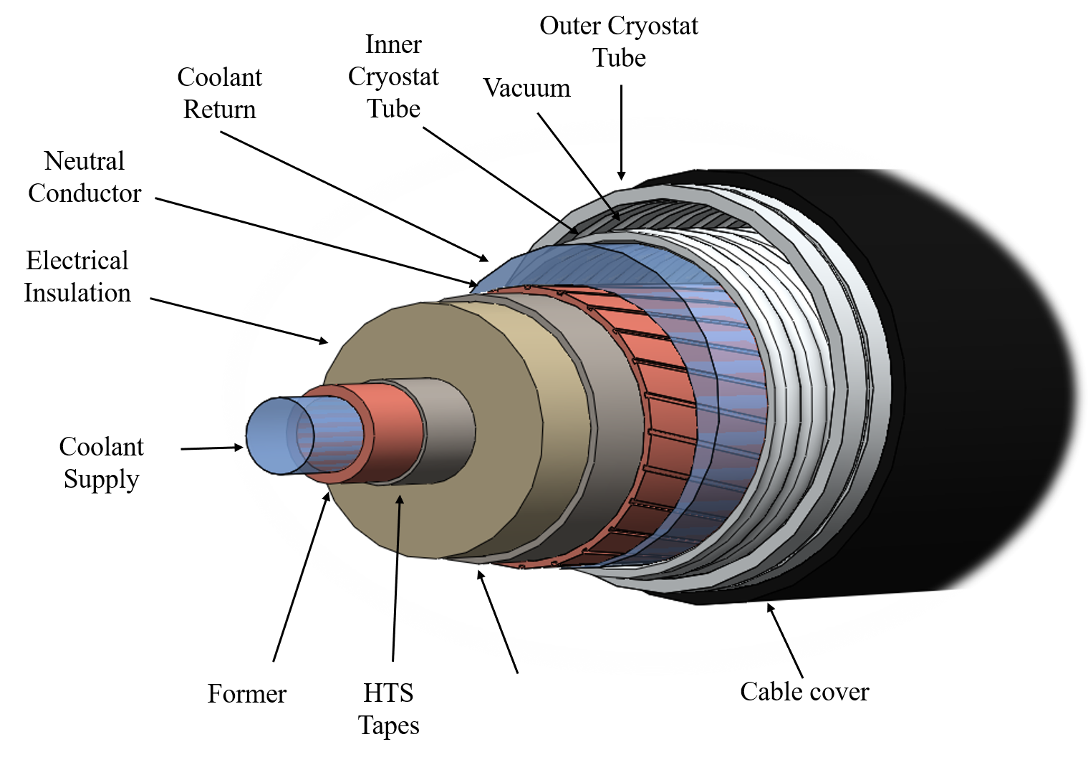
Models: 3D
3D finite element method (FEM) thermal analysis for solid core for 50 cm-long cable
[ J. He et al., IEEE TAS 2013]
3D FEM thermal-hydraulic analysis on eccentric cable
[ O. Maruyama et al., IEEE TAS 2015]

Slide 11
Needs of a general Thermal-Hydraulic model
Model features:
Transient, 1D (axial) + 1D (lumped?) radial (different layers)
Include V-I curve for SC materials + AC losses
Include parasitic heat from environment (radiation)
Flexibility to include different topological configuration
Flexibility for different coolants (→ compressible fluids, phase change)
(include auxiliaries)
Numerics:
Low computational cost to simulate long lengths
Adaptive grids to capture local quenches
Adaptive time stepping to capture different time-scales
Open-science!

Slide 12
Conclusions
Comprehensive review of the different models currently available for thermal-hydraulic analysis of HTS SCTL / SCTC has been presented
Based on the experience gained in fusion SC cables/magnets modelling, the needs of a general thermal-hydraulic model have been highlighted
Open-source should become the standard!

