Slide 1
Design and Testing of a New Cooling System using Solid Nitrogen
for Pulsed Field Magnetization and Characterization of HTS Bulks
Ghazi Hajiri¹
ghazi.hajiri@univ-lorraine.fr
Kévin Berger¹
kevin.berger@univ-lorraine.fr
Jean Lévêque¹
jean.leveque@univ-lorraine.fr
¹ Université de Lorraine, GREEN, F-54000 Nancy, France

Slide 2
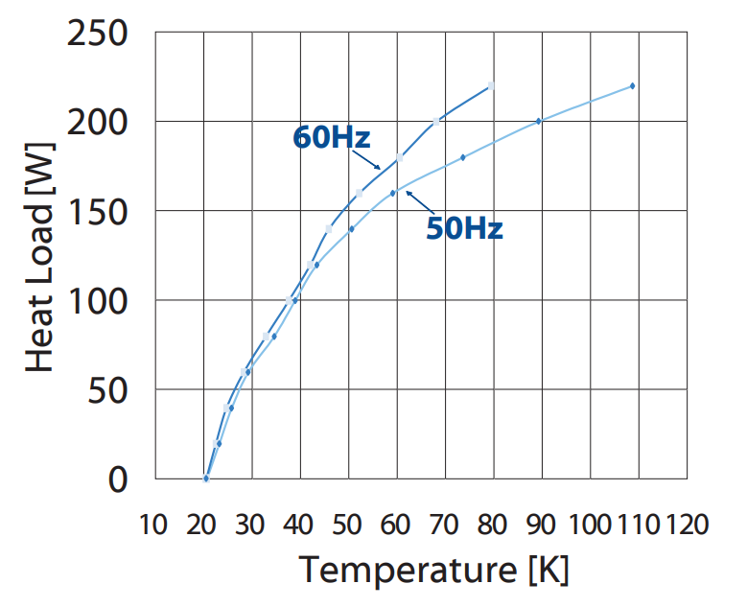
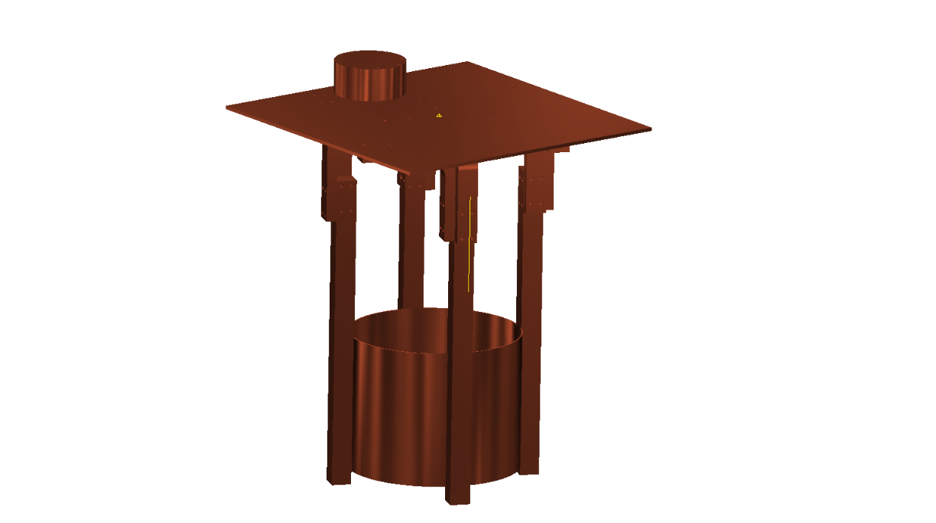

Nodal method
Cooling power
Cooling power
$$\dot{q}$$
Copper heat exchanger « CuC1 »
SN₂ bath center

Slide 3
Heat capacity formulation
The heat diffusion equation :
The thermal conductivity k :
The specific enthalpy H :
N₂
Solid region
The specific heat capacity C_{p} :
Phase change region
Liquid region
The Dirac pulse :

Slide 4
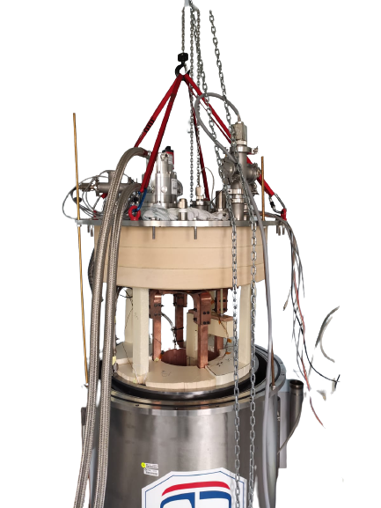
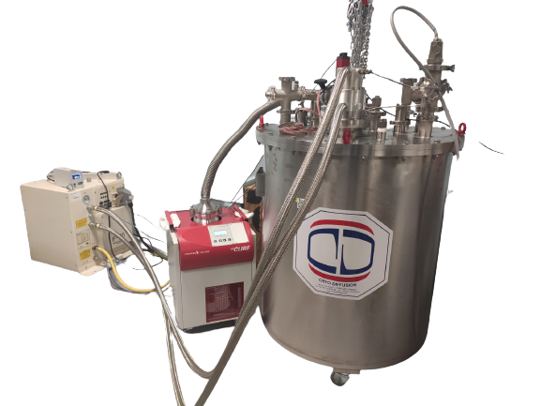
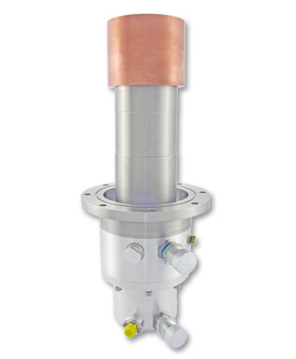
Cooling systems
Temperature sensor output
Pressure sensor
F-70 Indoor Water-Cooled Compressor
CH-110 77K Cryocooler
HiCube 300 Classic, DN 100 CF-F
Cryo Diffusion
Open cryostat view

Slide 5
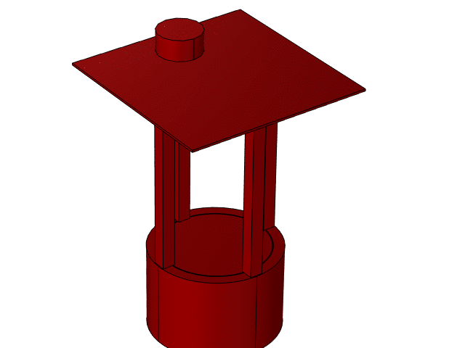

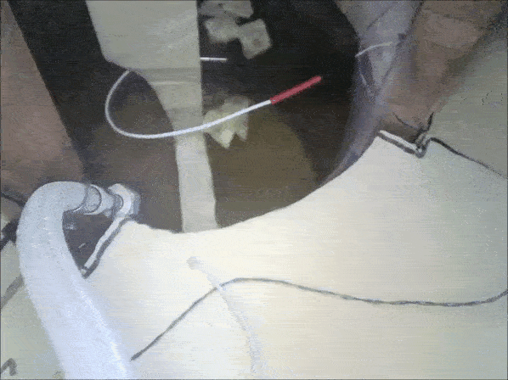
Results
Phase change at a temperature of 63.1 K and a constant pressure of 0.1253 bar.
Cooling temperatures e, 77 K to 25 K is about 45 h for 10 liter of liquid nitrogen.
T (K)
Reality
3D simulation

Slide 6
Conclusion
The analytical model based on a nodal method coupled with a heat capacity formulation and the 3D simulation in COMSOL were validated with experimental measurements.
Pulsed field magnetization tests and characterization of HTS bulbs are planned soon.

Slide 7
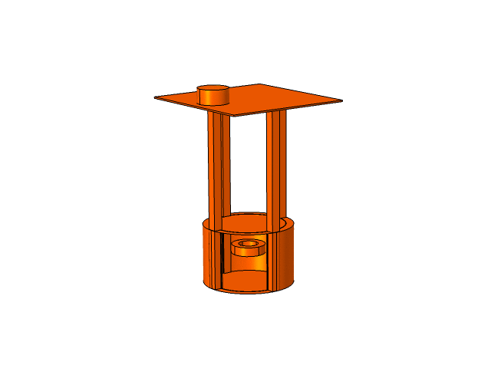

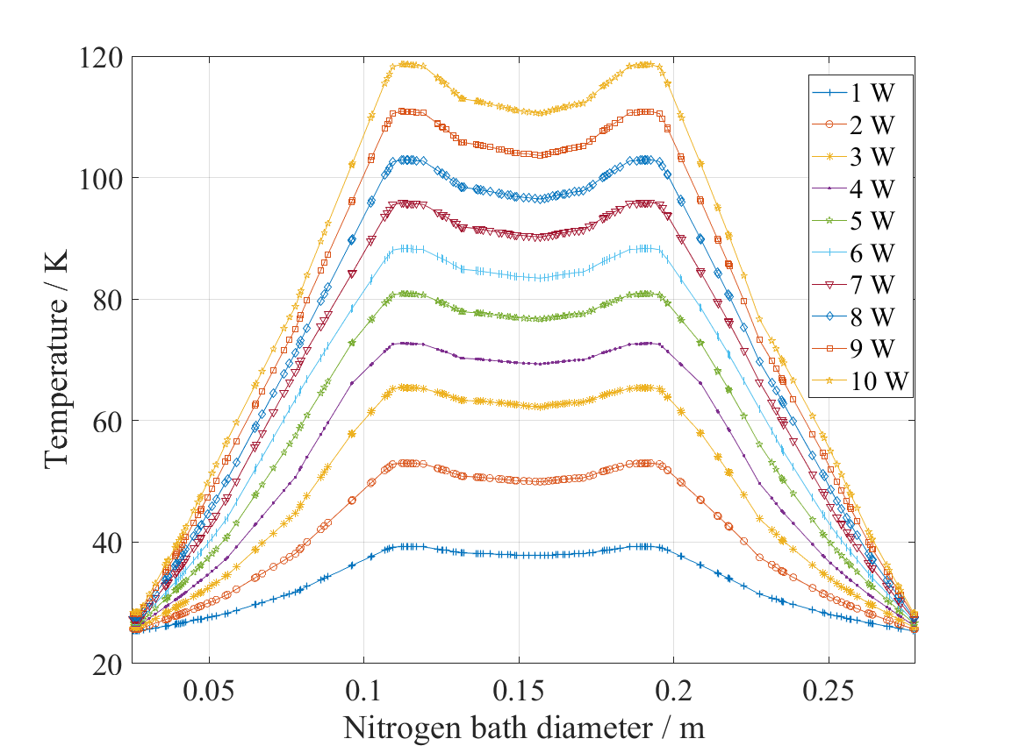
Perpetive PFM study
Heating power of 10 W
T(K)
Cooling capacity
Cut line
Conduction heat transfer system
Nitrogen
Coil heating power (W)
Resistive coil
Time (s)

Slide 8
Perpetive PFM study
With heat capacity formulation
Adiabatic
A formulation
H formulation
Heat formulation
Coil
HTS
Symmetry axis
Symmetry axis
Heat exchanger
Symmetry axis

Slide 9
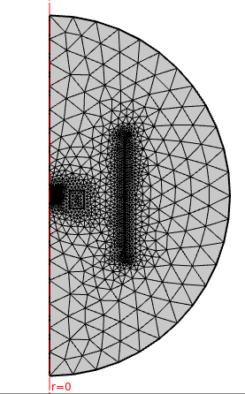




Perpetive PFM study
U_{c} =500 V
J (A/m²)
U_{c} =2000 V
J (A/m²)
With heat capacity formulation
With heat capacity formulation
U_{c} =500 V
U_{c} =2000 V
Adiabatic
Adiabatic

Slide 10
Perpetive PFM study

Slide 11
Thank you for your attention
Ghazi Hajiri,  (+33) (0)7 68 81 72 08  e-mail: ghazi.hajiri@univ.lorraine.fr

