Slide 1


3D modelling of HTS Ring Magnet
Dr Muhammad Ali
Hengpei Liao (PhD student)
Supervisor: Dr Min Zhang
Applied Superconductivity Laboratory
06/10/2020

Slide 2
1
HTS ring magnet
CONTENTS
2
3D modelling of superconducting ring magnet
3
Optimised ring magnet design
4
Conclusion

Slide 3
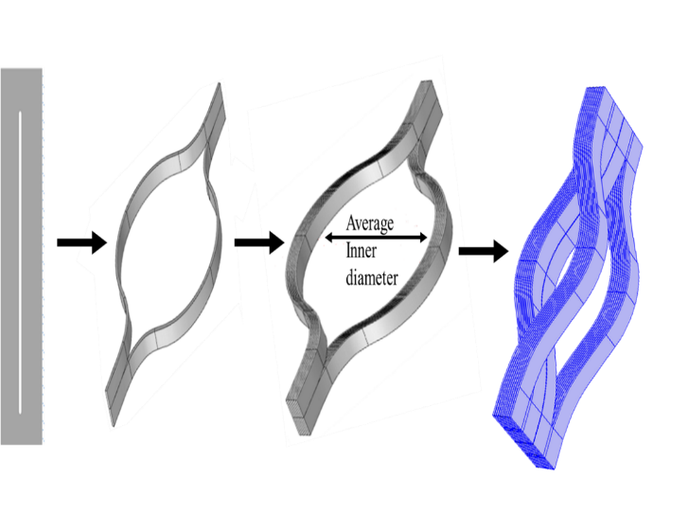
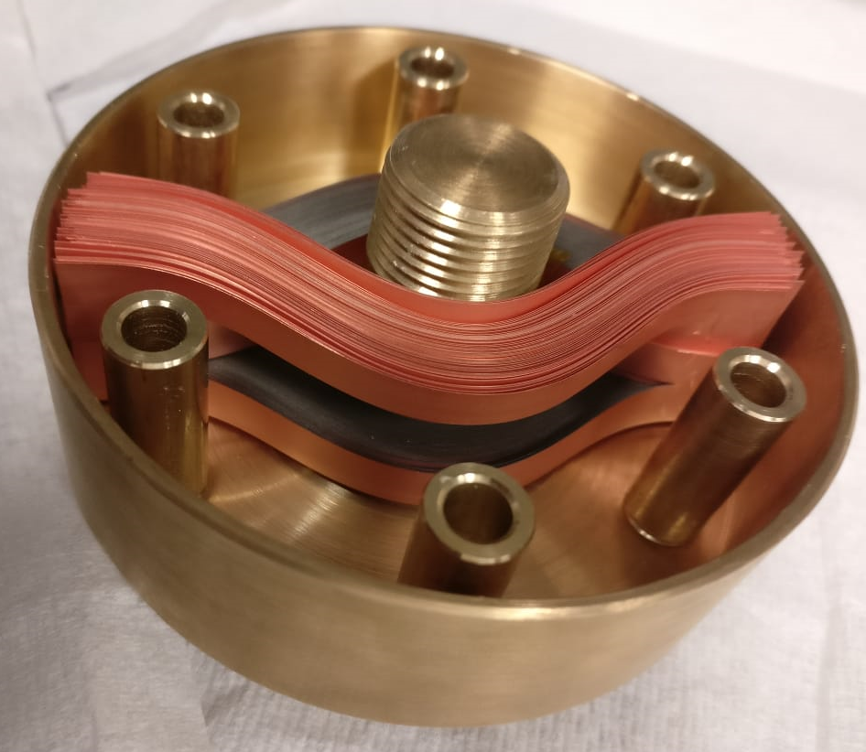
1.1 Fabrication of ring magnets
Closed side
Splitting HTS tapes
Create stacks
Opened side
Arranging stacks
Structure of the ring magnet
Sample parameters | Value
Inner magnet diameter | 10 mm
Outer magnet diameter | 90 mm
Ic of each tape | 500 A
No. of rings | 200
Tape supplier | Superpower
Encapsulation
paraffin impregnation

Slide 4
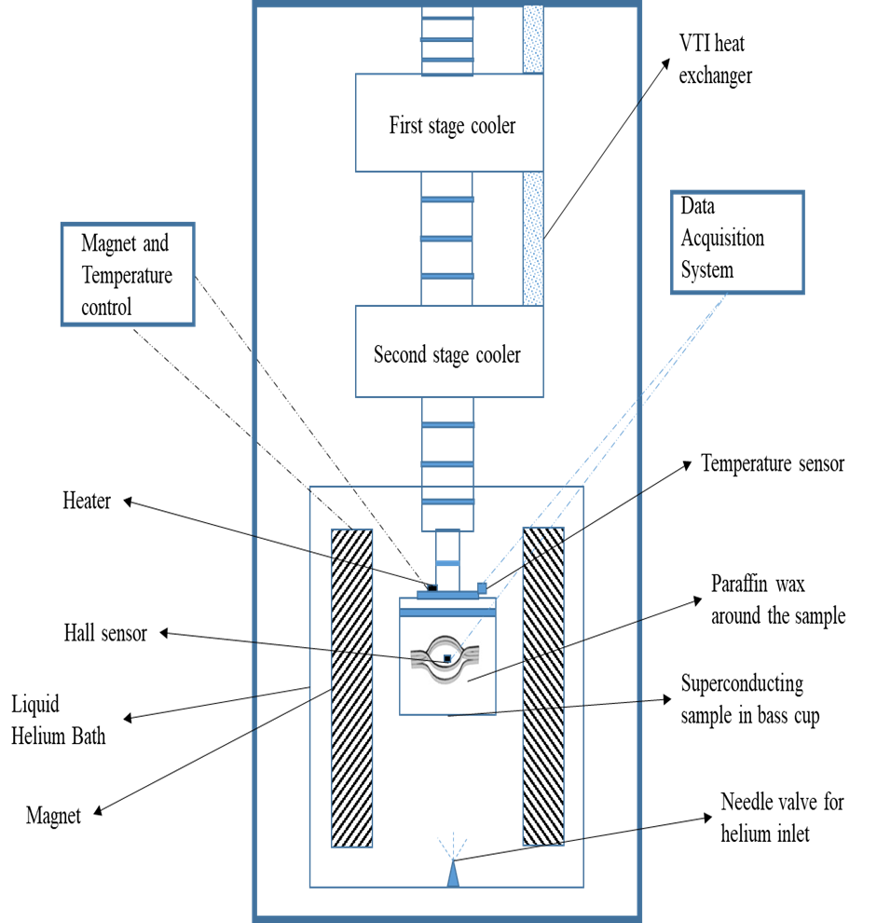
1.2 Magnetization
System parameters | Value
Sample space | 100 mm
Cooling medium | He
Temperature of sample | 25 K
Hall sensor used | 3
Applied field | 5 T
Ramping rate | 0.1 T/min
Experimental setup configuration at University of Cambridge. Bulk Superconductivity Group

Slide 5
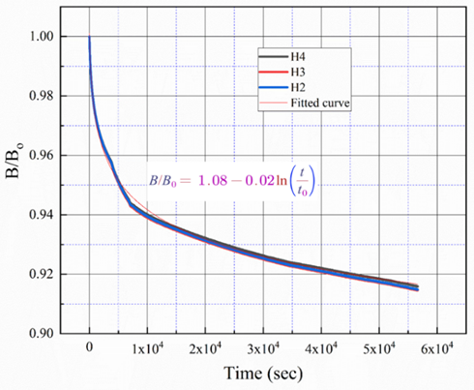
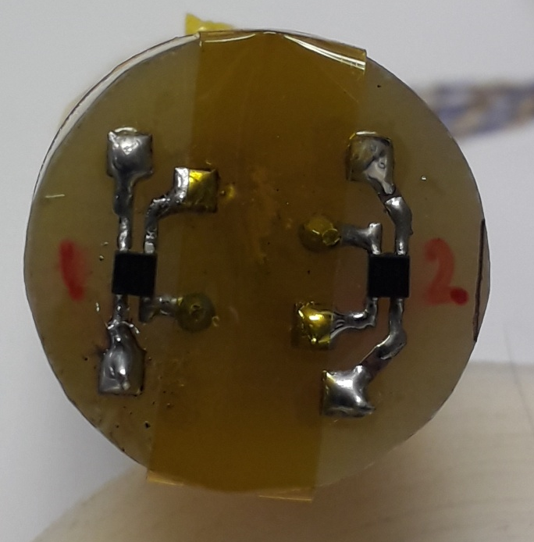
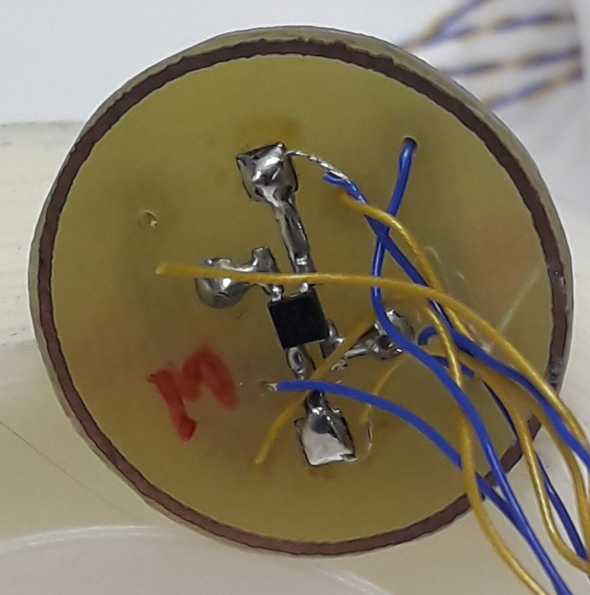
1.2 Field cooling results
H2
H4
H3
Hall sensor mounted on double sided PCB board.
FC Experiment
Normalised flux creep
H2,H3,H4 represent the position of the Hall Sensors
The maximum Trap field obtain in this experiment is 4.6 Tesla
Reduction in trapped field during first two hours is 2.5% while overall reduction in 16.7 hours is 5.3%

Slide 6
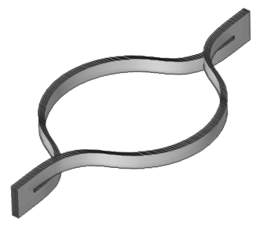
2.1 3D homogenized stacks model
One single HTS domain with 10 HTS rings
3D COMSOL geometry of 2*100 HTS rings
Two assumptions were made in the homogenized model
First, the thickness of the HTS layer has been artificially increased from 1 μm to 74 μm, which is the total thickness of the tape.
Second, it is assumed that every 10 HTS rings has the same critical current penetration depth.

Slide 7
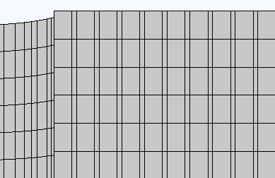
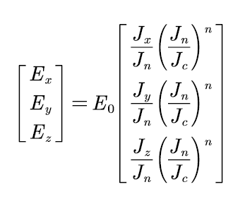
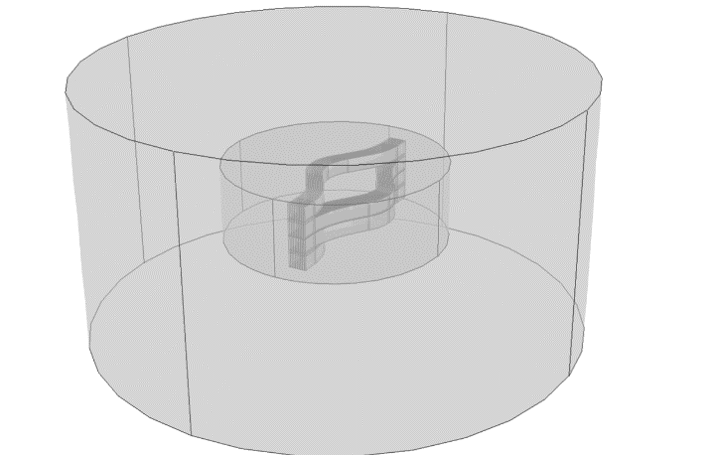
2.2 H-formulation
Air
HTS
  Governing equations
Is governed by E-J power law
  3D E-J power-law
Stacks of the ring magnet
Air domain
Ring magnet
Refinement area

Slide 8
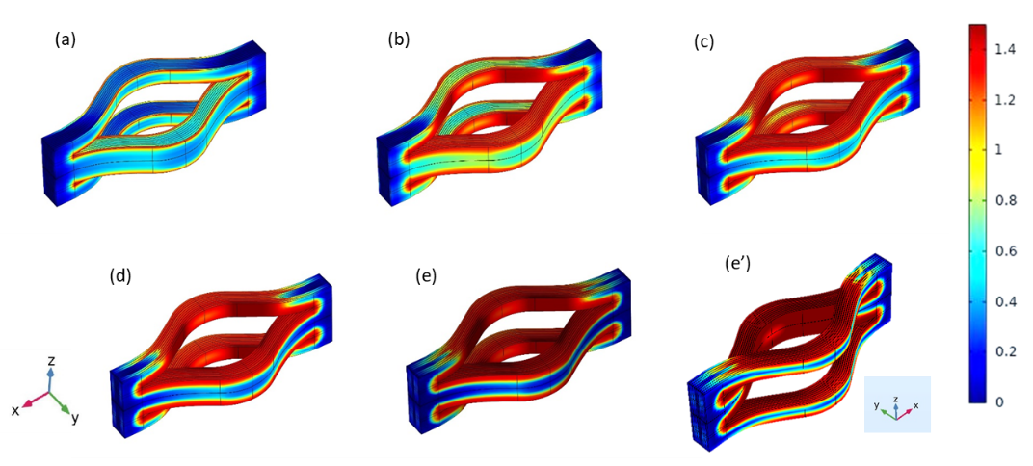
2.3 Modelling results
Ring 1–10 indicates the innermost domain while
Ring 91–100 indicates the outermost domain
4T
3T
2T
1T
0T
0T
Normalised current density J/Jc
The recorded current distribution in HTS ring domains were not uniform
Induced current penetrates from both inner and outer side of the ring magnet simultaneously

Slide 9
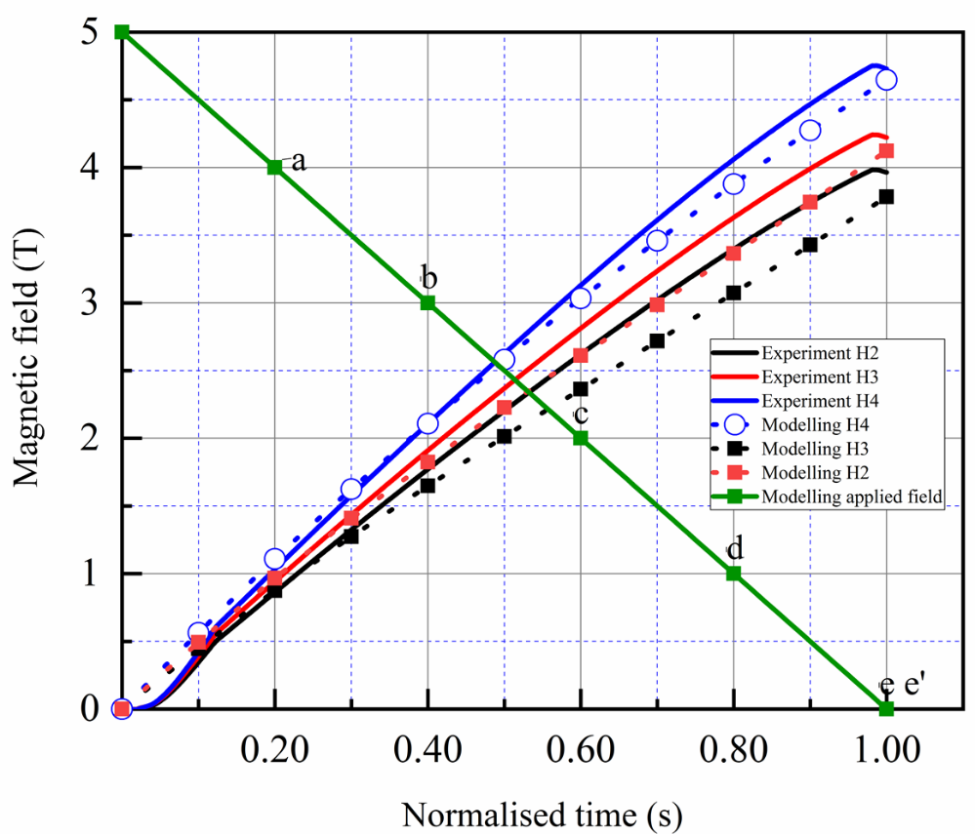
2.3 Modelling results
Simulation result with experiment results.
Points (a) and (e’) shows the time steps used to show the normalised current distribution.
The calculation uses a 10-sec ramping rate for the magnetic field.
Notes:
Here we see the current distribution in the HTS domains during the FC cycle. The current is being induced from both innermost and outermost HTS domains during magnetization, and process continues until the magnet fully saturates. The maximum induced current is noticed in the middle rings. Figure on the right side shows the current distribution in individual HTS domains and the total current induced in the rings during the FC process. Ring 1–10 indicates the innermost domain while ring 91–100 indicates the outermost domain

Slide 10
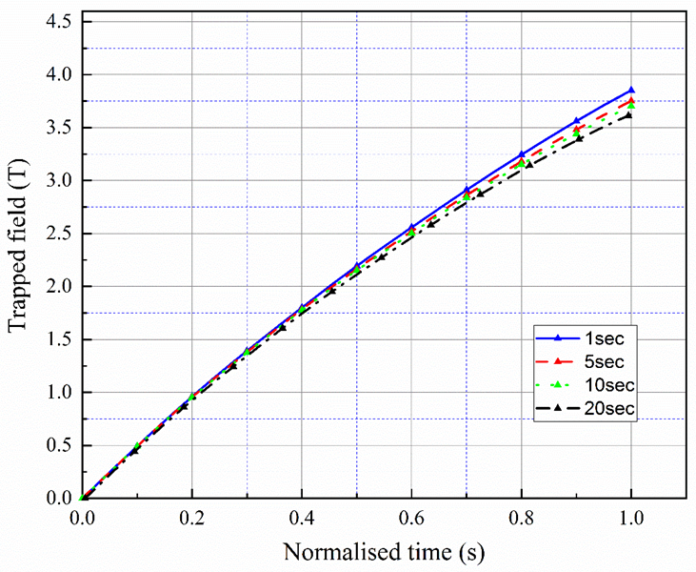
2.3 Modelling results
Comparison of the trapped field for four different ramping rates. The curves are for the sensor
H3, which is in the middle of the ring magnet.
Trapped field of the ring magnet using the field cooling method at various temperatures. H2, H3 and H4 are the sensors at different positions from the centre as already mentioned above.

Slide 11
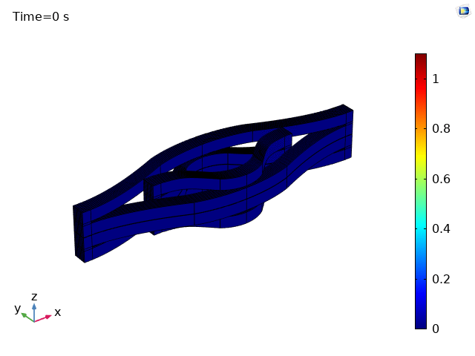
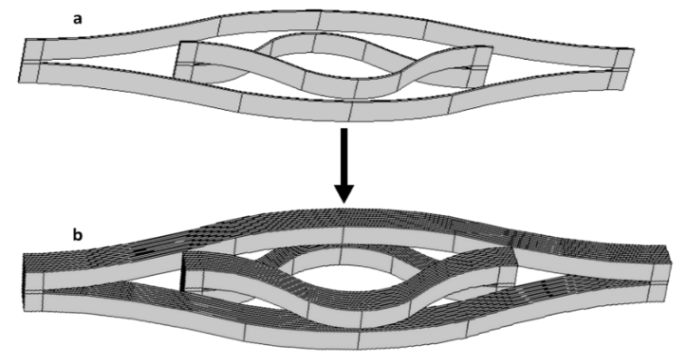
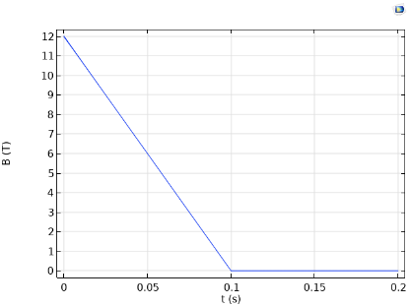
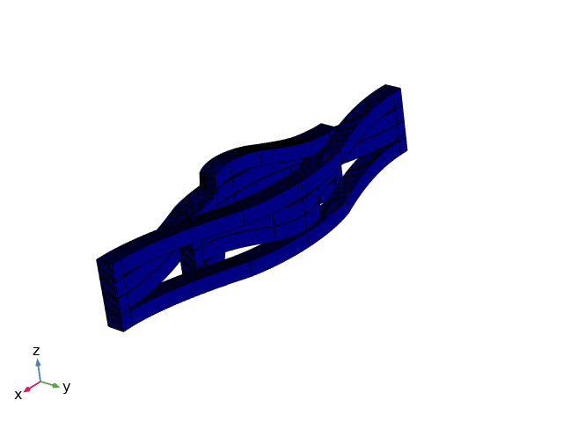
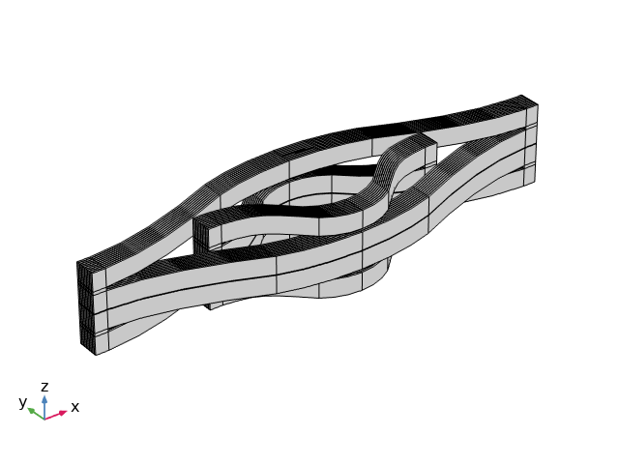
3. Optimized ring magnet design
Sample parameters | Value
Inner magnet diameter | 23 mm
Outer magnet diameter | 160 mm
Operating temperature | 4 K
No. of rings | 400
New optimised ring magnet design

Slide 12
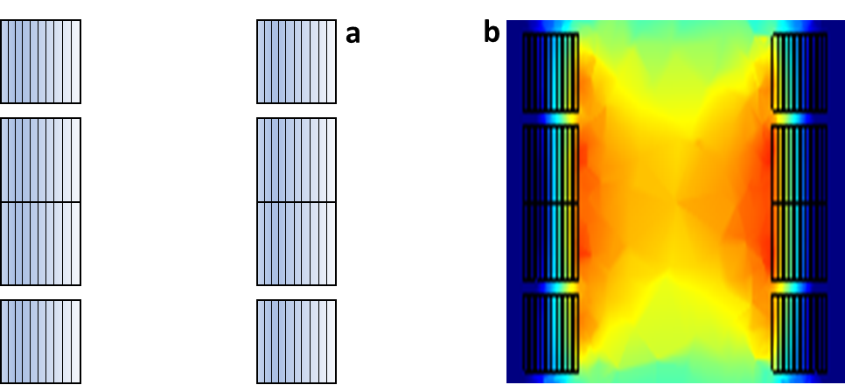
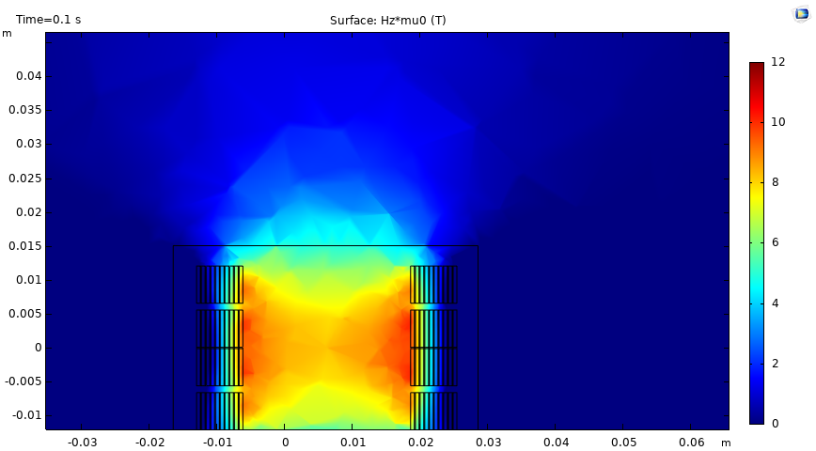
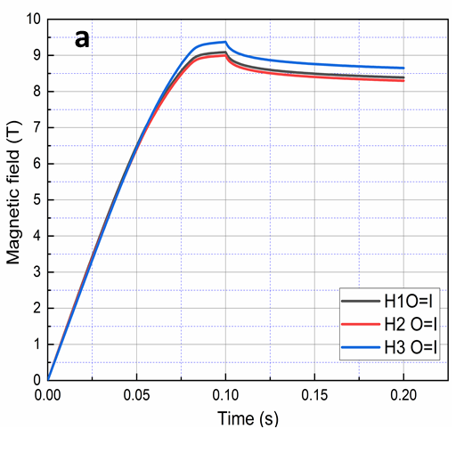
3. Optimized ring magnet design
Optimised ring magnet
Trapped field during field cooling
Symmetric field distribution and increased trapped field which is 9.4 Tesla.
Significant improvement in field homogenization.
Notes:
由于在轨道安装过程中，永磁体之间存在错位、缝隙、高度差异以及圆形底盘非完全平整等情况，在永磁轨道上方沿轨道纵向的磁场分布如上所述

Slide 13
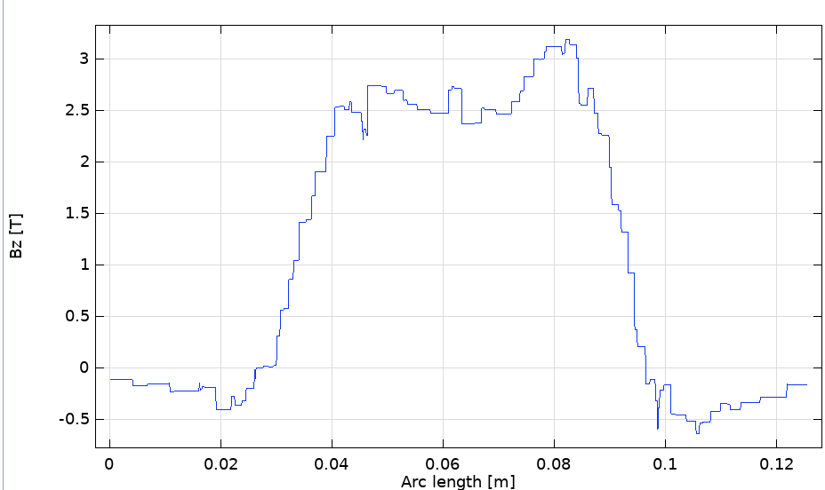
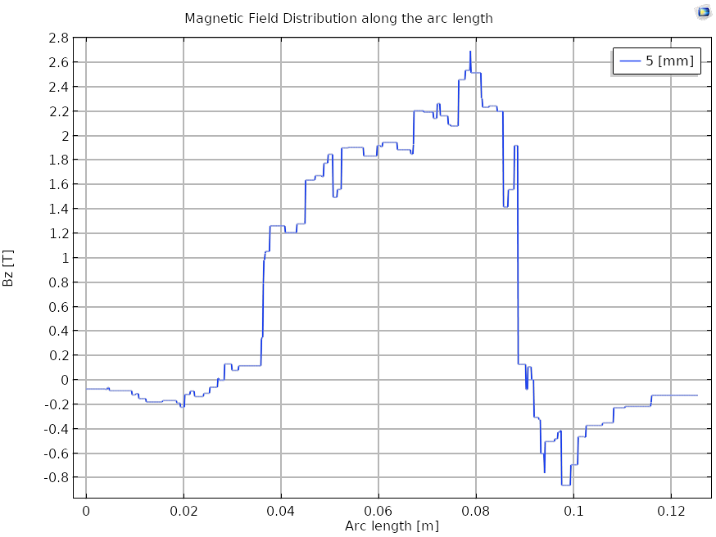
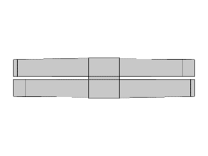
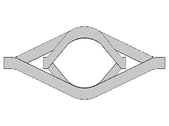
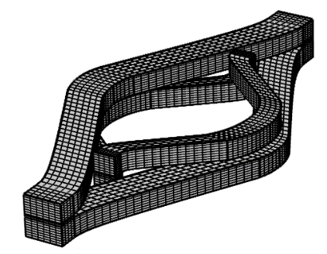
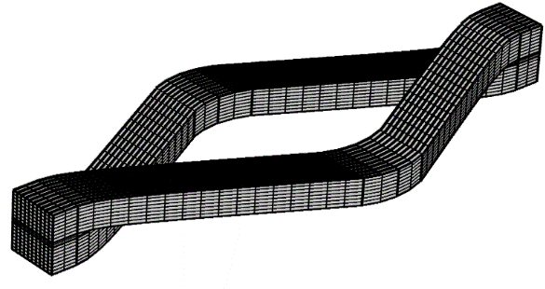
3. Optimized ring magnet design
Bz distribution at 5mm above the ring magnet
The field distribution of the optimized ring magnet has more even peak compared with a single ring magnet

Slide 14
4.Conclusion
We have demonstrated 4.6 T trapped field for 90 mm HTS ring magnet at 25 K.
3D model has been developed to understand the performance of the ring magnet
Optimised design has been proposed to improve field homogenization.
Next step is to perform FC and the pulse field magnetization for the optimised HTS ring magnet.

Slide 15
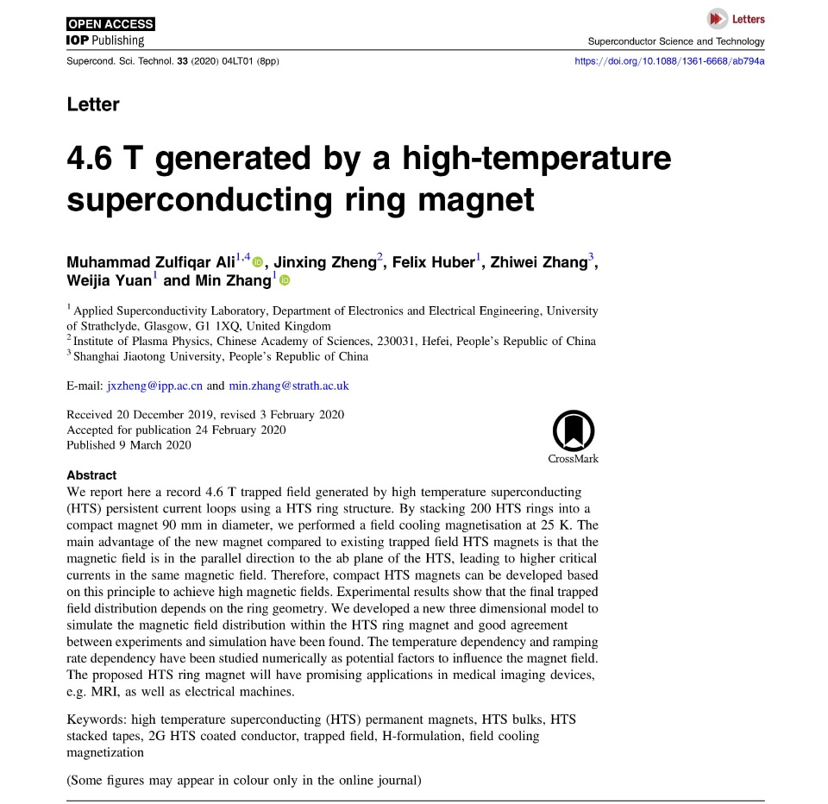
Reference
https://doi.org/10.1088/1361-6668/ab794a

Slide 16
Thank You
min.zhang@strath.ac.uk
muhammad.ali@strath.ac.uk
hengpei.liao@strath.ac.uk
Applied superconductivity laboratory

