Slide 1
Modelling of two topologies of trapped-flux machines using second generation tapes with T-A 3D formulation
Bárbara Maria Oliveira Santos*, Felipe Sass** and Rubens de Andrade Junior*
*Universidade Federal do Rio de Janeiro (UFRJ), Rio de Janeiro, Rio de Janeiro, Brazil
**Universidade Federal Fluminense (UFF), Niterói, Rio de Janeiro, Brazil

Slide 2
Table of contents
Trapped-flux machines with stacks of coated conductors
Overview
Topology T1
Topology T2
Methodology
T-A formulation
Simulation parameters
Results
Topology T1
Topology T2
Comparison
Conclusion

Slide 3
Overview
Various superconducting machines with HTS are investigated on current literature.
An interesting general topology is the trapped flux superconducting machine:
with bulks
with stacks of 2G tapes
FEM simulations: powerful tools to help design superconducting electric machinery.
H formulation
A-V formulation
T-A formulation

Slide 4
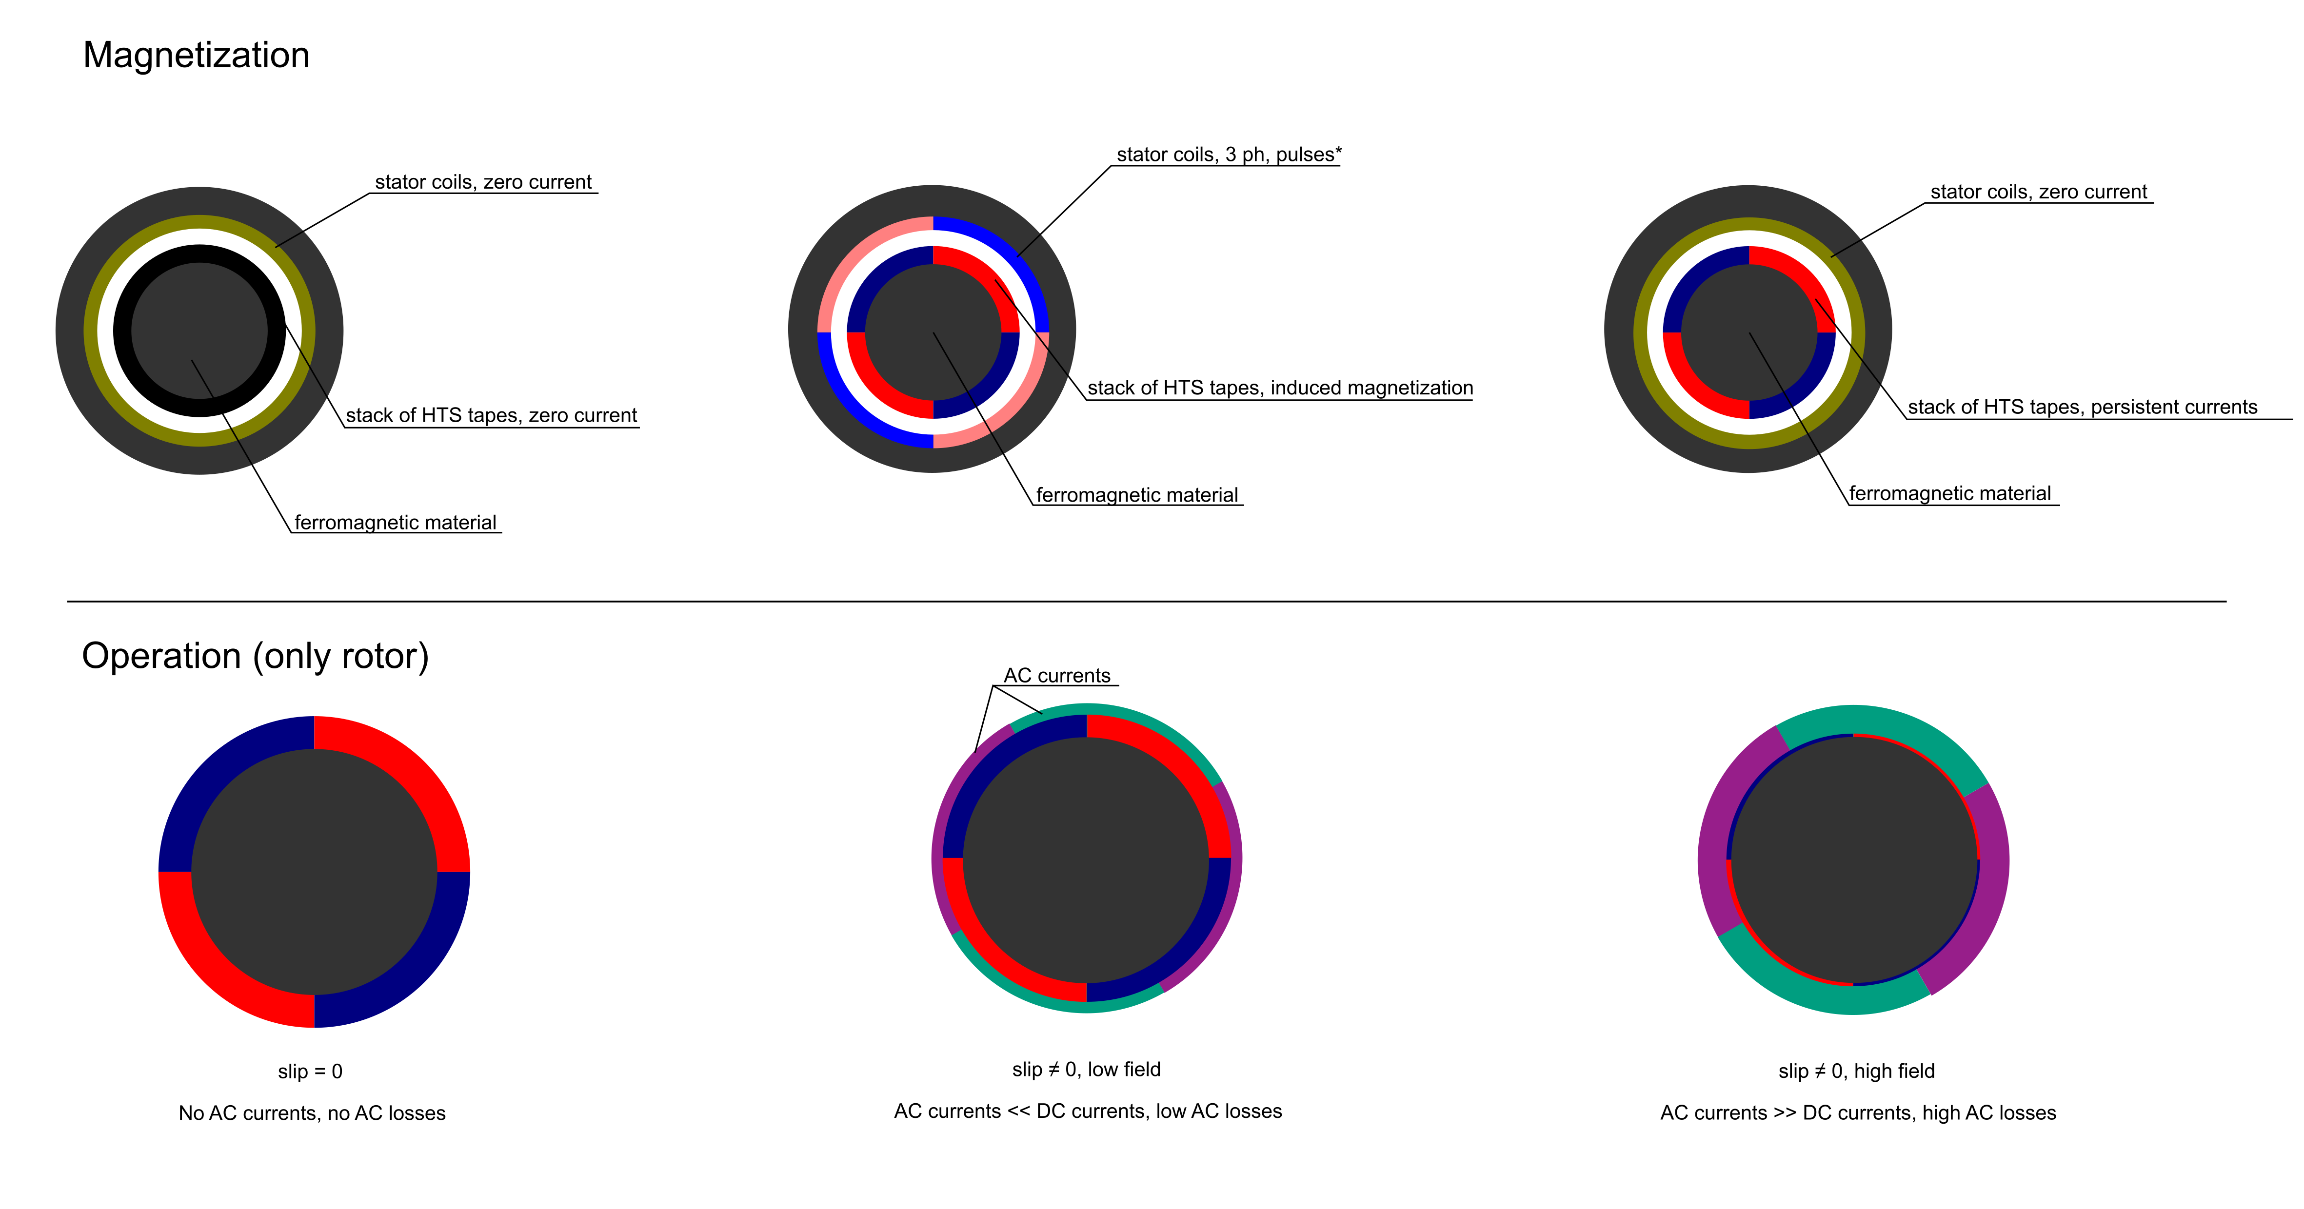
Trapped-flux machines with stacks
Partially superconducting machines with stacks of tapes acting as quasi-permanent magnet

Slide 5
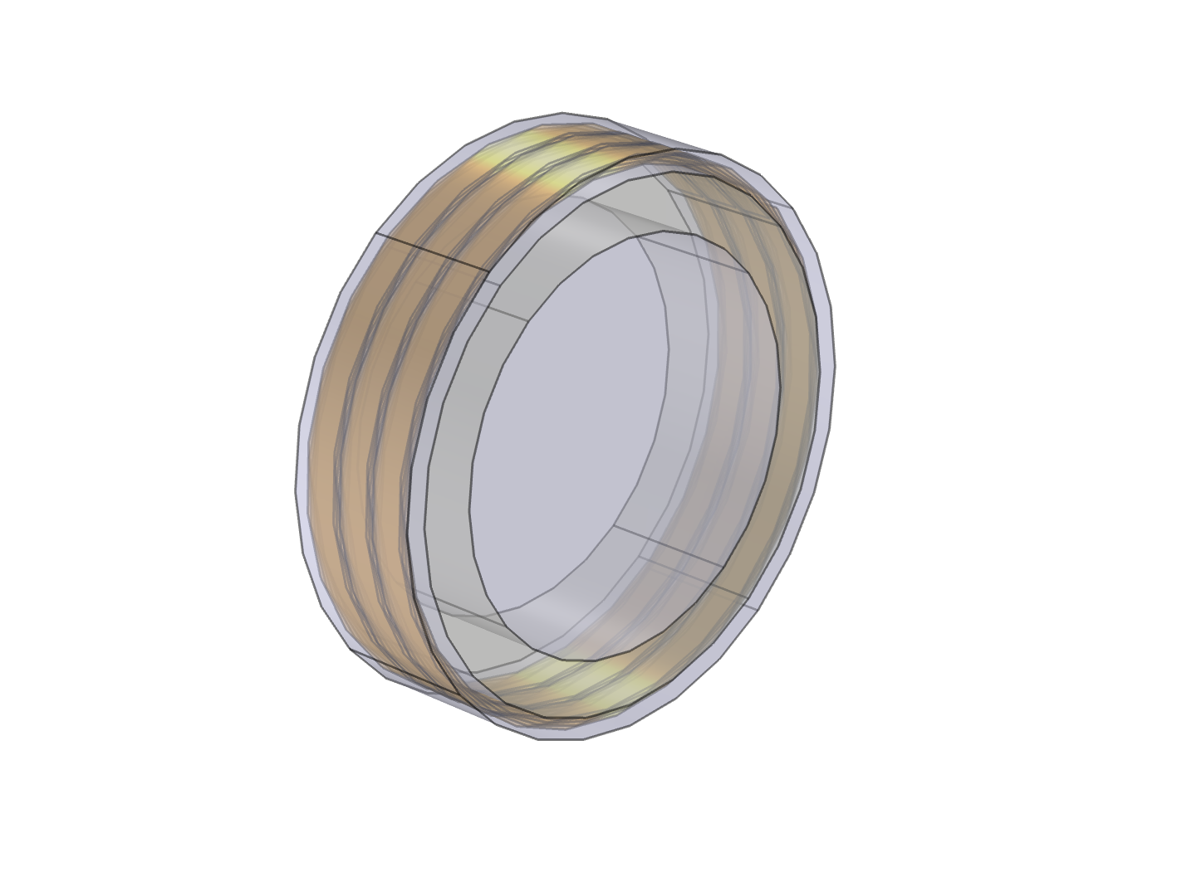
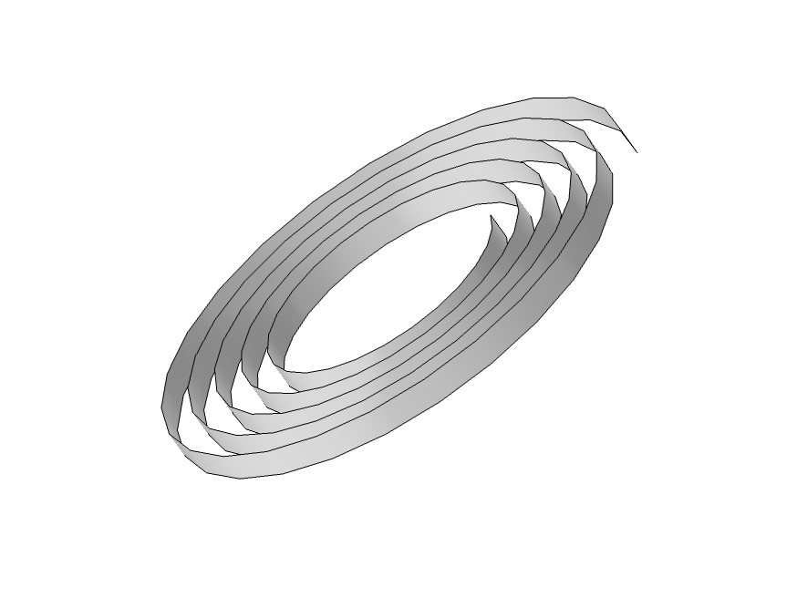
Topology T1
Current density
Spiral stacks
Magnetic field
17 mm
78 mm
Ferromagnetic material
θ
z
*stator not shown

Slide 6
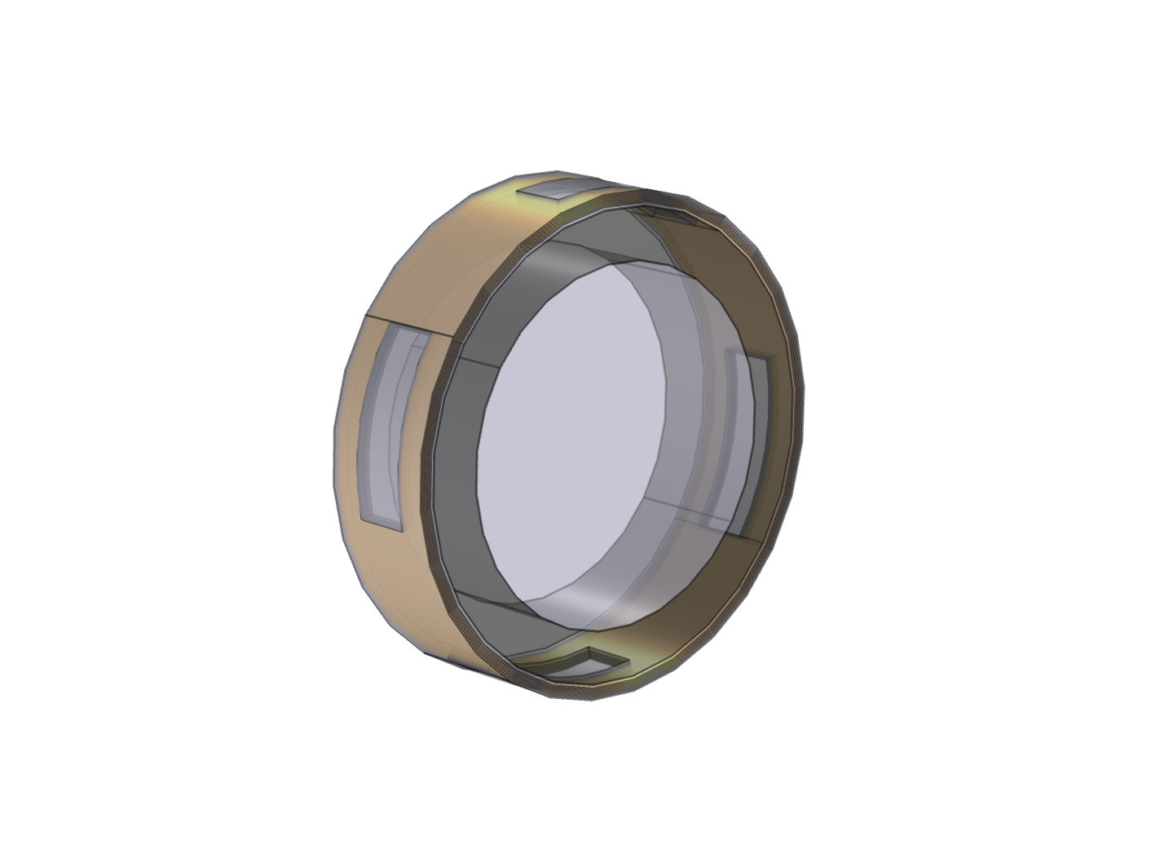
Topology T2
Current density
Stacks
17 mm
Magnetic field
78 mm
Ferromagnetic material
θ
z
*stator not shown

Slide 7
Methodology - overview
Simulation using finite element method (COMSOL Multiphysics) 3D with T-A formulation;
Objective: compare magnetization capabilities of T1 and T2;
Method: simulate the response to a pulse of current density applied to the stator forming four magnetic poles and check the current density in the superconducting material after the pulse.

Slide 8
T-A formulation
$$∇×\left(\frac{1}{μ}\right) ∇×\vec{A}=\vec{J}$$
$$∇×ρ ∇×\left(\vec{T}⋅ \vec{n}\right)=−\left(\frac{∂\vec{B}}{∂t}\right)⋅\vec{n}$$
$$\vec{n}$$
$$∇× \vec{A}= \vec{B}$$
$$∇×\vec{T}=\vec{J}$$
Boundary conditions
$$\vec{n}⋅\vec{B}=0$$
$$I_{total}=\oint{\vec{T}⋅d\vec{l}=0}$$

Slide 9
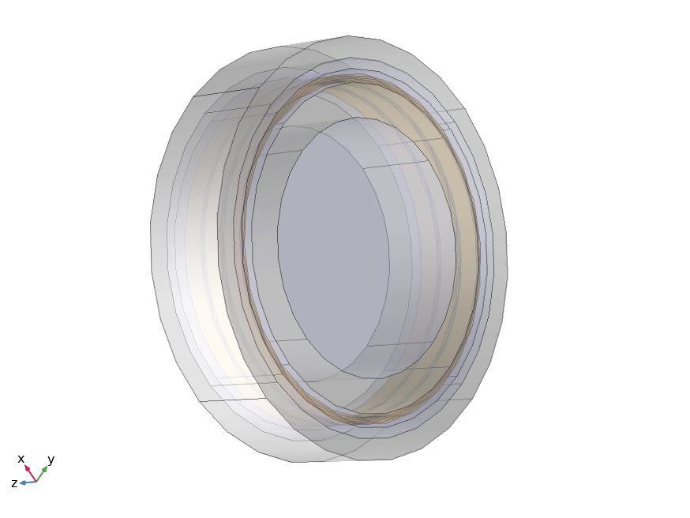
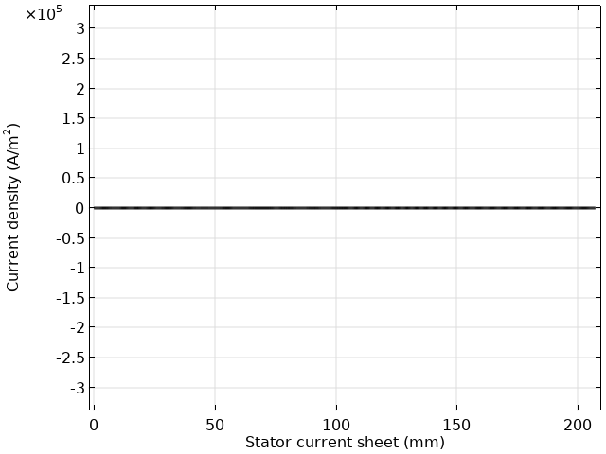
Simulation parameters
NGO 35PN250
Stack of tapes*
*SuperPower advanced pinning model: 4 mm, Ic @ 0 T = 47 A
Ic(B) curve from the HTS tape database @ Univ. of Wellington
0 – 0.2 s – no current
0.2 s to 0.4 s – with current
0.4 s to 0.5 s – no current

Slide 10
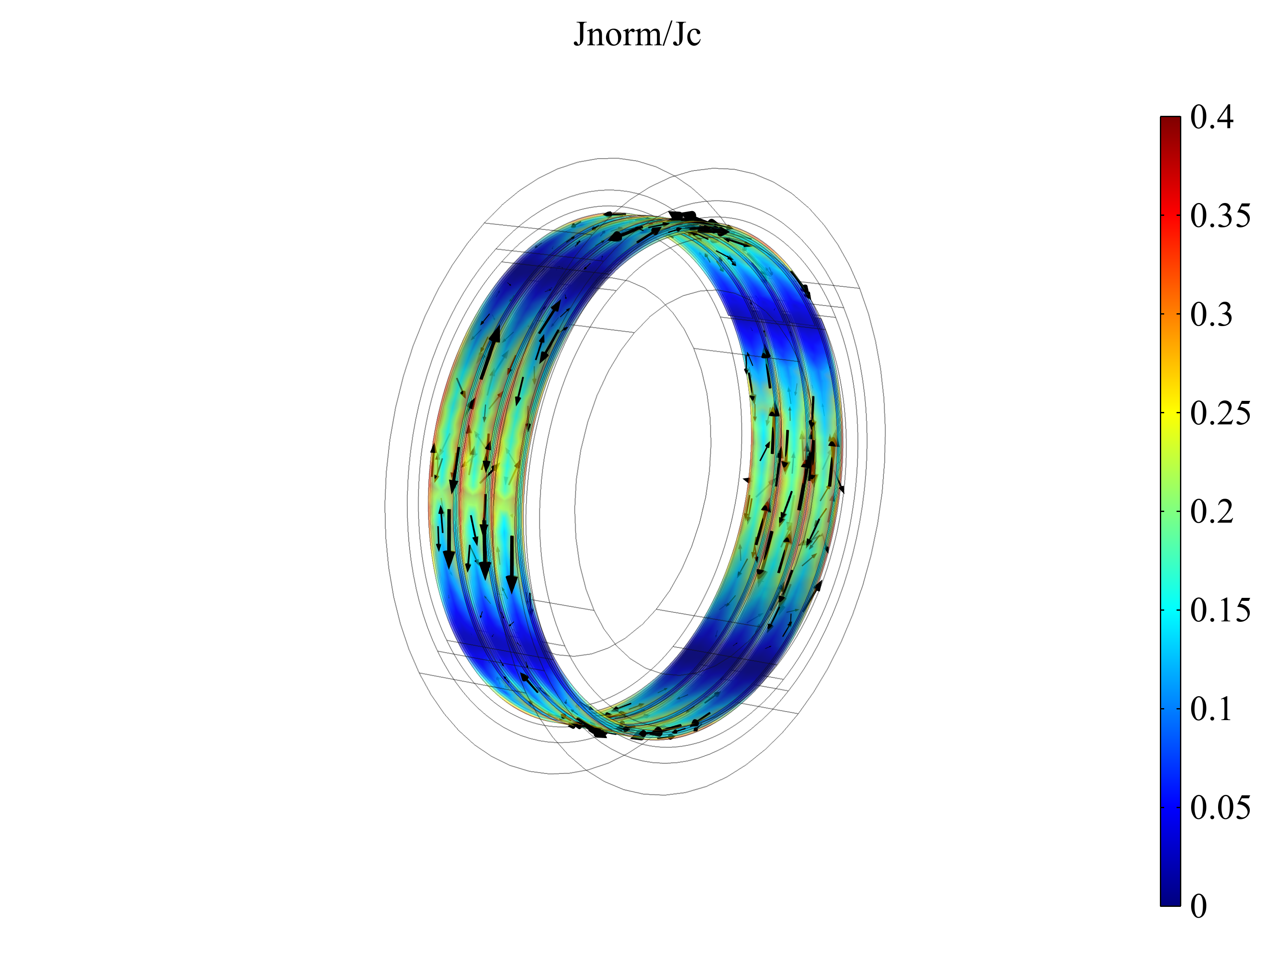
Results – T1
Current density in the stacks (J/Jc)
0.4 s
Pulse ended

Slide 11
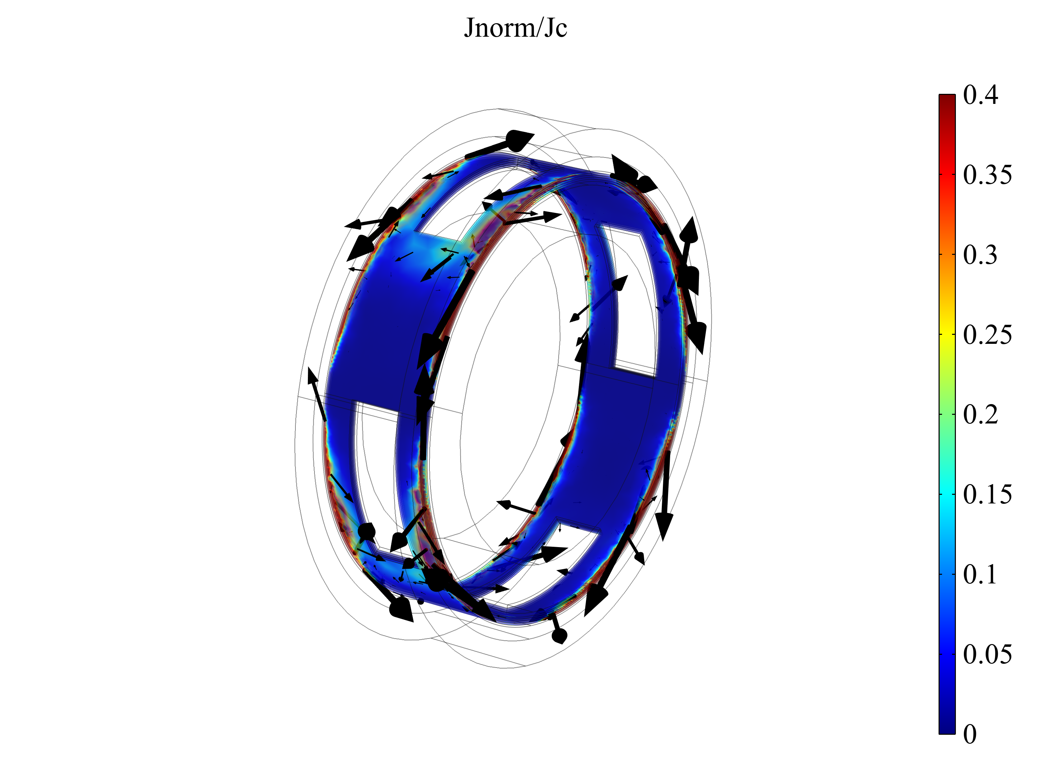
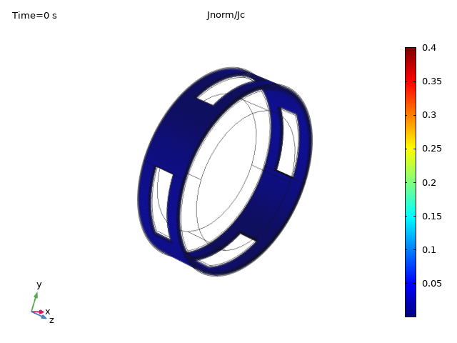
Results – T2
Current density in the stacks (J/Jc)
0.4 s
Pulse ended

Slide 12
Comparisons between T1 and T2

Slide 13
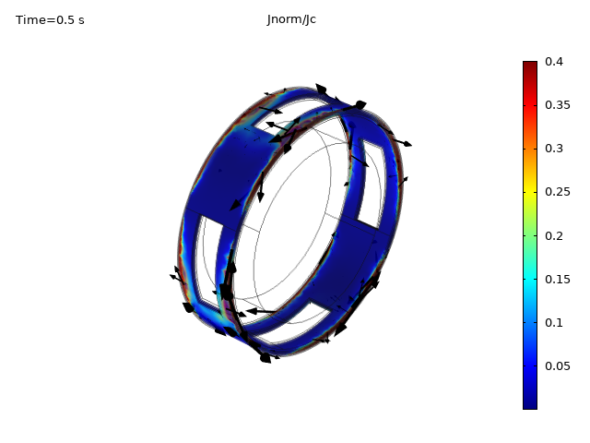
Comparisons between T1 and T2

Slide 14
Conclusions
Because of its geometric characteristics, topology T2 shows better magnetization capabilities;
Topology T2 is also more likely to generate reluctance torque;
Further investigation is needed to determine the optimal configuration for T2.

Slide 15
Thank you!
Bárbara Maria Oliveira Santos, M.Sc.
D.Sc. Student @UFRJ
santosbmo@coppe.ufrj.br

