Slide 1
Monte Carlo simulations of vortex dynamics in high-temperature superconductors under pulsed-field magnetization
Anna Moroz*, Anastasiia Maksimova, Vladimir Kashurnikov, Igor Rudnev
National Research Nuclear University MEPhI
(Moscow Engineering Physics Institute), Moscow, Russia *anmoroz@mephi.ru

Slide 2
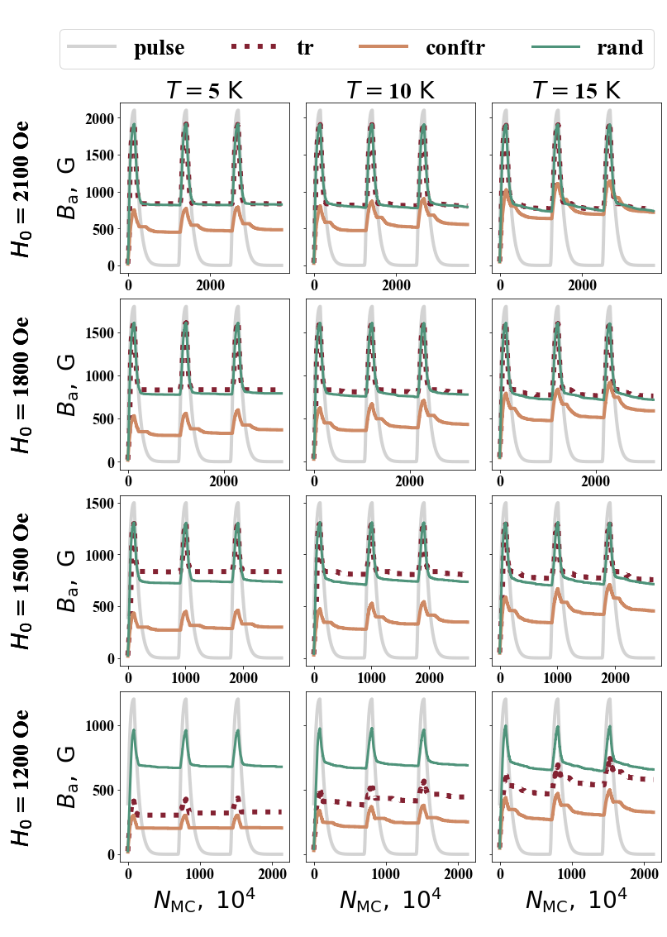
Time-dependences of the trapped field
T
CT
R

Slide 3
Instant vortex behavior upon pulsed magnetization

Slide 4
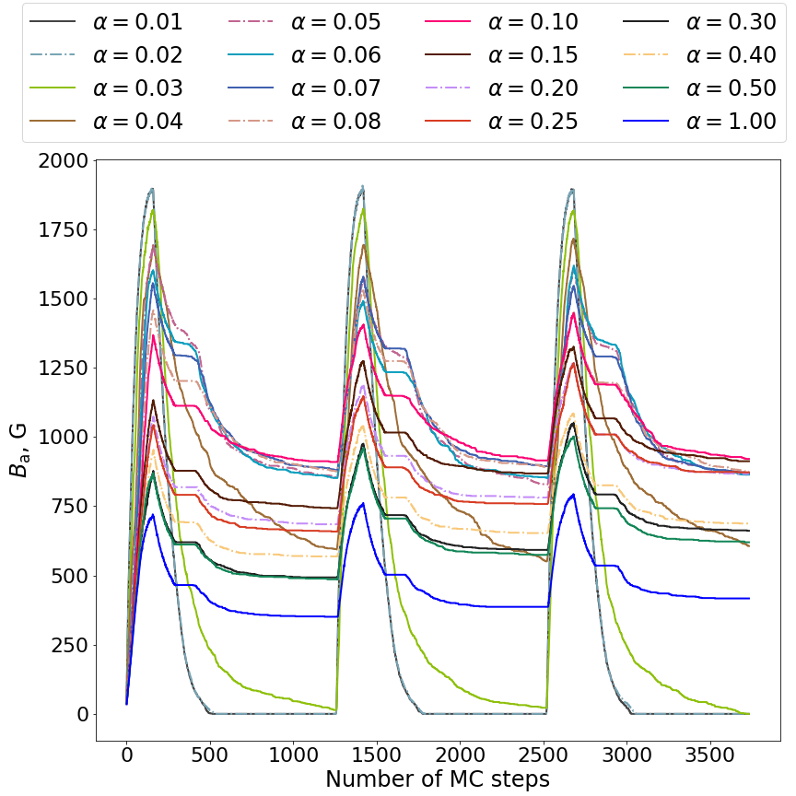
The influence of potential well-depth
α = 0.04 eV
α = 1.0 eV

Slide 5
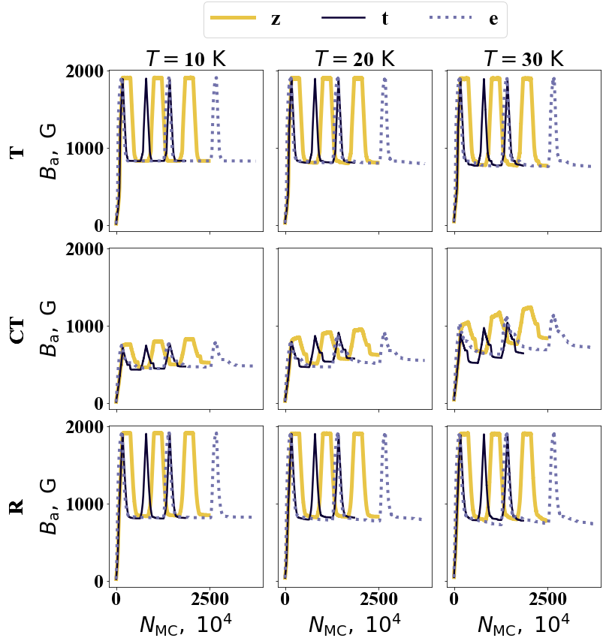
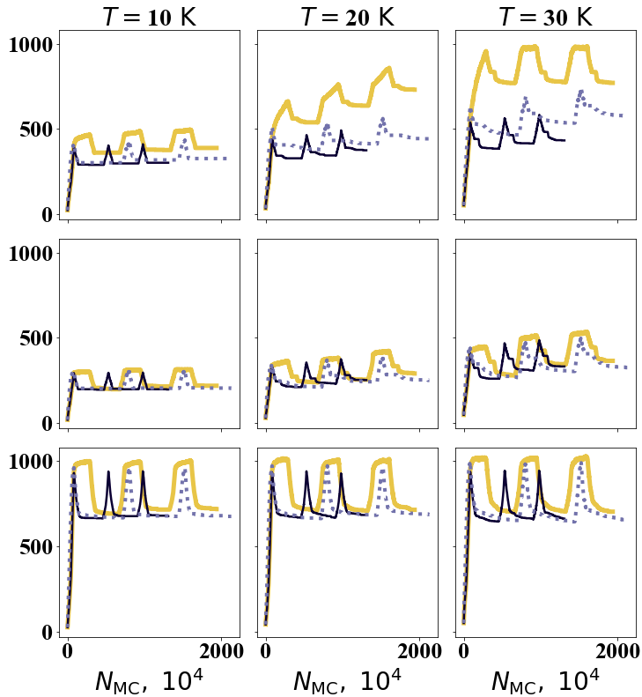
The influence of pulse shape

Slide 6
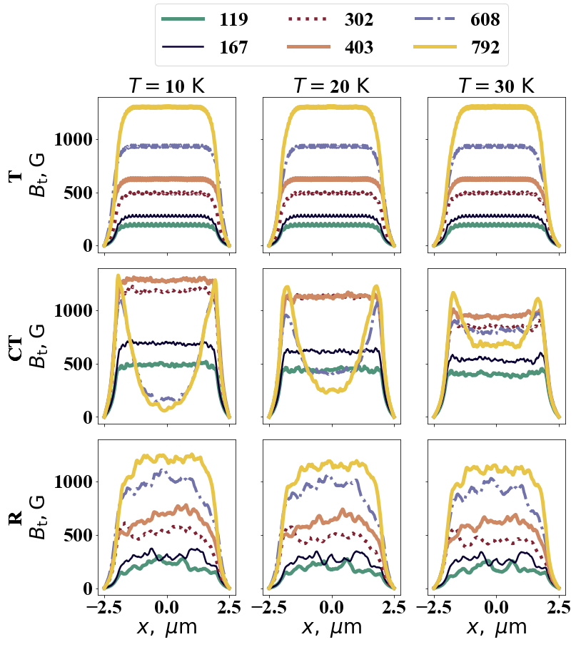
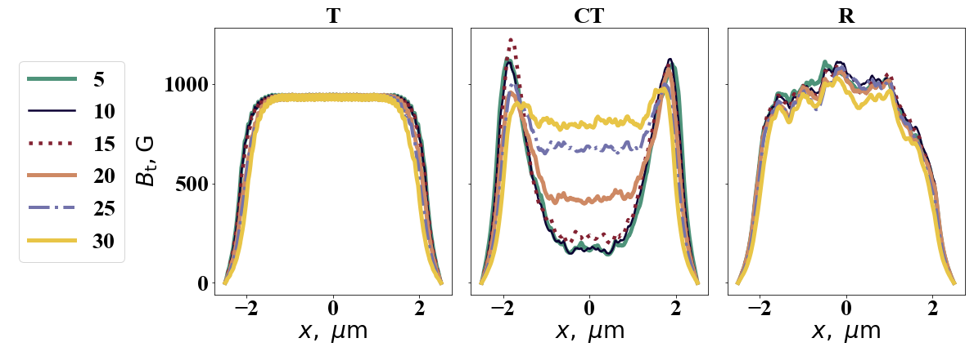
The influence of temperature and defect concentration

Slide 7
Thank you for your attention!
The reported study was funded by RFBR, Projects No. 19-32-90279 (A N Moroz) and 17-29-10024 (A N Maksimova and I A Rudnev), and by RFBR and ROSATOM according to the research Project No. 20-21-00085 (V A Kashurnikov).

